Slide 1
ICR/RMH Patient Cohort
Supplementary Figures
Patients previously treated at the Royal Marsden Hospital (RMH), and enrolled into protocols approved by the RMH ethics review committee, with sufficient previously collected formalin-fixed, paraffin embedded (FFPE) mCRPC biopsy tissue available for assessment (≥50 tumor cells).
Survival data from time of CRPC biopsy relative to JMJD6 CRPC IHC (n=74)
74 CRPC biopsies
JMJD6 IHC
AR-V7 IHC
64 matched,
same-patient CSPC
samples available
64 CSPC biopsies
JMJD6 IHC
CSPC
CRPC
Supplementary Figure 1: ICR/RMH patient cohort overview. CSPC = diagnostic castration-sensitive prostate cancer tissue sample. CRPC = castration-resistant prostate cancer tissue sample.
Non-targeting Control siRNA
Non-targeting Control siRNA
Non-targeting Control siRNA
JMJD6 siRNA
JMJD6 siRNA
JMJD6 siRNA
225 kDa
102 kDa
76 kDa
JMJD6
52 kDa
38 kDa
31 kDa
GAPDH
Supplementary Figure 2: JMJD6 IHC antibody validation. Antibody signal specificity was confirmed by detection of a single band in LNCaP95 whole cell lysates by Western blot, with downregulation following treatment with pooled JMJD6 siRNA compared to non-targeting control siRNA.
Tubulin

Slide 2
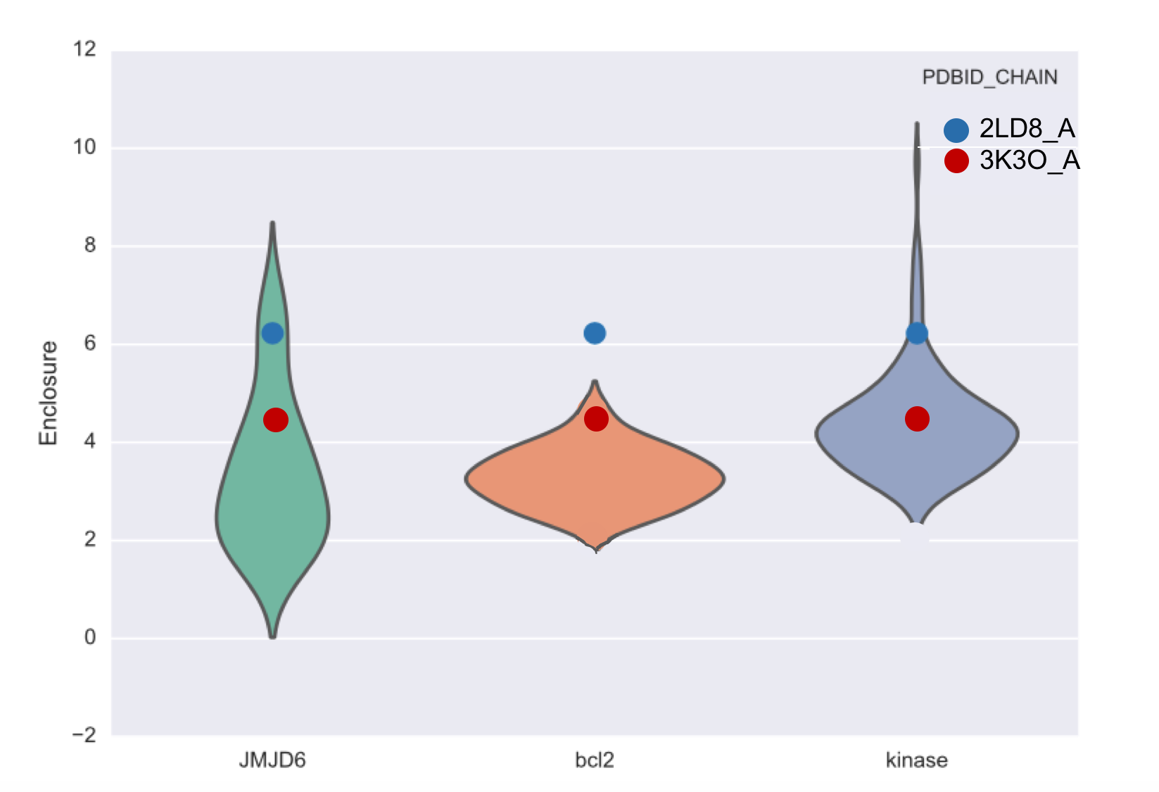
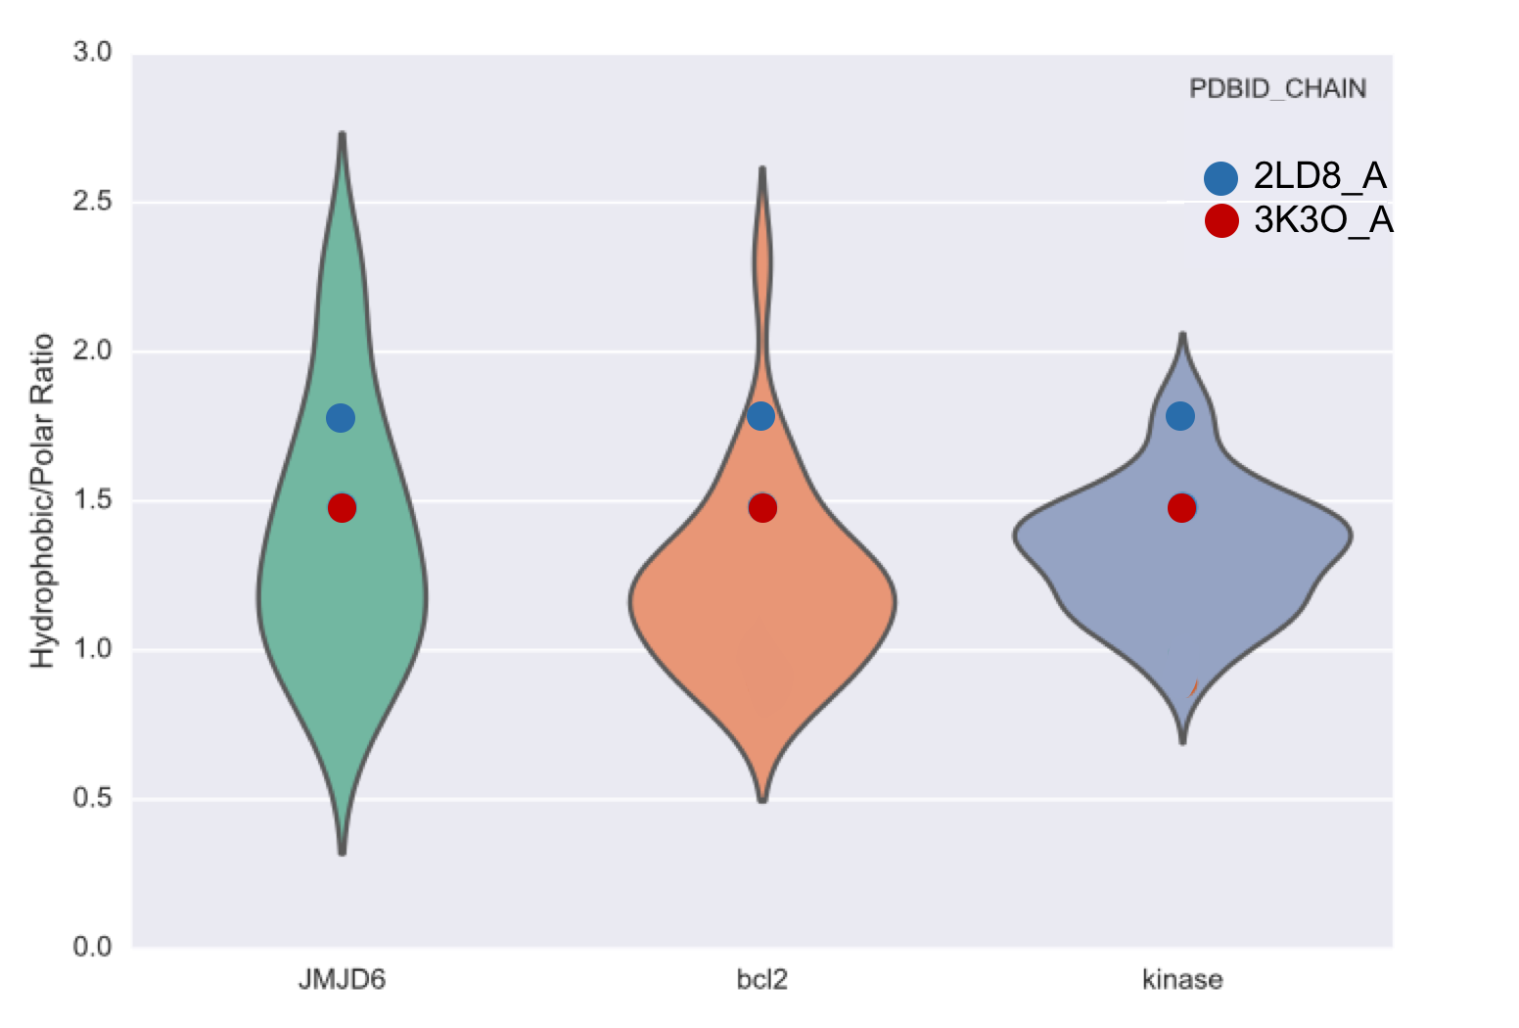
Target Identification Strategy Overview
Stage One
RNA-seq Analysis
LNCaP vs LNCaP95
Differential expression analysis of spliceosome related gene set
Genes excluded if baseline expression (FPKM) < median expression level of all 315 genes at baseline across both experiments
Stage Two
RNA-seq Analysis
LNCaP95: I-BET151 vs Vehicle
Differential expression analysis of spliceosome related gene set
Genes excluded if baseline expression (FPKM) < median expression level of all 315 genes at baseline across both experiments
Stage Three
Targeted siRNA Screen
LNCaP95 and 22Rv1
Significant results = reduction in AR-V7 protein expression relative to AR-FL > 50%
Amalgamation of RNA analyses
Top Hit across all three experimental arms to be taken forward for further validation studies
Supplementary Figure 3: Overview of the strategy for identify key splicing factors involved in AR-V7 generation.
Supplementary Figure 4: JMJD6 is a pharmacologically tractable protein. Comparing 25 physicochemical and geometric properties calculated in canSAR for JMJD6 with known drug targets, such as protein kinases, indicates that parameters of the JMJD6 druggable cavity fall within the same ranges as those of protein kinases; suggesting it will be druggable. The cavity enclosure (A) and the ratio of hydrophobic to polar chemical groups (B) within the cavity are shown as evidence.

