Slide 1
Supplementary Figure 1
Abbreviations | Protein species | Functions
AMPKa | AMP-activated protein kinase | Cellular energy homeostasis
eEF2 | Eukaryotic Translation Elongation Factor 2 | Protein synthesis
eIF4G | Eukaryotic translation initiation factor 4G | Protein synthesis
FASN | Fatty acid synthase | Fatty acid synthesis
Glutamate-D1-2 | Glutamate dehydrogenase 1 | Nitrogen and glutamate metabolism and energy homeostasis
LDHA | Lactate dehydrogenase A | Lactate metabolism
FoxO3a | Forkhead box O3 | Reactive oxygen metabolism
HK-II | Hexokinase-II | Glucose metabolism
SLC1A5 | Solute Carrier Family 1 Member 5 | Neutral amino acid transporter
eEF2K | Eukaryotic Elongation Factor 2 Kinase | Protein synthesis
 | USP18 shRNA 1 |  | USP18 shRNA 2
 | fold change | P value | fold change | P value | Average fold change
AMPKa | 0.82 | 0.0084 | 0.93 | 0.0686 | 0.88
eEF2 | 0.74 | 0.0977 | 0.84 | 0.2741 | 0.79
eIF4G | 0.99 | 0.8249 | 0.87 | 0.163 | 0.93
FASN | 0.86 | 0.0485 | 0.86 | 0.1237 | 0.86
Glutamate-D1-2 | 0.92 | 0.2558 | 1 | 0.9985 | 0.96
LDHA | 0.77 | 0.1612 | 0.85 | 0.259 | 0.81
FoxO3a | 0.91 | 0.0049 | 0.95 | 0.0997 | 0.93
HK-II | 0.92 | 0.001 | 0.86 | 0.0002 | 0.89
SLC1A5 | 0.79 | 0.001 | 0.66 | 0.0005 | 0.72
eEF2K | 0.69 | 0.0007 | 0.71 | 0.0007 | 0.7
Figure S1. USP18 regulates metabolism-related proteins by Reverse Phase Protein Array (RPPA) in A549 lung cancer cells. These A549 lung cancer cells were engineered to express stably USP18 shRNA (USP18 shRNA 1 or USP18 shRNA2) or control shRNA before harvesting proteins for RPPA. Metabolic proteins downregulated in A549 lung cancer cells by USP18 knock-down are displayed and normalized to those of control shRNA expressing A549 lung cancer cells. There were no statistically-significantly up-regulated species linked to regulation of metabolism that were detected by this RPPA (data not shown). Other species regulated by USP18 knock-down will be independently reported.

Slide 2
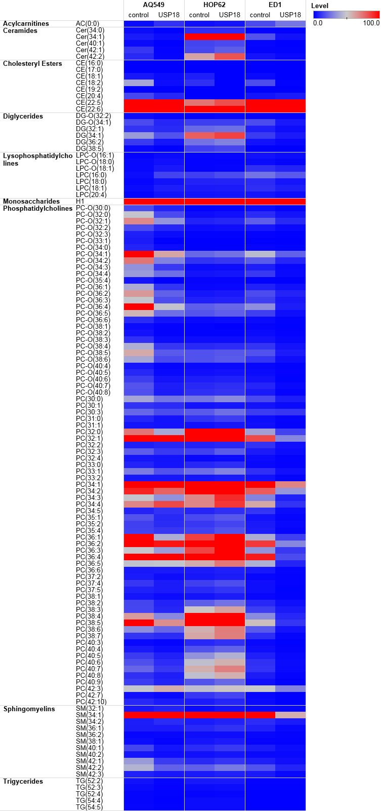
Supplementary Figure 2
Lysophosphatidylcholines
Figure S5: USP18 regulates lipid metabolism in lung cancer cell lines. Human (A549 and HOP62) and murine (ED1) lung cancer cells were independently engineered to overexpress USP18 or a control vector before harvesting for a lipid metabolite assay using the AbsoluteIDQ® p400 HR kit. The full list of lipid species measured in this assay is provided in the product manual: https://biocrates.com/wpcontent/uploads/2020/02/Biocrates_p400_metabolites.pdf

Slide 3
Supplementary Figure 3
Empty vector
****
UCP1 vector
****
Relative cell viability
CellTiter-Glo assay
Manual counting
Figure S2. This figure compares CellTiter-Glo assays and manual counting for lung cancer cell proliferation at day 3. The A549 lung cancer cell line was transfected with an empty vector or with a UCP1 expression plasmid. Cell viability was measured and normalized to empty-vector transfectants at day 1 with **** P < 0.0001. Error bars are standard deviations.

Slide 4
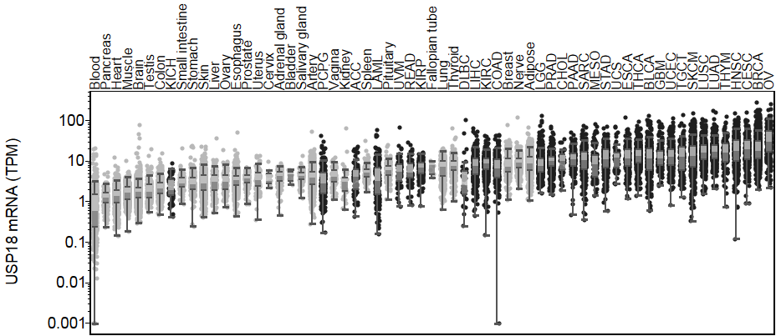
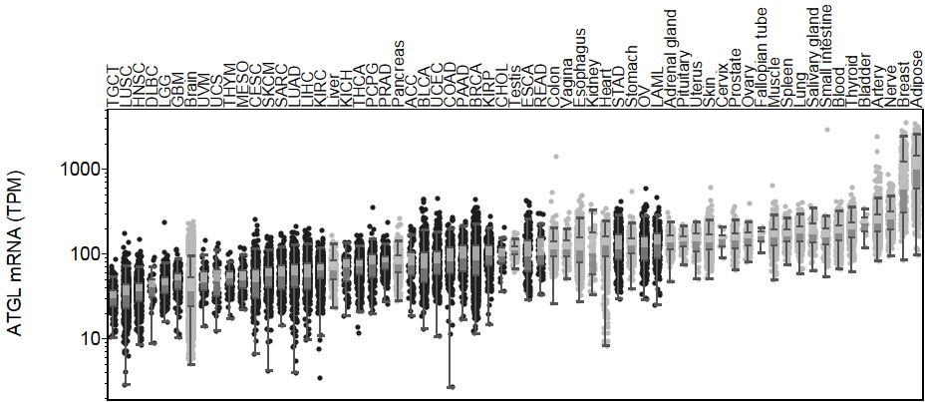
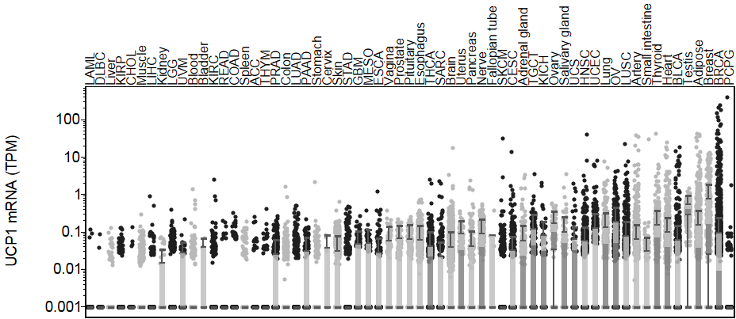
Supplementary Figure 4
C
USP18 mRNA (TPM)
ATGL mRNA (TPM)
UCP1 mRNA (TPM)
Figure S3: The mRNA expression profiles of USP18, ATGL and UCP1 in the indicated different cancer types using TCGA database.

Slide 5
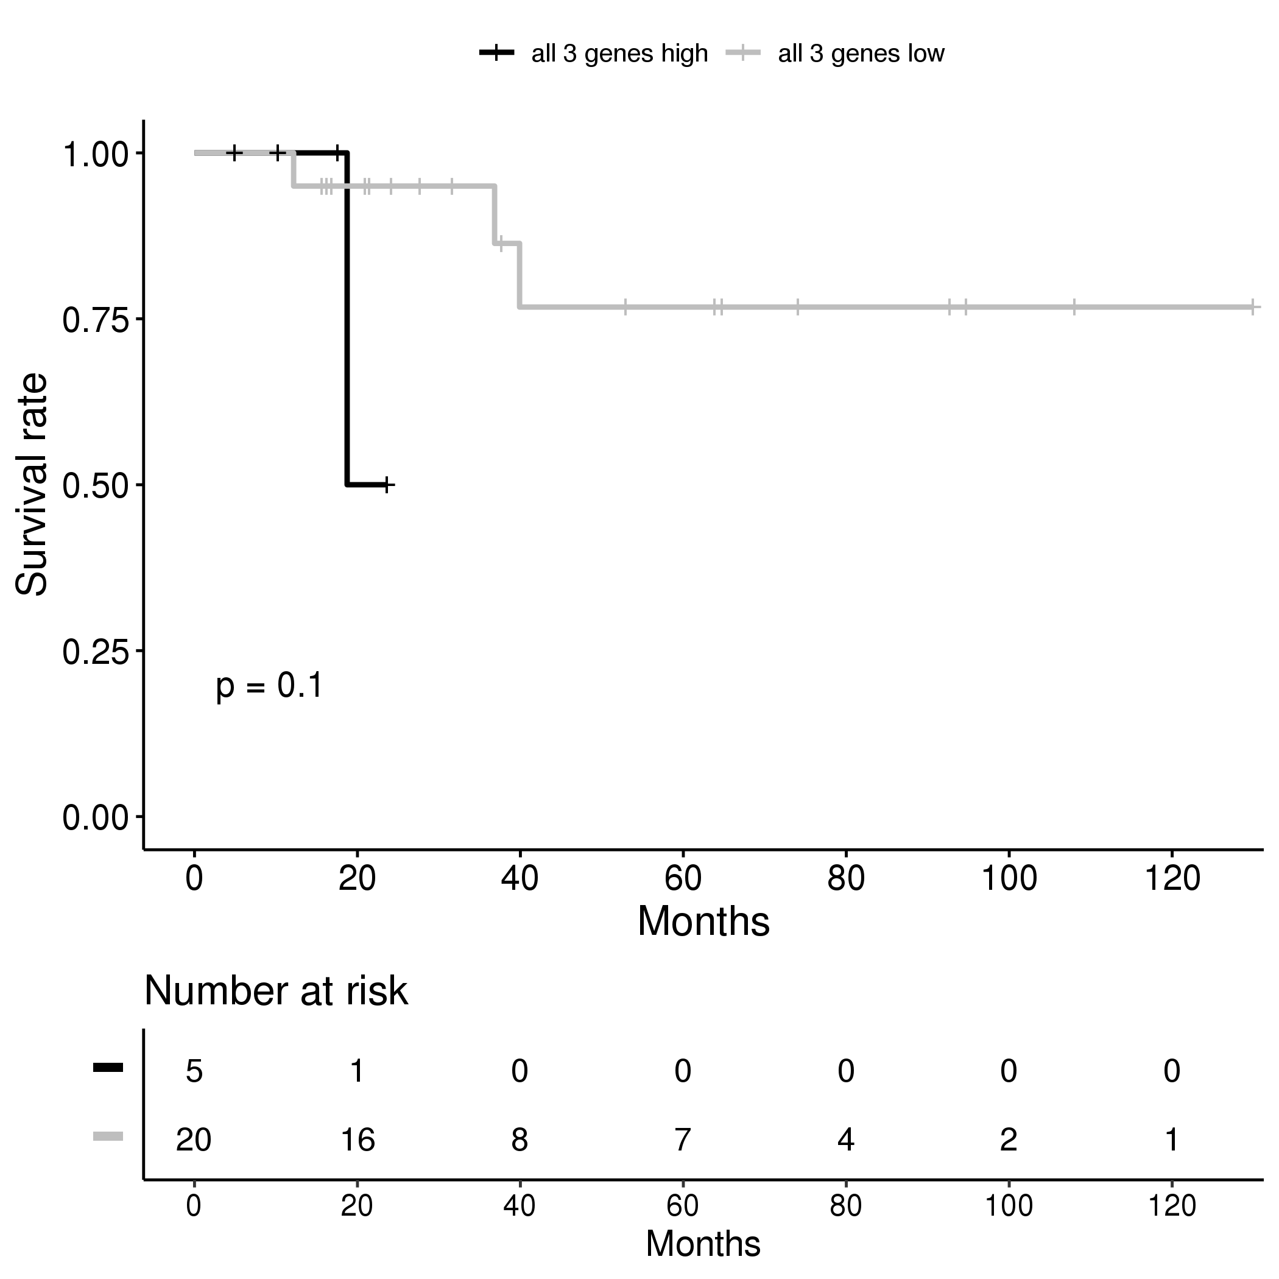
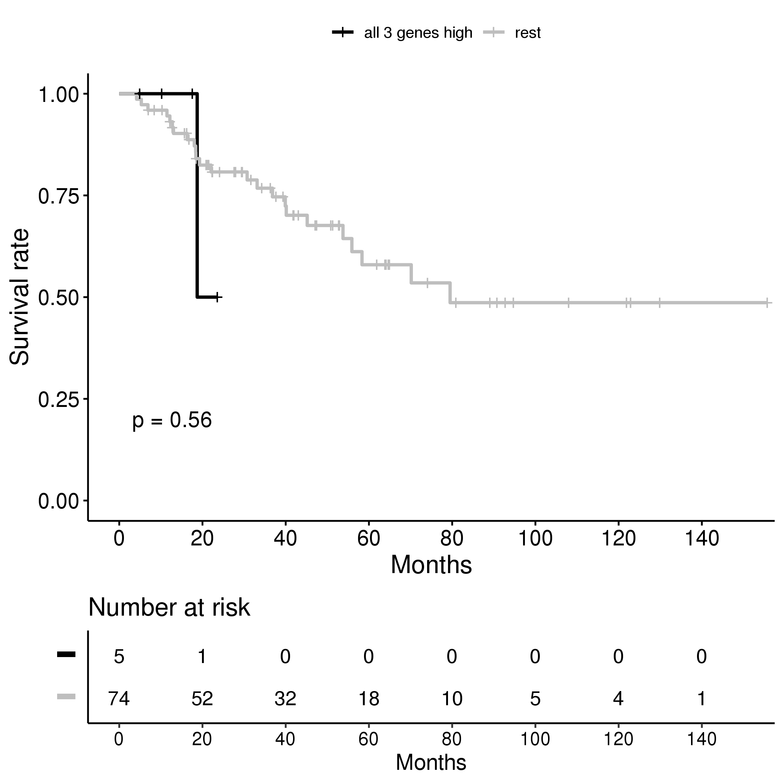
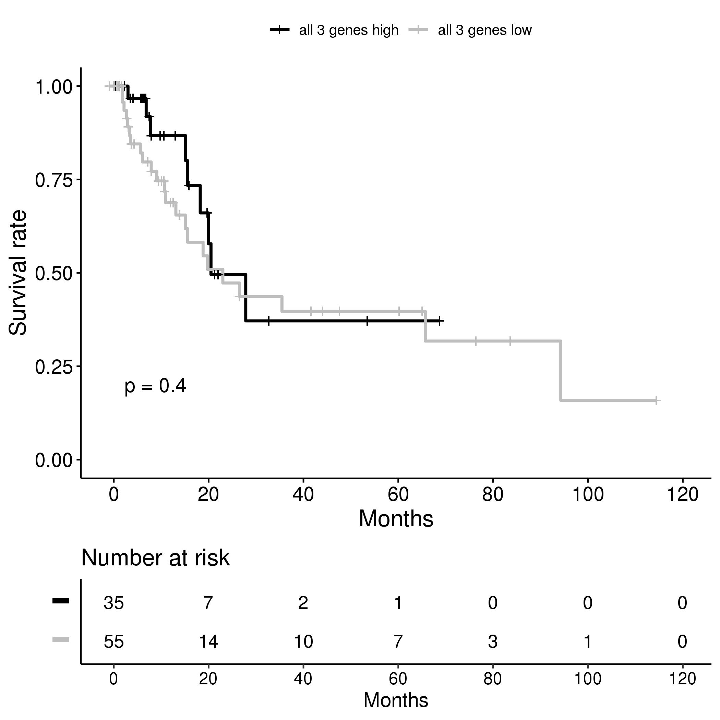
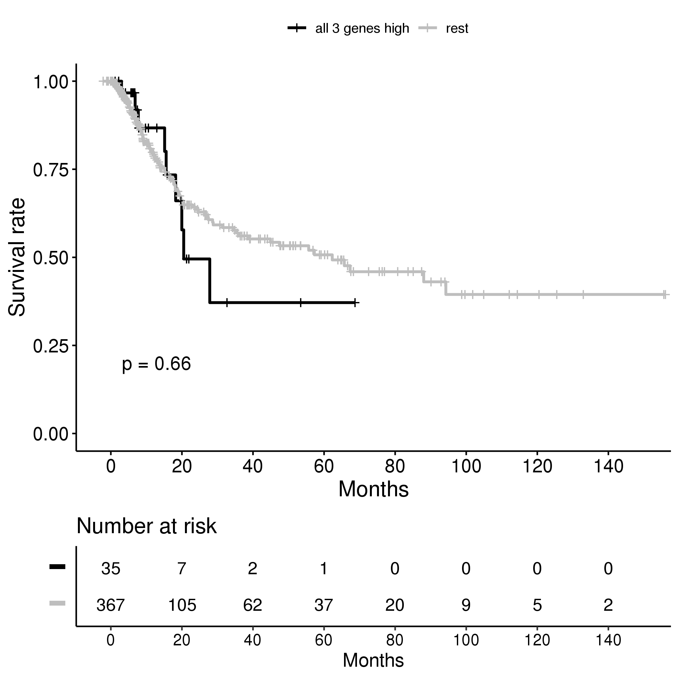
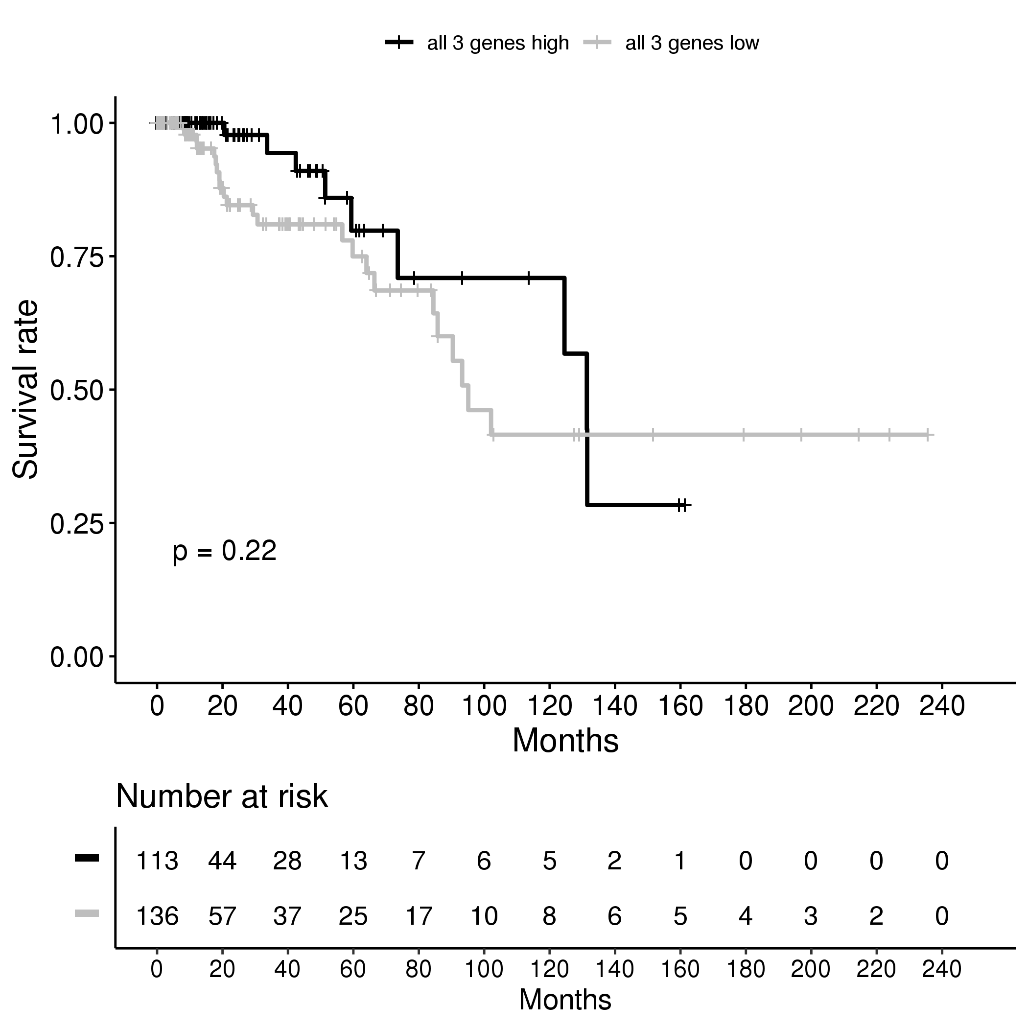
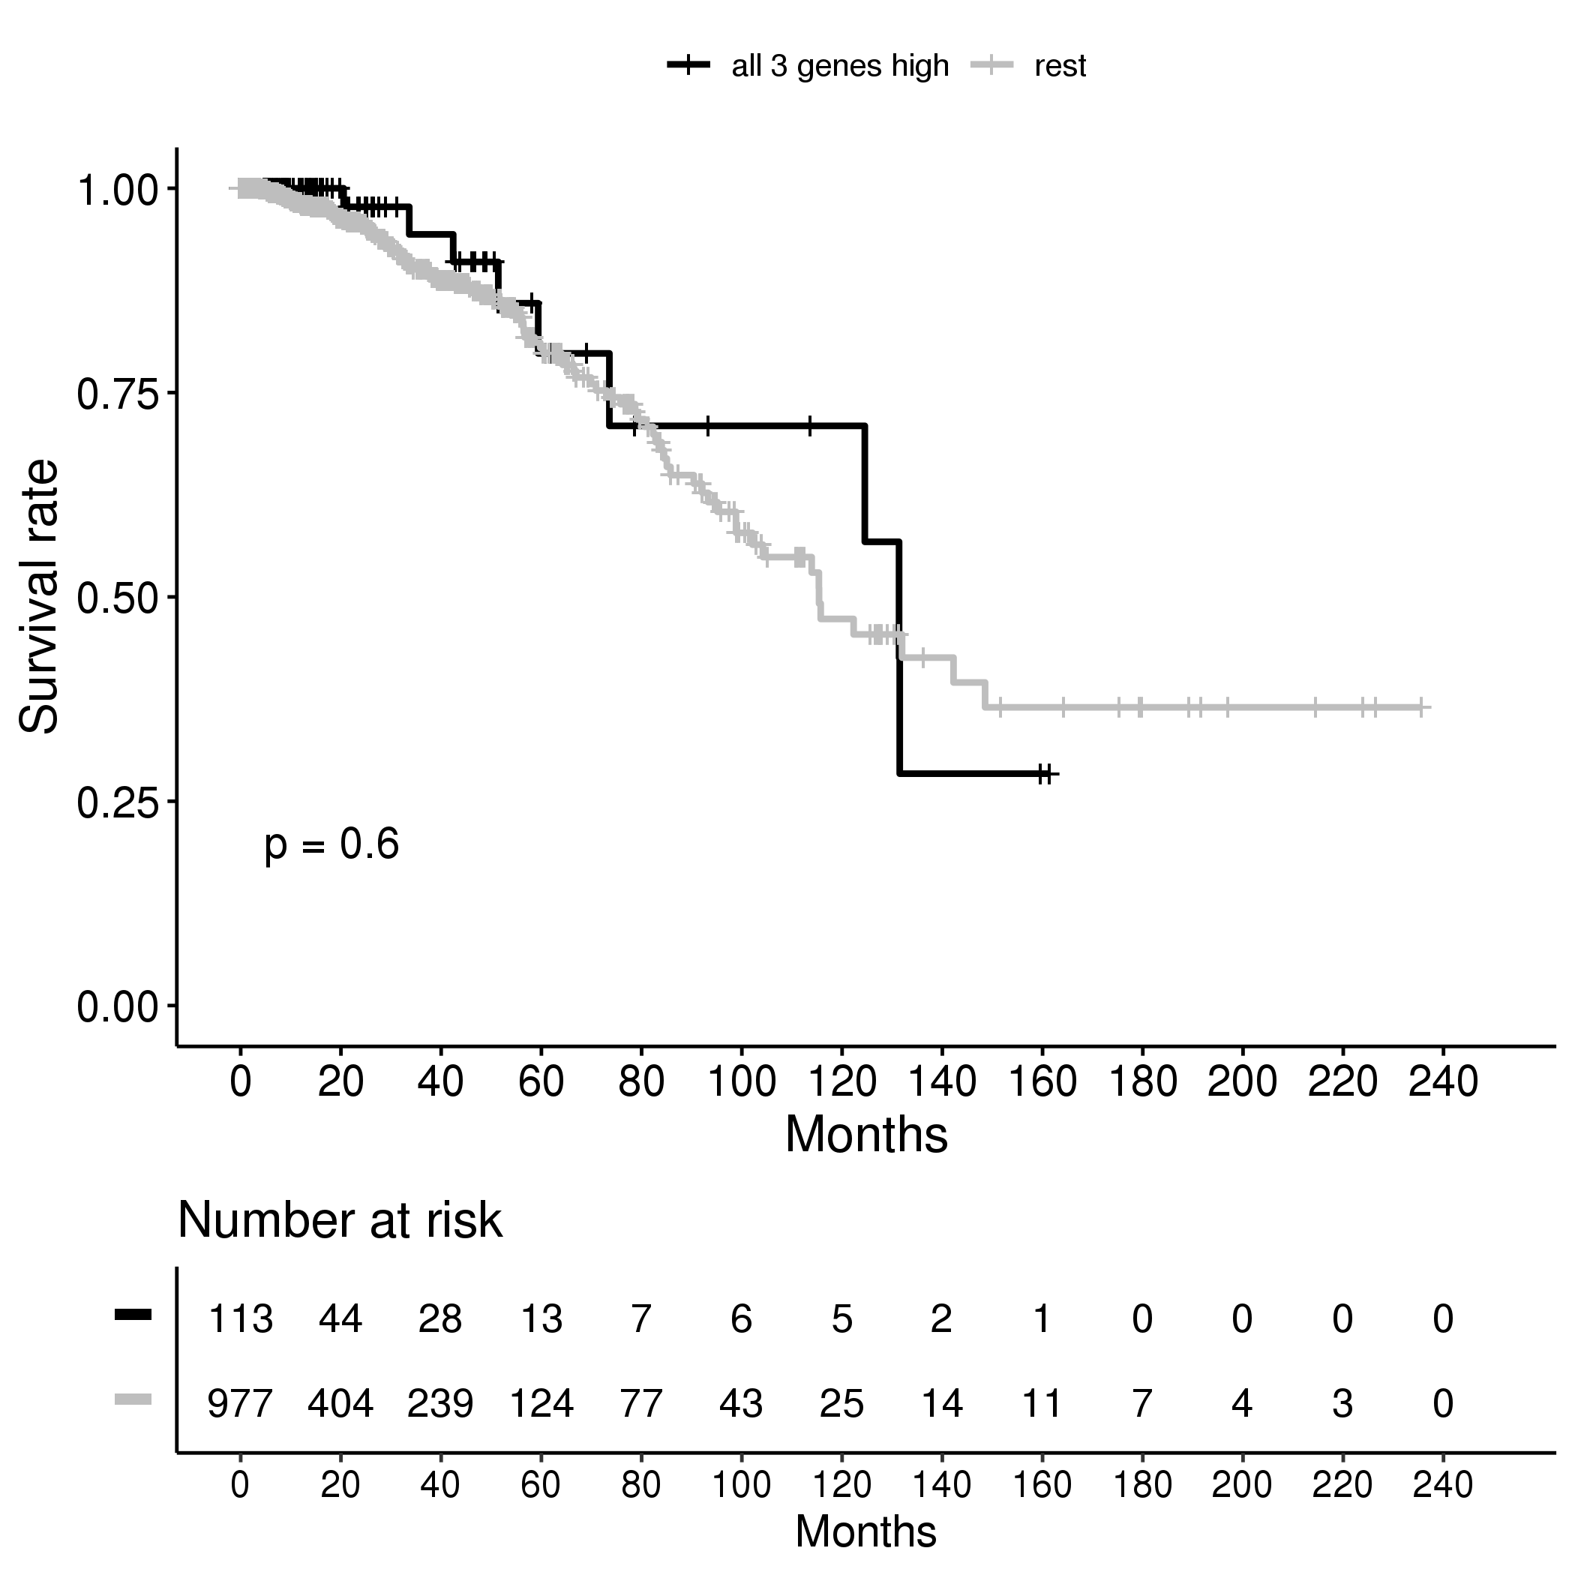
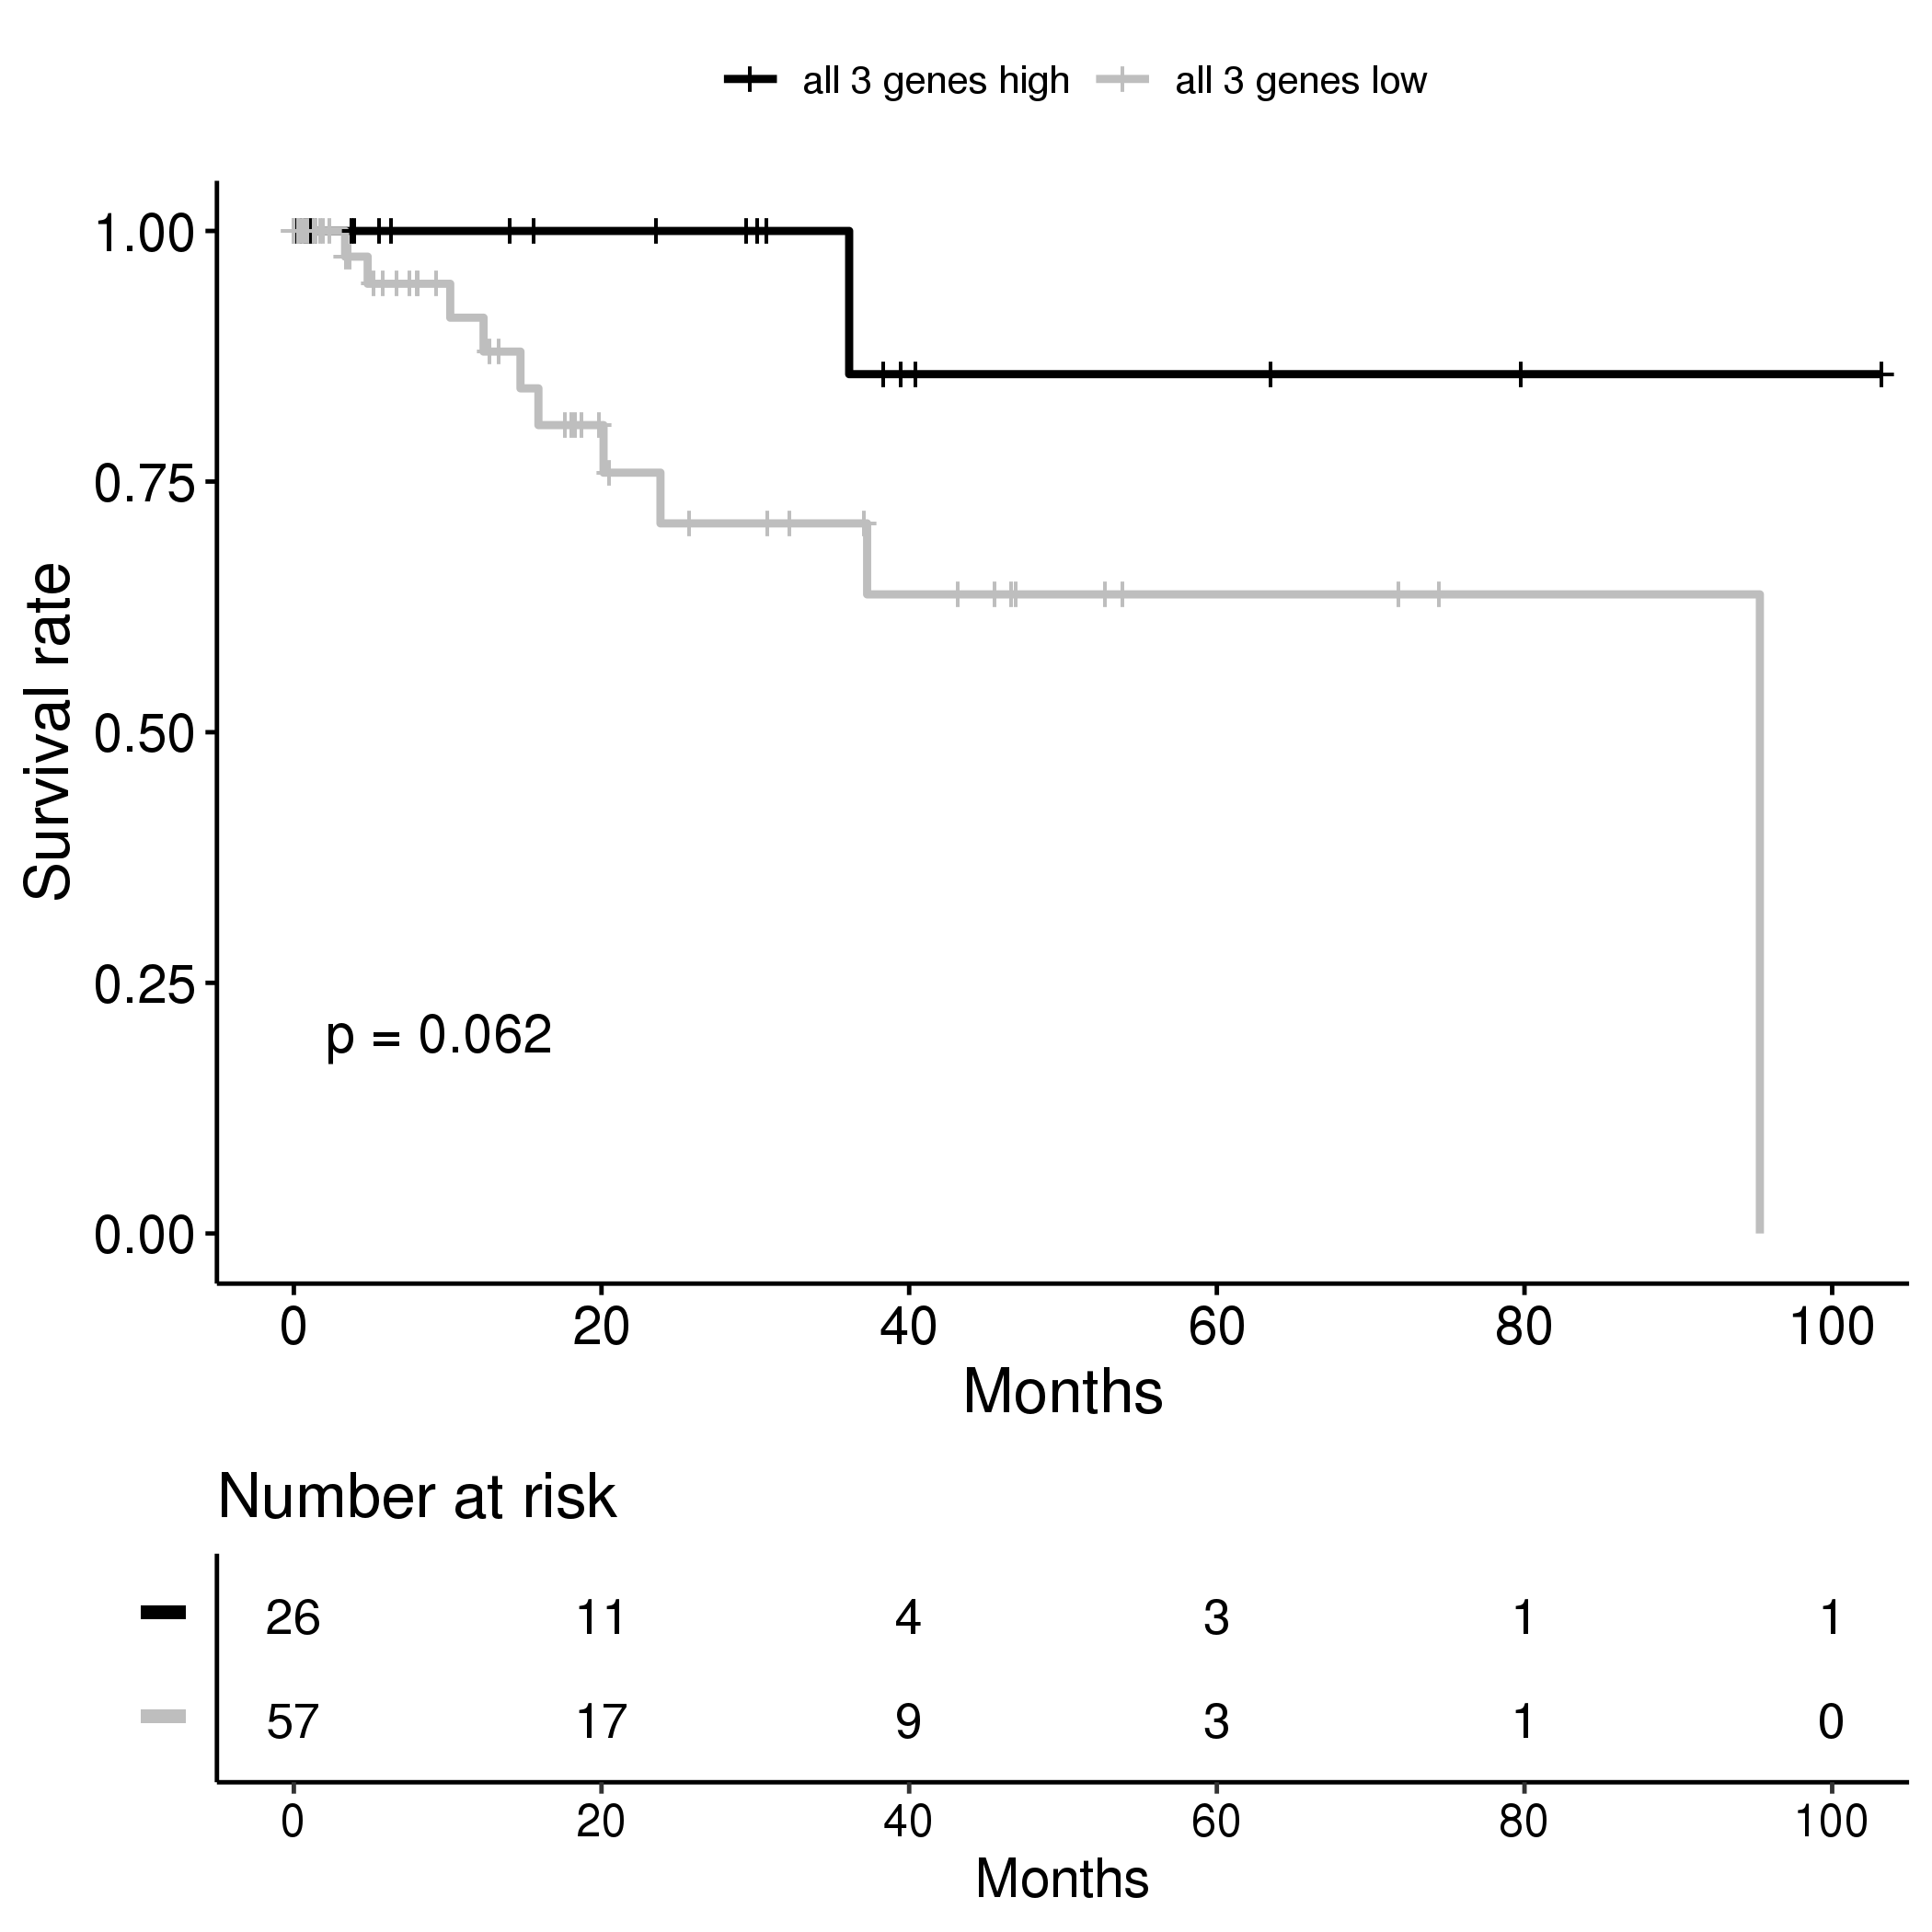
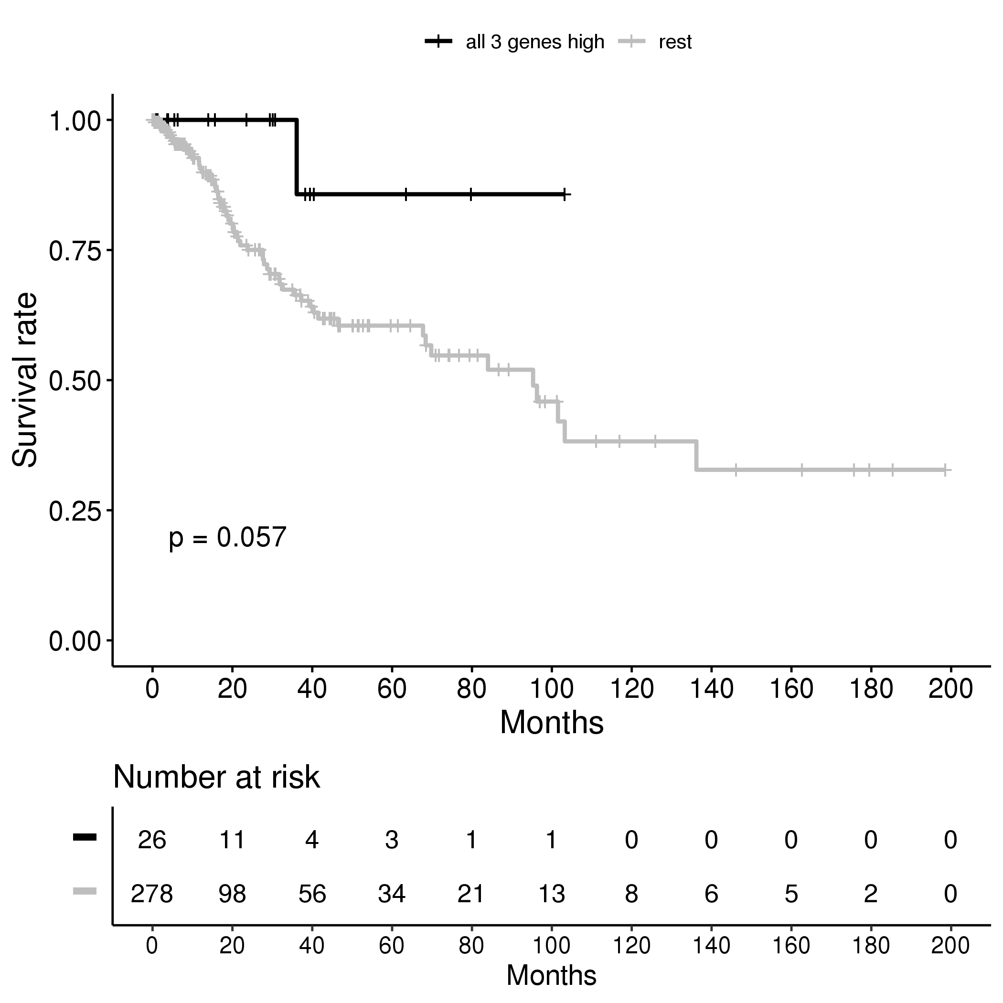
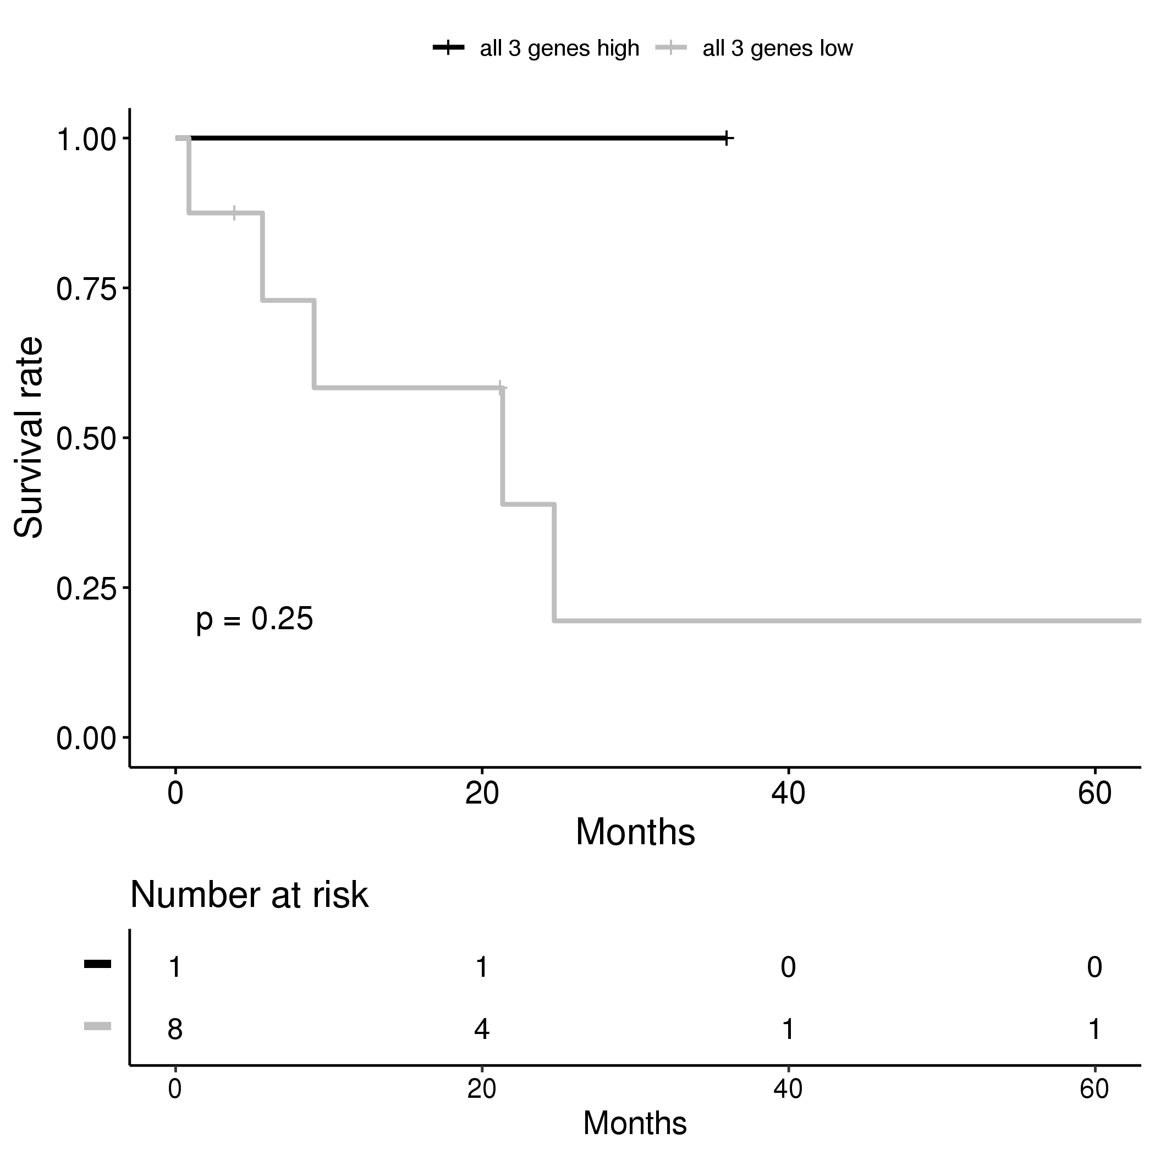
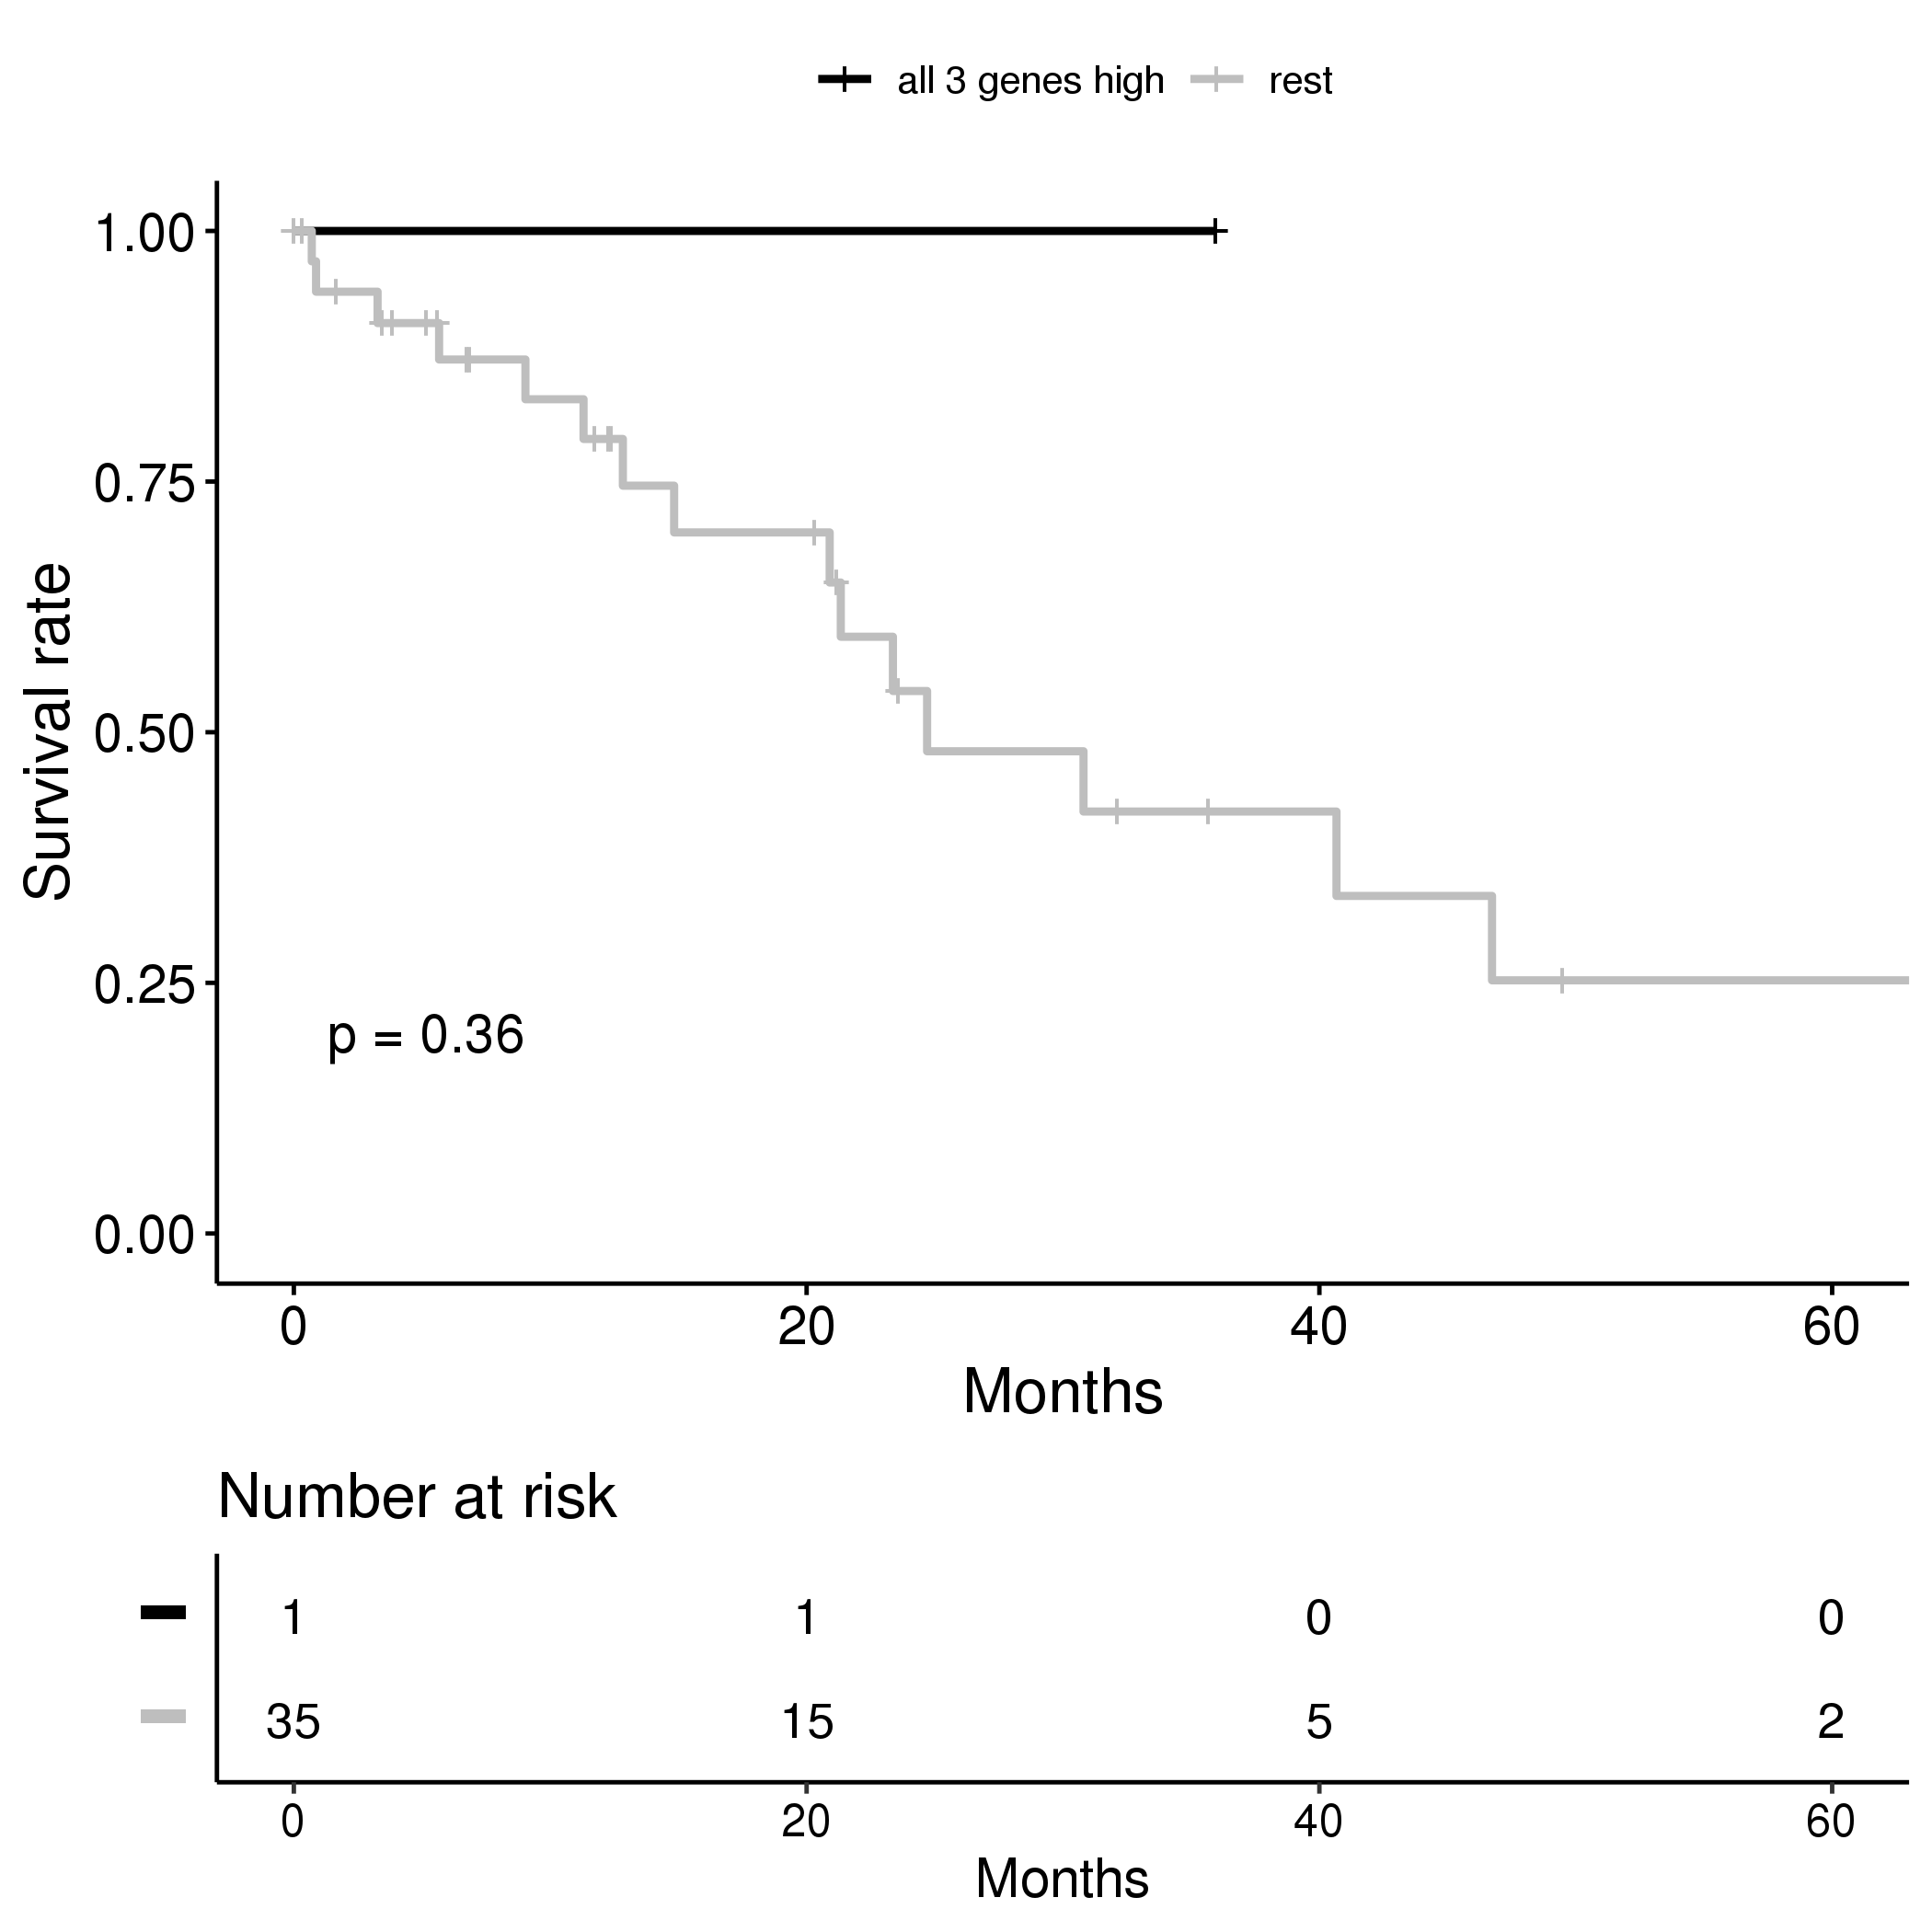
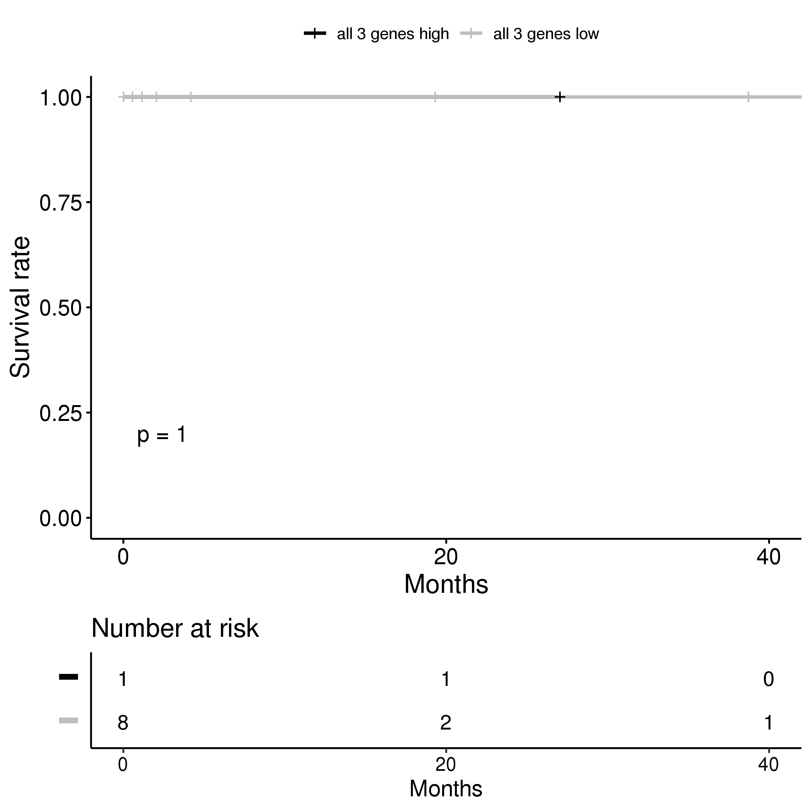
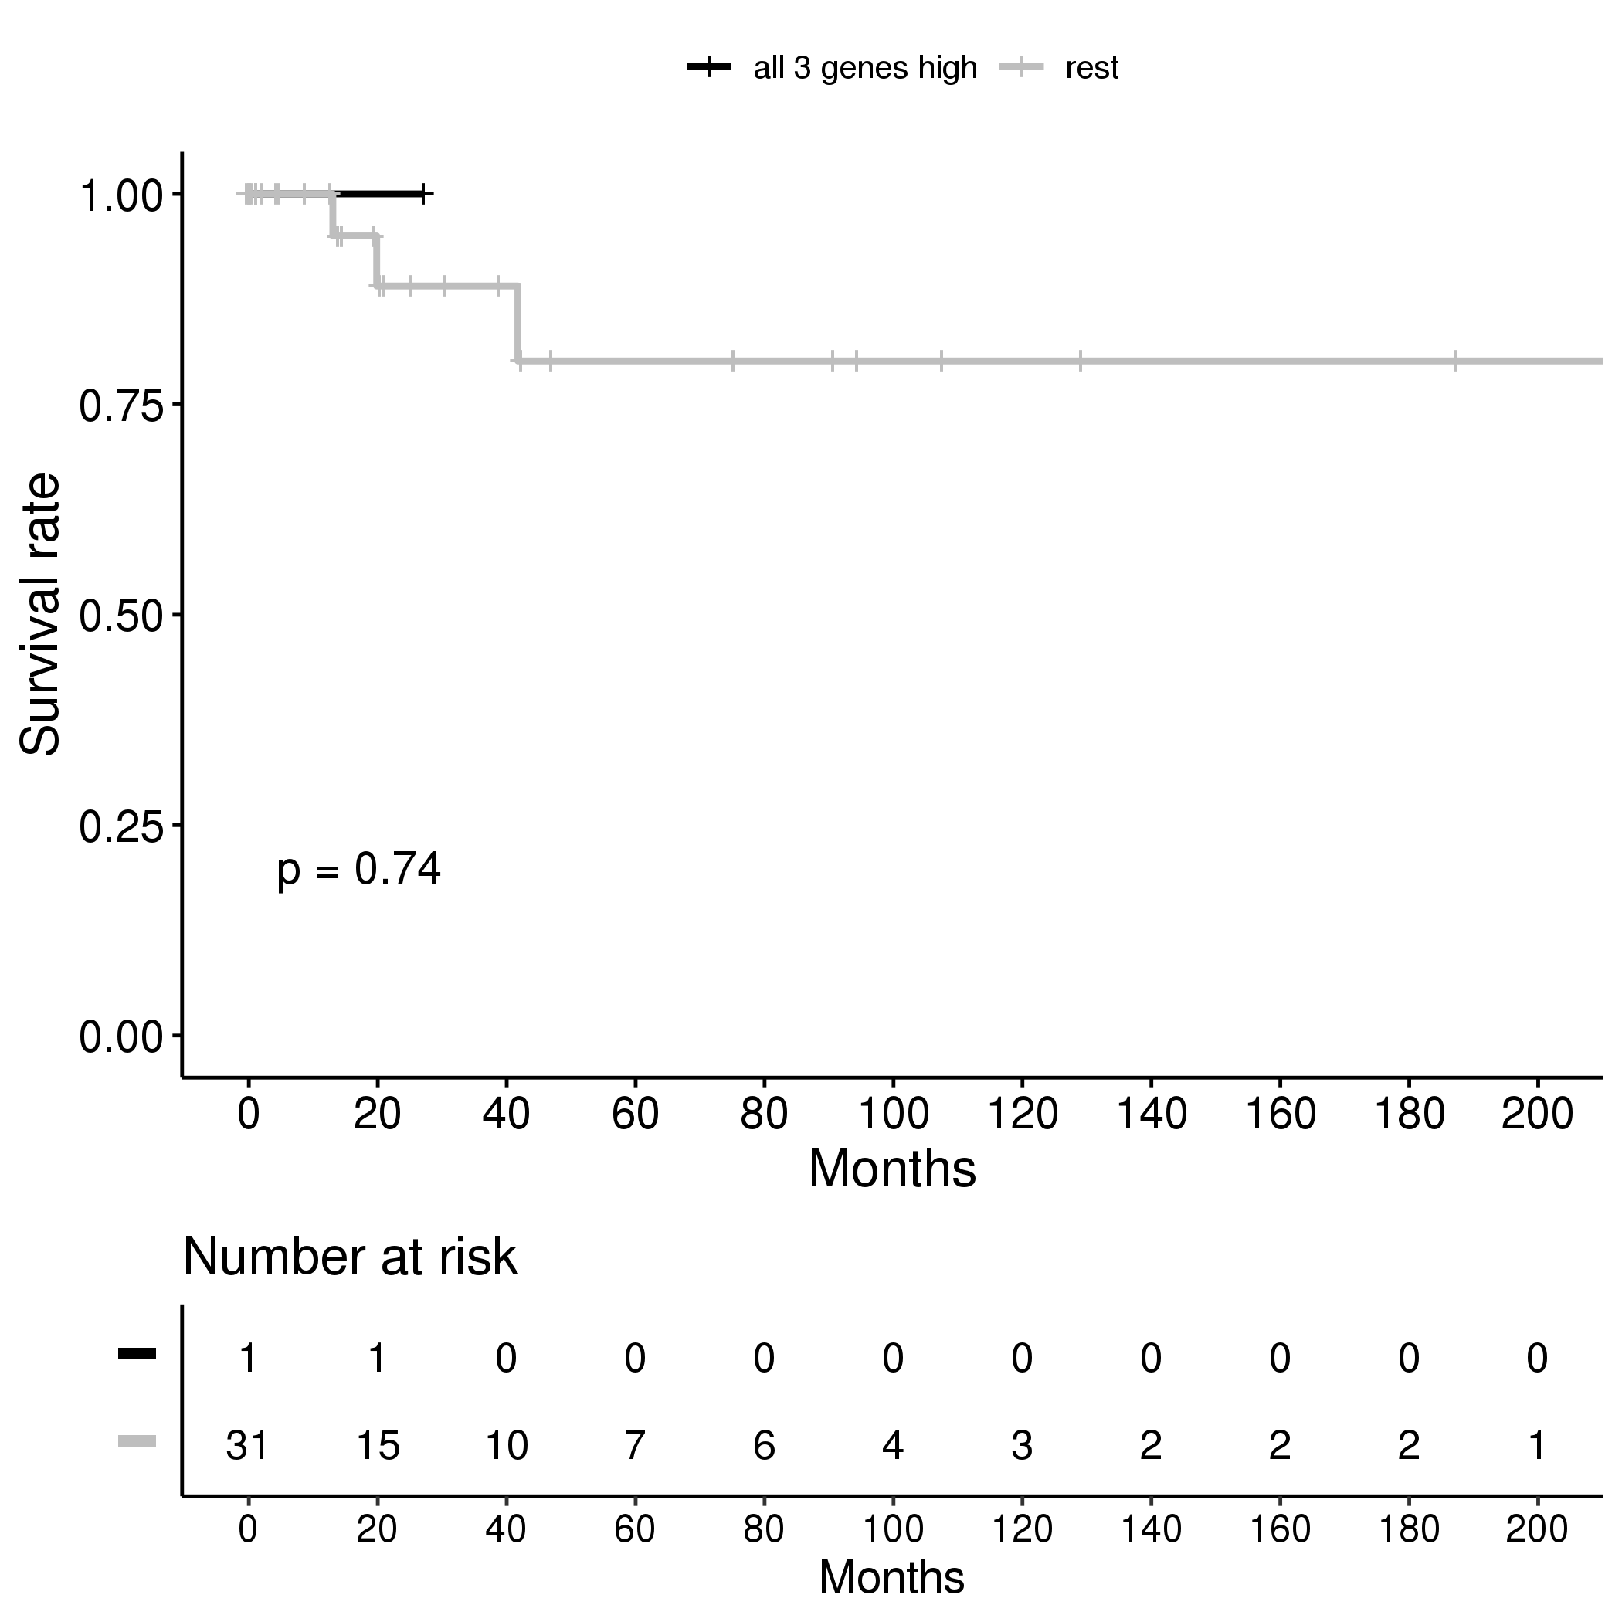
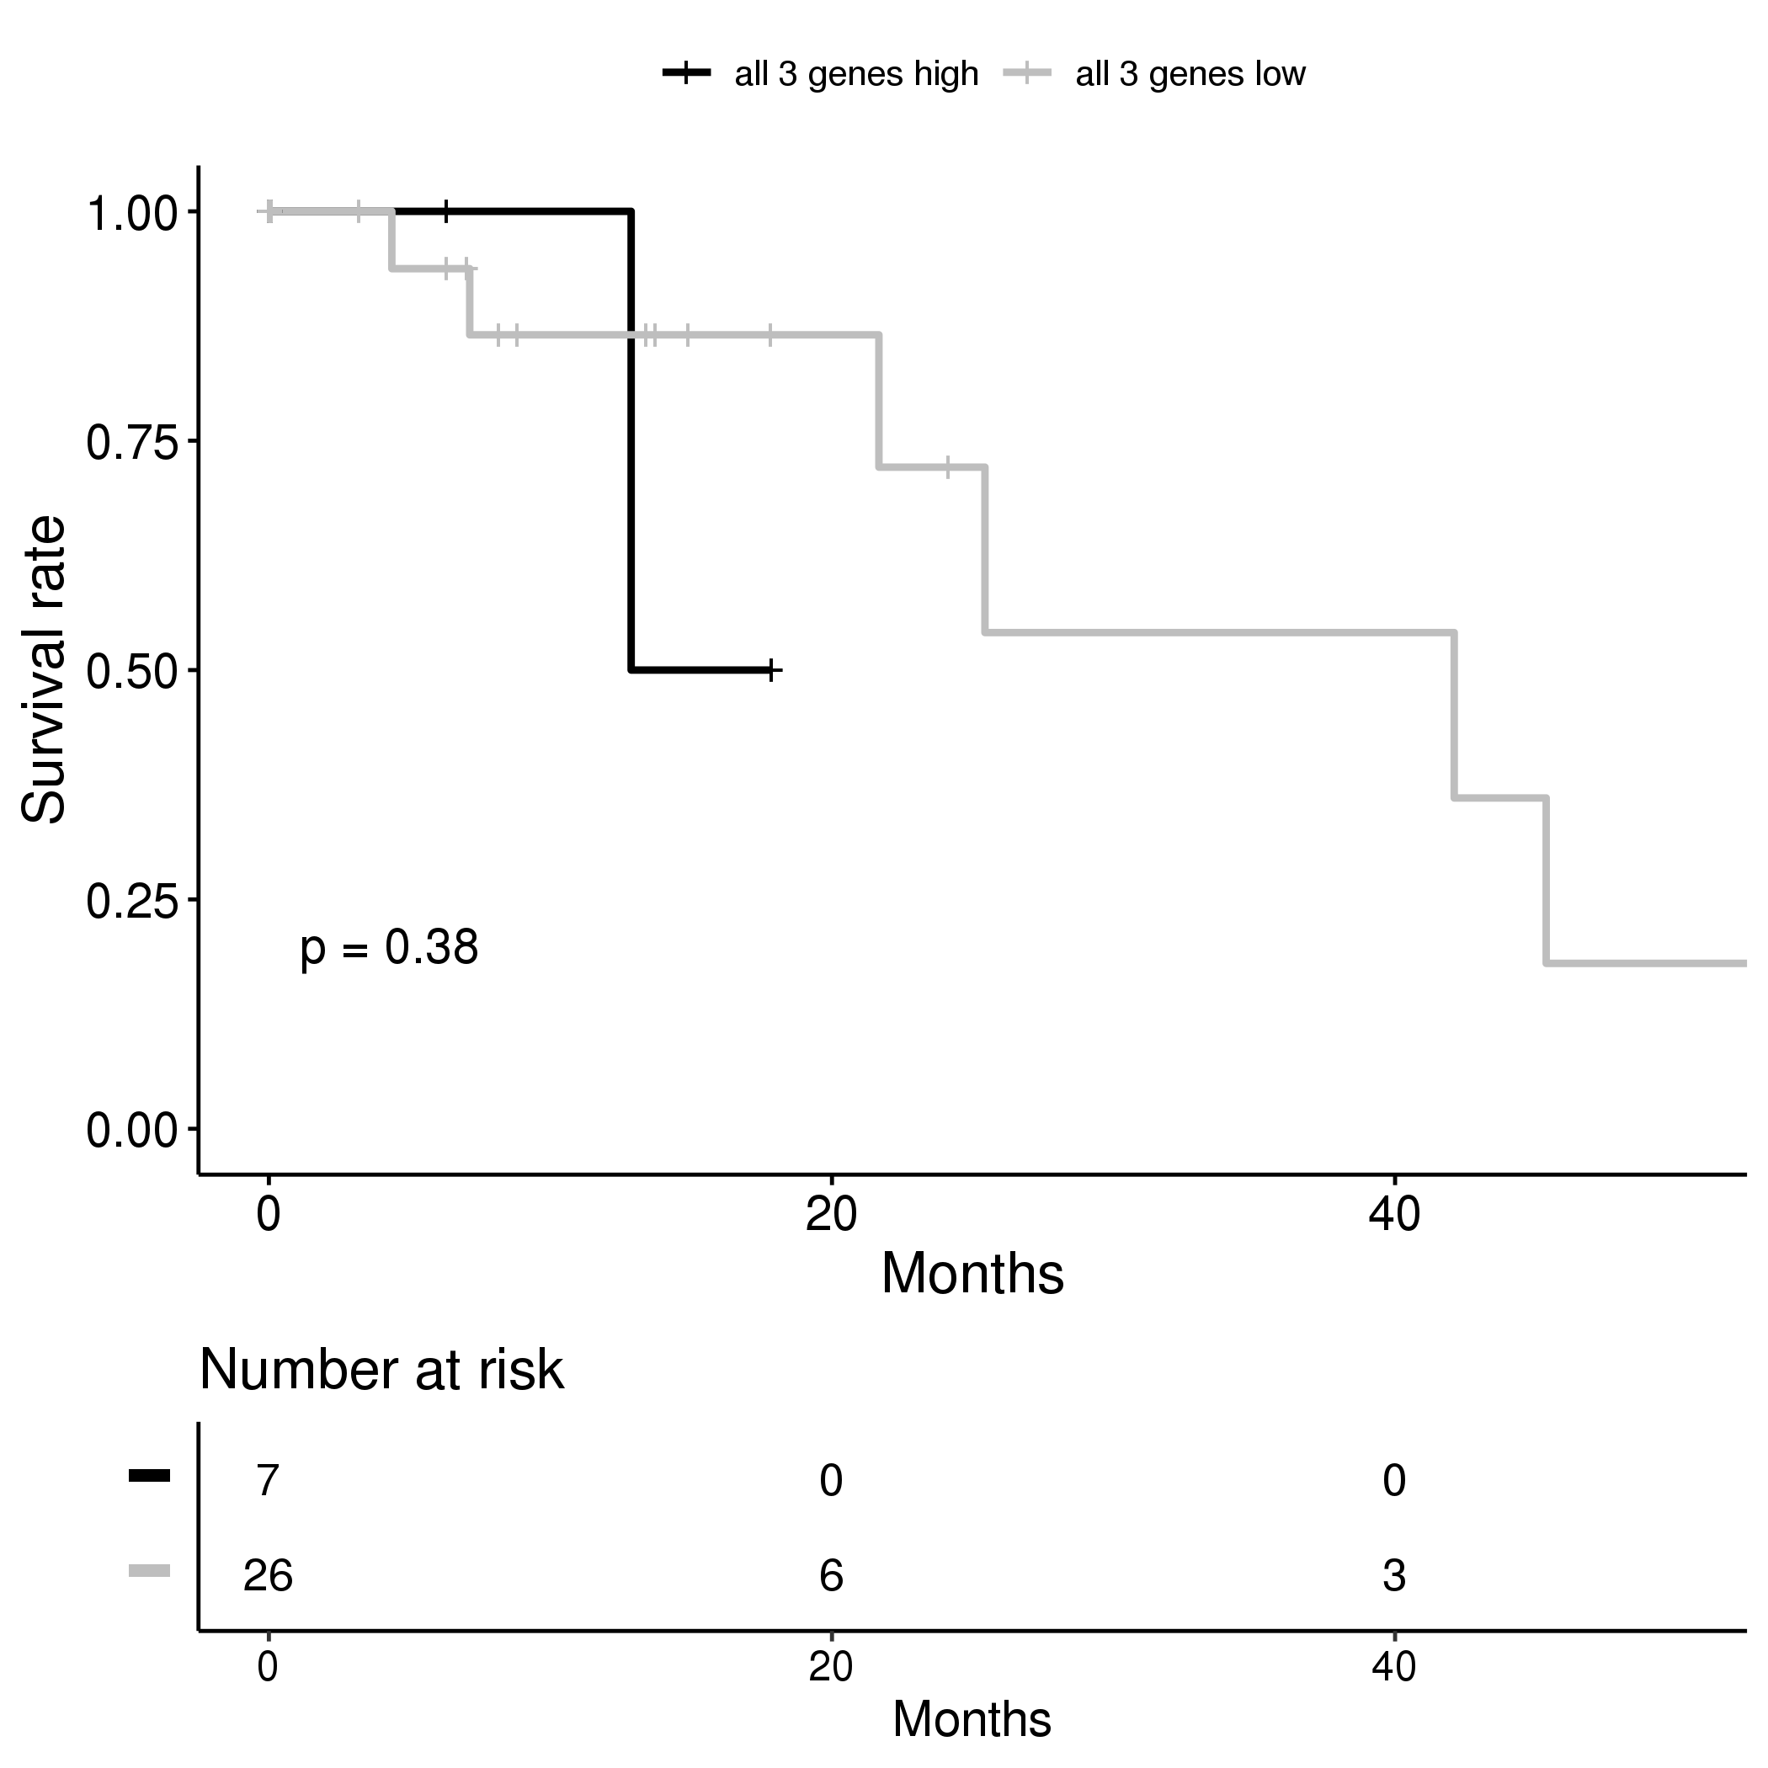
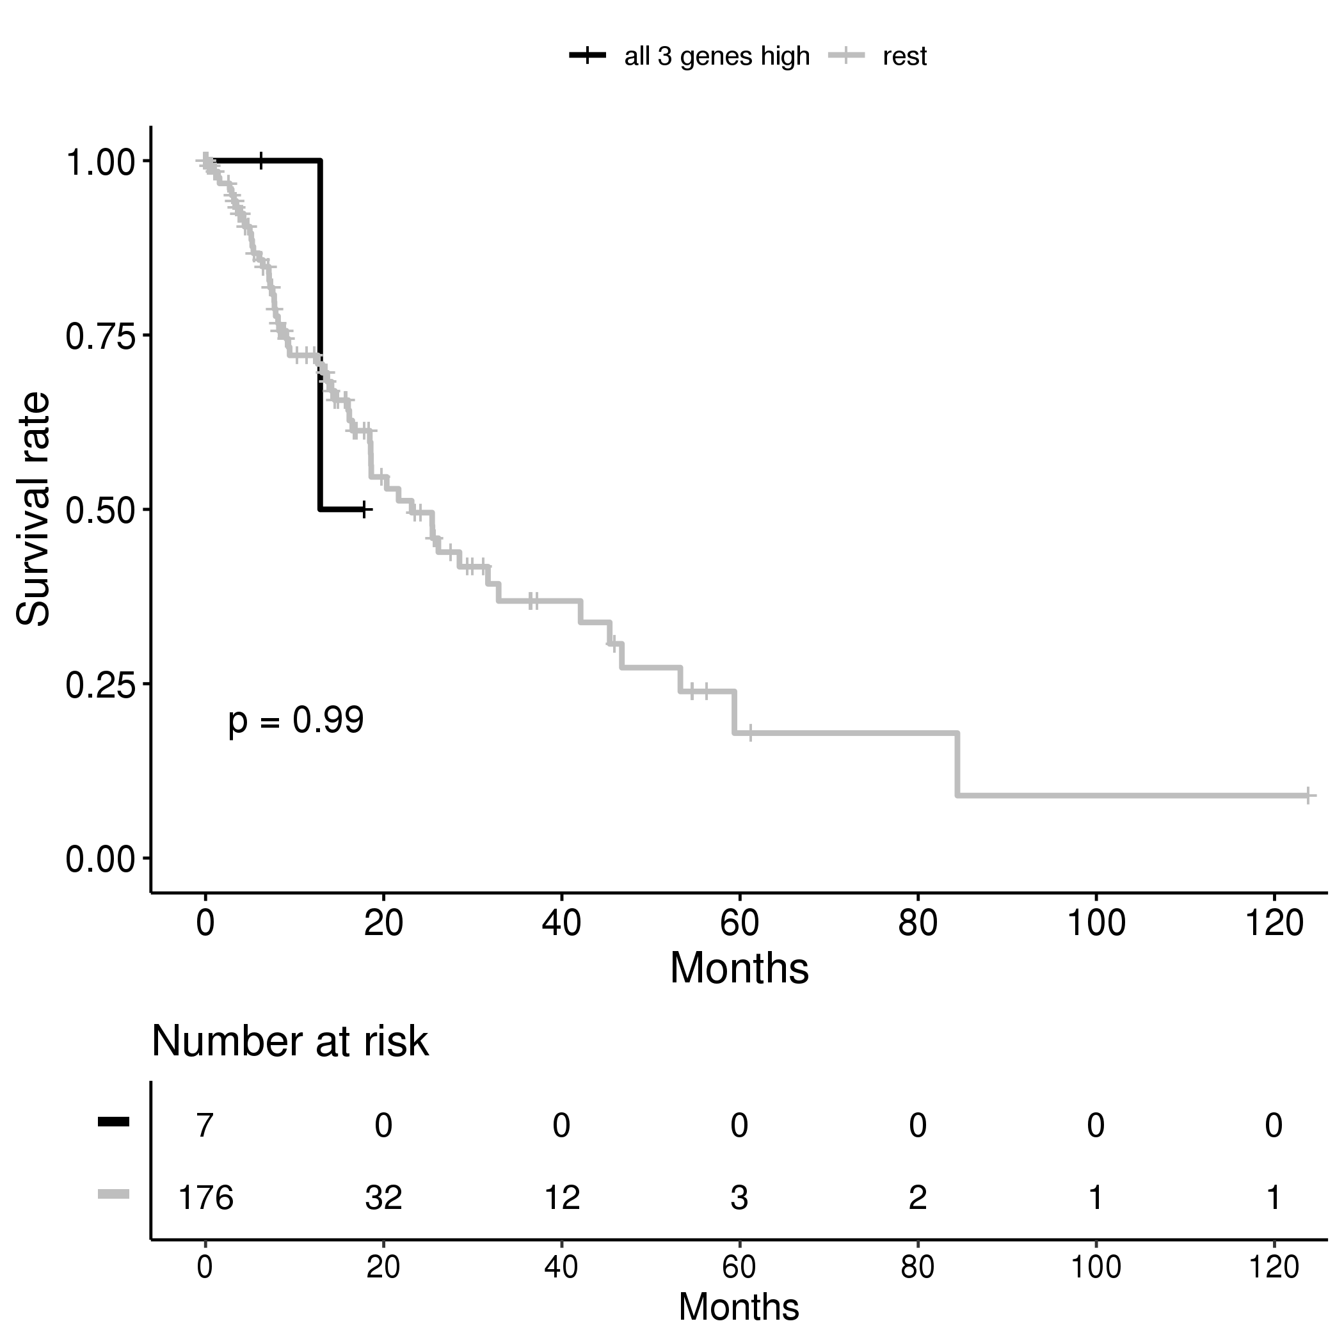
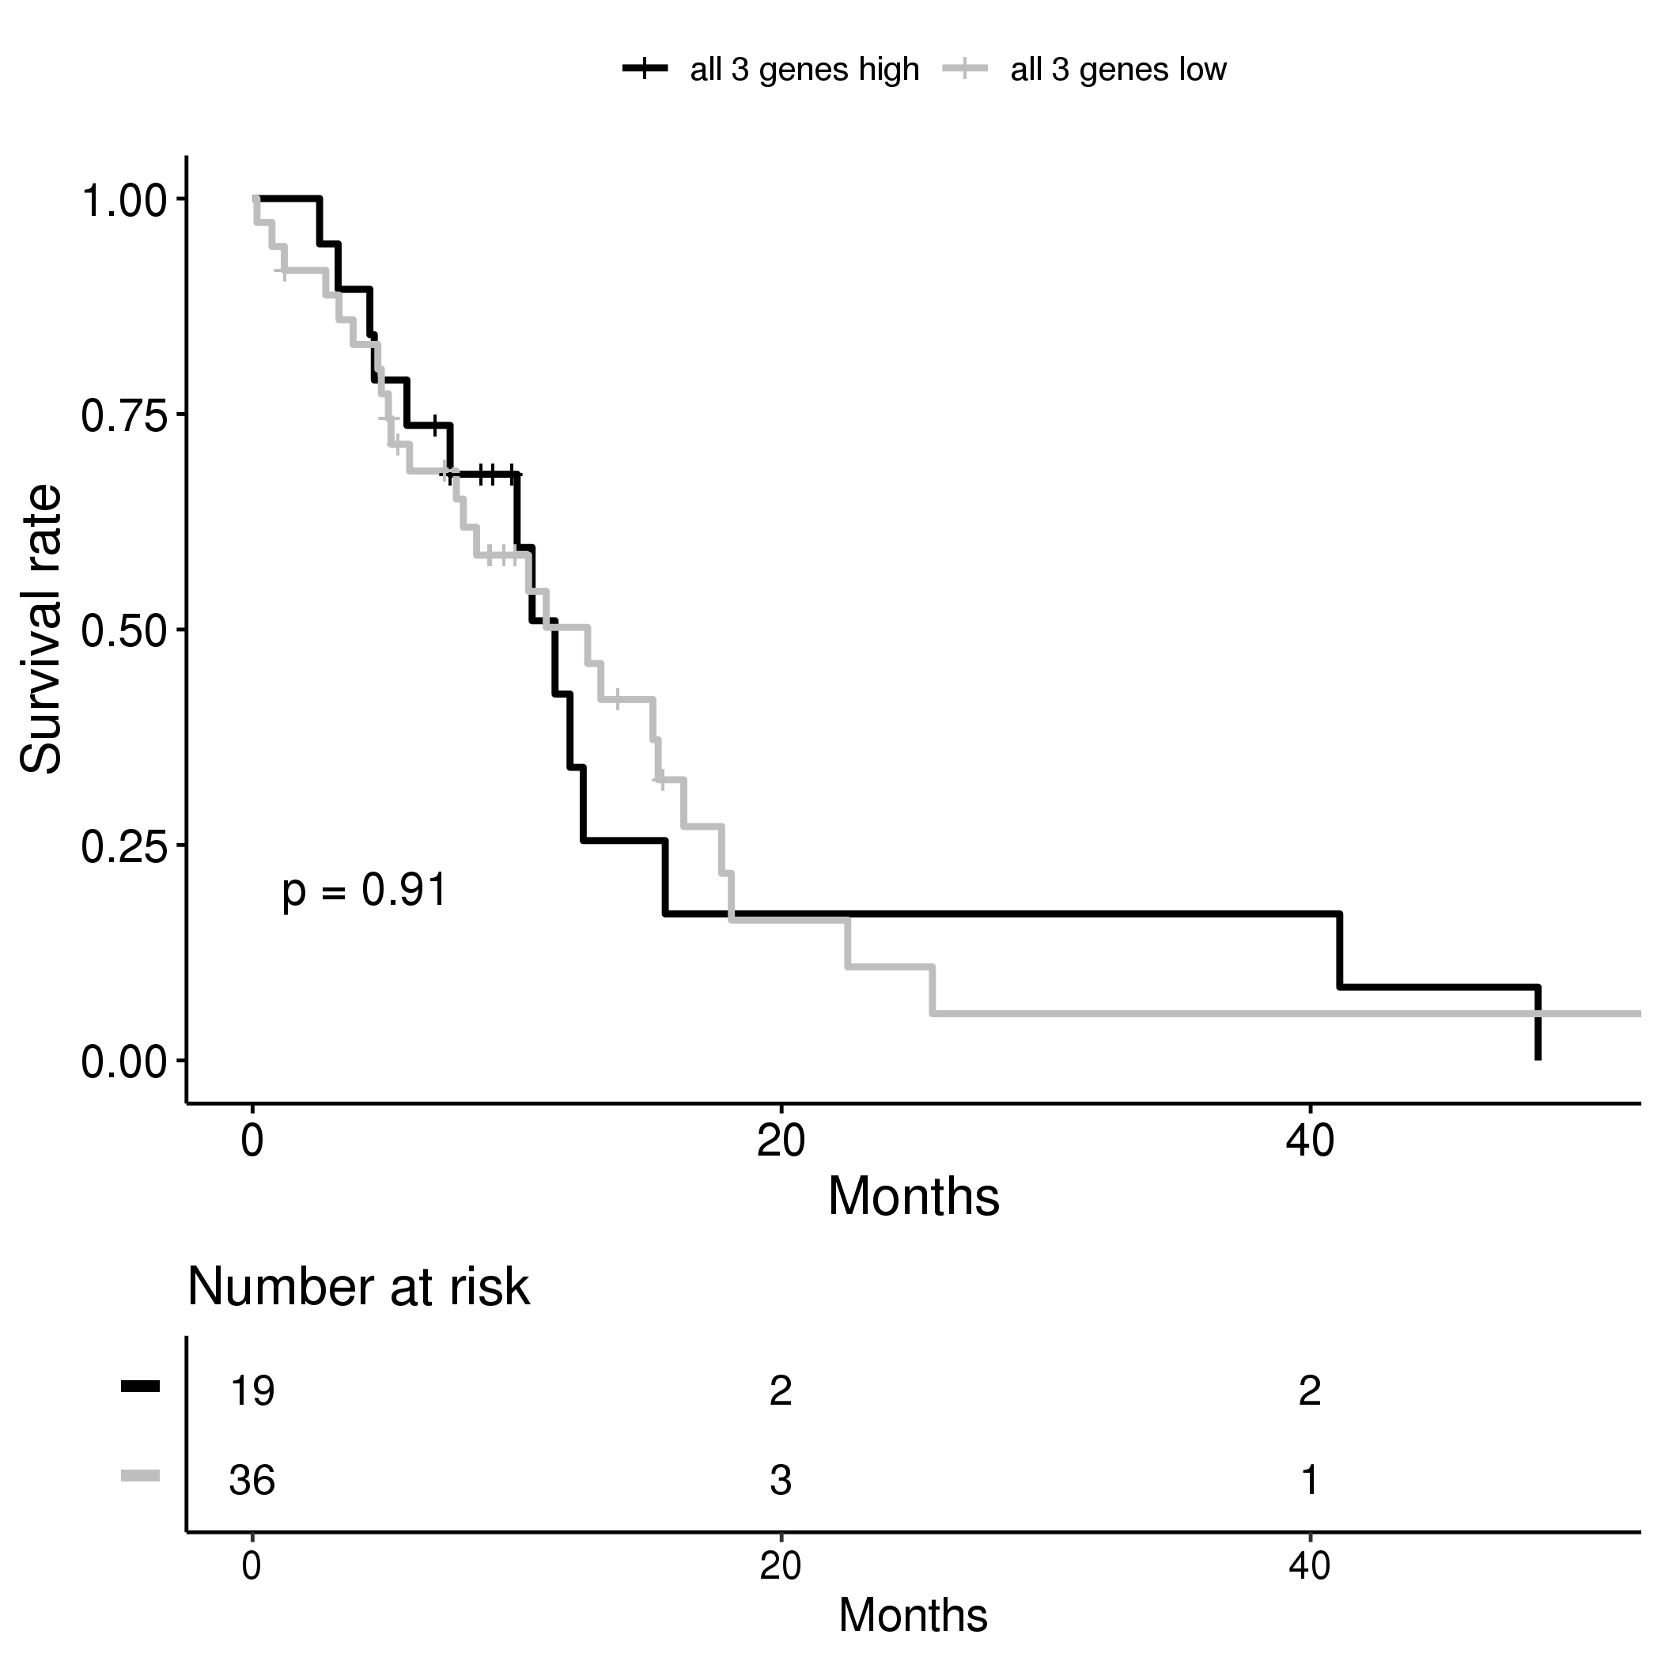
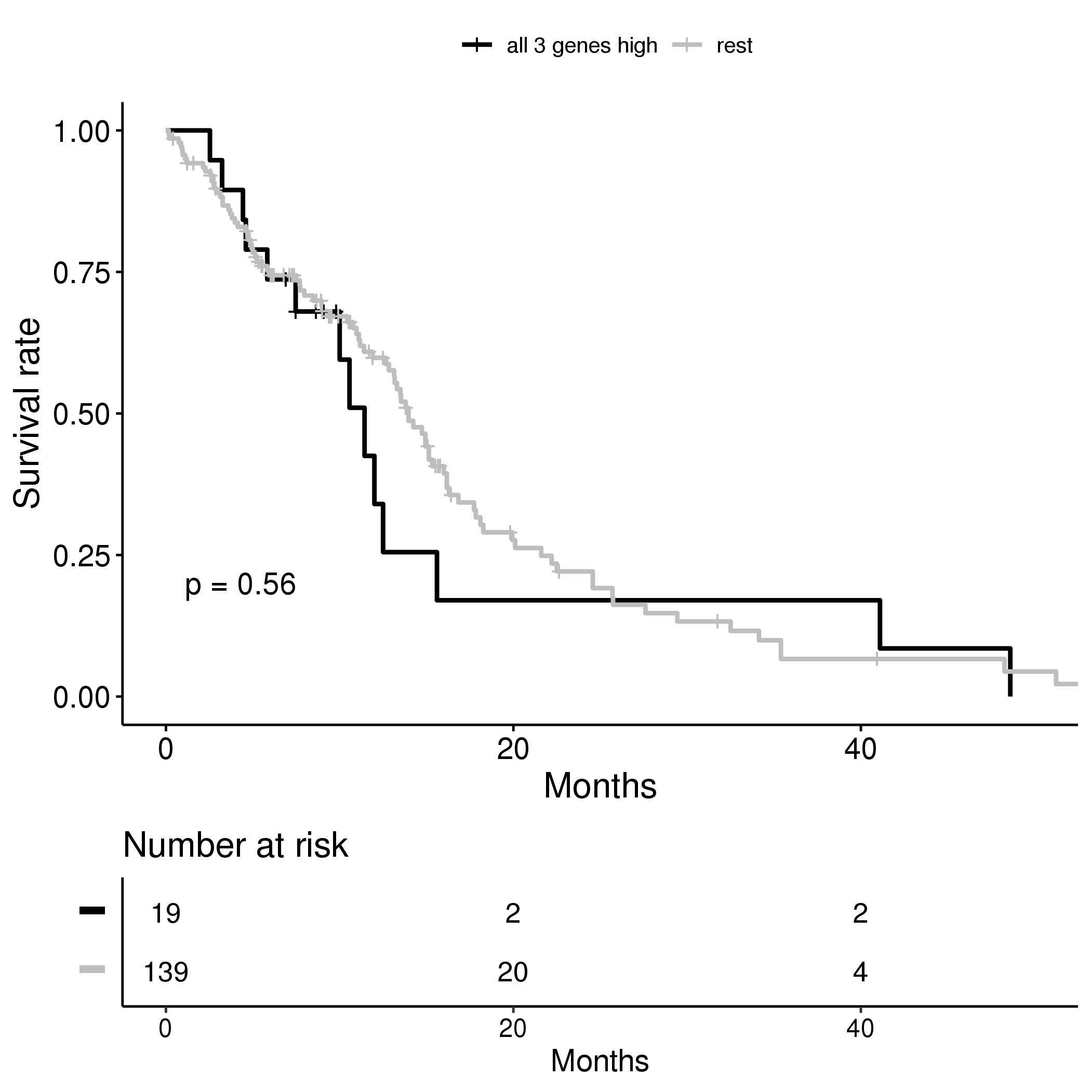
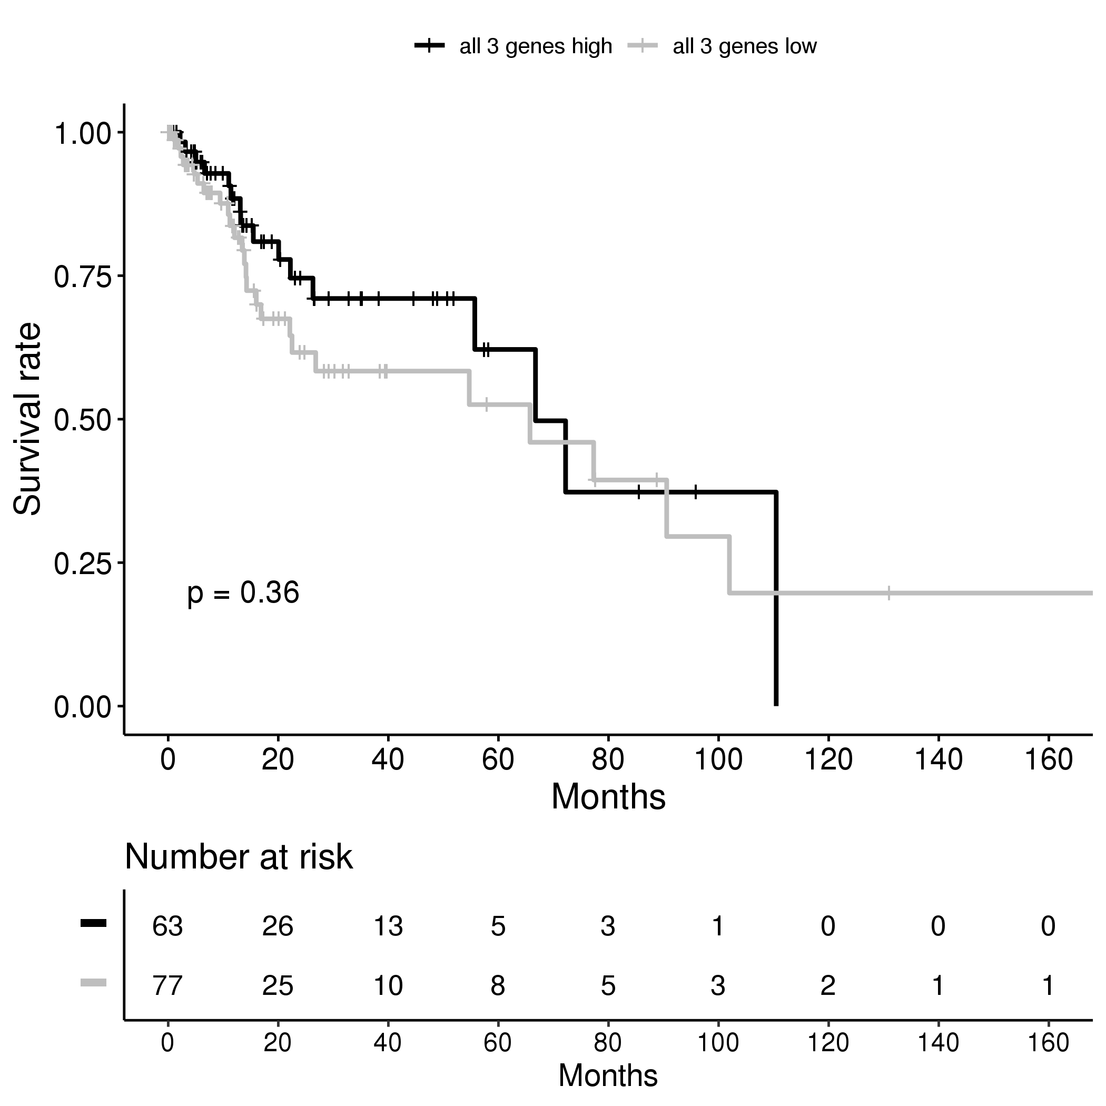
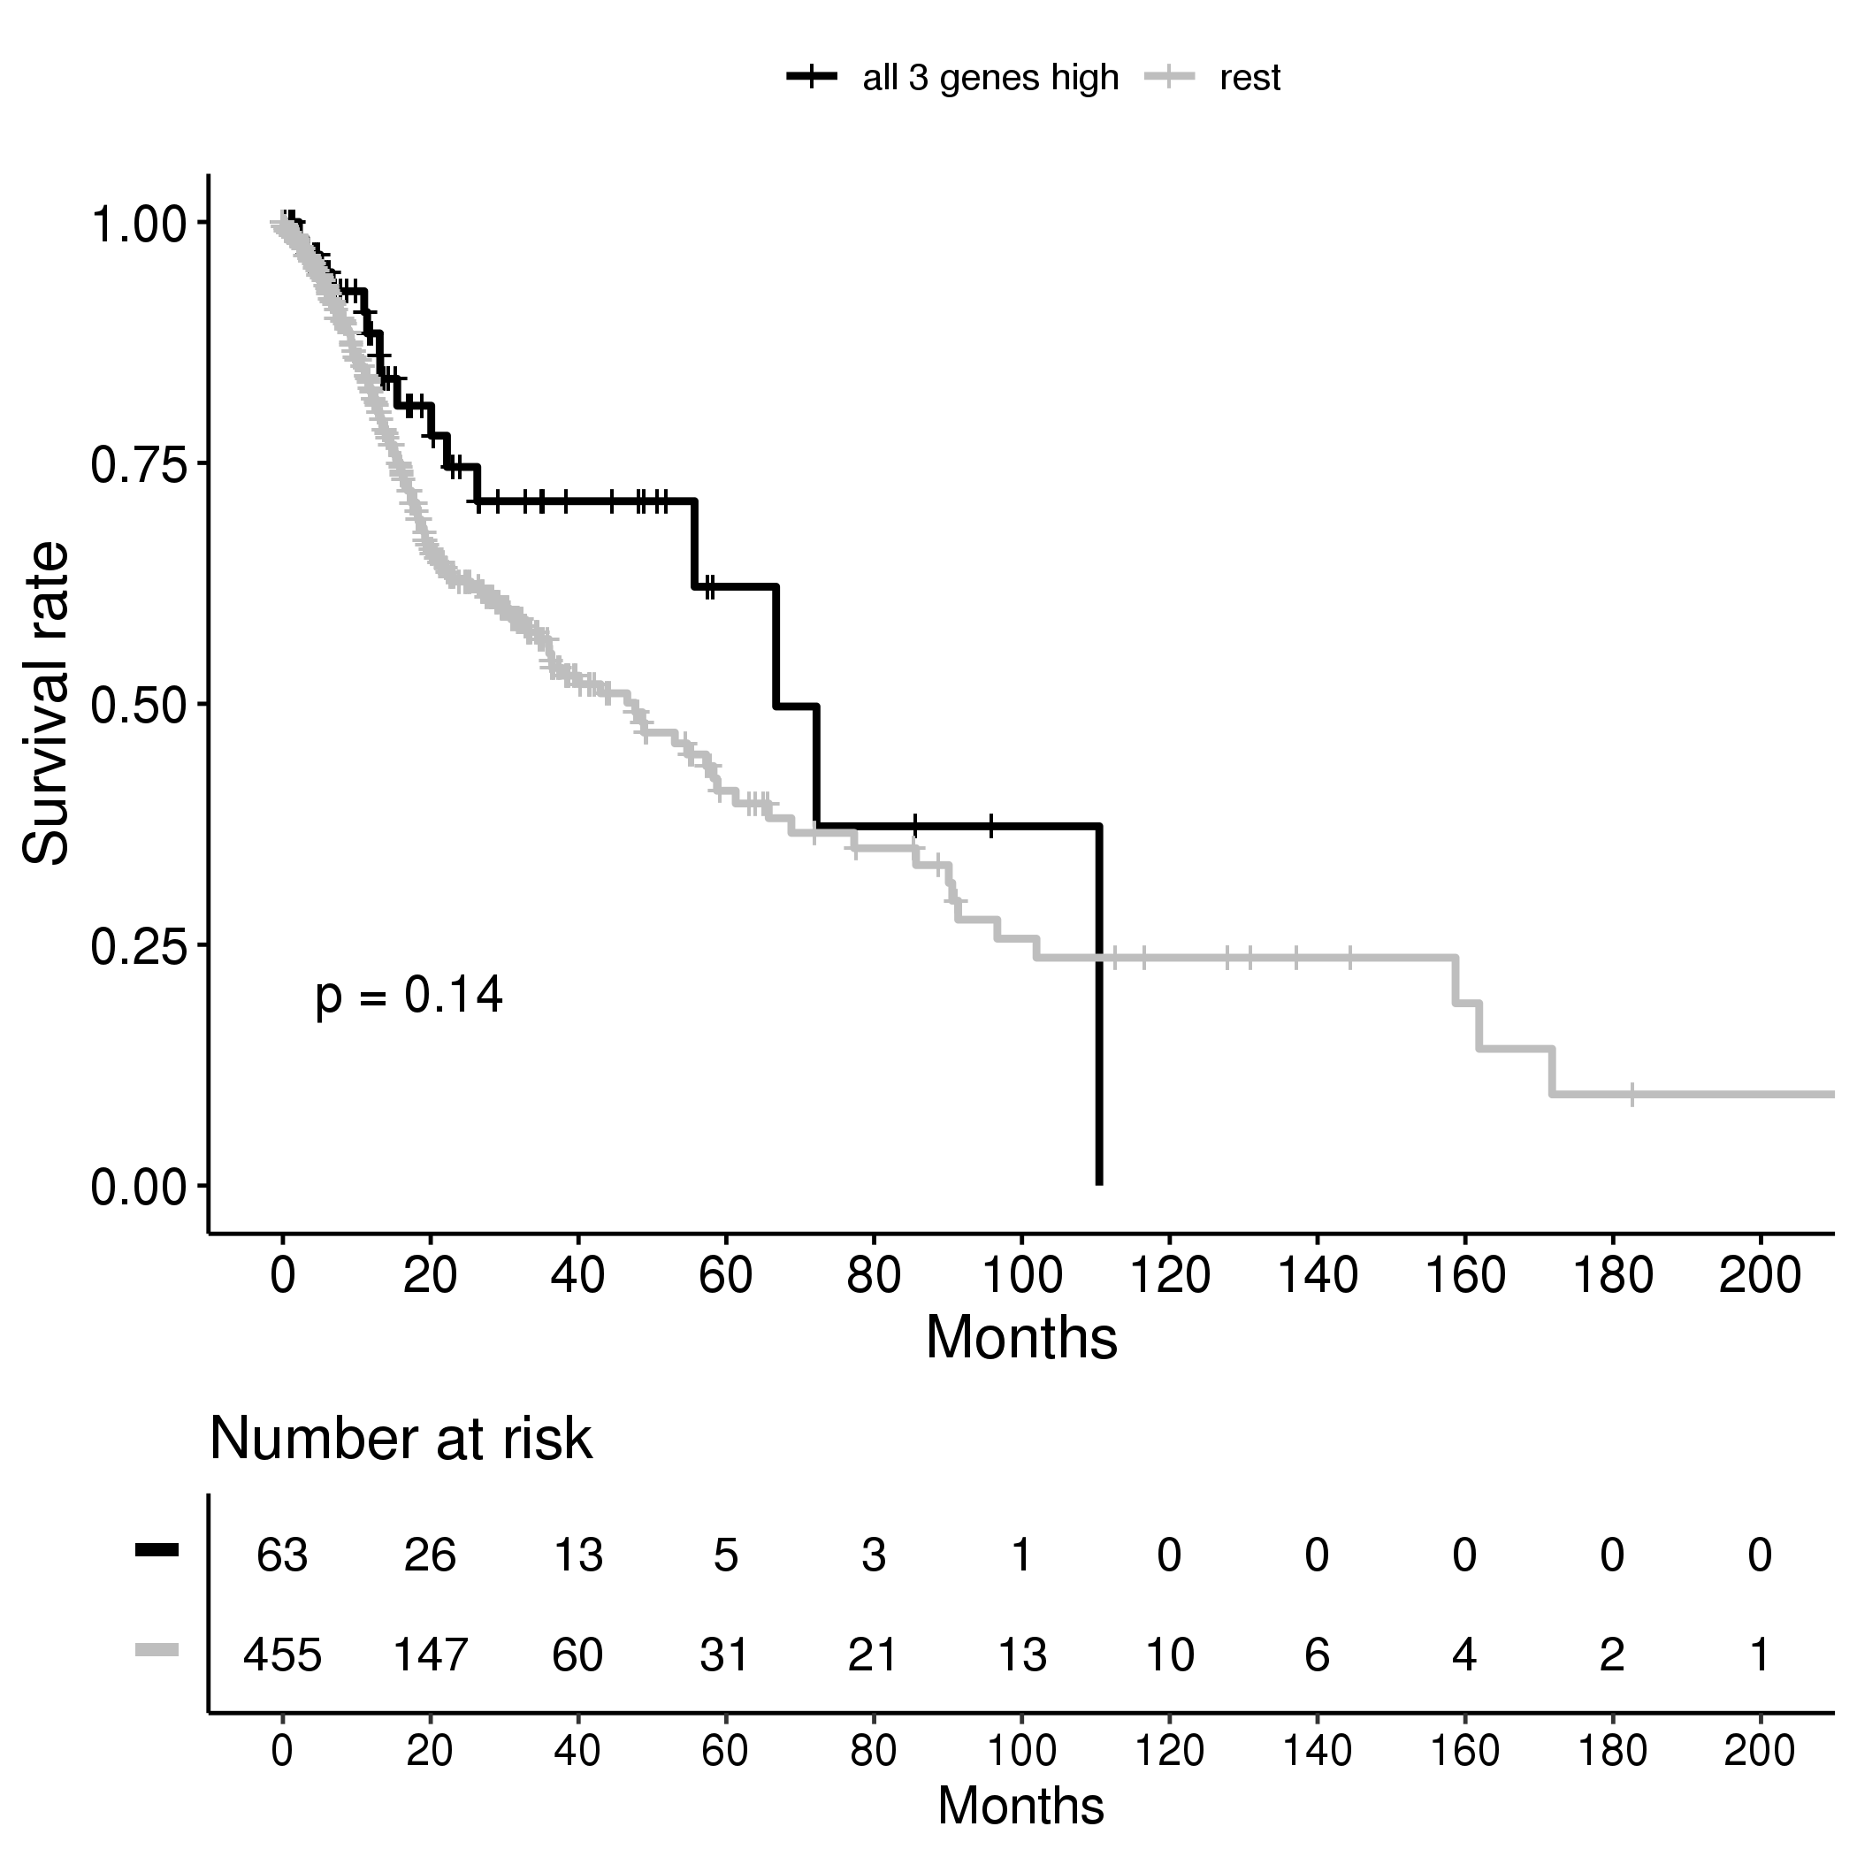
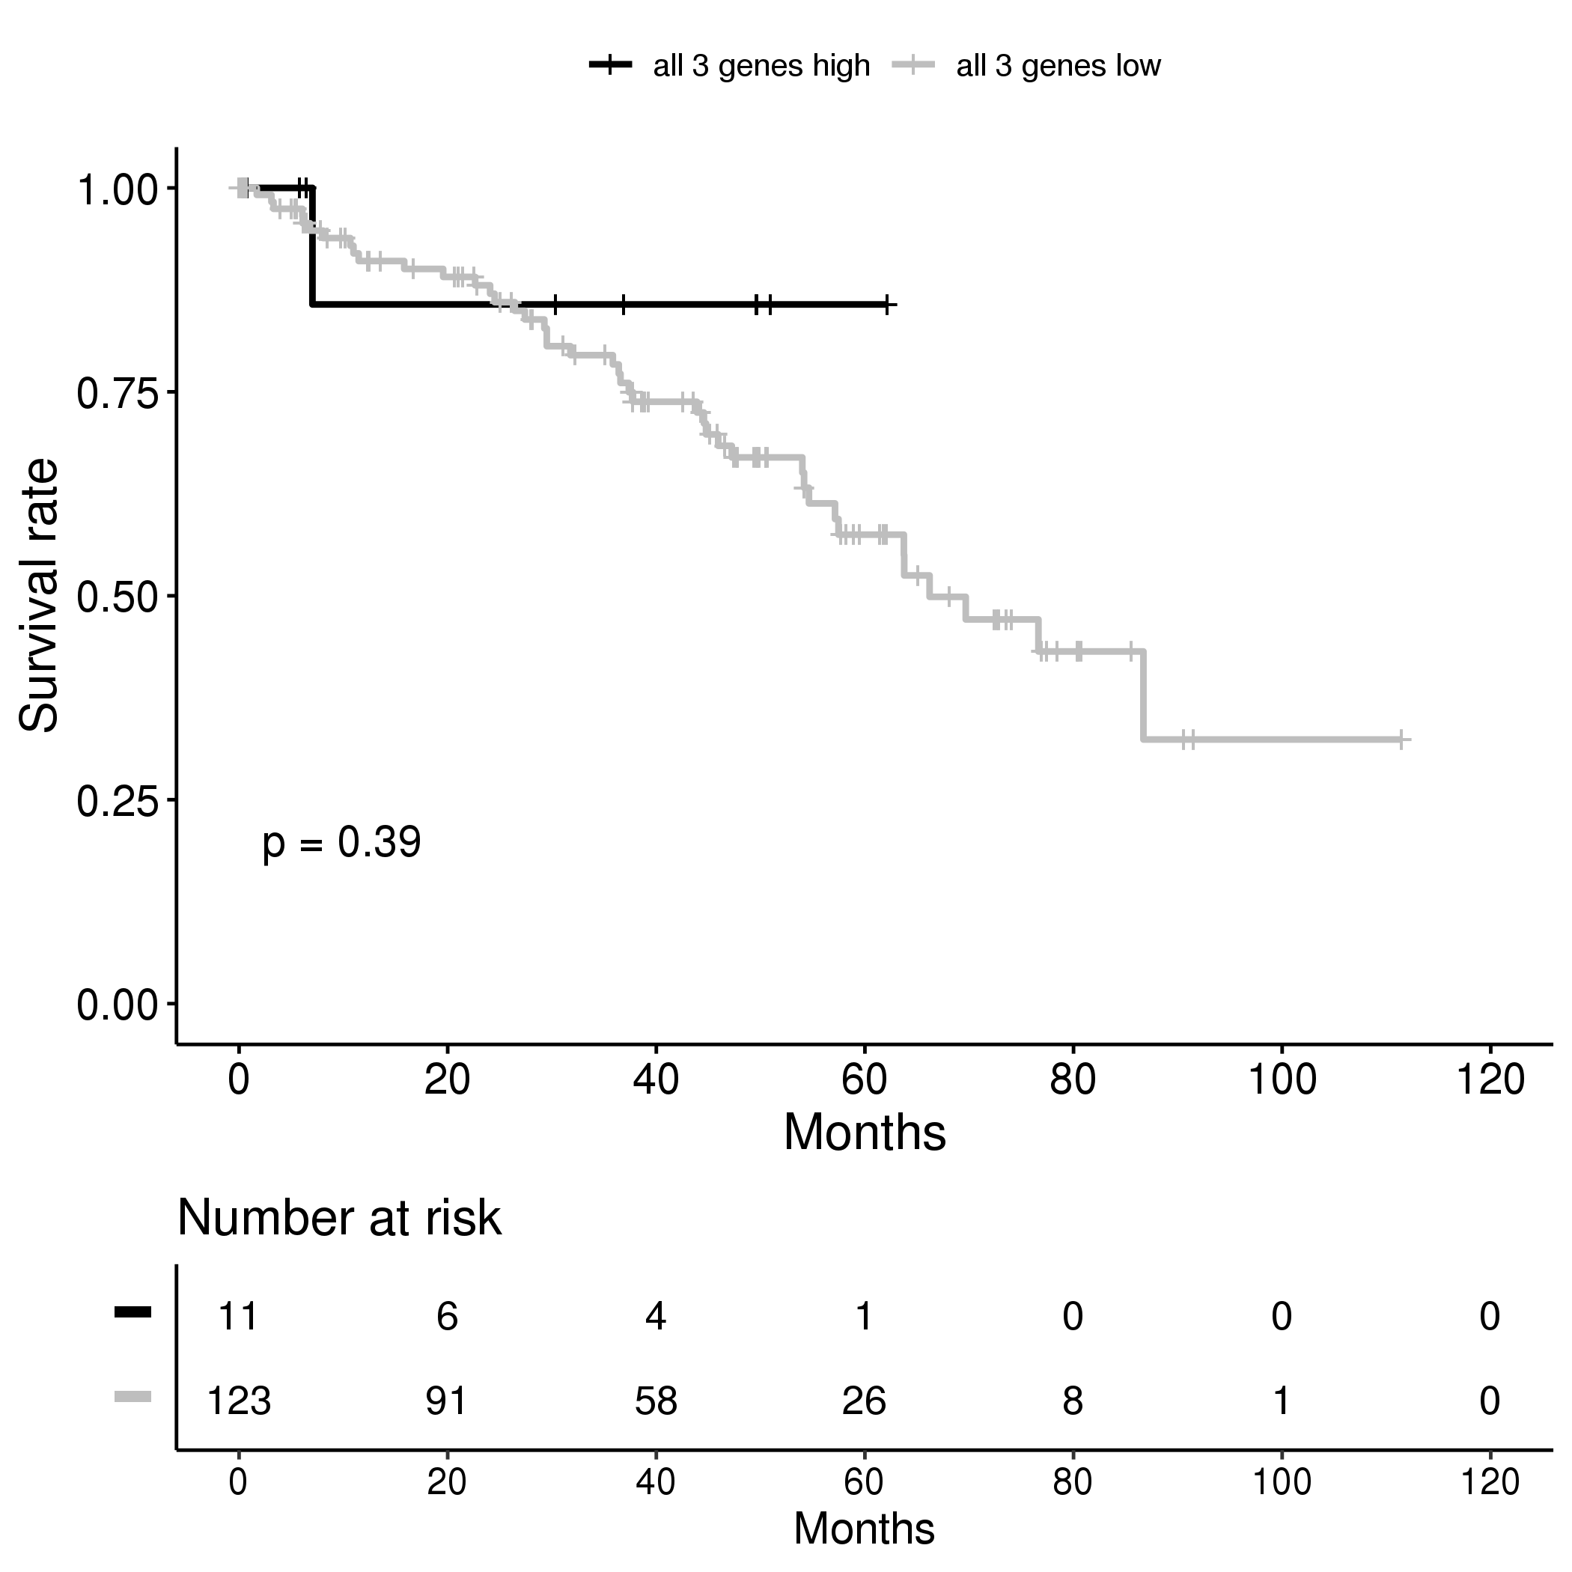
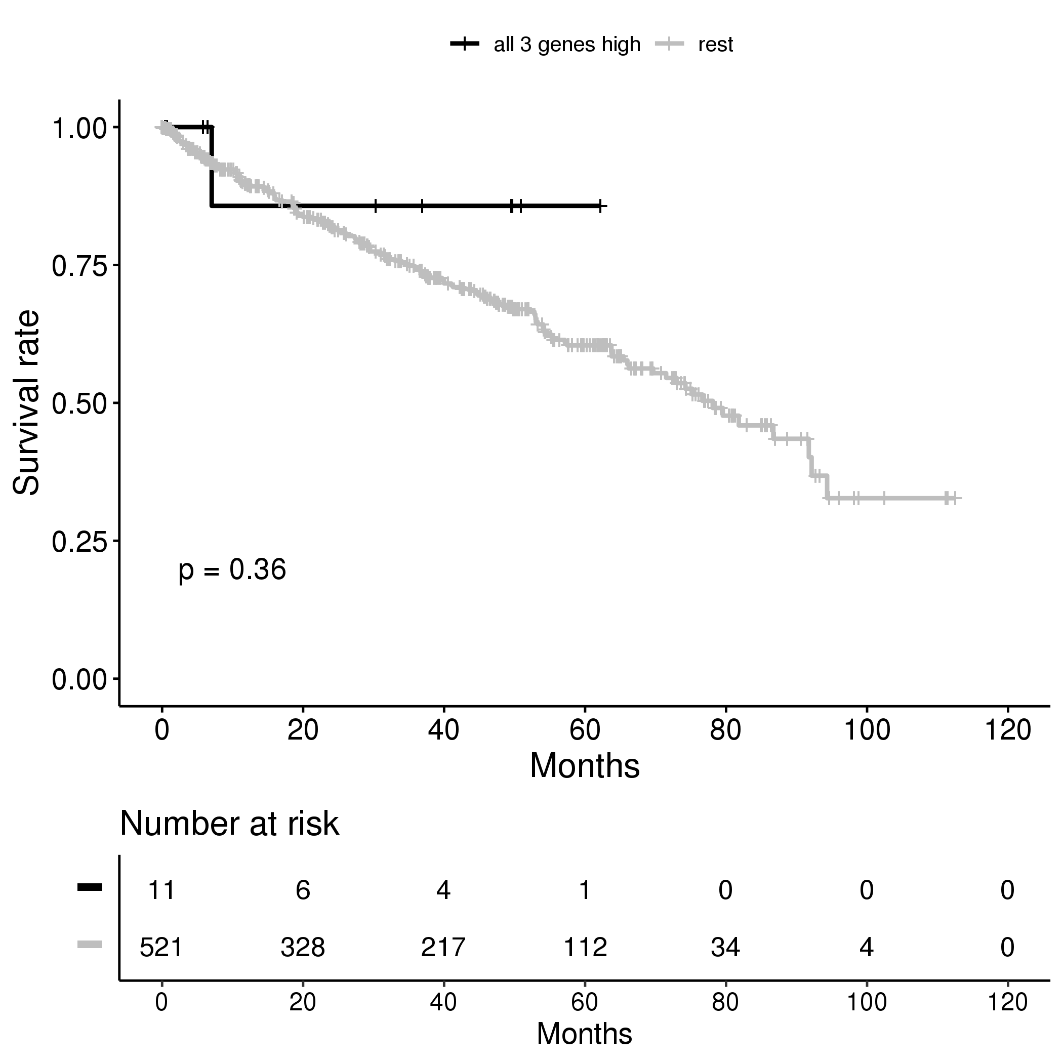
Supplementary Figure 5A
Adrenocortical Carcinoma
Bladder Carcinoma
Invasive Breast Carcinoma
Cervical Squamous Cell Carcinoma and Endocervical Adenocarcinoma
Cholangiocarcinoma
Diffuse Large B Cell Lymphoma
Esophageal Carcinoma
Glioblastoma Multiforme
Head and Neck Squamous Cell Carcinoma
Renal Clear Cell Carcinoma

Slide 6
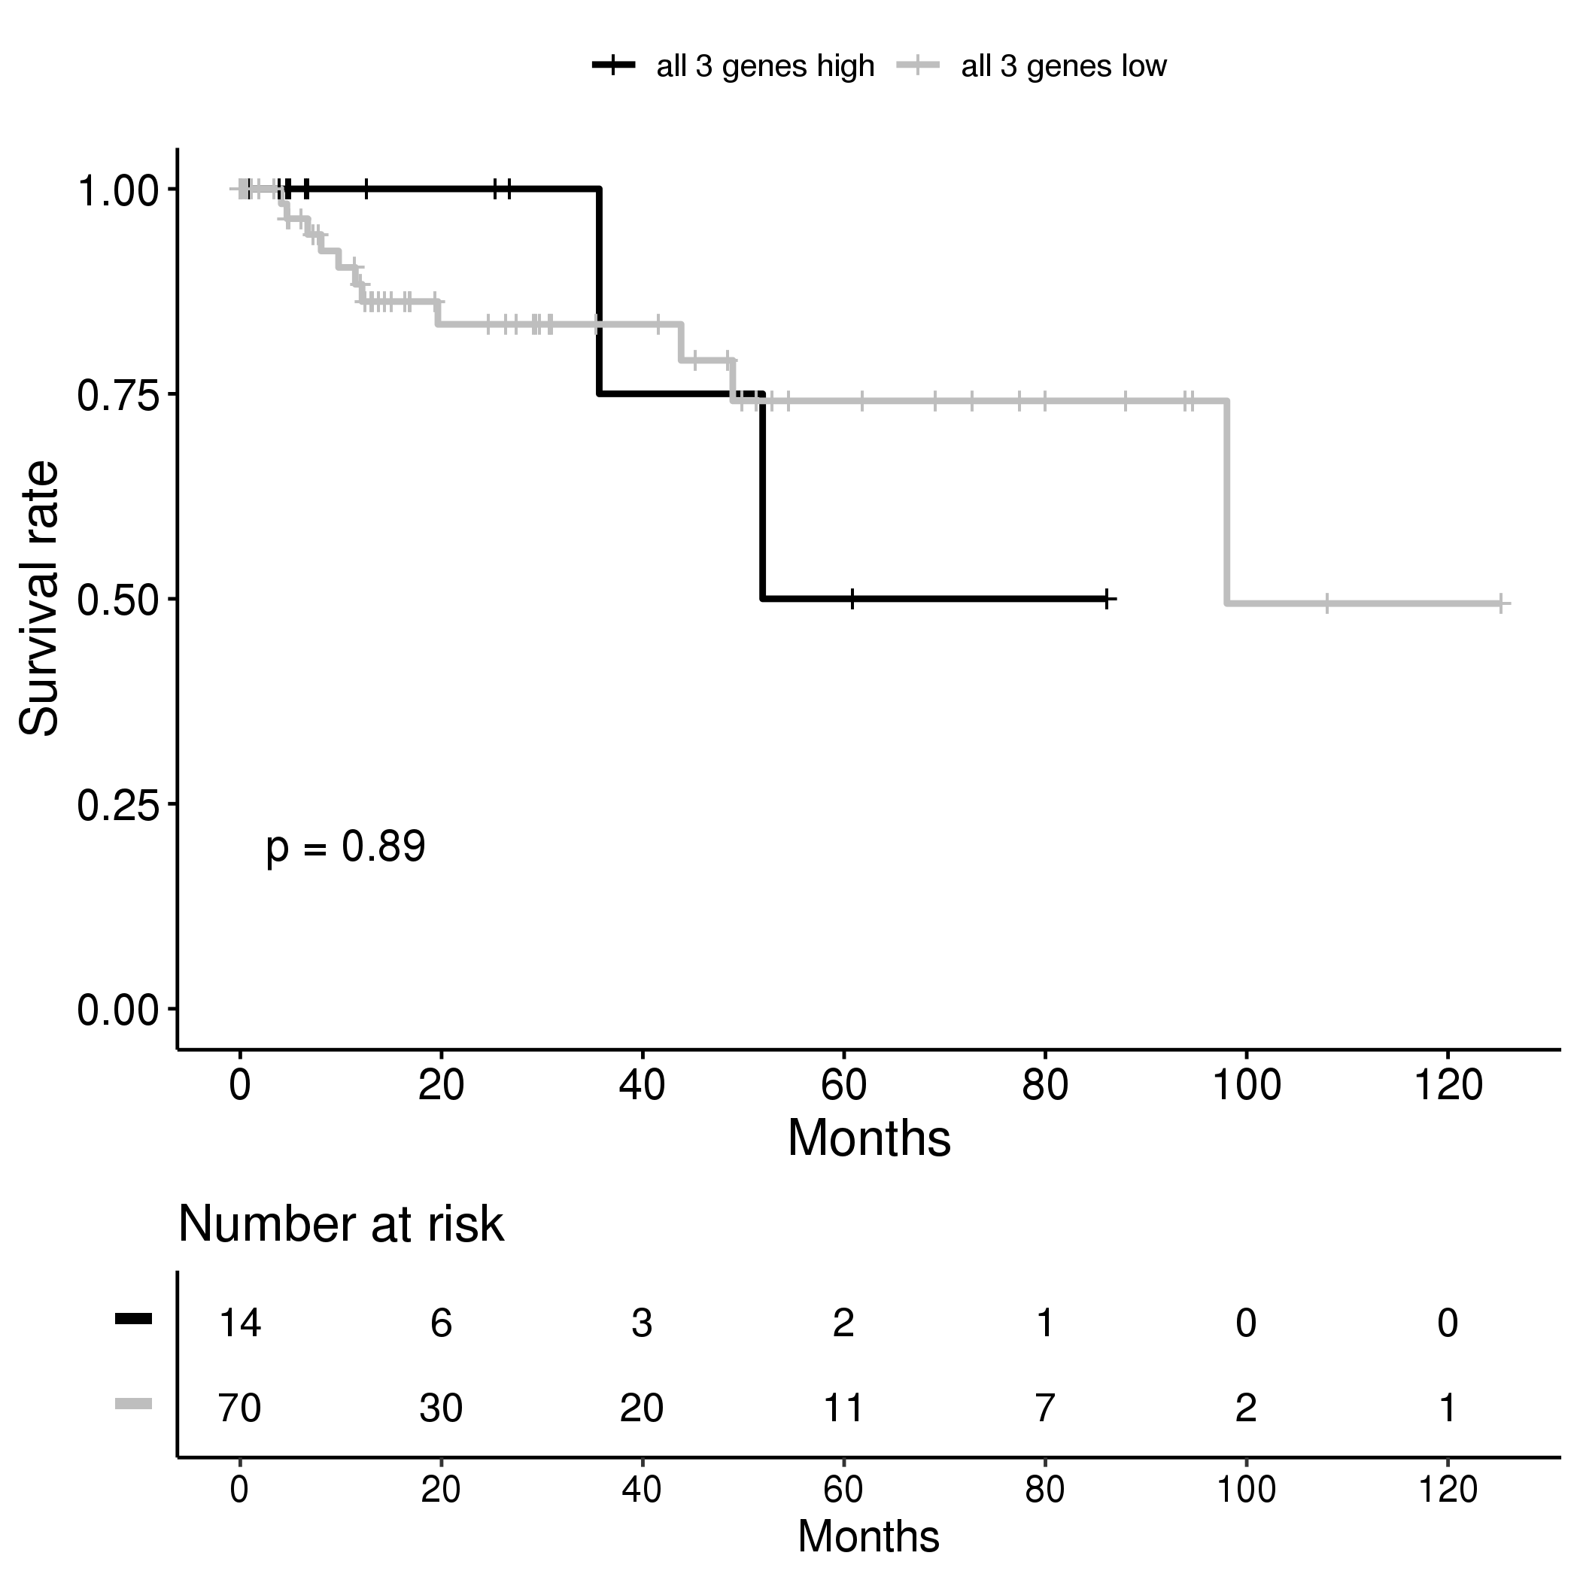
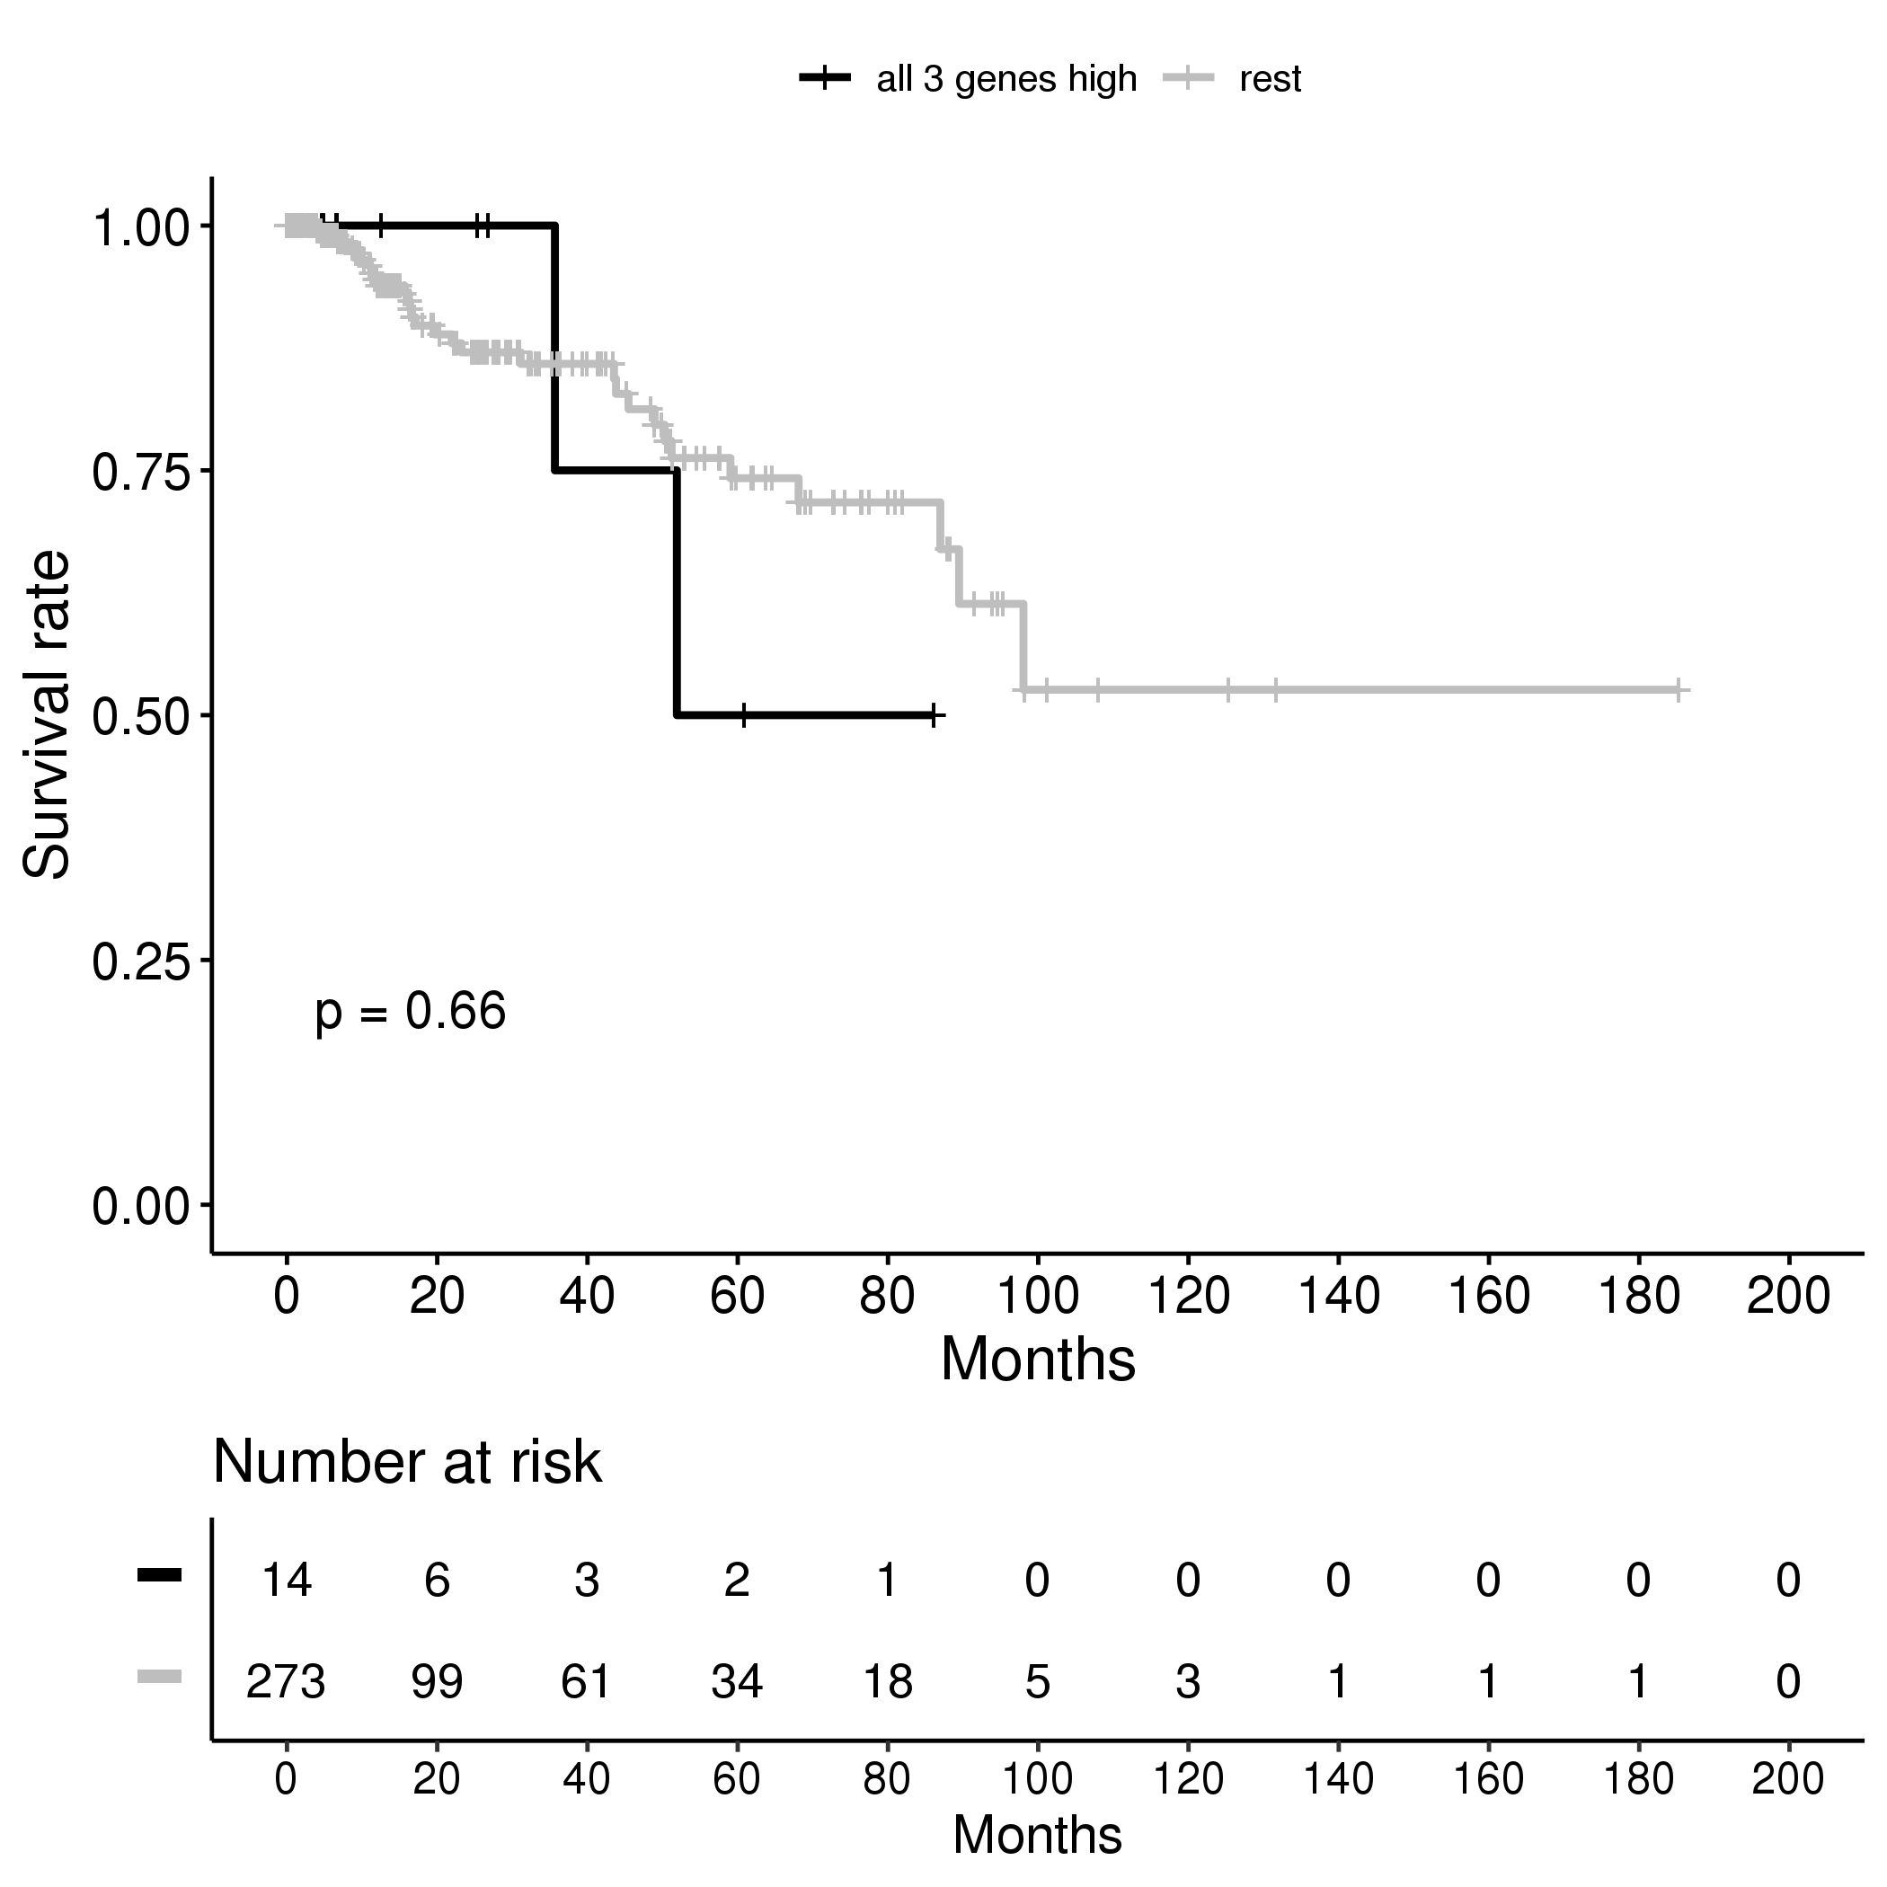
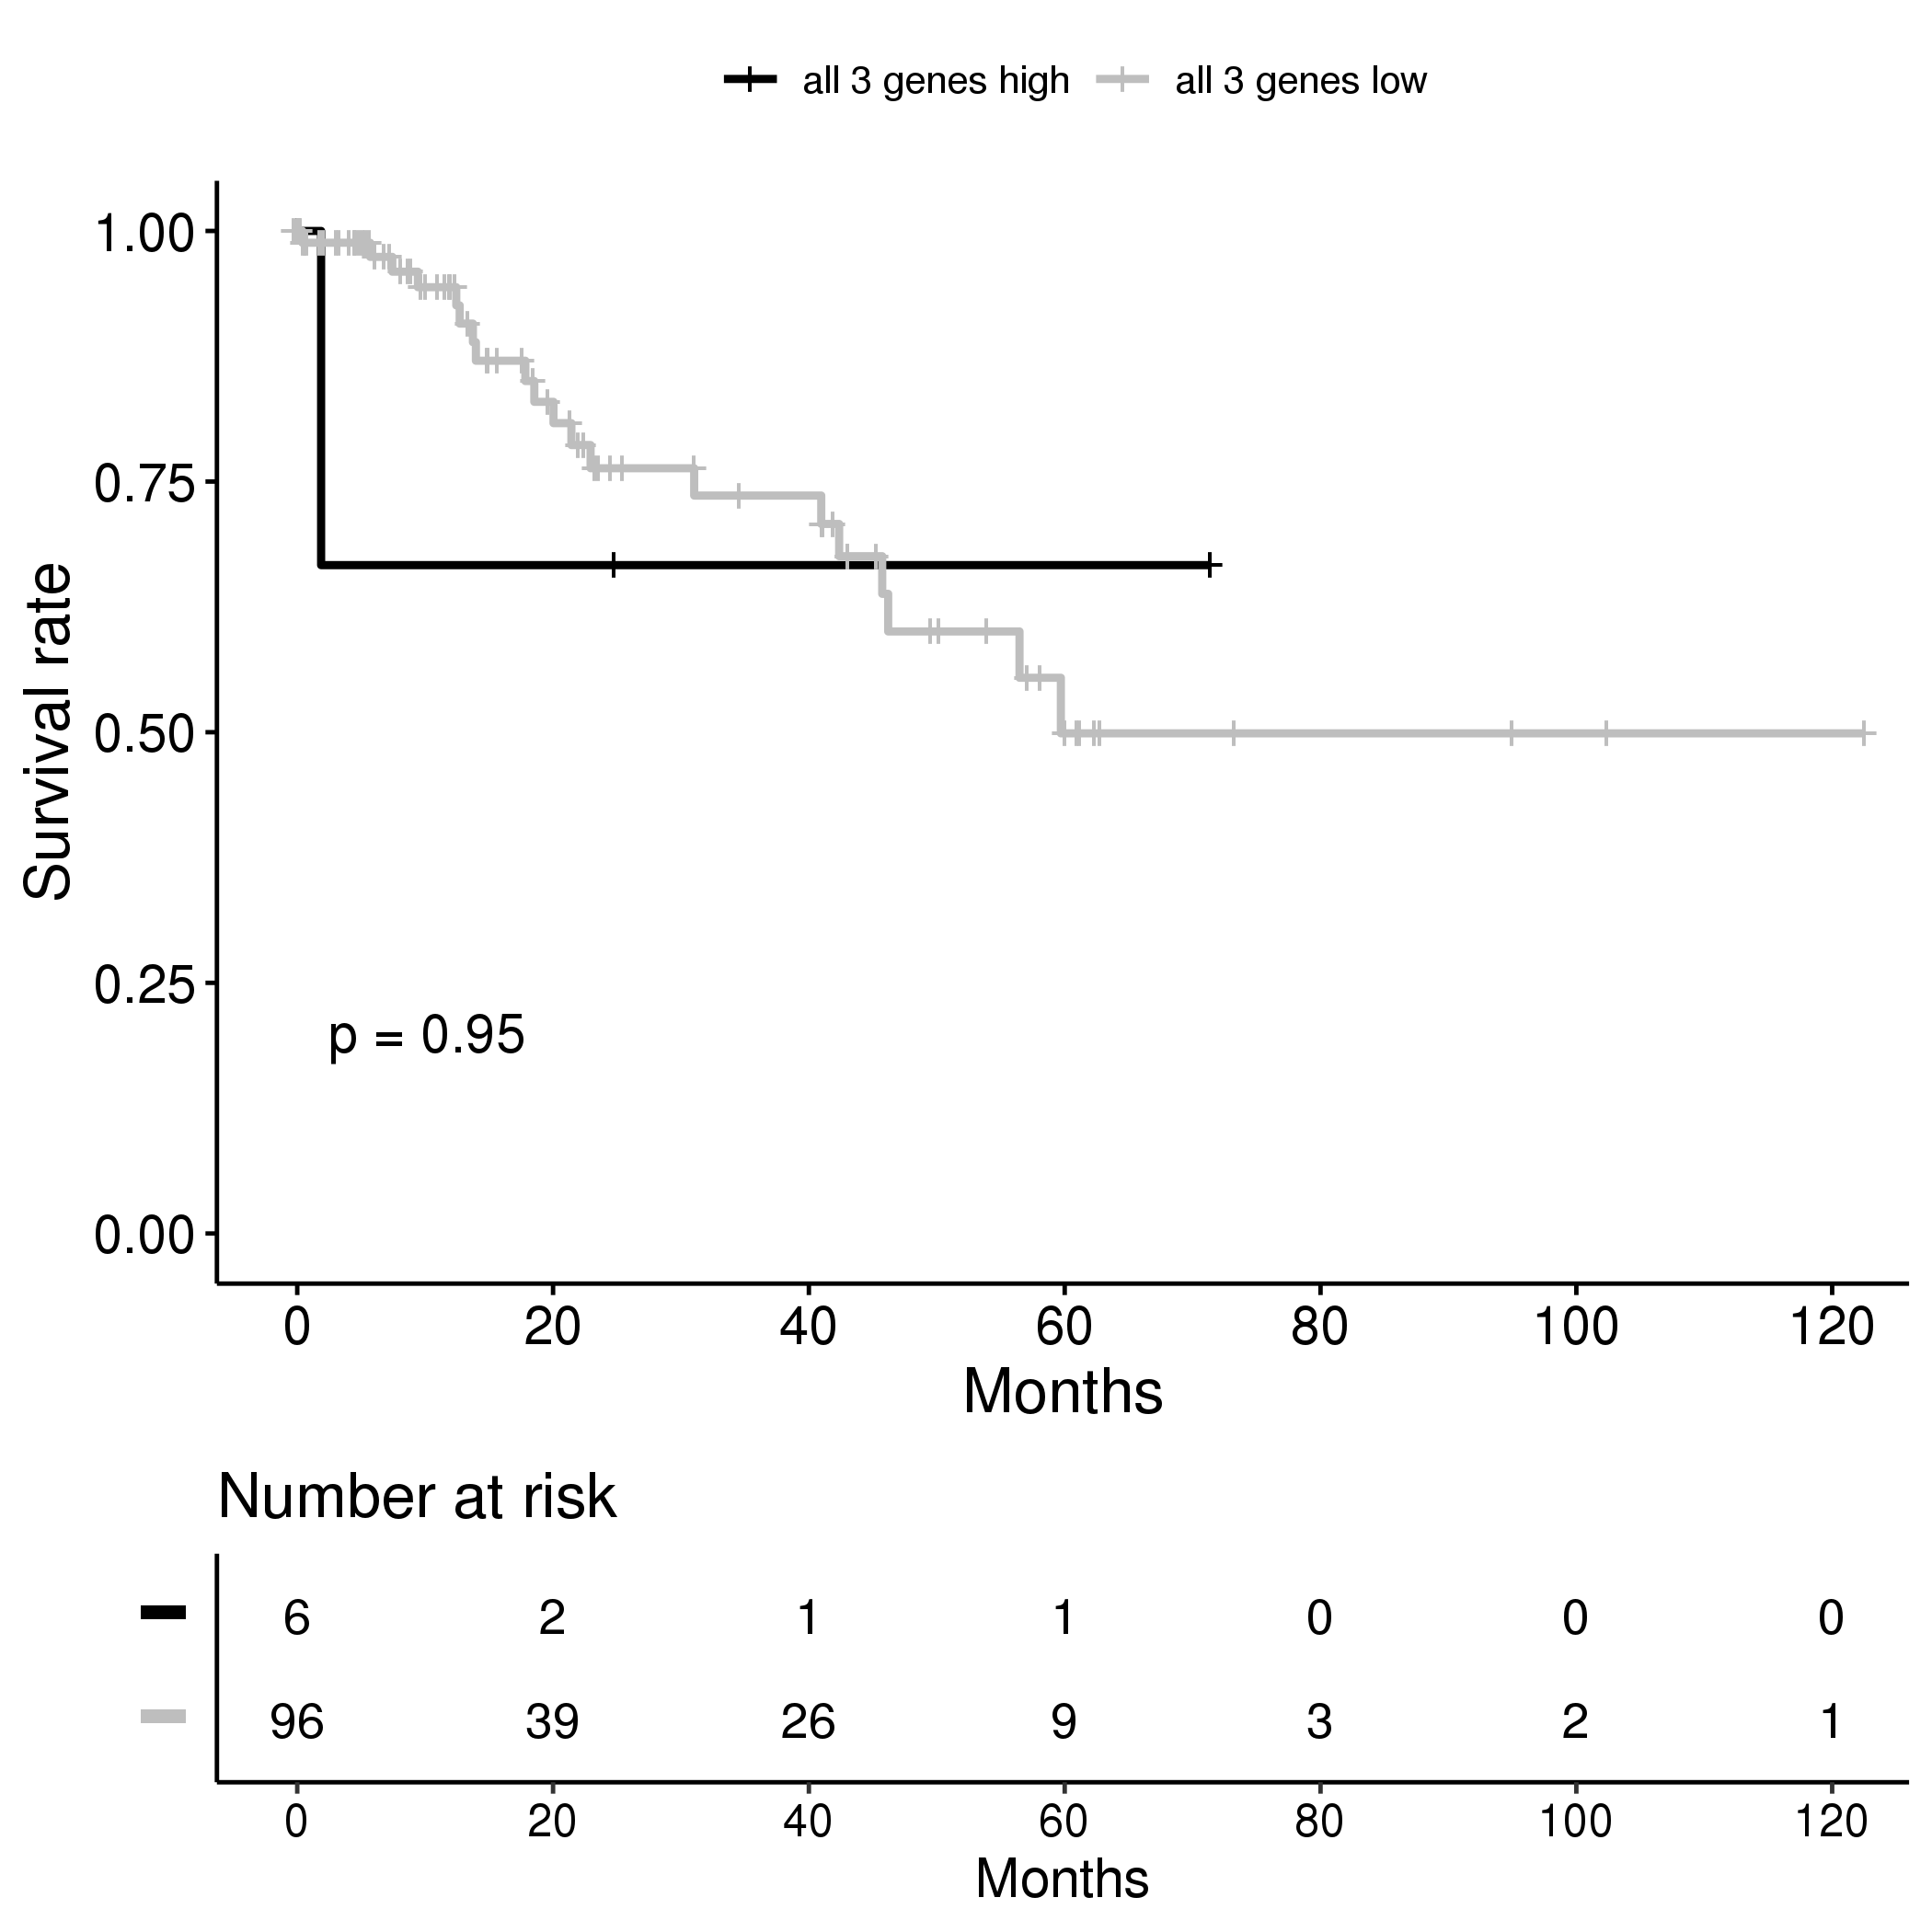
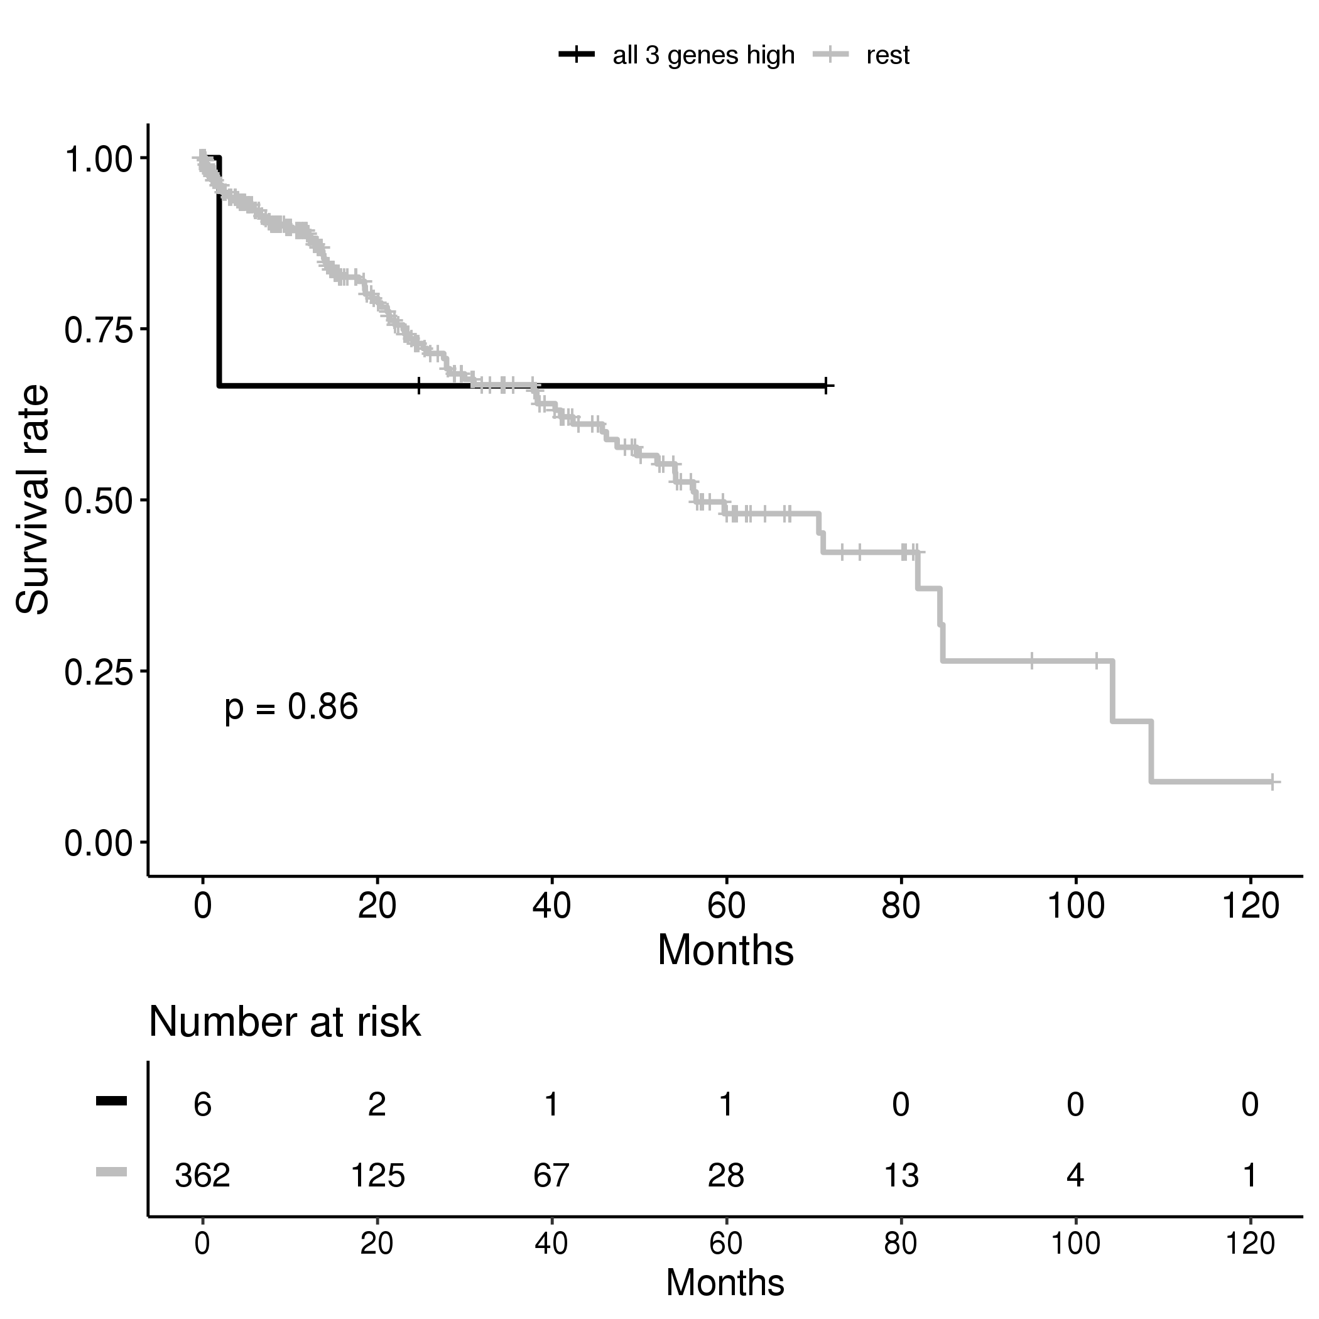
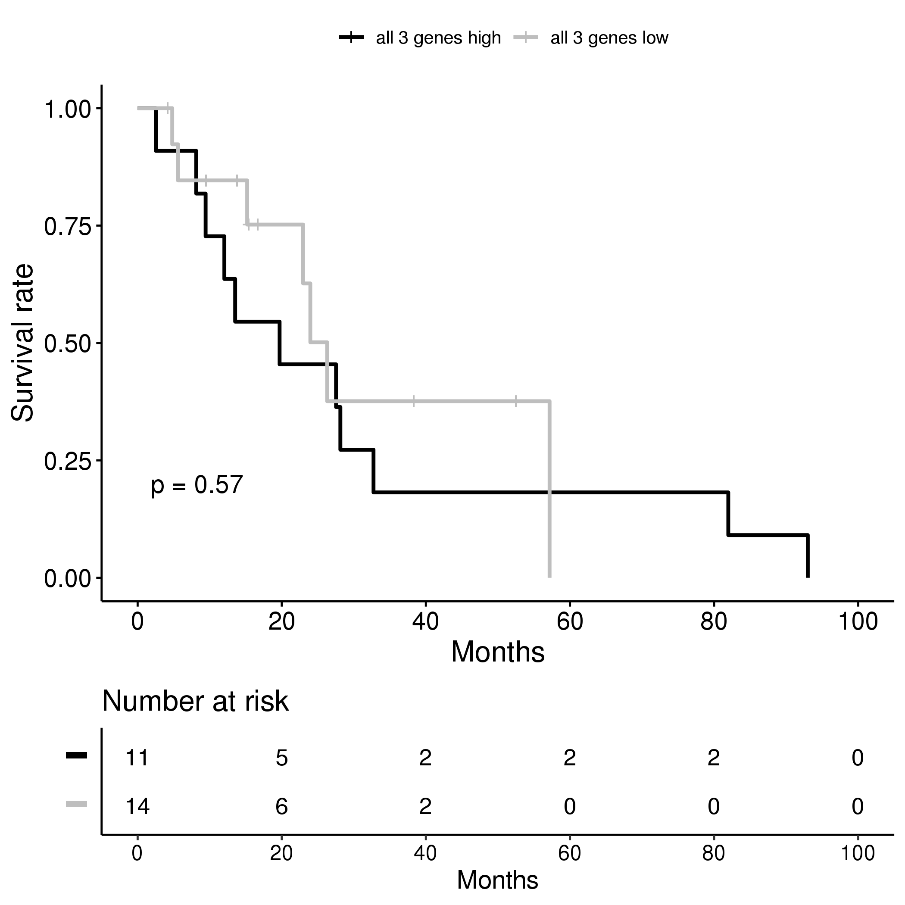
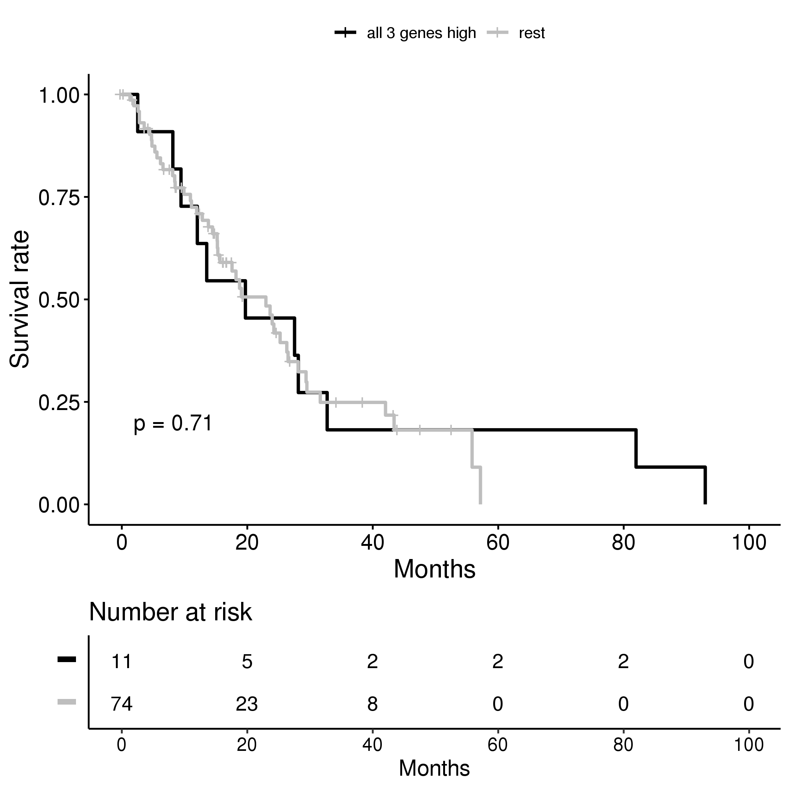
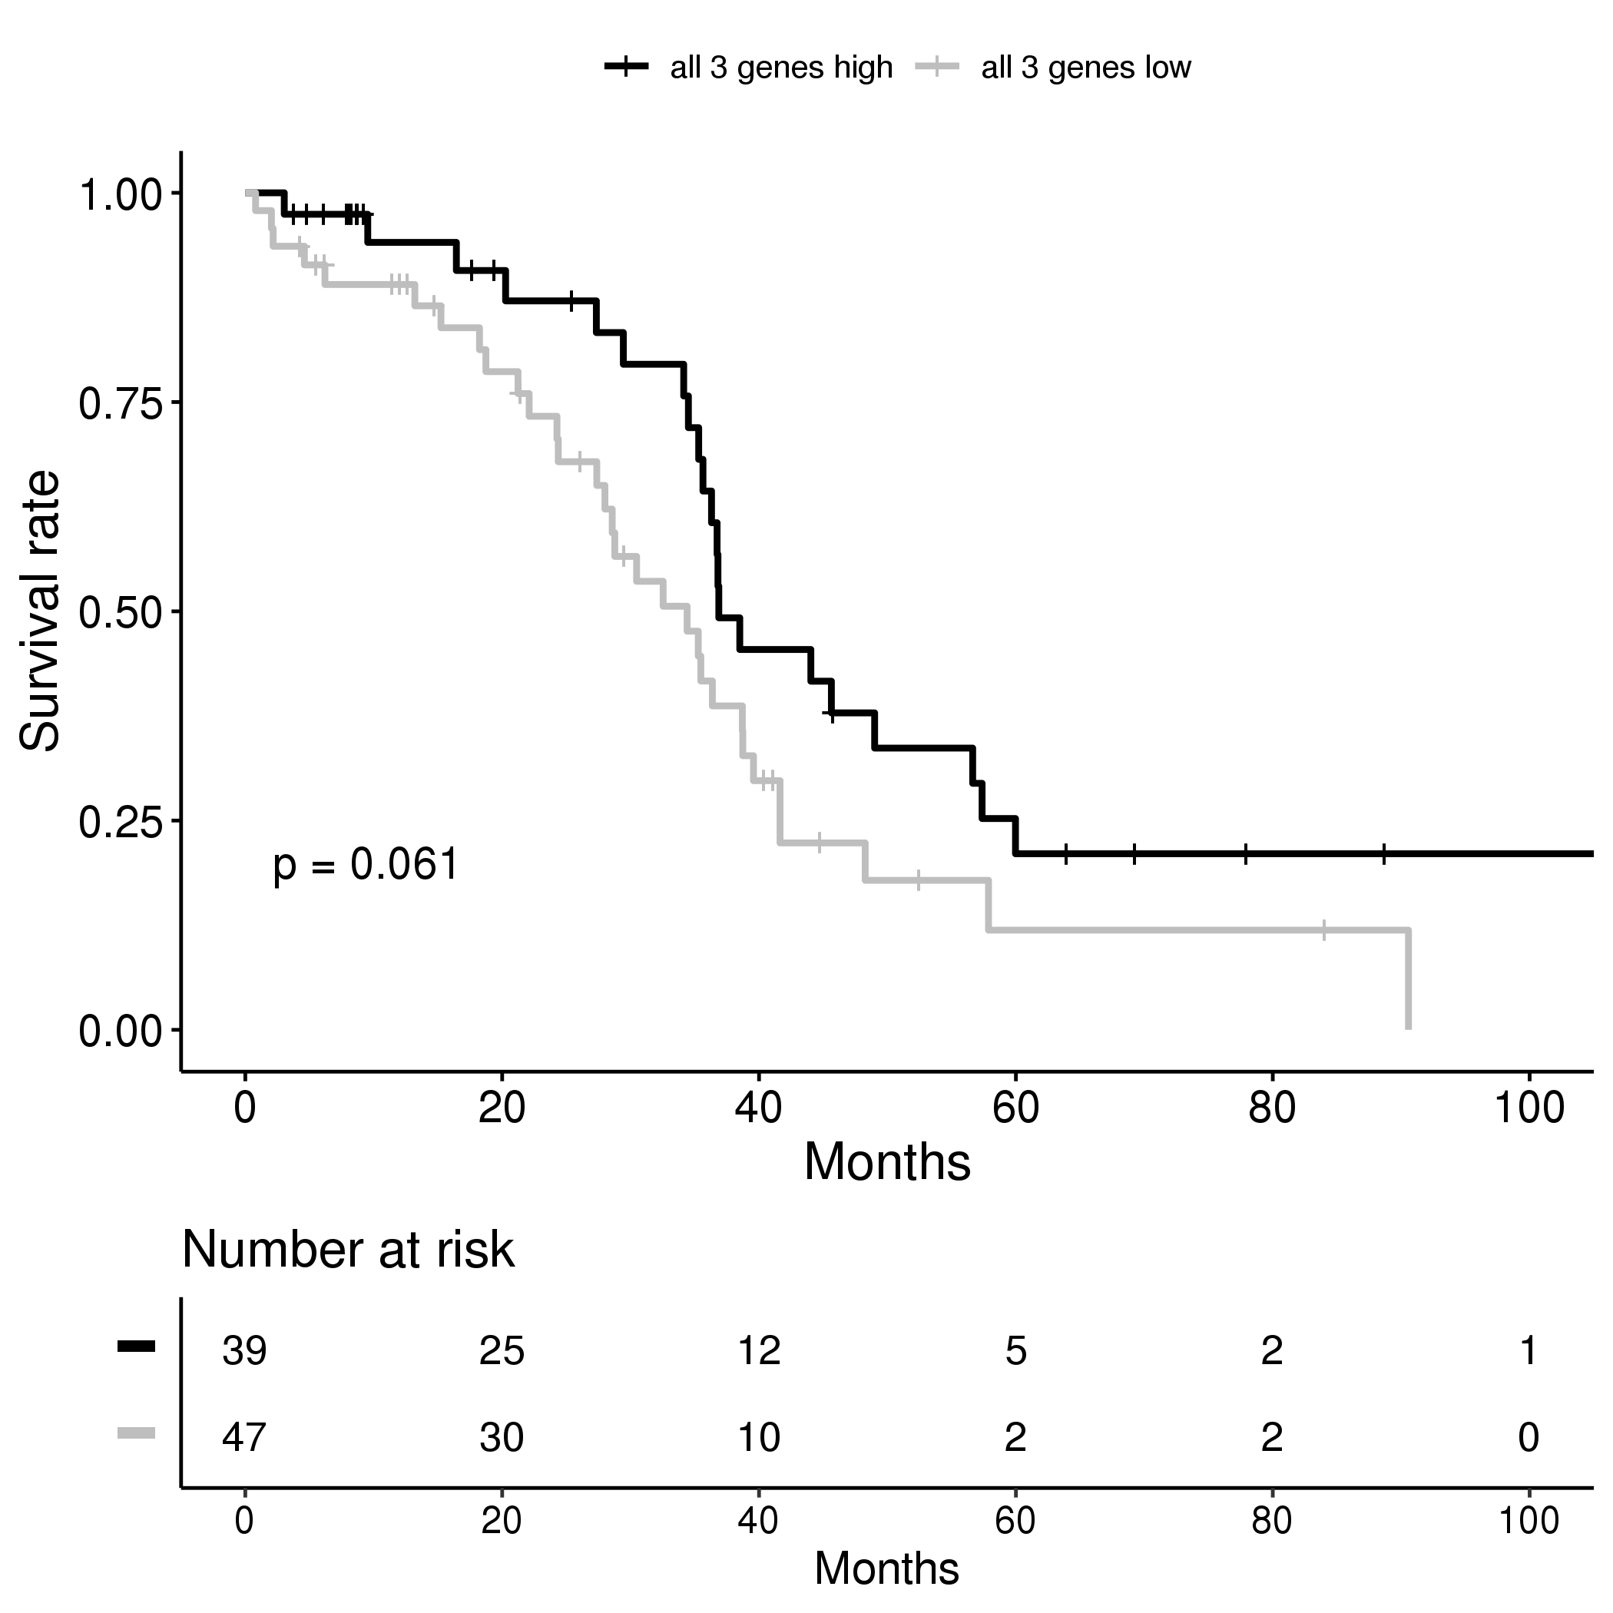
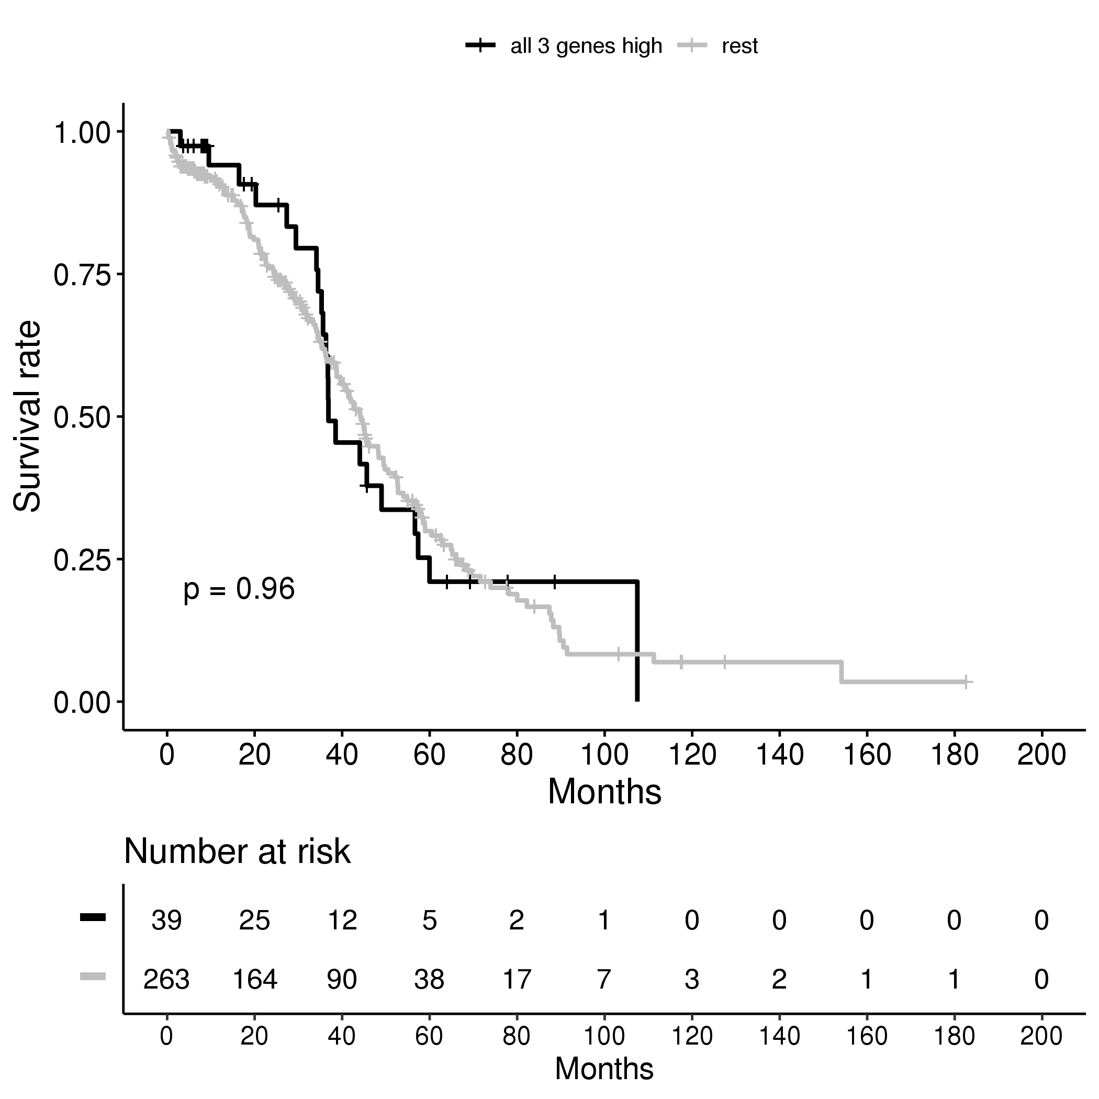
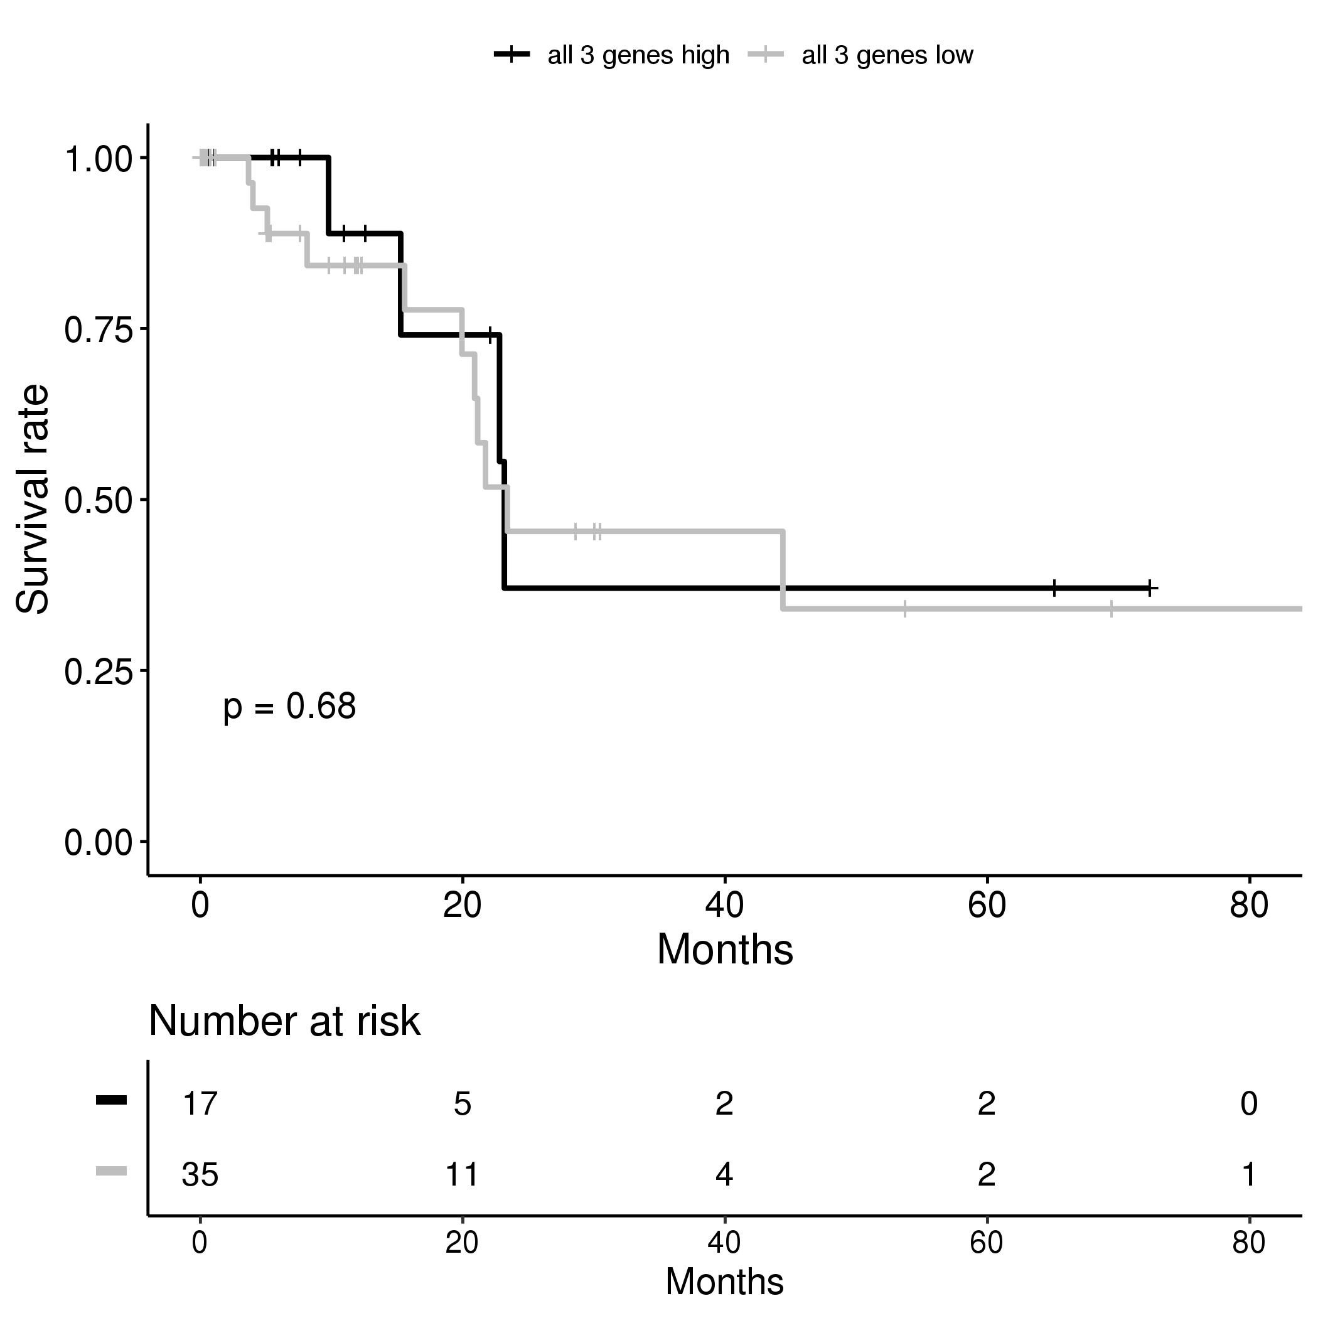
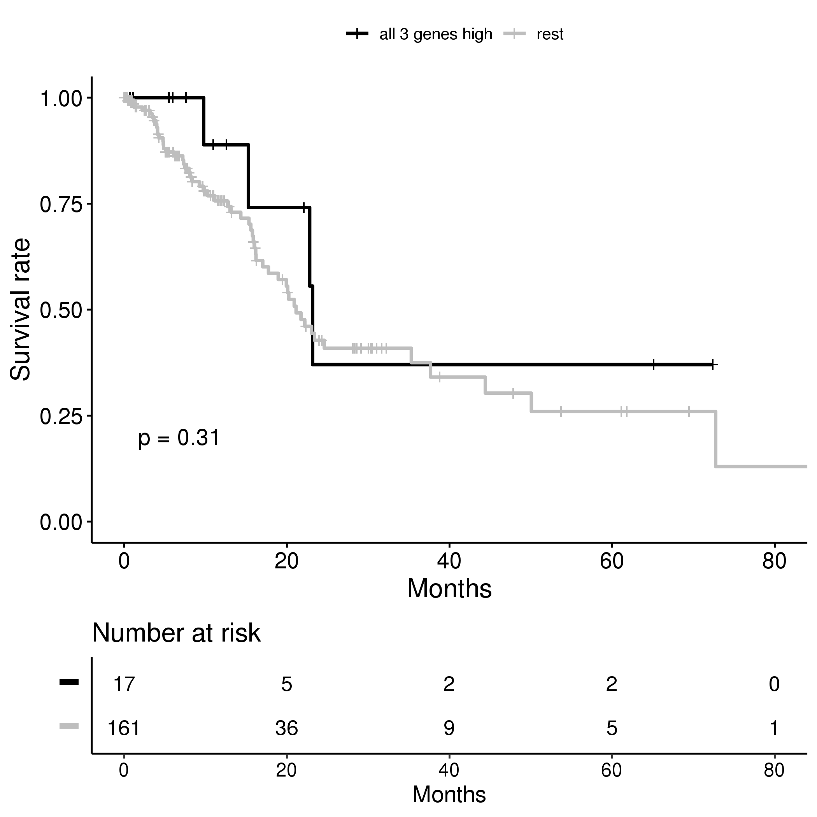
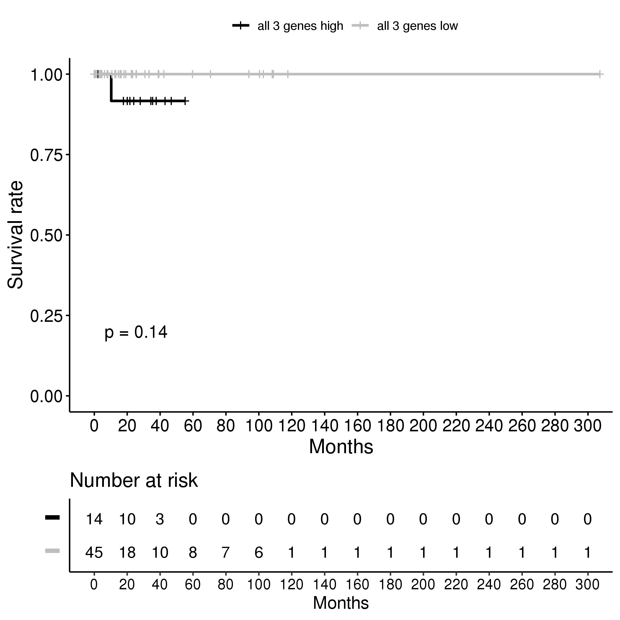

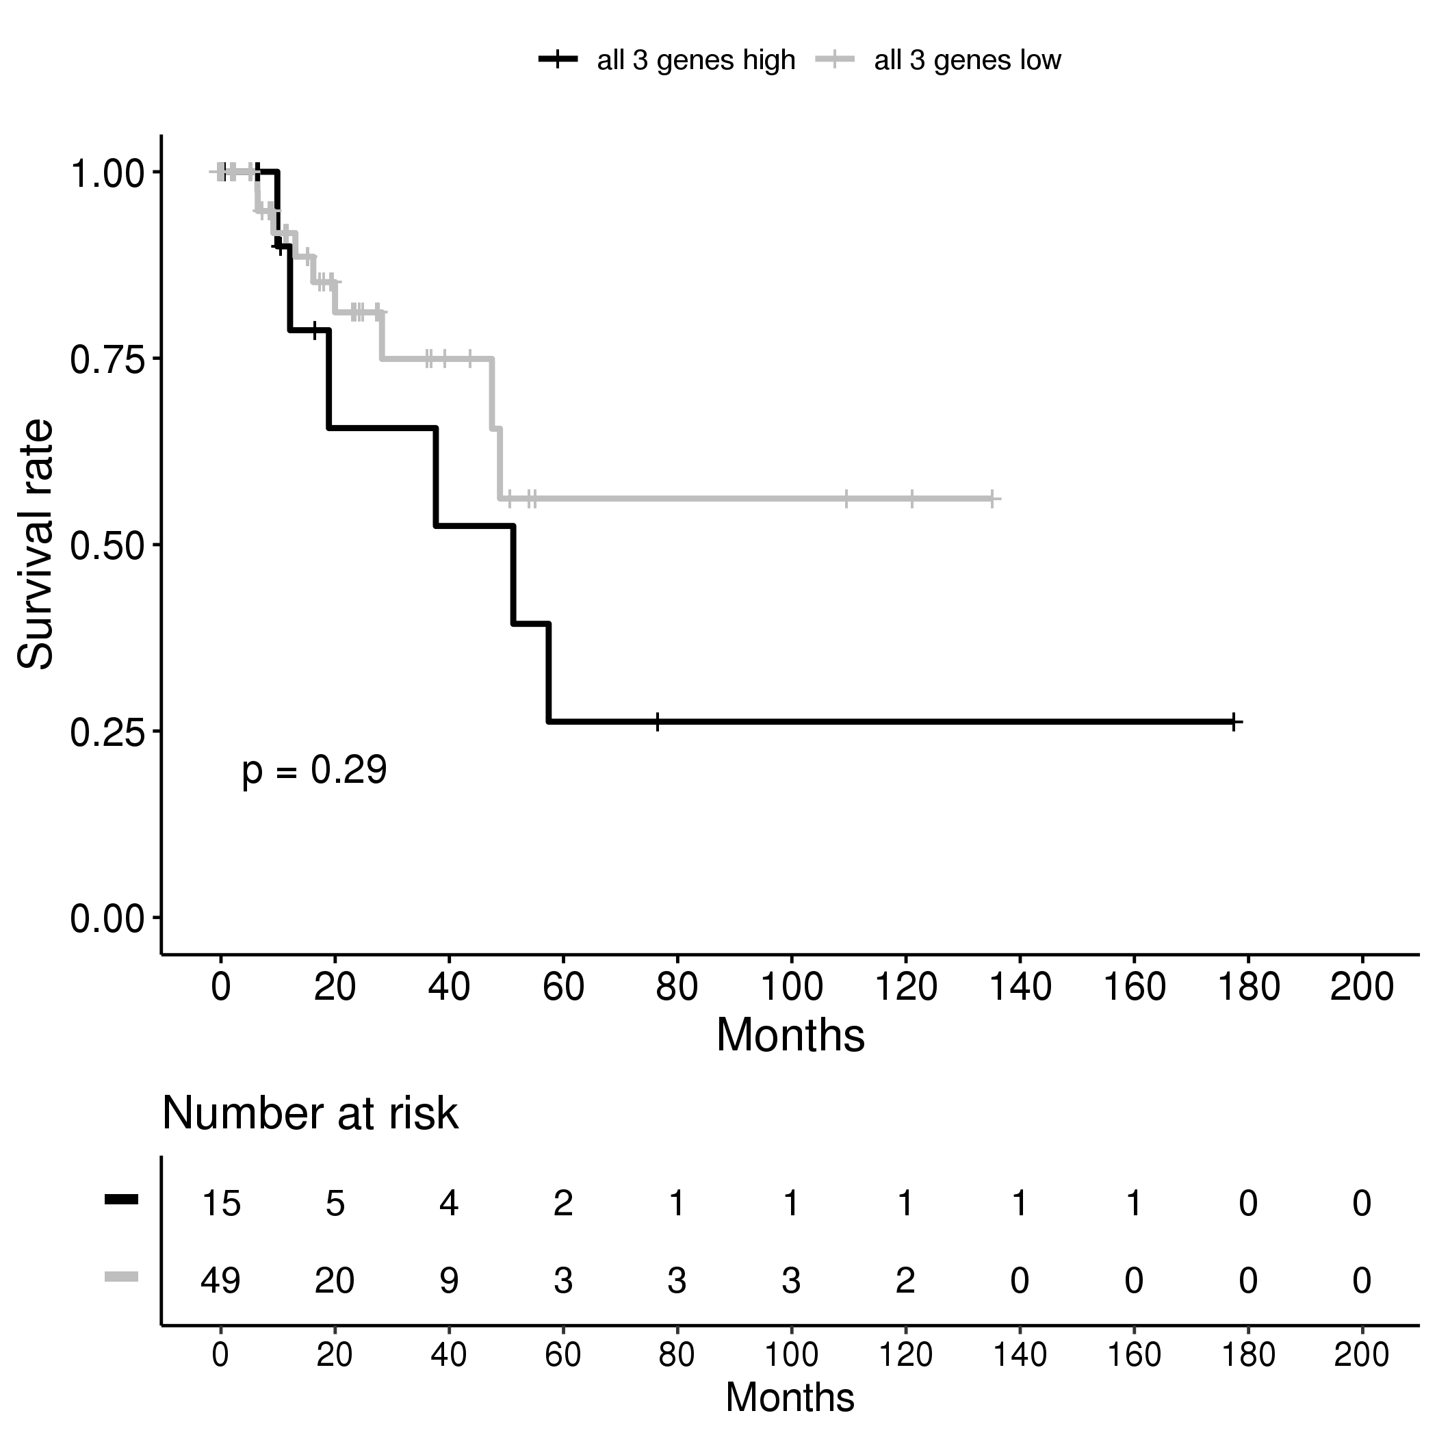
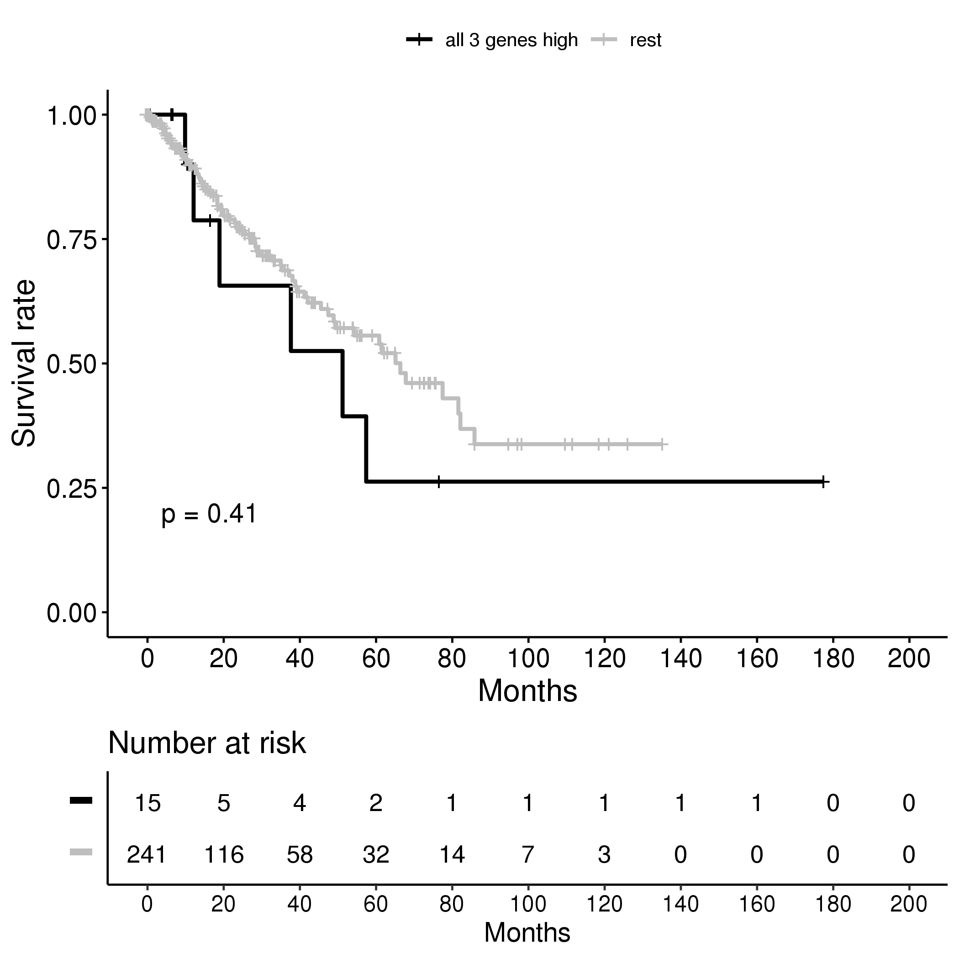
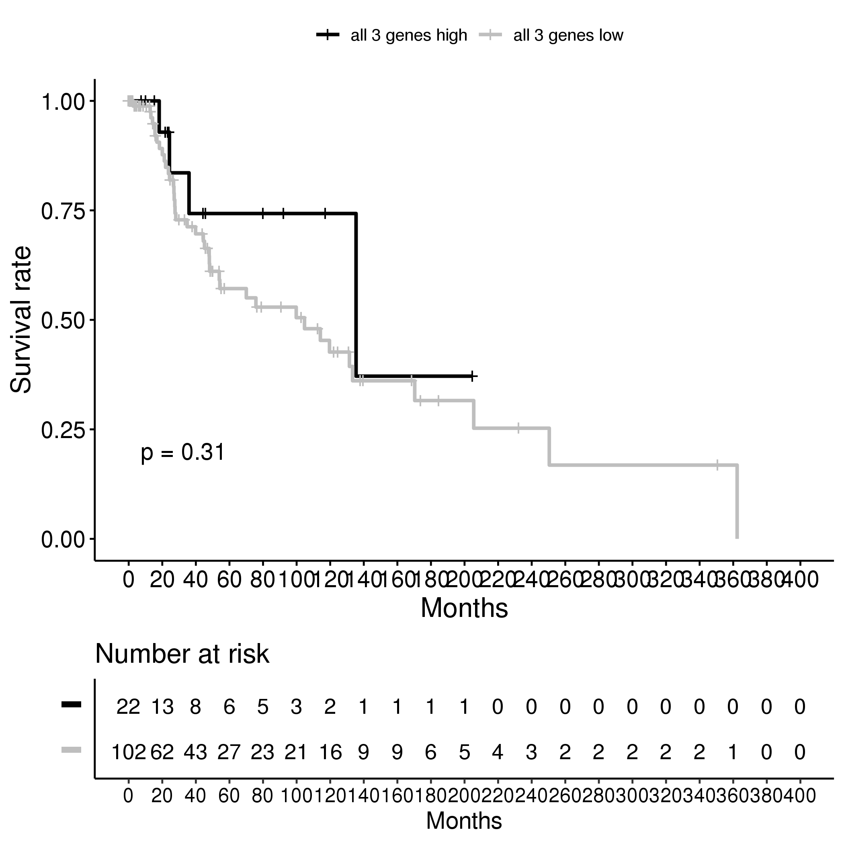
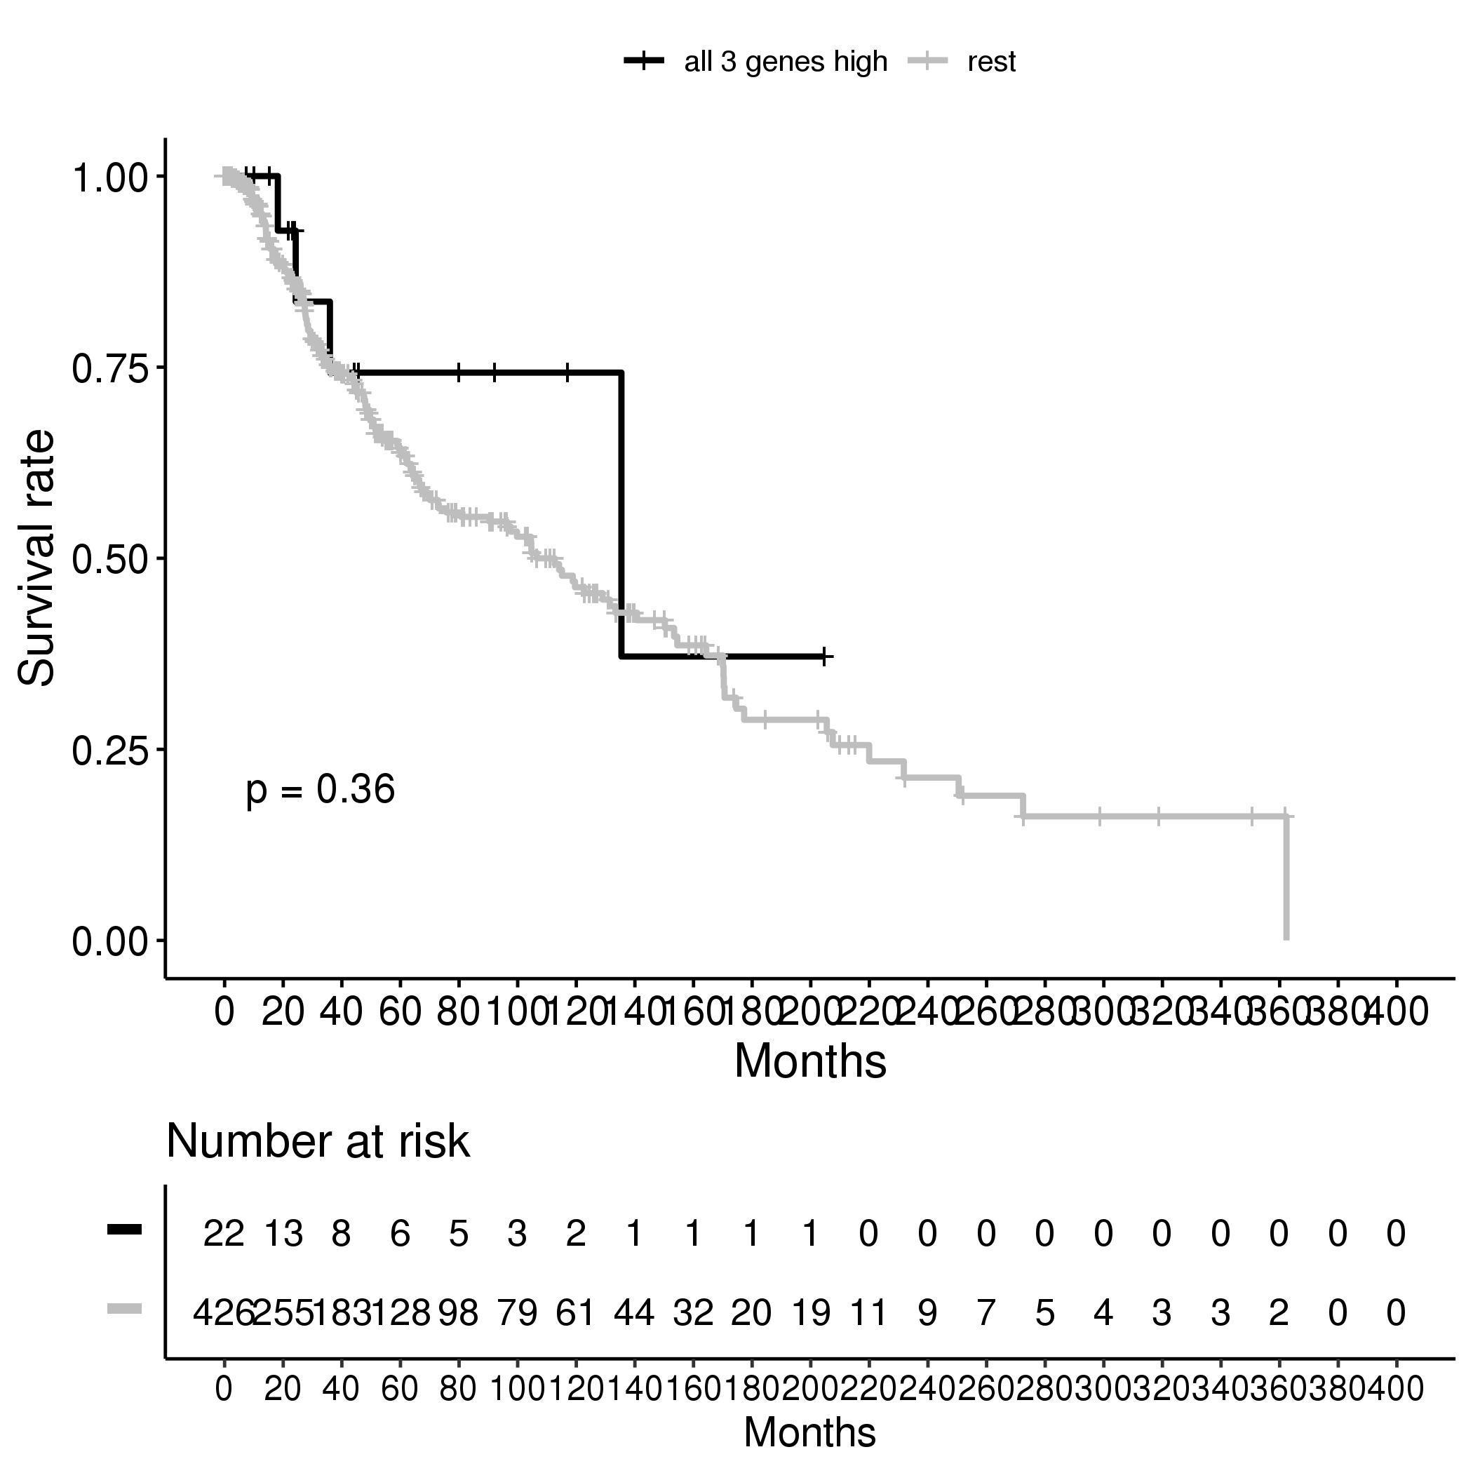
Supplementary Figure 5B
Renal Papillary Cell Carcinoma
Hepatocellular Carcinoma
Renal Papillary Cell Carcinoma
Hepatocellular Carcinoma
Pancreatic Adenocarcinoma
Pheochromocytoma and Paraganglioma
Sarcoma
Cutaneous Melanoma

Slide 7
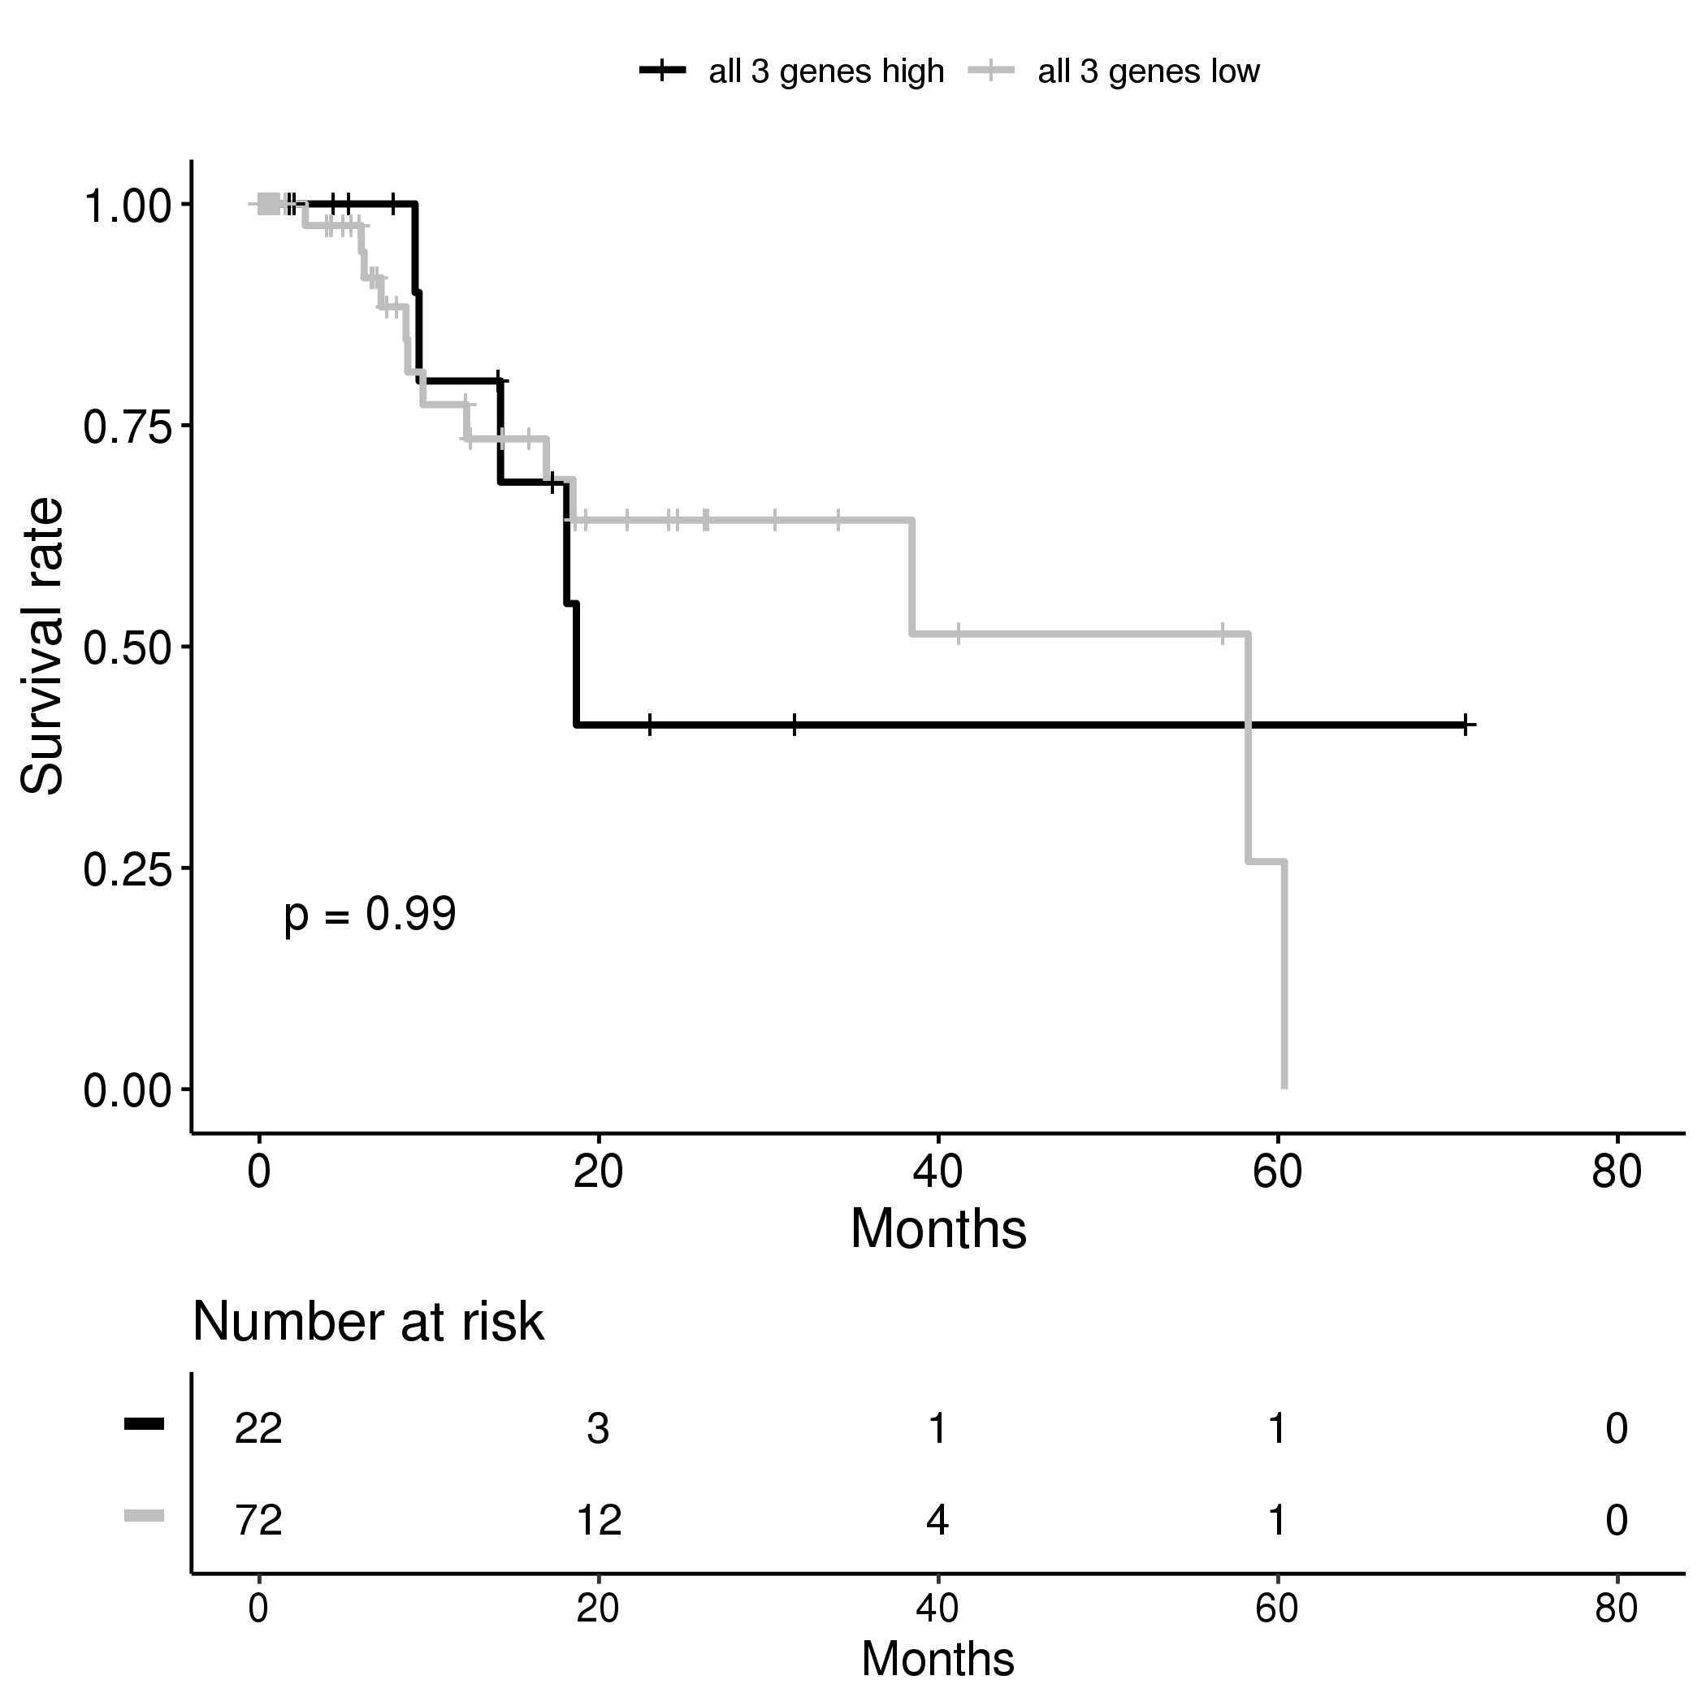
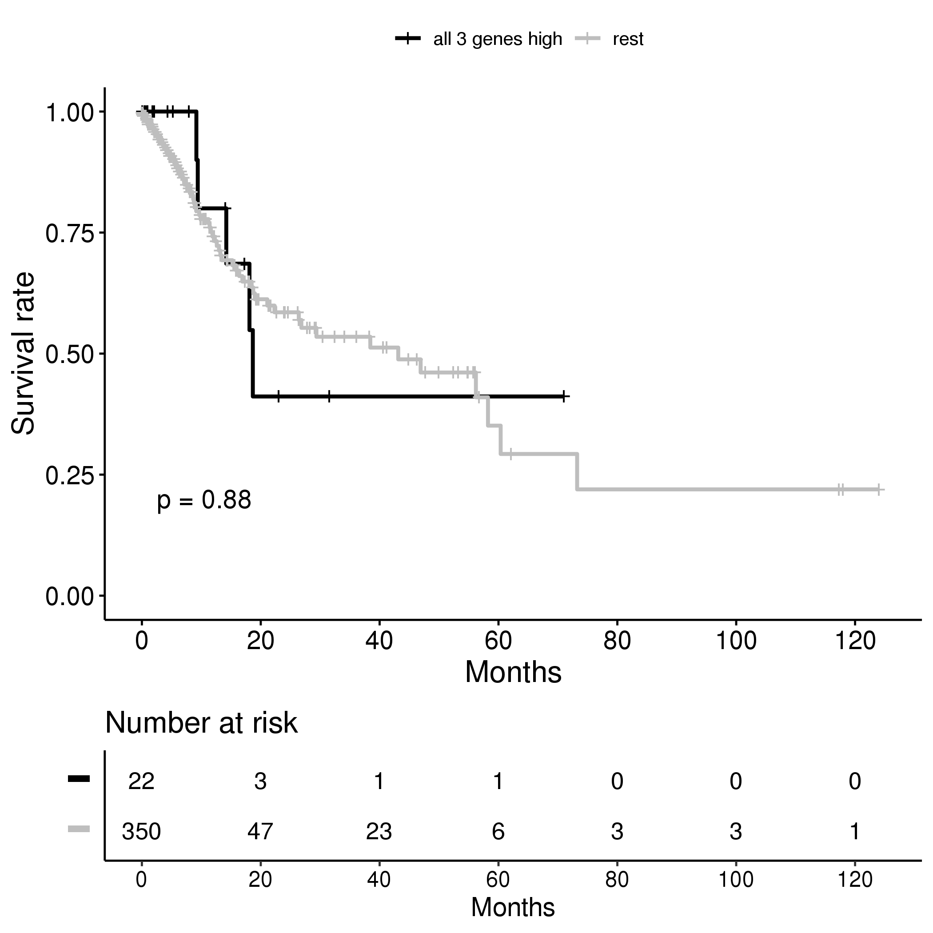
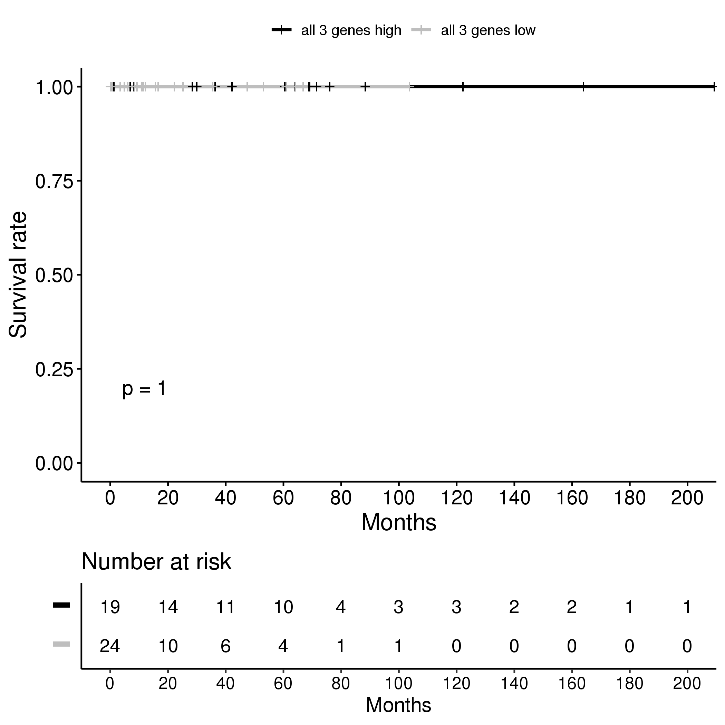
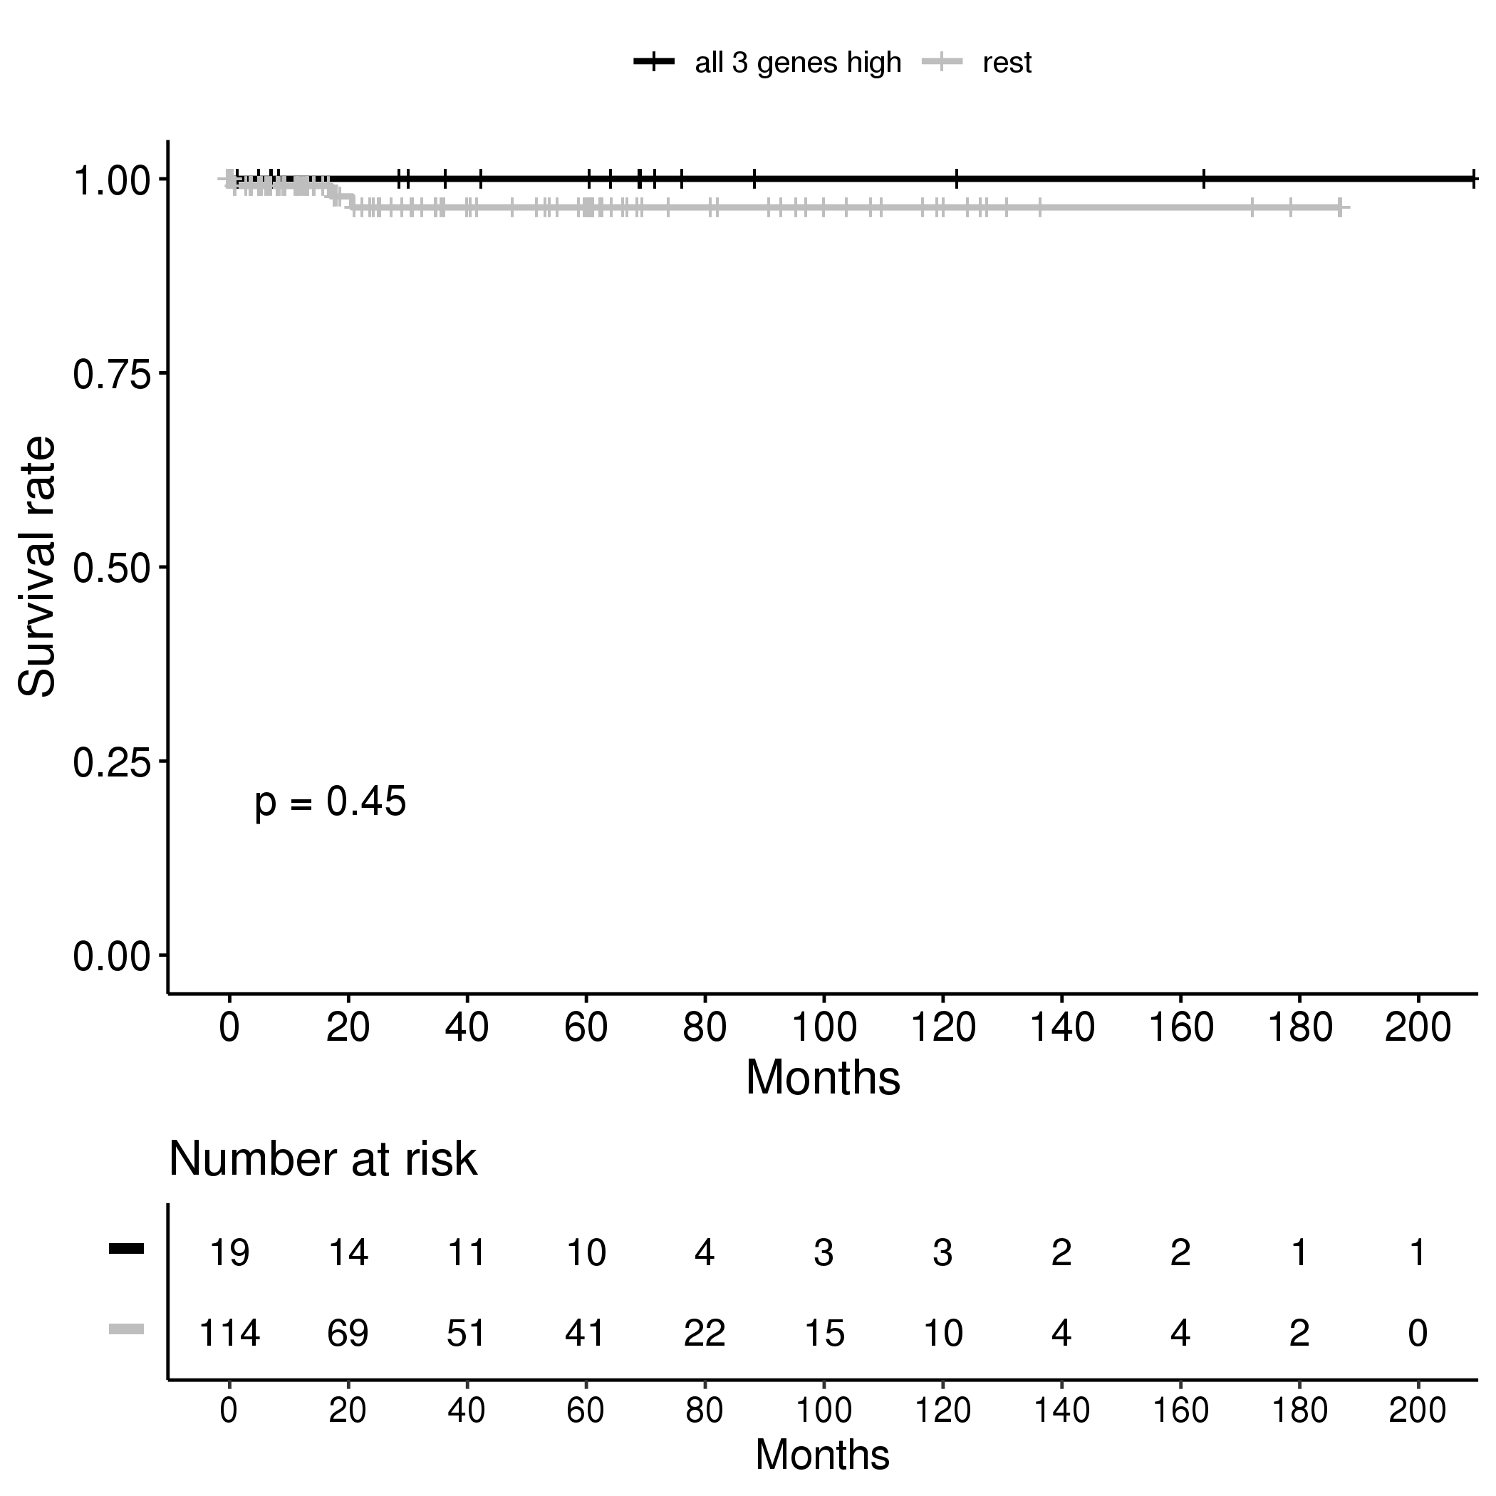
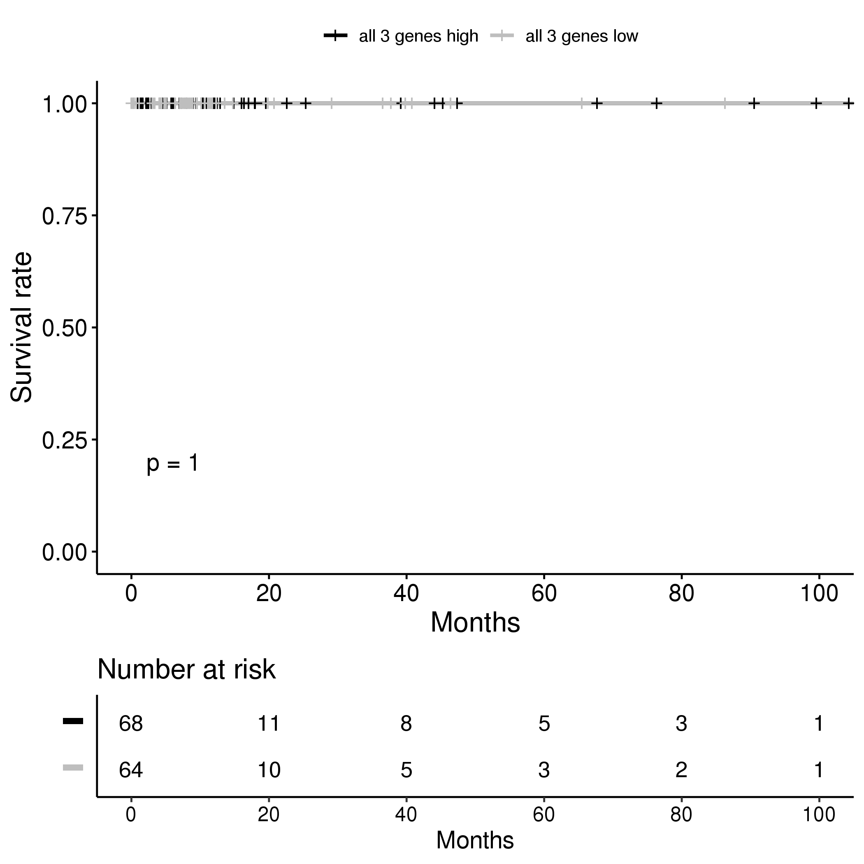
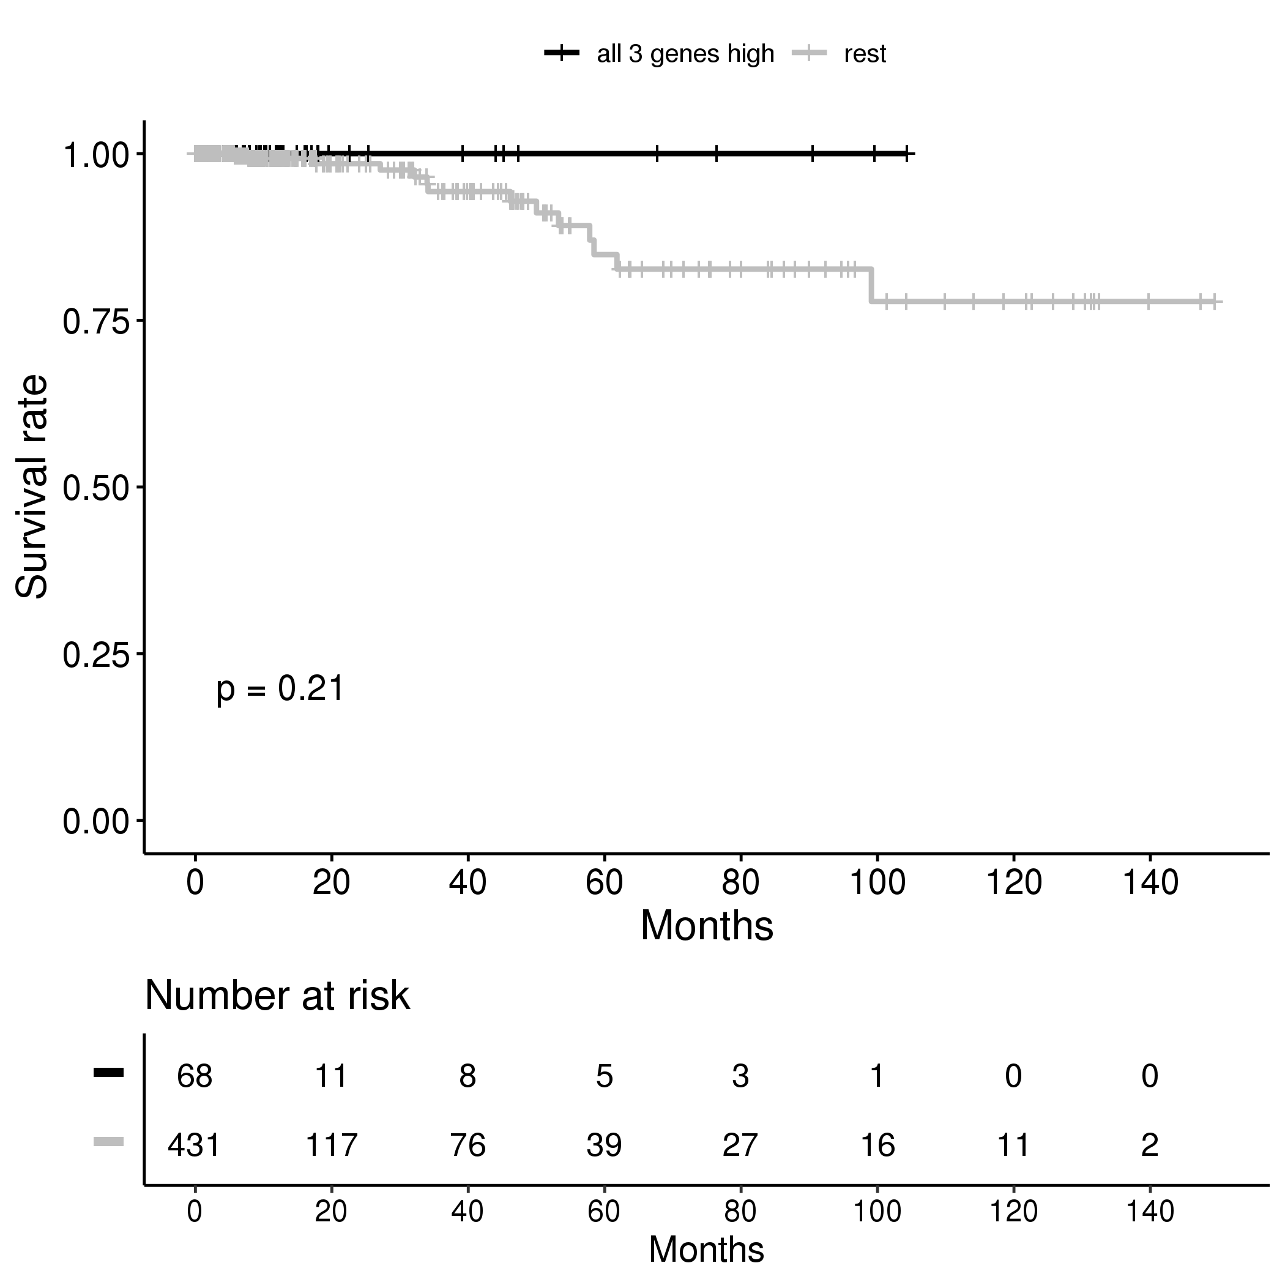
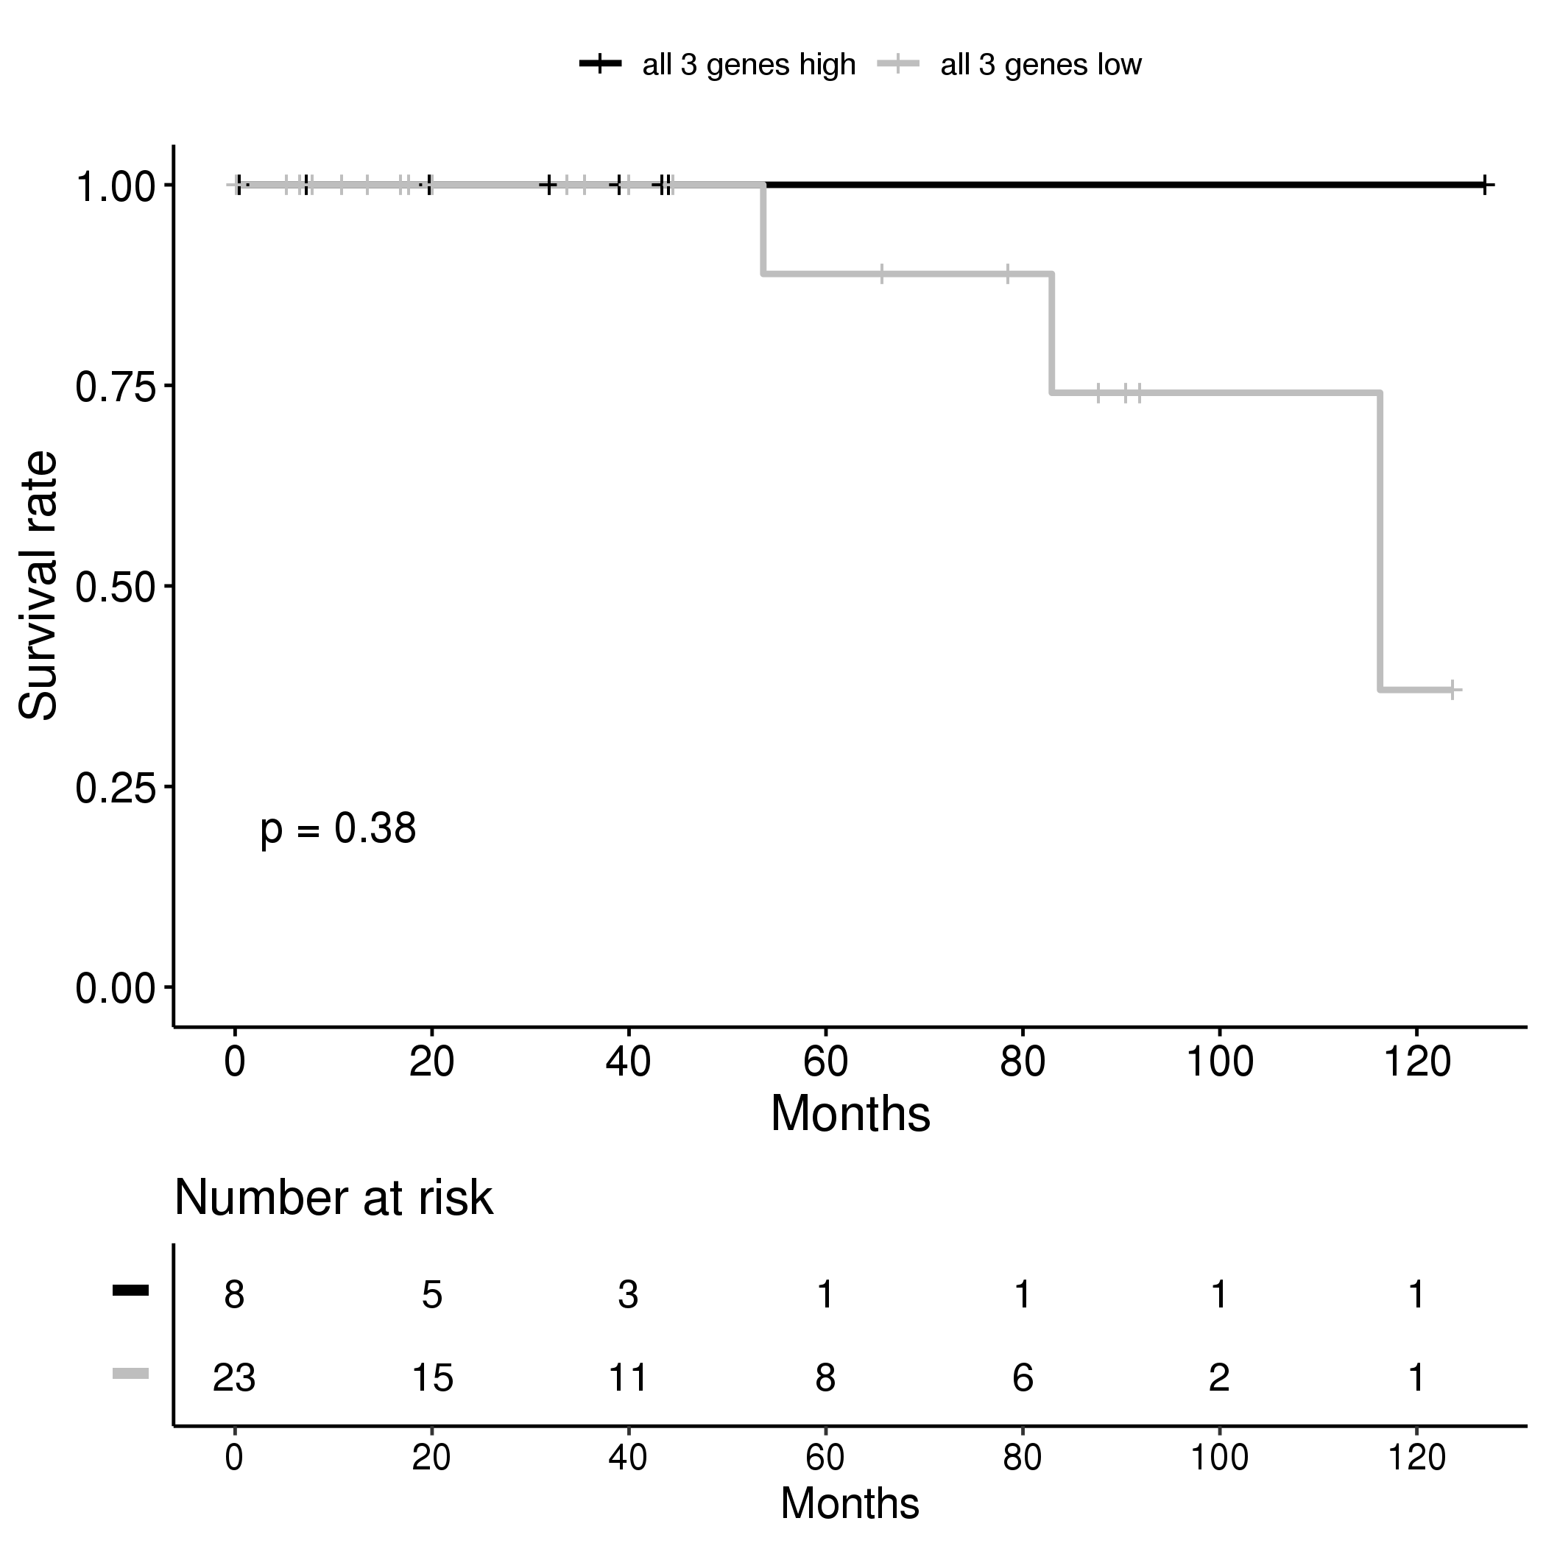
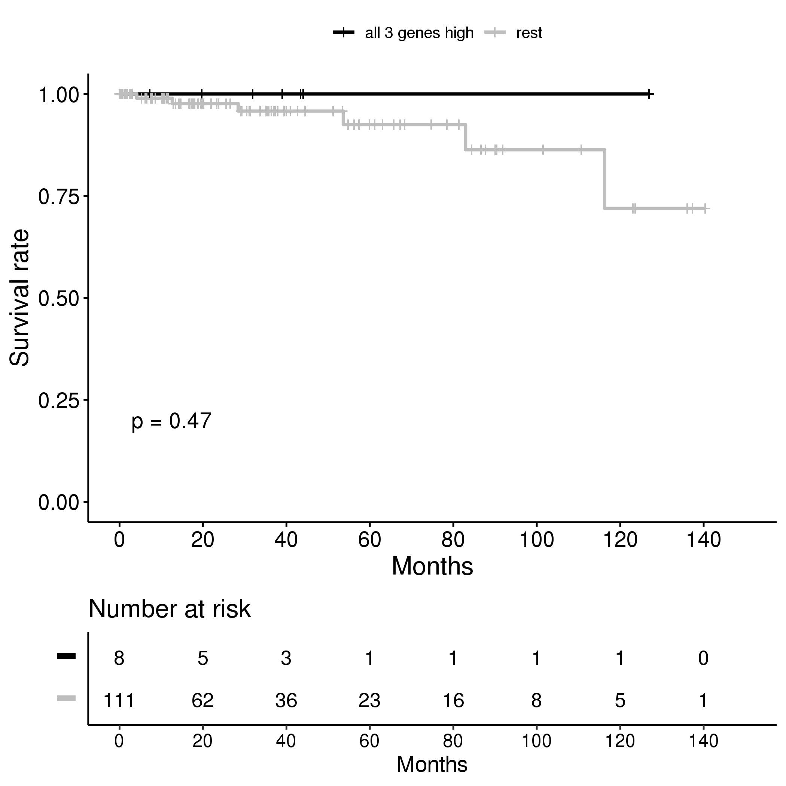
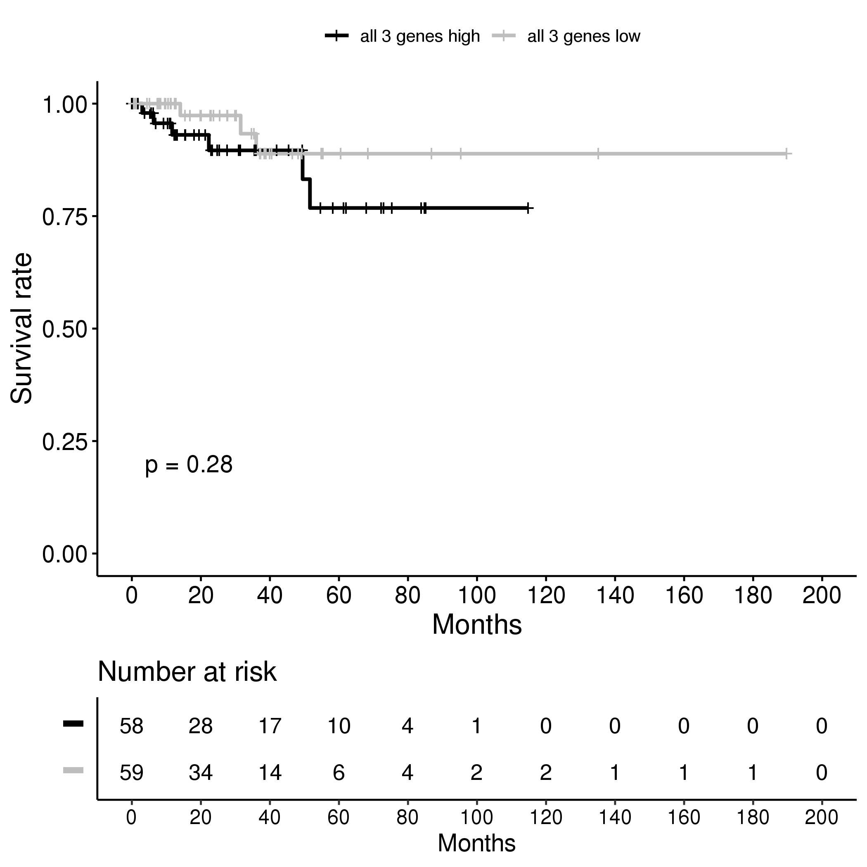
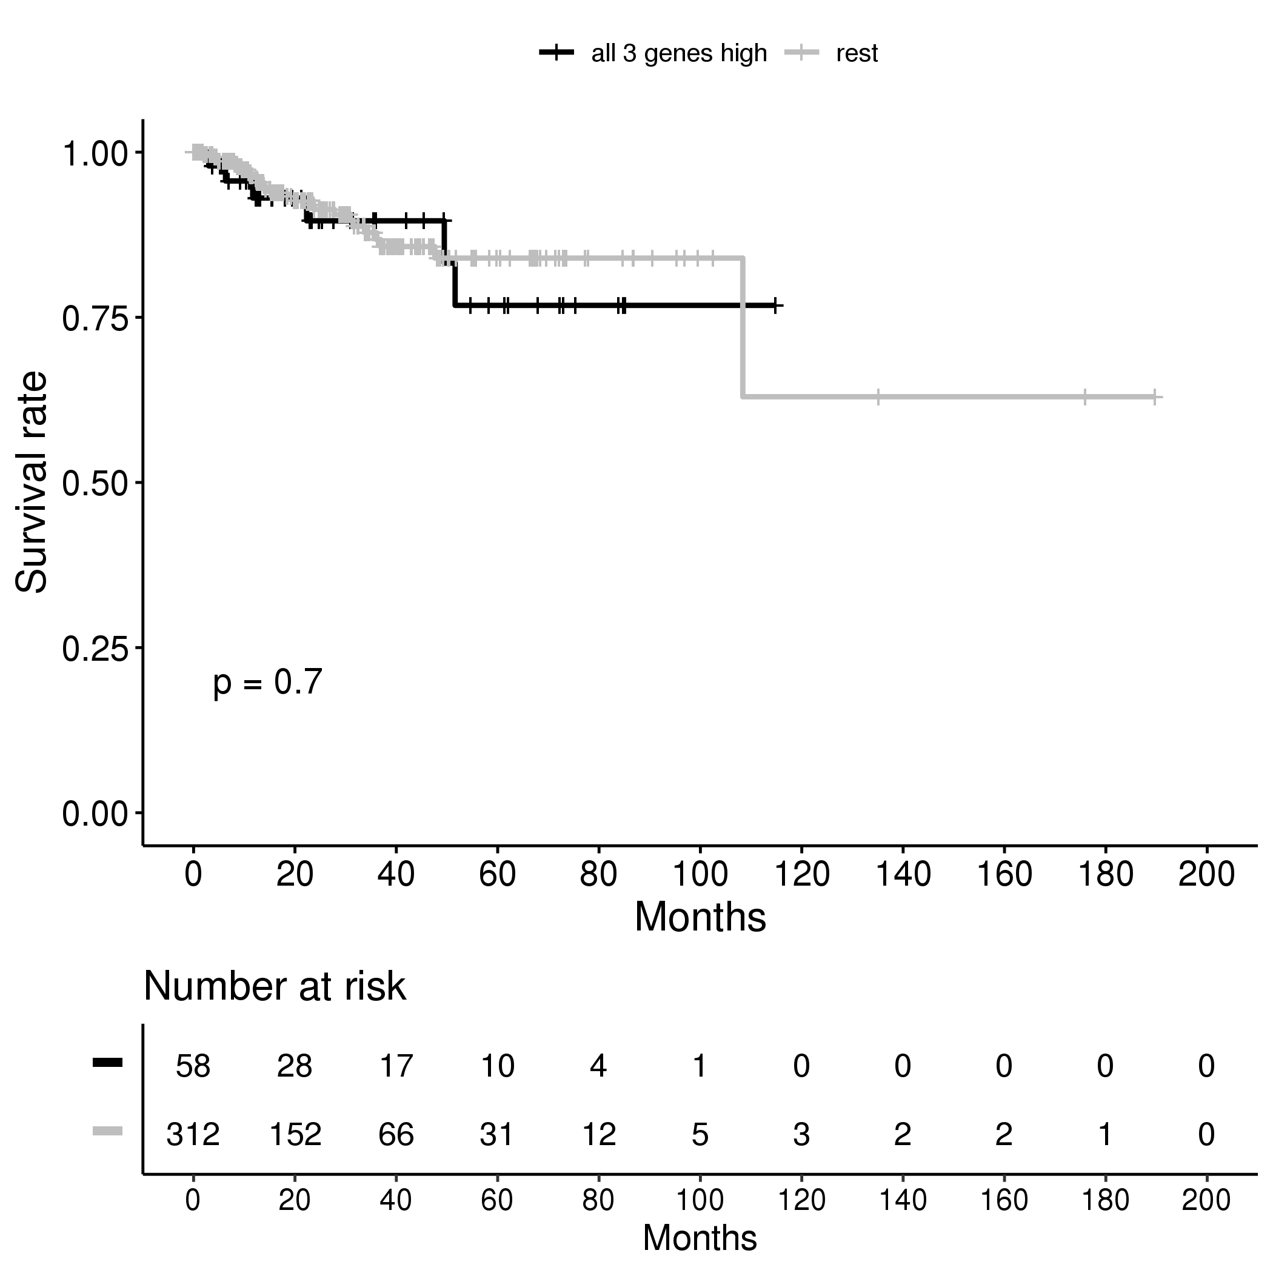
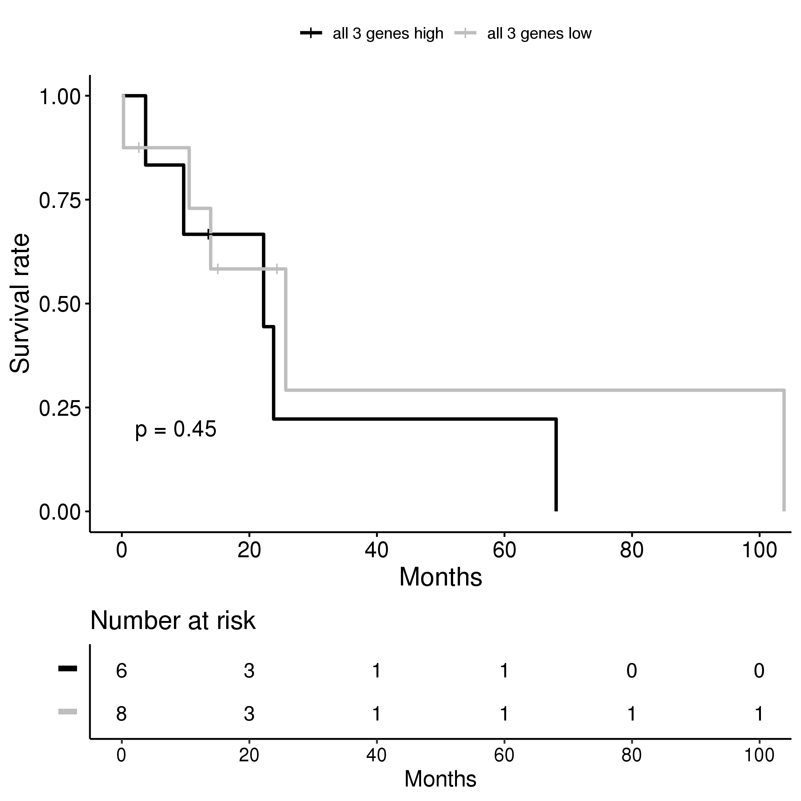



Supplementary Figure 5C
Stomach Adenocarcinoma
Testicular Germ Cell Tumors
Thyroid Carcinoma
Thymoma
Uterine Endometrial Carcinoma
Uterine Carcinosarcoma
Uveal Melanoma
Figure S4 A, B and C: Combined USP18, ATGL and UCP1 expression profiles in cancers that were interrogated using TCGA database. For each cancer type, black lines represent cases with higher USP18, ATGL and UCP1 levels and gray lines represents lower USP18, ATGL and UCP1 levels versus other cases.

Slide 8
Supplementary Figure 6
ATGL Immunostaining | Lung Cancer Cases
High | 0
Medium | 5
Not detected | 7
Figure S5: Differential ATGL expression profiles by immunohistochemical staining of human lung cancer cases using the Human Protein Atlas. Twelve human non-small cell lung cancers were stained with the HPA075175 antibody and five cases had ATGL protein levels detected.

