Slide 1
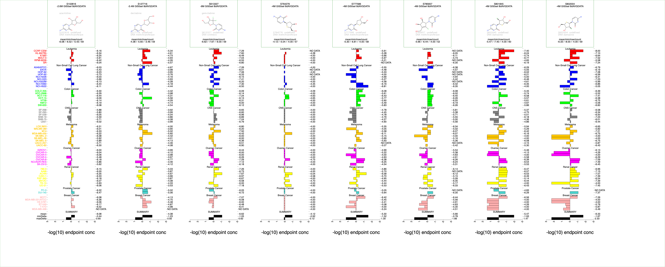
Figure S1: Cytidine agent NCI-60 mean graphs

