Slide 1
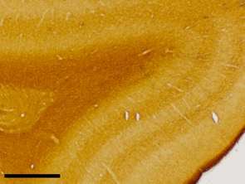
Figure.S6
a-1
a-2
a-3
pT172
Goat serum
Rabbit serum
b
c

