Slide 1
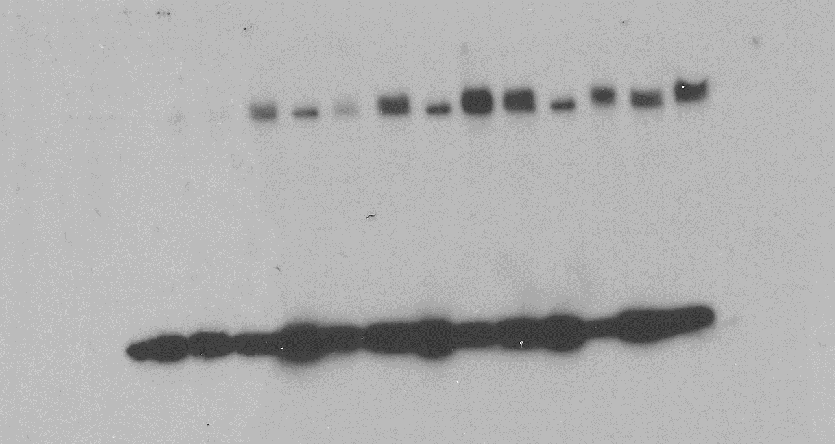
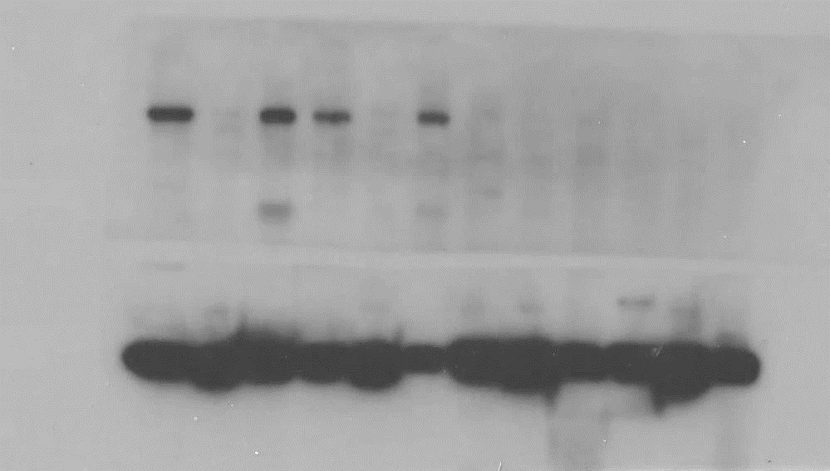
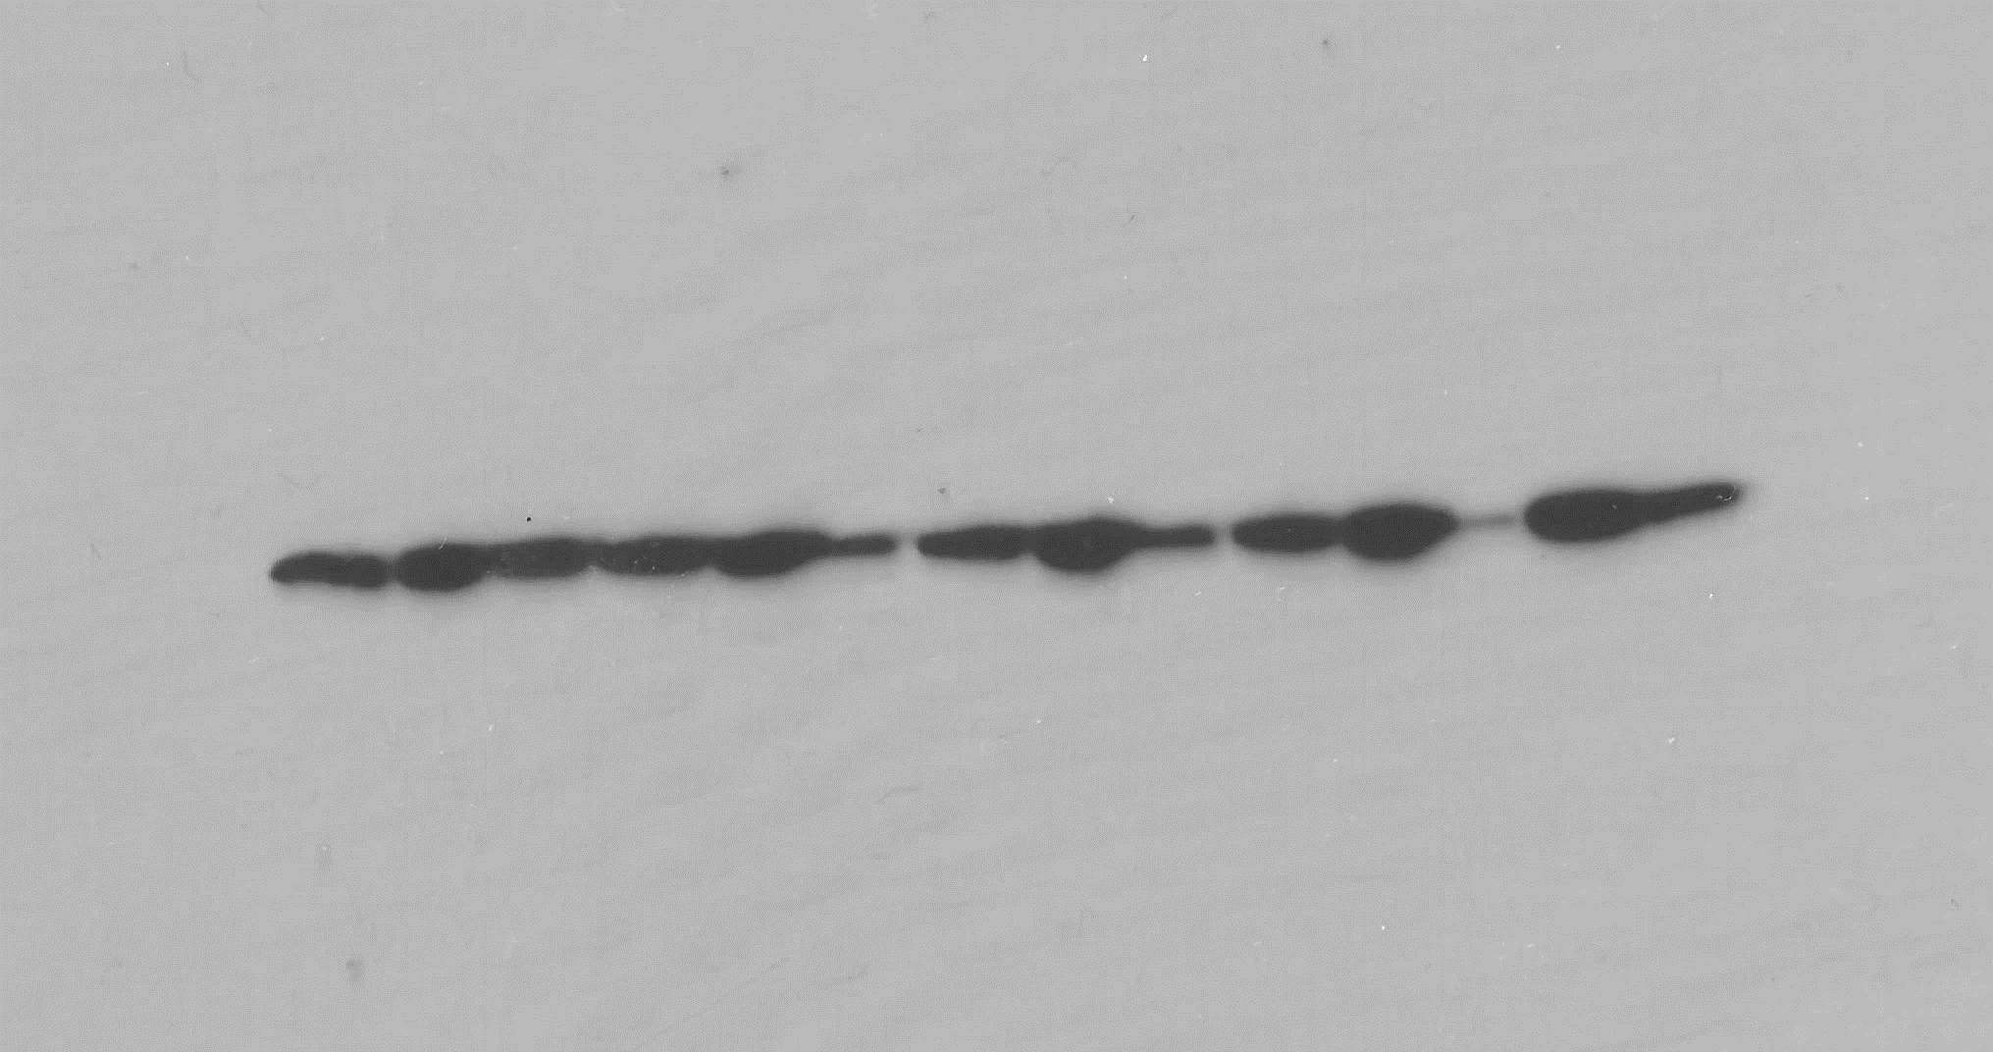
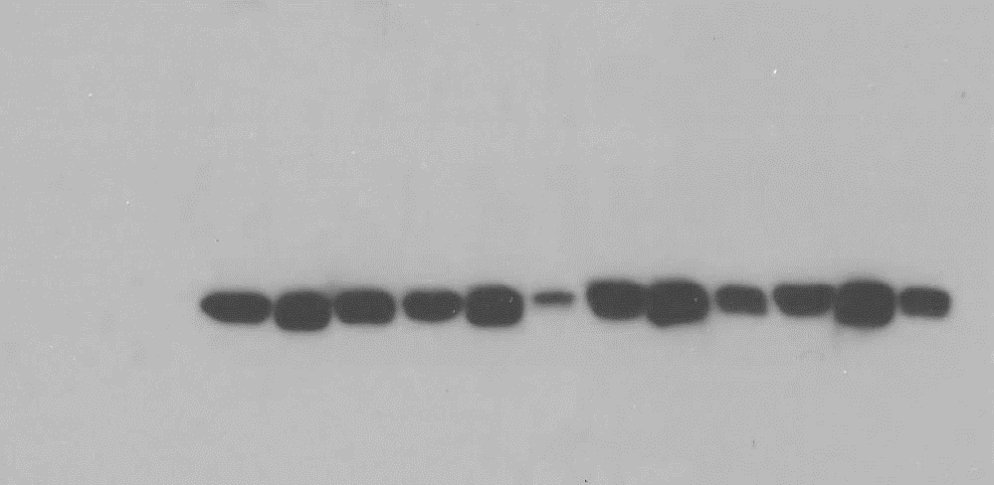
Supplementary Figure 4 - Western Blots (uncropped raw files)
A.
Figure 1A.
MDA mem.
HCC mem.
MDA cyt.
MDA cell
HCC cyt.
MW (kDa)
MW (kDa)
HCC cell
EGFR
250
250
190
HER2
190
134
134
MW (kDa)
MW (kDa)
β-Actin
46
46
32
β-Actin
32

Slide 2
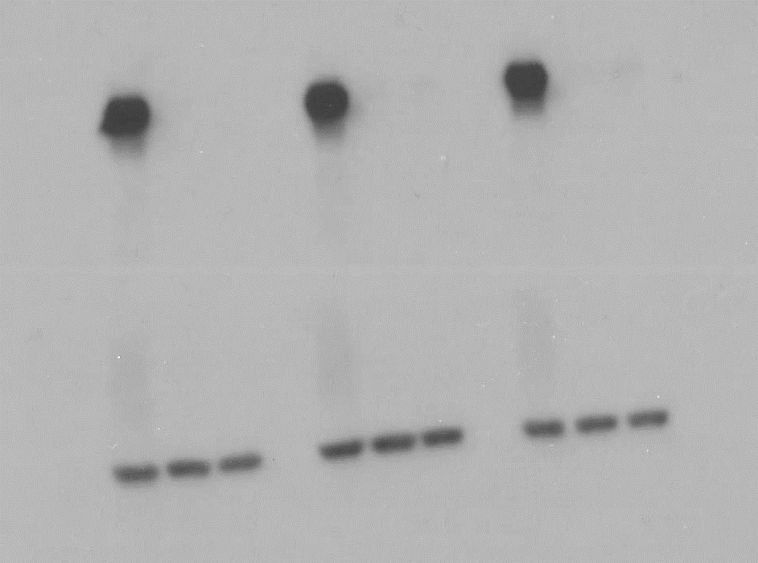
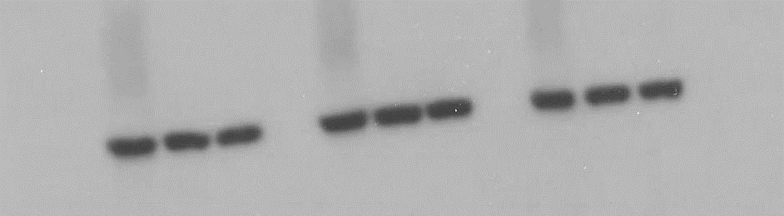
Supplementary Figure 4 - Western Blots (uncropped raw files)
B.
Figure 3A.
MDA-MB-321
MDA-MB-321
MDA-MB-321
MW (kDa)
HCC-1954
MCF-10A
HCC-1954
MCF-10A
HCC-1954
MCF-10A
250
HER2
190
134
MW (kDa)
β-Actin
46
32
N=1
N=2
N=3

Slide 3
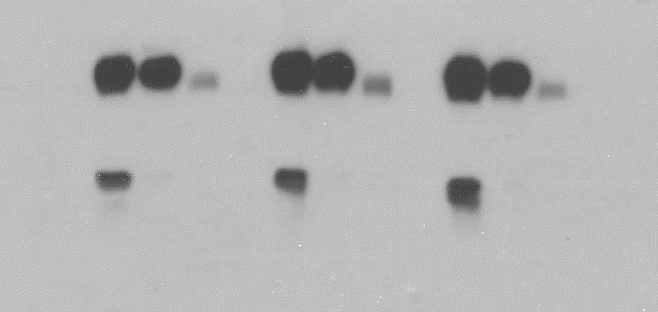
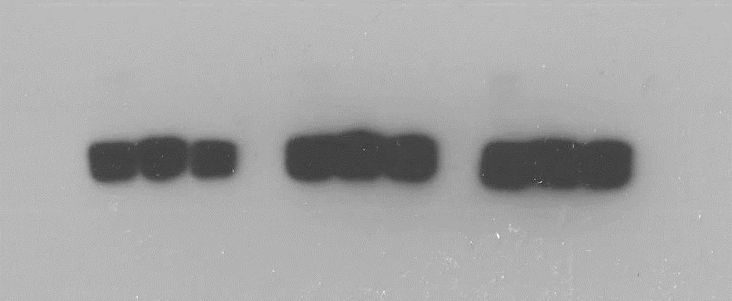
Supplementary Figure 4 - Western Blots (uncropped raw files)
C.
Figure 3B, 3C.
MDA-MB-321
MDA-MB-321
MDA-MB-321
MW (kDa)
HCC-1954
MCF-10A
HCC-1954
MCF-10A
HCC-1954
MCF-10A
EPHA2
134
100
80
STEAP4
57
46
MW (kDa)
β-Actin
46
32
N=1
N=2
N=3

Slide 4
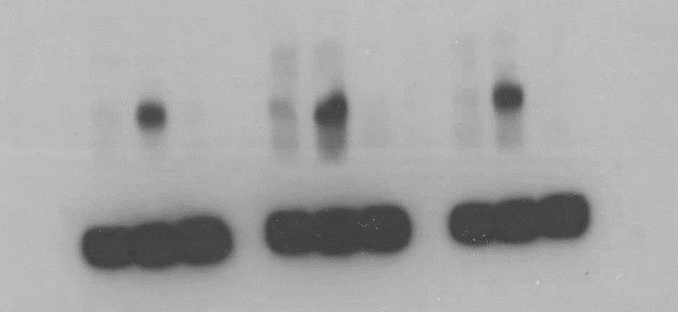
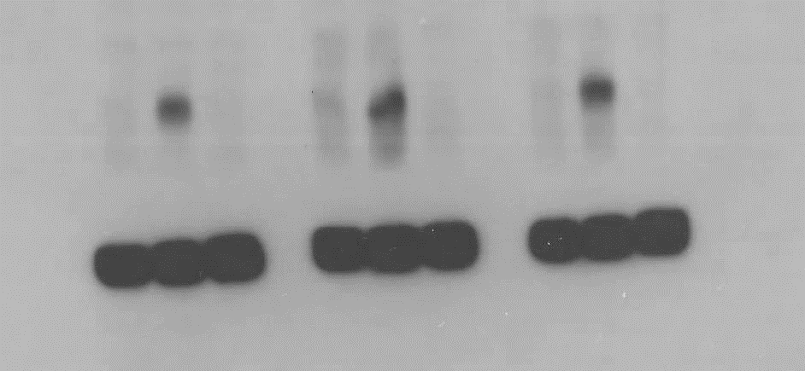
Supplementary Figure 4 - Western Blots (uncropped raw files)
D.
Figure 3D.
MDA-MB-321
MDA-MB-321
MDA-MB-321
MW (kDa)
HCC-1954
MCF-10A
HCC-1954
MCF-10A
HCC-1954
MCF-10A
134
CD97
100
80
57
MW (kDa)
β-Actin
46
32
N=1
N=2
N=3

Slide 5
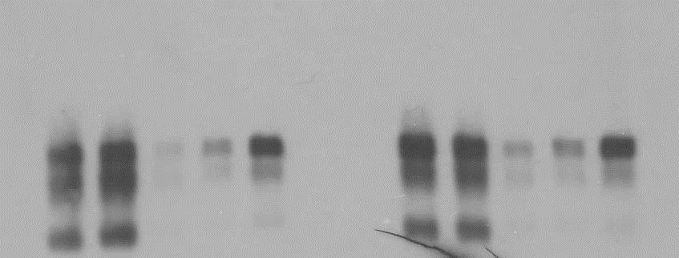
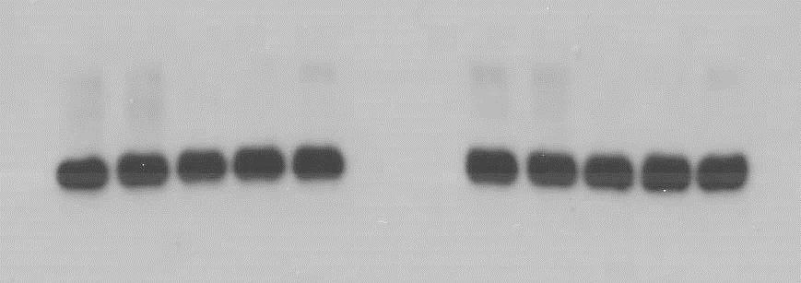
Supplementary Figure 4 - Western Blots (uncropped raw files)
E.
Figure 6A.
HCC-1954
HCC-1954
NC-siRNA
NC-siRNA
A-siRNA
A-siRNA
B-siRNA
C-siRNA
B-siRNA
C-siRNA
MW (kDa)
80
STEAP4
57
46
MW (kDa)
β-Actin
46
32
N=1
N=2

