Slide 1
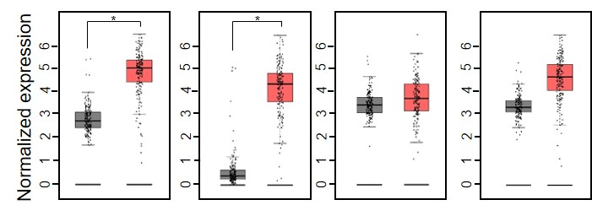
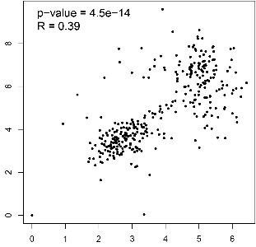
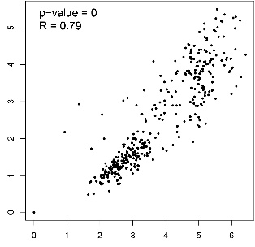
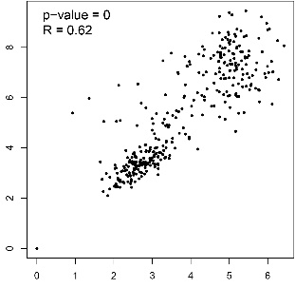
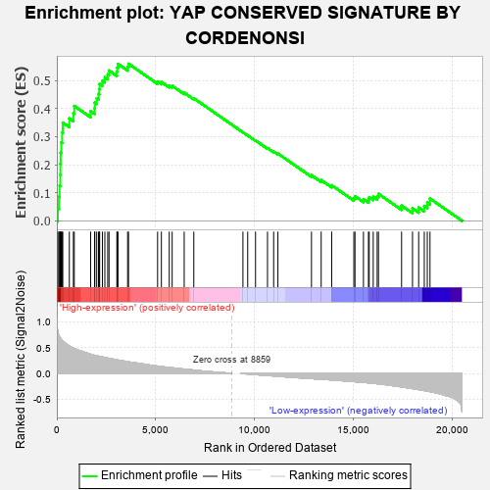
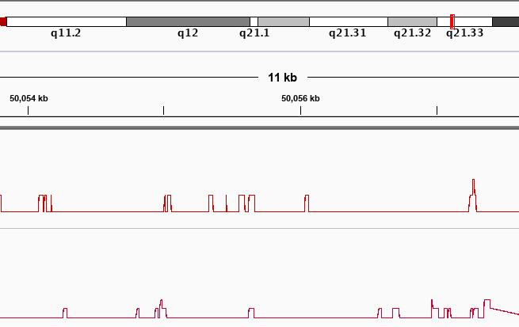







A
B
C
YAP1
Lef1
CAF
P300
MIA PaCa-2
AsPC-1
N
T
N
T
N
T
N
T
D
E
F
G
H
Log2(SLC39A4 TPM)
Log2(ZEB1 TPM)
Log2(ITGA3 TPM)
I
Log2(YAP1 TPM)
Log2(YAP1 TPM)
Log2(YAP1 TPM)
L
J
K
AsPC-sh-ZIP4
Enrichment Score (ES):0.5599606
p-value: 0.0
MIA-ZIP4
Xenograft tumor
MIA-V
AsPC-shV
50,055kb
50,057kb
ZIP4
ZEB1
YAP1
ZEB1
YAP1
ACTB
ITGA3 promoter
Supplementary Figure S1. YAP1 is a potent co-activator of ZEB1 to promote ITGA3 transcription. (A). Expression of YAP1, Lef1, CAF and P300 in pancreatic cancer tissues (n=179) and normal pancreatic tissues (n=171) from TCGA and GTEx database. (B). mRNA level of ITGA3 in MIA PaCa-2 siYAP1, siLef1, siCAF and siP300 cells. (C). mRNA level of ITGA3 in AsPC-1 siYAP1, siLef1, siCAF and siP300 cells. (D-F). Correlations between YAP1 and ZIP4 (D), YAP1 and ZEB1 (E), YAP1 and ITGA3 (F) in pancreatic cancer tissues (n=179) and normal pancreatic tissues (n=171) from TCGA and GTEx database. P< .01. (G-H). mRNA level of YAP1 in MIA-V, MIA-ZIP4 cells (G), AsPC-shV and AsPC-shZIP4 cells (H), Xenograft tumor tissues derived from AsPC-shV and AsPC-shZIP4 cells (I). ** means P< .01. (J). Protein level of YAP1 in MIA-V, MIA-ZIP4, AsPC-shV and AsPC-shZIP4 cells. (K). GSEA report from TCGA database showed the gene sets of YAP1 is strongly enriched when ZEB1 is highly expressed in pancreatic cancer. (L). ChIP sequencing data from ChIP-Atlas database with MIA PaCa-2 cells. It showed the transcription peak calls of ZEB1 and YAP1 at the promoter of ITGA3.

Slide 2
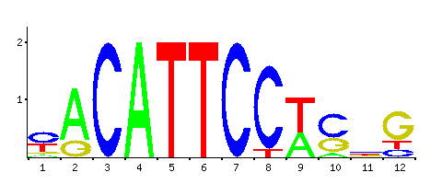
A
B
C
D
E
ITGA3
F
MIA PaCa-2
G
AsPC-1
WT
Mut
WT
Mut
chr17:50055692-50055693:
CGCAGGAAAGCG
CGCATTGAAGCG
chr17:50055750-50055752:
CCAATGCCAG
CTGATGCCAG
Supplementary Figure S2. YAP1 is required for ITGA3 transcription activated by ZEB1. (A). Fold change of Fig. 1E. (B). mRNA level of ITGA3 in MIA-V siNC, MIA-ZIP4 siNC and MIA-ZIP4 siYAP1 cells. ** means P< .01. (C). Fold change of Fig. 1F. (D). mRNA level of YAP1 and ITGA3 in KPC and KPCZ cells with mYAP1 overexpressed. (E). YAP1/TEAD binding sites mutation at ITGA3 promoter. (F). Promoter activity of ITGA3 in MIA PaCa-2 siNC, MIA PaCa-2 siZEB1 and MIA PaCa-2 siZEB1+siYAP1 cells transfected with WT ITGA3 promoter vector or mutant promoter vector (YAP1 binding sites mutant). ** means P<.01. (G). Promoter activity of ITGA3 in AsPC-1 cells transfected with WT or mutant promoter vector. ORF vector of ZEB1/YAP1 was transfected in combination with ITGA3 promoter vector. ** means P<.01.

Slide 3






A
B
C
YAP1 mutation vector | Mutation or Deletion
YAP1 ORF TID (TEAD binding domain) mutation vector | Mutation
YAP1 ORF PDZ deletion vector | Deletion
YAP1 ORF WW mutation vector | Mutation
YAP1 ORF phosphorylation mutation vector | Mutation
YAP1 WT
Vector
YAP TID mu
YAP1
ITGA3
ACTB
D
E
F
G
MIA-ZIP4
MIA-V
MIA-ZIP4
YAP1
ITGA3
ACTB
DMSO
DMSO
Verteporfin
Supplementary Figure S3. Mutation of YAP1 protein domain inhibits ITGA3 transcription. (A). Information of YAP1 protein structure mutation. (B). Protein level of YAP1 and ITGA3 in MIA PaCa-2 cells transfected with empty vector, YAP1 ORF WT vector, or YAP1 ORF TID (TEAD binding domain) mu vector. (C-F). Promoter activity of ITGA3 in MIA PaCa-2 cells transfected with empty vector, YAP1 ORF WT vector, or YAP1 ORF TID mu vector (C), YAP1 ORF PDZ deletion vector (D), or YAP1 ORF WW mutation vector (E), or YAP1 ORF phosphorylation mutation vector (F). ** means P< .01. (G). Protein levels of YAP1 and ITGA3 in MIA-ZIP4 cells treated with YAP1 inhibitor Verteporfin with 10 μM for 24 h. Verteporfin can reduce the interaction between YAP1 and TEAD.

Slide 4






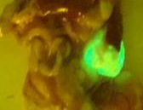
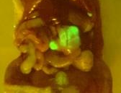
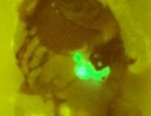
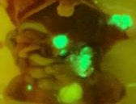
A
B
C
AsPC-shZIP4
D
AsPC-shZIP4
AsPC-shV
AsPC-shV
YAP1
GAPDH
Laminin A/C
Cytoplasm
Nucleus
I
MIA-ZIP4 Anti-C
MIA-ZIP4
Anti-miR-373
E
F
G
H
AsPC-shZIP4
Pre-C
AsPC-shZIP4
Pre-miR-373
Supplementary Figure S4. miR-373 upregulates ITGA3 through LATS2-YAP1 axis. (A-B). Fold change of Fig. 2A (A), Fig. 2B (B). (C). Protein level of YAP1 in cytoplasm and nucleus of AsPC-shV and AsPC-shZIP4 cells. (D). Fold change of Fig. 2C. (E-H). Relative level of miR-373 (E), LATS2 (F), YAP1 (G), and ITGA3 (H) in AsPC-1 cells. * means P< .05, ** means P< .01. (I). Orthotopic xenografts were established using AsPC-shZIP4-Pre-C, AsPC-shZIP4-Pre-miR-373, MIA-ZIP4-Anti-C, MIA-ZIP4-Anti-miR-373 stable cell lines. Mouse photos were taken using Illumatool fluorescence imaging system at 5 weeks after tumor implantation (n=5).

Slide 5
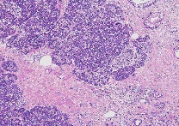
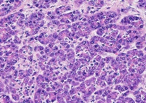
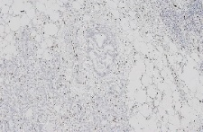
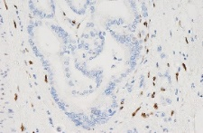
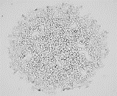
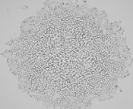
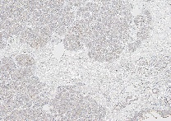
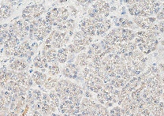
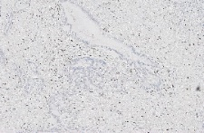
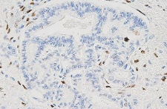
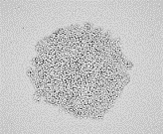
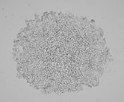
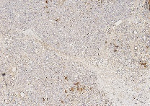
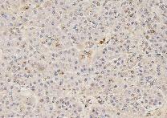
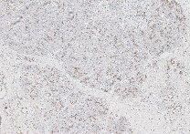
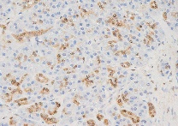
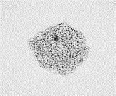
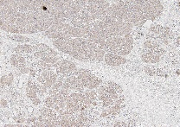
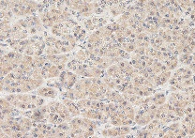
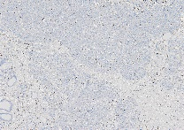
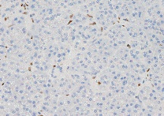
A
B
D
siNC
si-ITGA3
H&E
ZEB1
2h
Human pancreatic cancer
specimen C
ZIP4
ZEB1
4h
LATS2
Human pancreatic cancer
specimen D
C
siNC
si-ITGA3
YAP1
24h
ITGA3
ZEB1
Human adjacent pancreas
Supplementary Figure S5. Expression of ZIP4 and downstream targets in pancreatic cancer in vivo.
(A). IHC staining of ZIP4, LATS2, YAP1, ITGA3 and ZEB1 in human adjacent pancreatic tissues from human pancreatic cancer specimen C. The scale bar is 50 μm. (B). IHC staining of ZEB in human pancreatic cancer specimen C and D. The scale bar is 50 μm. (C). Adhesion assay in MIA-ZIP4 siNC and MIA-ZIP4 si-ITGA3 cells. The scale bar is 500 μm. (D). Spheroid formation assay. The solidified spheroid drops (generated from MIA-ZIP4 siNC and MIA-ZIP4 si-ITGA3 cells) were kept on the dish lid for 2, 4, and 24 h and were imaged using a light microscope. The scale bar is 200 μm.

Slide 6
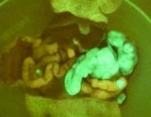
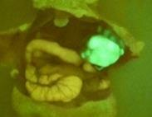
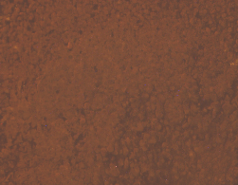
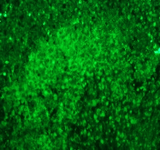
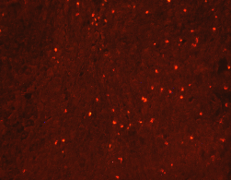
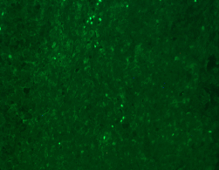
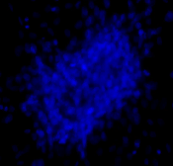
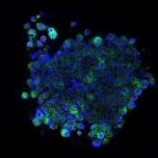
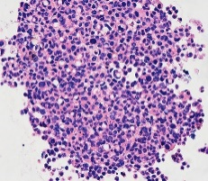
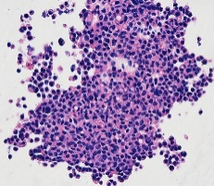
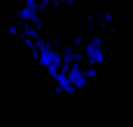
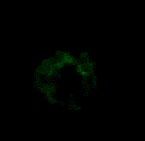
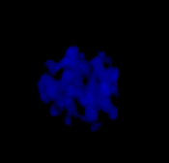
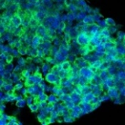
A
shV
sh-ITGA3
B
F-actin
ITGA3
shV
sh-ITGA3
C
ITGA3
F-actin
DAPI
Merged
D
ZIP4
DAPI
Merged
E
AsPC-shV
AsPC-shZIP4
MIA-V
MIA-V
MIA-ZIP4
MIA-ZIP4
3D organoid Matrigel embedded
AsPC-shV
MIA-V
3D spheroid
AsPC-sh-ZIP4
MIA-ZIP4
3D organoid Matrigel embedded
3D Spheroid section
Supplementary Figure S6. ZIP4 upregulates ITGA3 in the 3D organoid model. (A). Photos of the orthotopic tumors derived from MIA-ZIP4 shV and MIA-ZIP4 sh-ITGA3 cells were taken 5 weeks after tumor implantation. (B). Immunofluorescence staining showed the expression of ITGA3 and level of F-actin in the xenograft tumor tissues. The green fluorescence indicated ITGA3 and red signal showed F-actin expression in the two groups. The scale bar is 50 μm. (C). Images were taken using 3D confocal microscopy. ITGA3 was stained in a 3D organoid Matrigel-embedded model derived from MIA-V, MIA-ZIP4, AsPC-shV, and AsPC-shZIP4 cells. The scale bar is 50 μm.(D). Images were taken using 3D confocal microscopy. ZIP4 was stained in a 3D organoid Matrigel-embedded and a 3D spheroid model derived from MIA-V and MIA-ZIP4 cells. The scale bar is 50 μm.(E). H&E staining of 3D spheroids established from AsPC-shV and AsPC-shZIP4 cells. The scale bar is 50 μm.

Slide 7





AsPC-shV
AsPC-shZIP4
A
B
E
ZIP4
YAP1
N-cadherin
Vimentin
C
D
ACTB
3D organoid Matrigel suspension
Supplementary Figure S7. ZIP4 promotes EMT plasticity in pancreatic cancer organoid. (A). Fold change of Fig. 6B. (B) Fold change of Fig. 6C. (C) Fold change of Fig. 6D. (D) Fold change of Fig. 6E. (E). Protein level of ZIP4, YAP1, N-cadherin, Vimentin in 3D organoid Matrigel suspended model generated from AsPC-shV and AsPC-shZIP4 cells.

