Slide 1
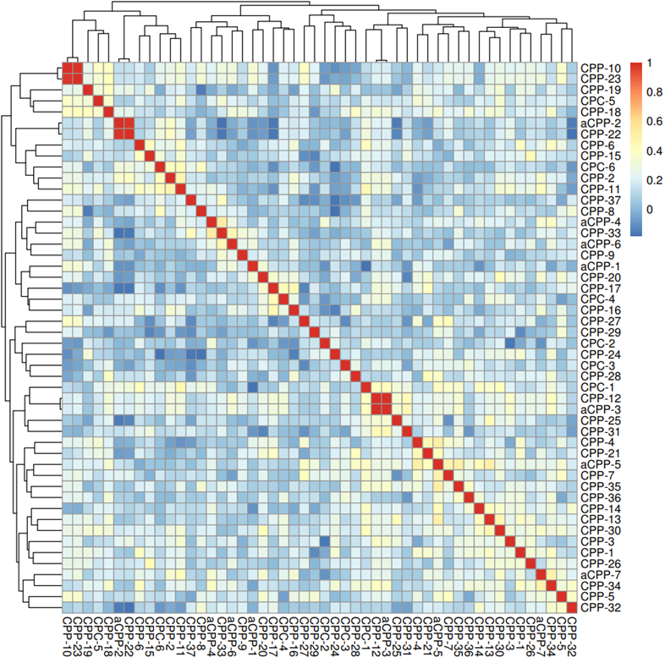
Figure S1: Heatmap showing the sample-to-sample correlation of beta values targeting 59 SNP probes located on both the HumanMethylation450 and the MethylationEPIC BeadChip array. Samples of the same individual (CPP-10 and CPP-23, aCPP-2 and CPP-22, CPP-12 and aCPP3) show high correlation values.

Slide 2
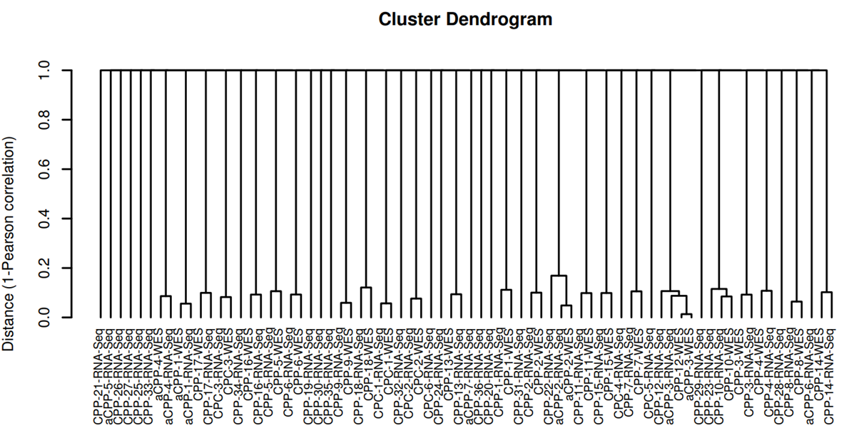
Figure S2: Sample similarity based on single nucleotide polymorphism calls in whole exome sequencing and RNA sequencing data. Dendrogram of the distance (1-Pearson correlation) derived from allele fractions of known single nucleotide polymorphisms (SNPs) in whole exome sequencing (WES) and RNA sequencing (RNA-seq) data using NGSCheckMate suggests a high probability that matched WES and RNA-seq and recurrent samples were derived from the same indivudial.

Slide 3
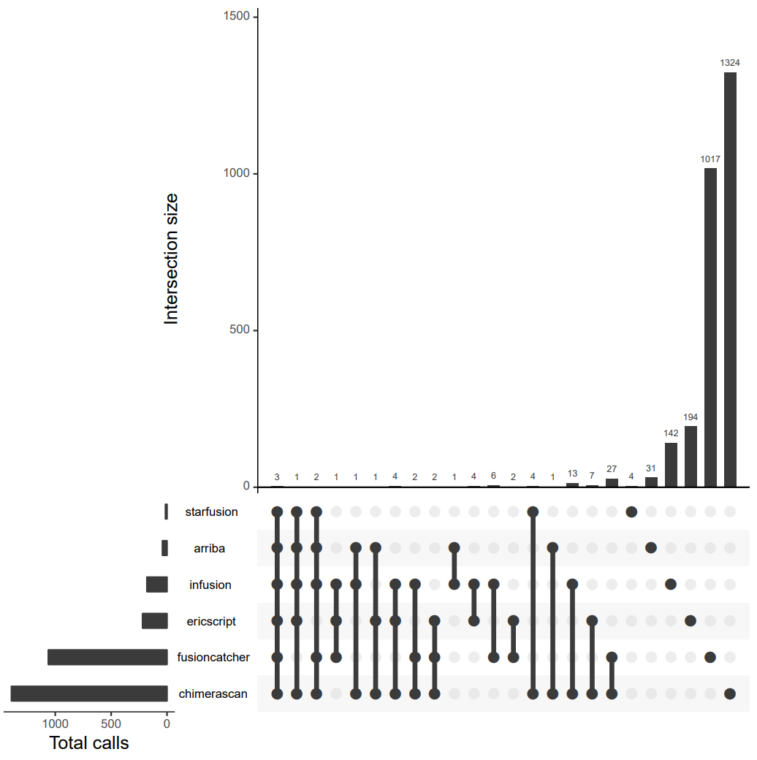
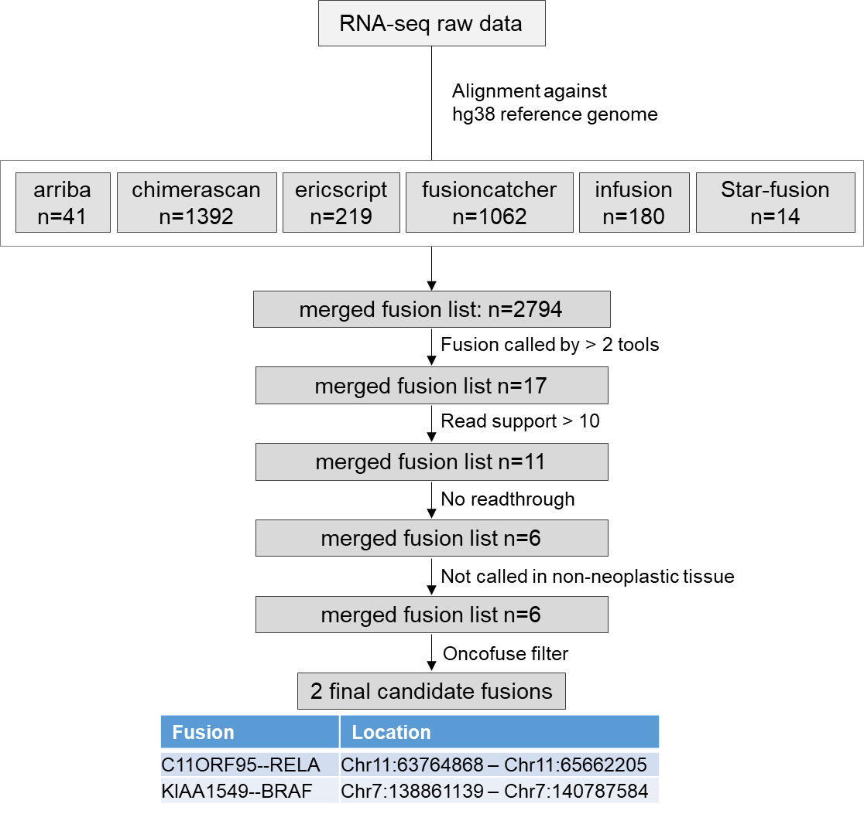
A
B
Figure S3: Evaluation of the gene fusion calling pipeline. Two RNA-seq data sets from tumors with known gene fusion status (pilocytic astrocytoma with KIAA1549-BRAF fusion and ependymoma with C11orf95-RELA fusion) from the Children’s Brain Tumor Tissue Consortium (CBTTC) database were evaluated. A, UpSet plot showing the intersection of the raw fusion candidates detected from each tool. B, Detailed flow chart showing results of each filtration step.

Slide 4
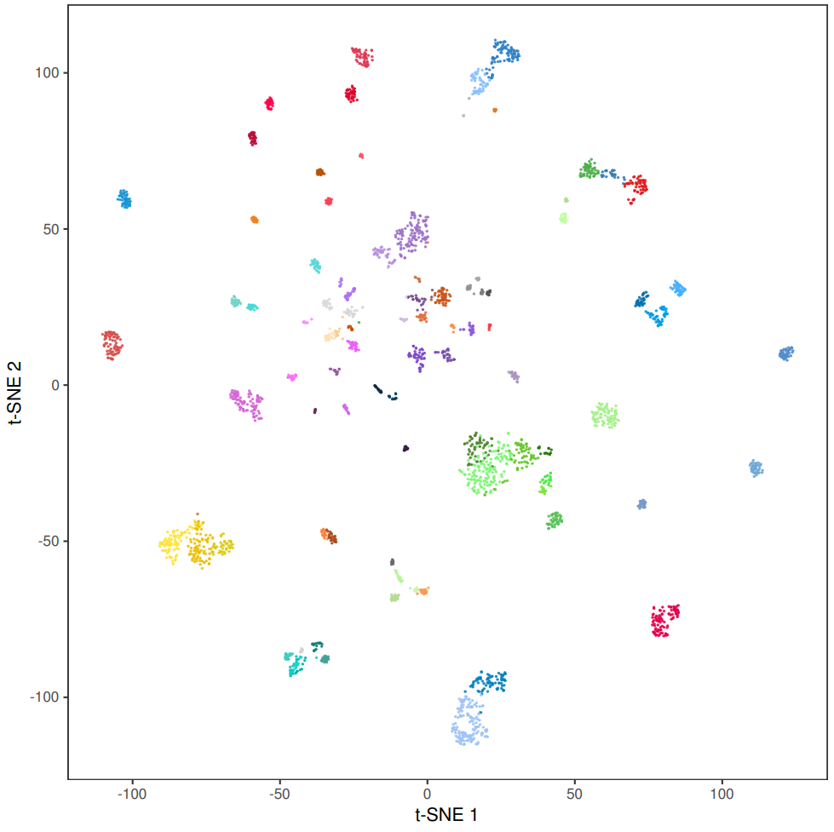
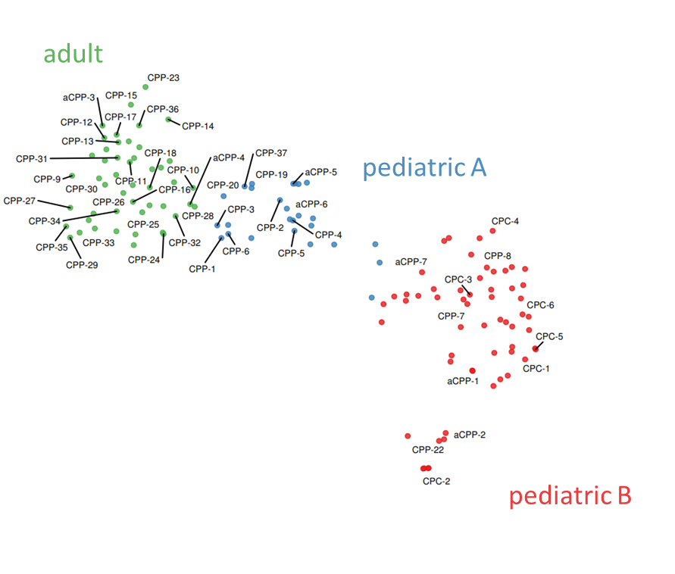
Figure S4: Unsupervised t-SNE analysis comprising all 50 CPT samples of this cohort and 2801 samples from 82 distinct molecular CNS tumor entities (including 83 CPTs). All CPTs of our cohort can be assigned to one of the three molecular choroid plexus tumor subgroups (right panel).

Slide 5
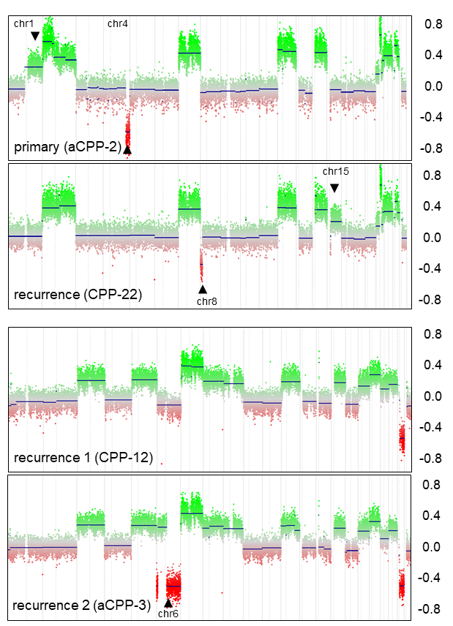
A
B
Figure S5: Copy-number plots of recurrent choroid plexus tumor samples from the same individuals. (A) The primary tumor (aCPP-2) shows gain of chr1q and a focal loss of chr4q that were not observed in the recurrence (CPP-22), while a focal loss of chr8p was only present in the recurrence. (B) The second recurrence (aCPP-3) shows chromosomal losses on chr6 not being detected in the first tumor recurrence (CPP-12).

Slide 6
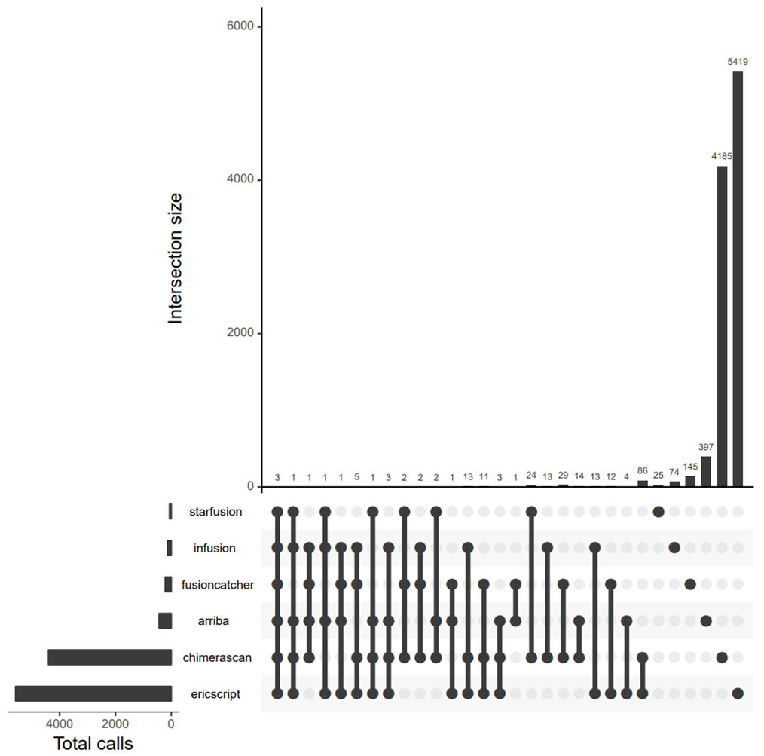
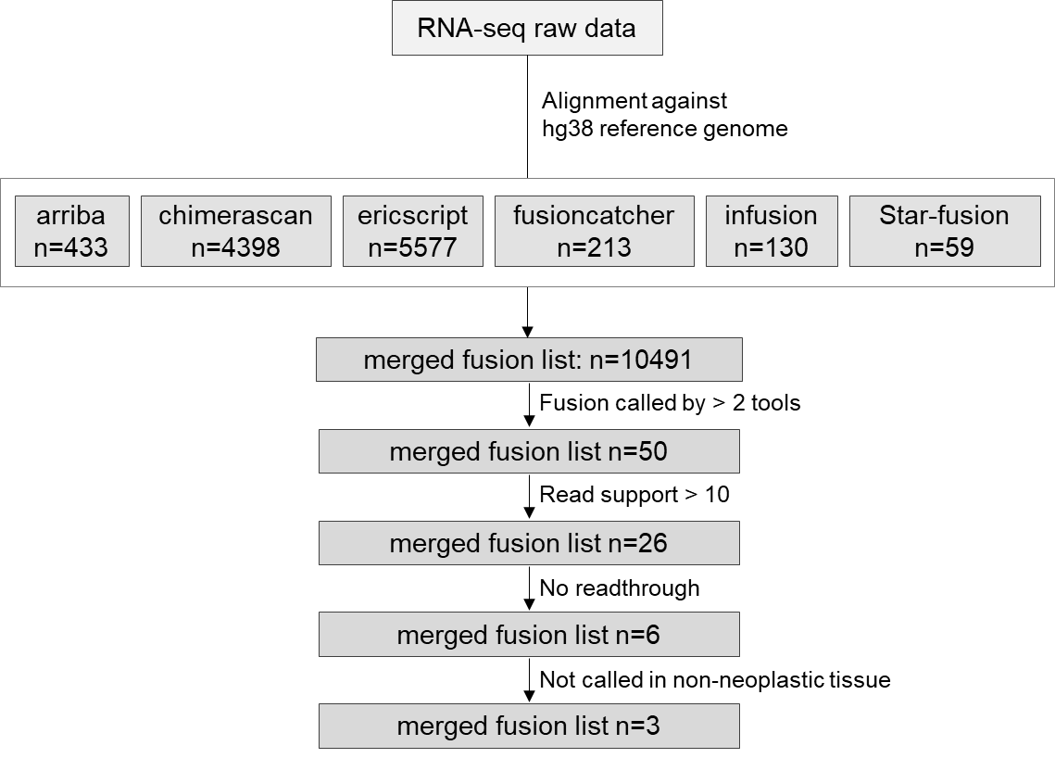
A
B
Figure S6: Fusion Calling in RNA sequencing data of choroid plexus tumors. A, UpSet plot showing the intersection of the raw fusion gene candidates detected from each tool. B, Detailed flow chart showing results of each filtration step.

Slide 7
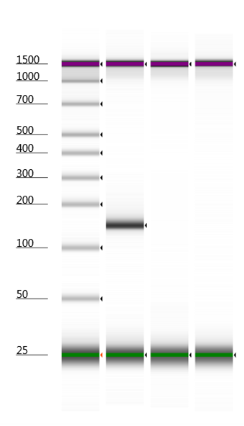
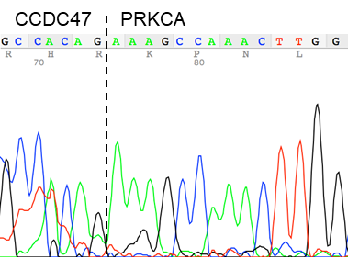
A
B
1
2
3
Figure S7: Validation of the CCDC47-PRKCA fusion transcript. A, PCR amplification of cDNA from CPP-23 using primers that span the fusion breakpoint shows expected band at 141 bp (1), whereas another CPP without PRKCA-fusion (2) and the non-template control (NTC) (3) show no band. B, Sanger sequencing confirms the fusion breakpoint in CPP-23.

Slide 8
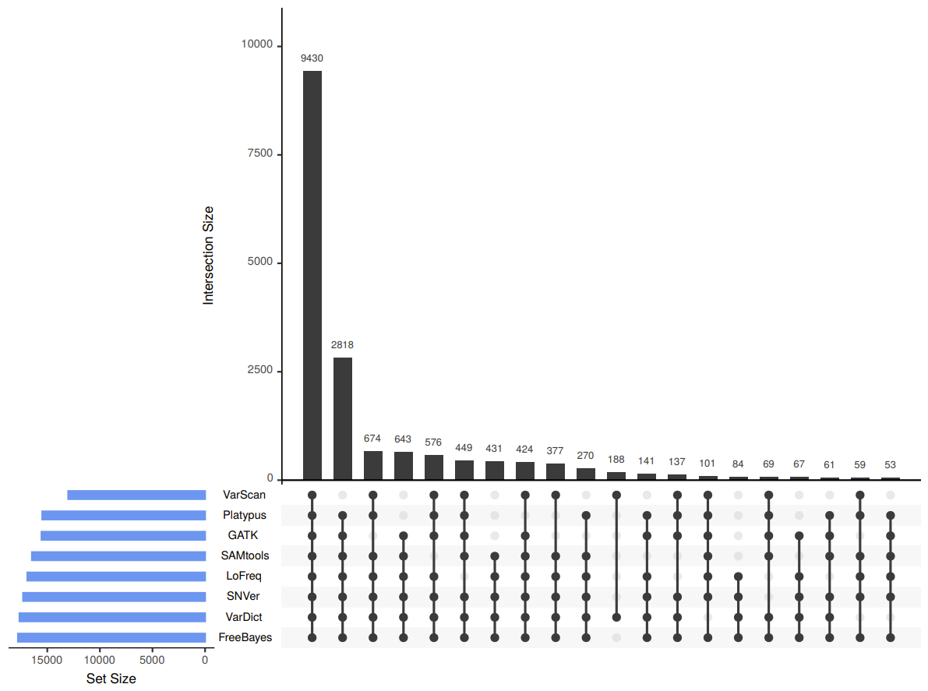
A
B
Variant Caller | Detected Variants
GATK | 15549
Platypus | 15480
VarScan | 13013
LoFreq | 16899
FreeBayes | 17789
SNVer | 17299
SAMtools | 16460
VarDict | 17643
Combined Calls: 18.148 variants
Intersection: >99.99 % variants
were called by ≥ 2 tools
Figure S8: Appreci8 Output. Variants detected by 8 different callers (A) show a high intersection (B). More than 99.99% of the variants were detected by ≥2 tools.

Slide 9
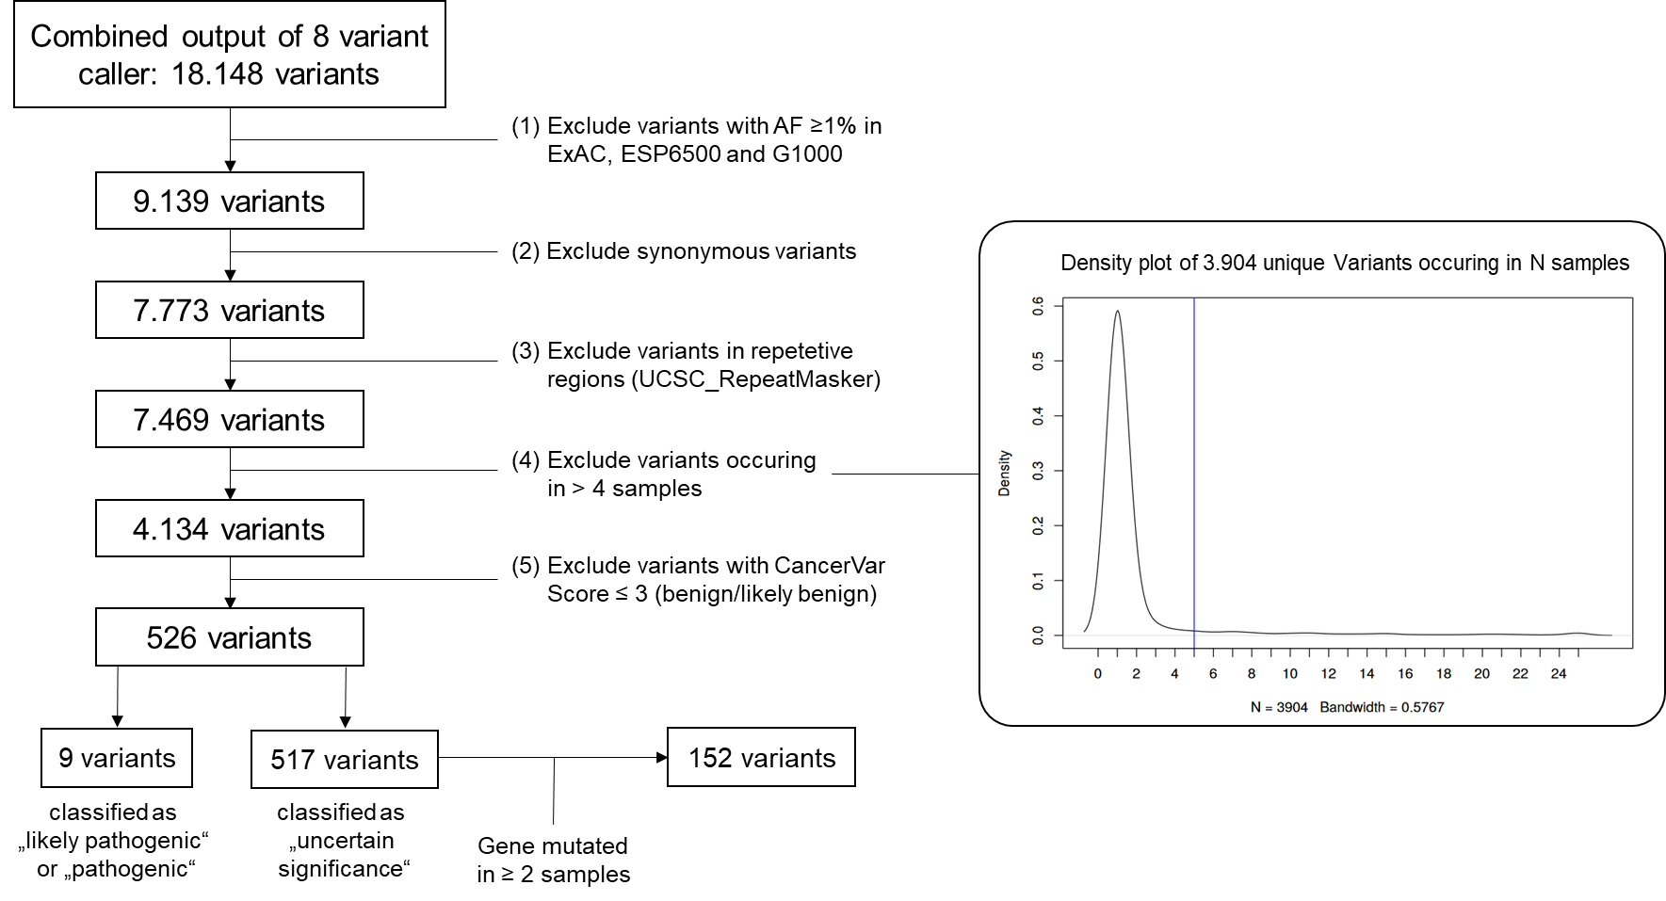
Figure S9: Schematic representation of the filtration strategy. Of 18.148 calls, (1) variants that were common in the ExAC, ESP6500 and G1000 population databases (frequency ≥ 1%) were excluded. Next (2), synonymous variants and (3) variants that map to repetitive regions in the genome (as defined by the UCSC repeat masker) were excluded because these regions are more prone to artifacts and variants in repetitive regions are rather unlikely to represent oncogenic alterations. Manual inspection of the remaining 7469 variants (containing 3904 unique variants) revealed a high number of variants that likely represent artifacts (especially if they occur in >80% of the samples). Since recurrent oncogenic mutations in tumor suppressor genes occur at different positions, we (4) excluded variants that occur in > 4 samples. Discarded variants were checked for oncogenic hotspot mutations with the CancerVar algorithm. Next, (5) variants being predicted as benign/likely benign by the CancerVar algorithm were excluded resulting in 526 variants. Of those, a total of 9 variants were classified as likely pathogenic / pathogenic and 517 variants were classified as “uncertain significance”. Of the latter, 152 variants occurred in genes being affected in ≥ 2 samples.

Slide 10
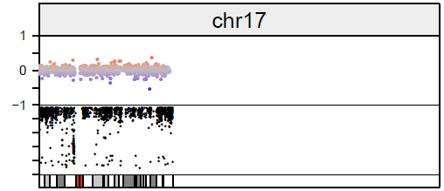
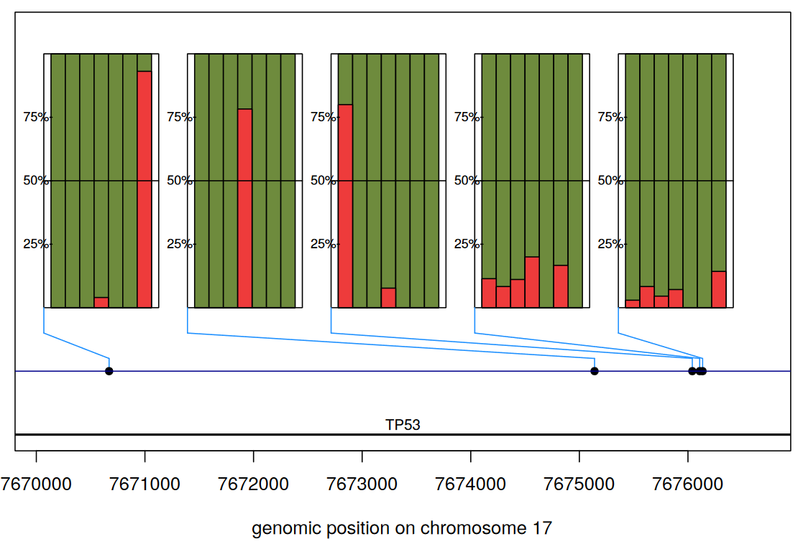
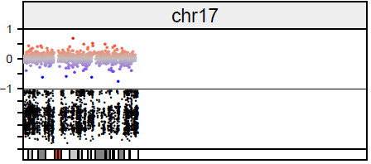
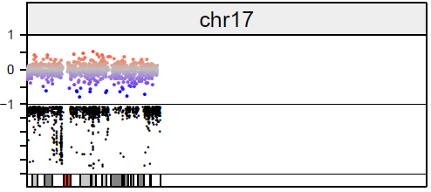
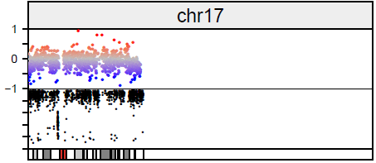
A
B
1 2 3 4 5 6 7
1 2 3 4 5 6 7
1 2 3 4 5 6 7
1 2 3 4 5 6 7
1 2 3 4 5 6 7
VAF CNV
CPC-1
VAF CNV
CPC-2
VAF CNV
aCPP-1
VAF CNV
CPP-9
1 = CPP-9
2 = aCPP-1
3 = CPC-1
4 = CPC-2
5 = CPP-30
6 = CPC-4
7 = CPC-6
Figure S10: Allelic imbalances on chromosome 17 in whole exome and RNA-sequencing data of TP53-mutated cases. A, combined copy-number and variant allele frequency (VAF) plot derived from whole exome sequencing data of four TP53-mutated cases showing copy-neutoral loss of heterozygosity (CN-LOH) of whole chromosome 17 in CPC-1, aCPP-1 and CPP-9. B, Allelic imbalances of single nucleotide polymophisms (SNPs) within the TP53 gene in all seven TP53-mutated samples.

Slide 11
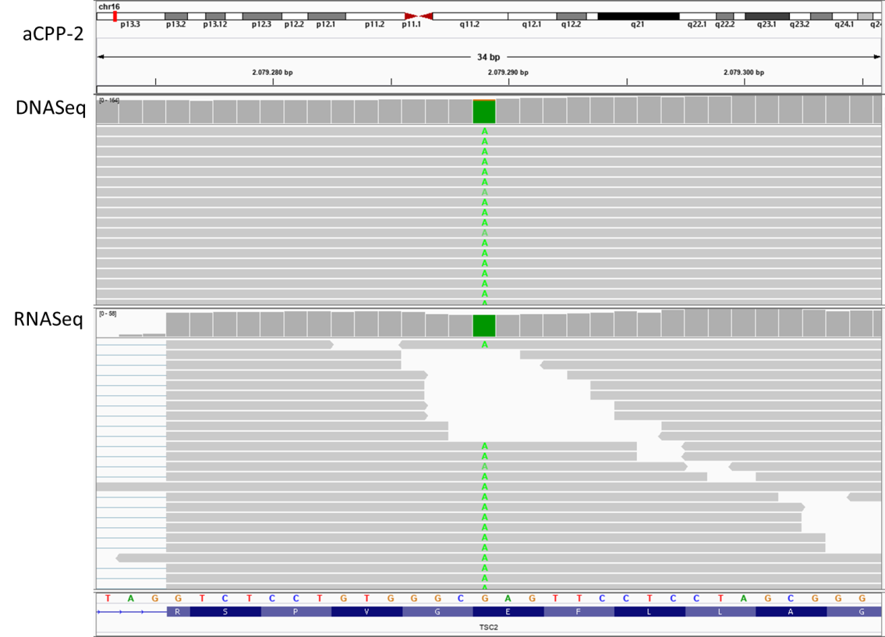
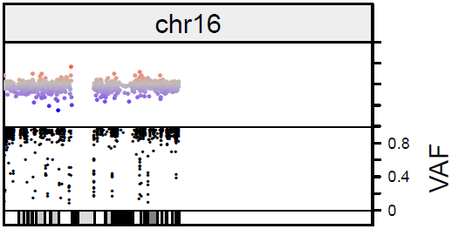
A
B
TSC2 (NM_001318831) c.G2413A;p.E805K
1
-1
VAF CNV
aCPP-2
Figure S11: Allelic imbalance of the TSC2 c.G2413A;p.E805K variant on chromosome 16 in whole exome and RNA-sequencing data of aCPP-2. A, IGV screenshot of the c.G2413A;p.E805K variant in whole exome (top track) and RNA-seq data (bottom track) of aCPP-2. B, a combined copy-number and variant allele frequency (VAF) plot derived from whole exome sequencing data of aCPP-2 showing copy-neutoral loss of heterozygosity (CN-LOH) of chromosome 16.

Slide 12
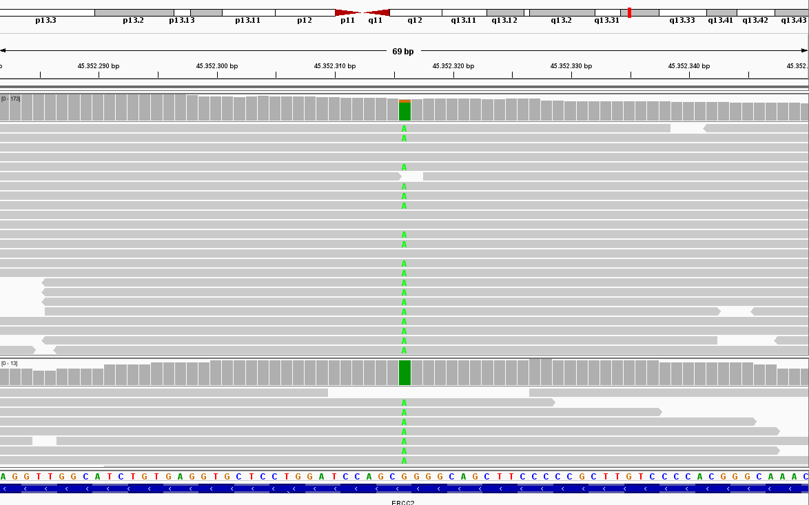
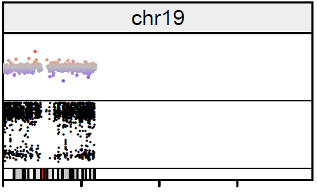
A
B
ERCC2 (NM_000400) c.C2083T;p.R965C
CPC-3
DNAseq
1
-1
VAF CNV
RNAseq
CPC-3
Figure S12: Allelic imbalance of the ERCC2 c.C2083T;p.R965C variant on chromosome 19 in whole exome and RNA-sequencing data of CPC-3. A, IGV screenshot of the c.C2083T;p.R965C variant in whole exome (top track) and RNA-seq data (bottom track) of CPC-3. B, a combined copy-number and variant allele frequency (VAF) plot derived from whole exome sequencing data of CPC-3 showing copy-neutoral loss of heterozygosity (CN-LOH) of chromosome 19.

Slide 13
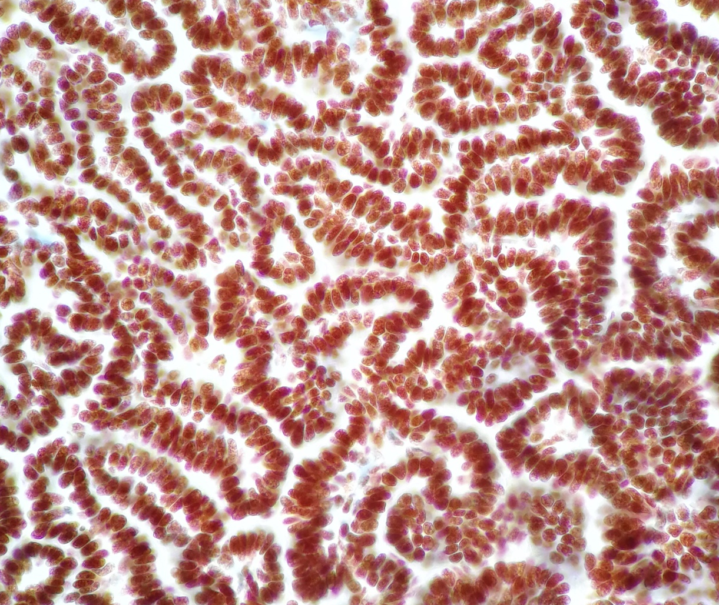
Figure S13: Immunohistochemistry for BRG1/SMARCA4. Immunohistochemistry for BRG1/SMARCA4 (rabbit monoclonal, 1:200, abcam, cat# ab110641) shows retained expression in sample CPP-5.

Slide 14
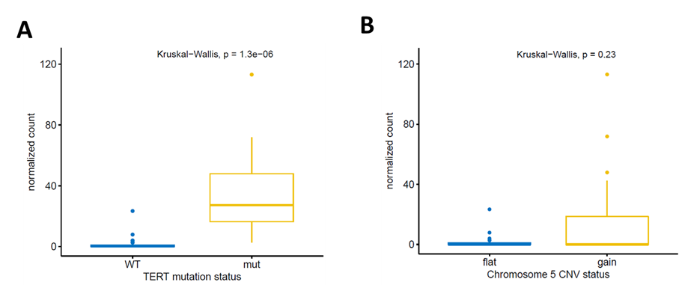
Figure S14: TERT expression levels. TERT expression levels (normalized counts) accoring to (A) TERT promotor mutation status (C228T and C250T) was significantly higher in mutated cases as compared to cases without promotor mutation (38.8 vs. 1.3 normalized counts; Kruskal-Wallis test, p= 1.3x10⁻⁶), whereas there was no association with chromosome 5 copy-number status (B).

Slide 15
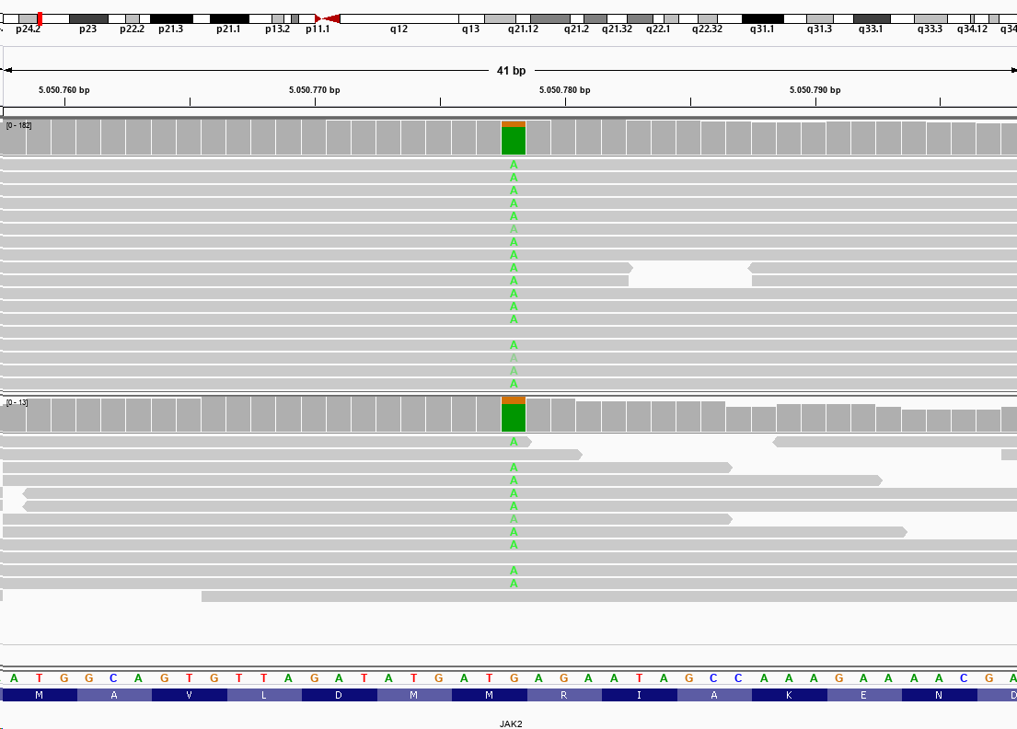
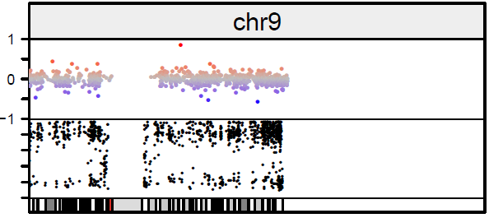
A
B
JAK2 (NM_001322204) c.G114A;p.M38I
CPC-3
DNAseq
RNAseq
VAF CNV
Figure S15: Allelic imbalance of the JAK2 c.G114A;p.M38I variant on chromosome 9 in whole exome and RNA-sequencing data of CPC-3. A, IGV screenshot of the c.G114A;p.M38I variant in whole exome (top track) and RNA-seq data (bottom track) of CPC-3. B, a combined copy-number and variant allele frequency (VAF) plot derived from whole exome sequencing data of CPC-3 showing copy-neutral loss of heterozygosity (CN-LOH) of chromosome 9.

Slide 16
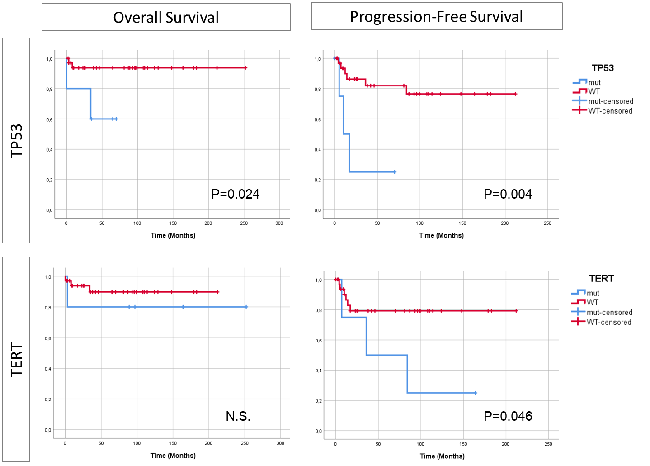
Figure S16: Overall and progression-free survival of 39 CPTs according to TP53 and TERT mutation status. Upper panel: TP53 status was significantly associated with overall survival (log-rank test, p=0.024) and progression-free survival (log-rank test, p=0.004). Bottom panel: TERT status was not associated with overall survival, but with progression-free survival (log-rank test, p=0.046)

