Slide 1
Figure E4. Rotating MIP images of PET_{ASC} (left) and PET_{DL} (right) that are shown in Figure E3, in terms of low-uptake pseudo-patterns in the (a) colon, (b) stomach, (c-d) abdomen and (e) chest; and in terms of (f) low-contrast missing patterns in the heart.
CT -less Direct Correction of Attenuation and Scatter in the Image Space
Performed by Using Deep Learning for Whole-Body FDG PET: Potential Benefits and Pitfalls

Slide 2
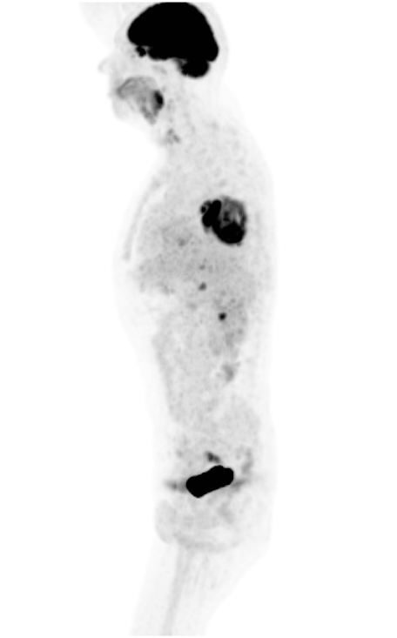
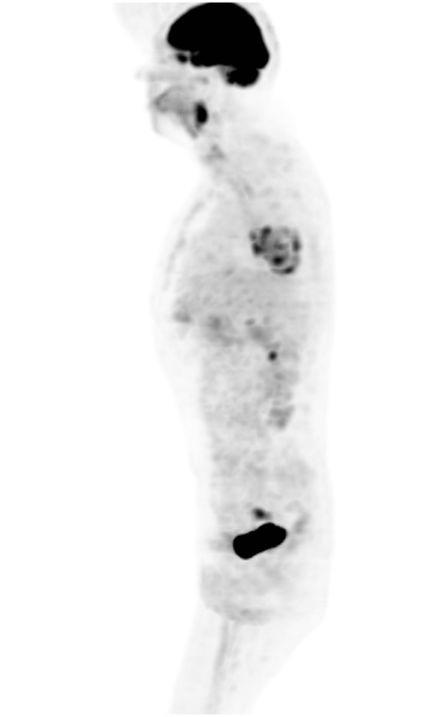
(a) Male, 55 years old

Slide 3
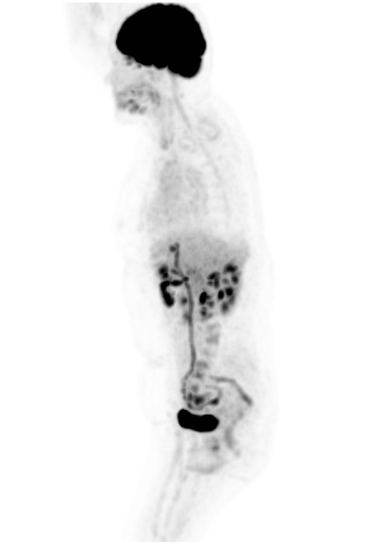
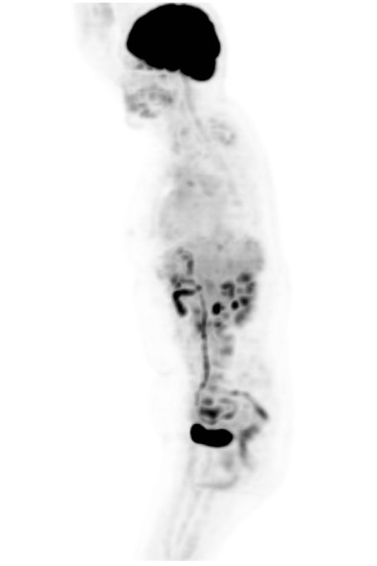
(b) Female, 58 years old

Slide 4
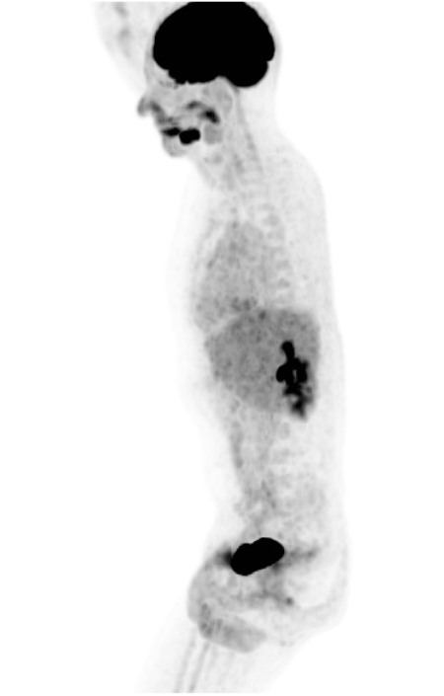
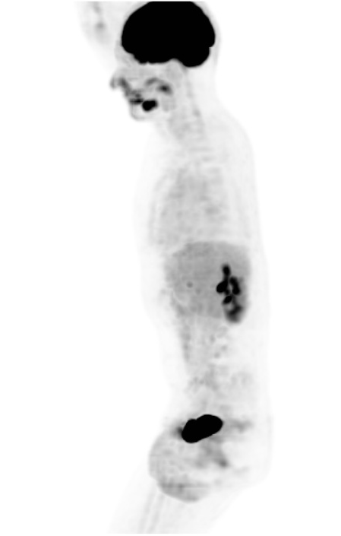
(c) Male, 36 years old

Slide 5
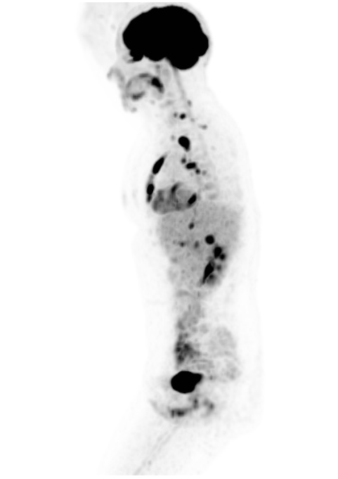
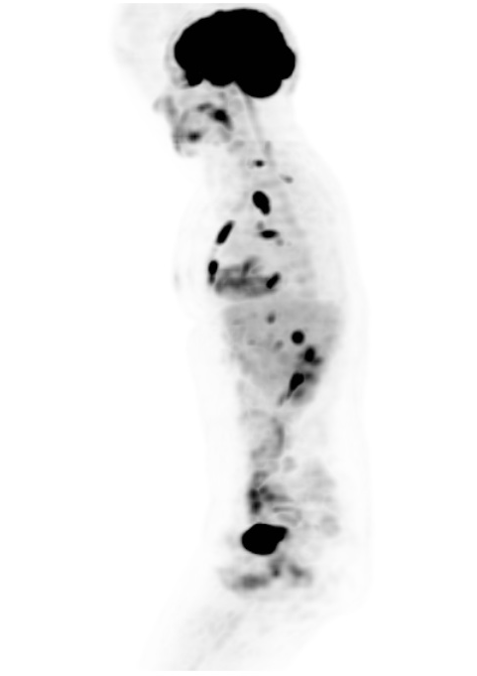
(d) Female, 34 years old

Slide 6

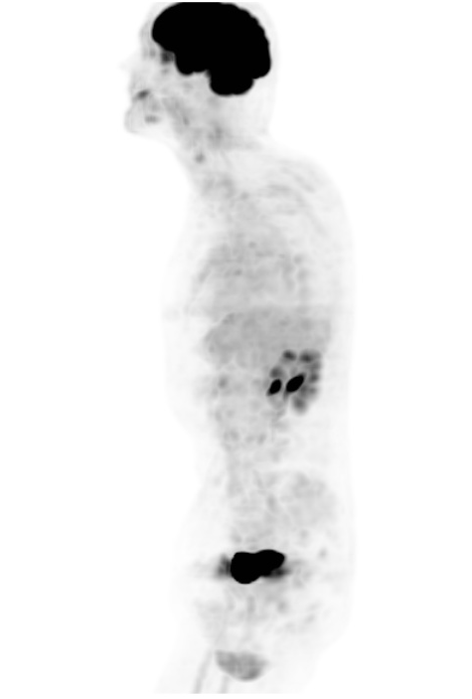
(e) Male, 69 years old

Slide 7
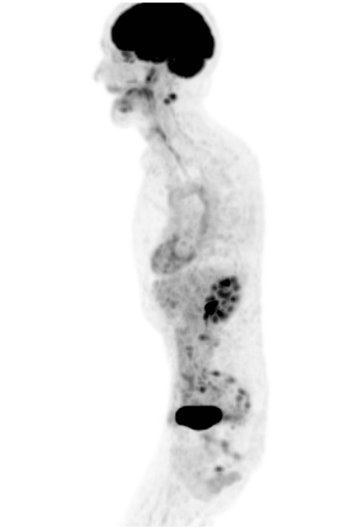
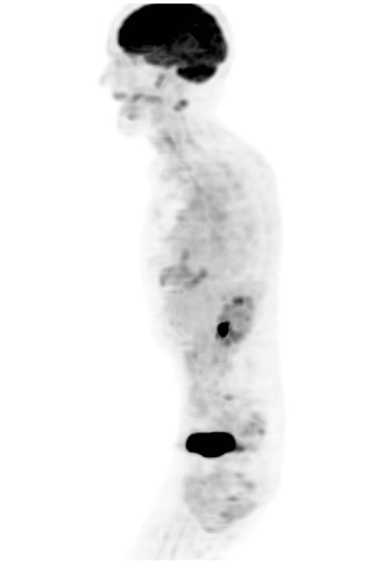
(f) Male, 65 years old

