Slide 1
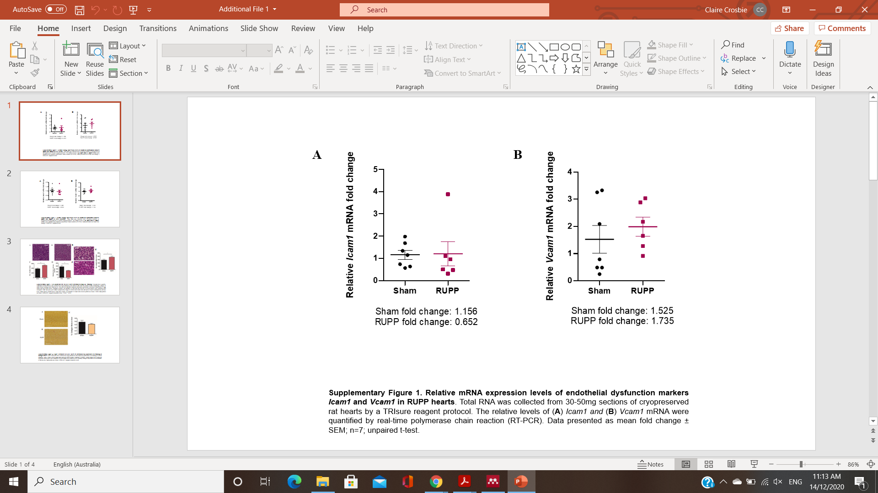
Additional Figure 1

Slide 2
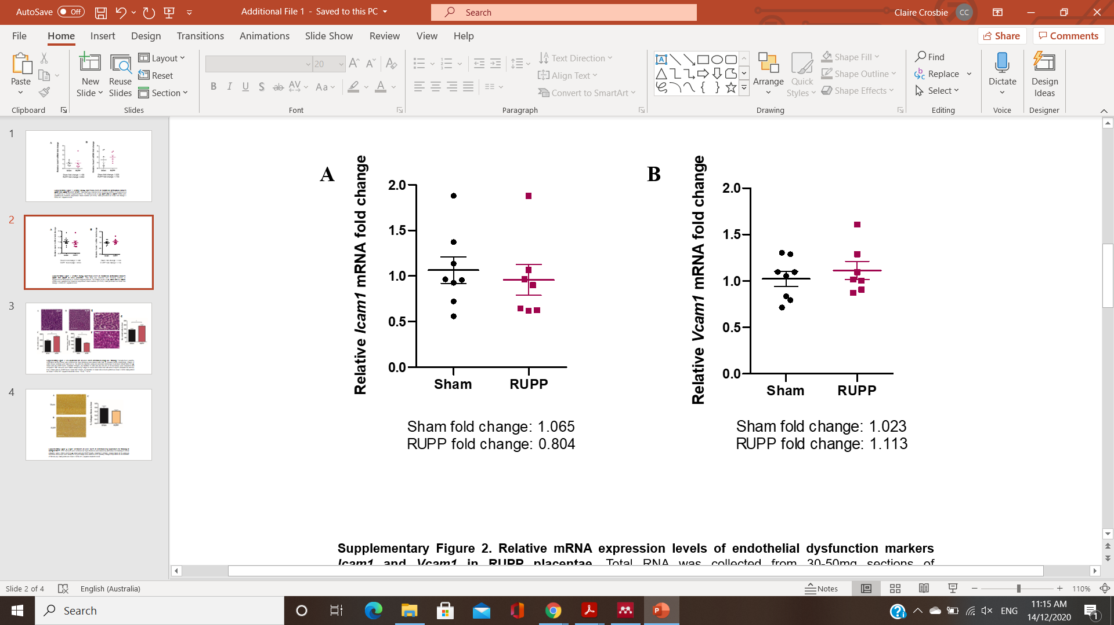
Additional Figure 2

Slide 3
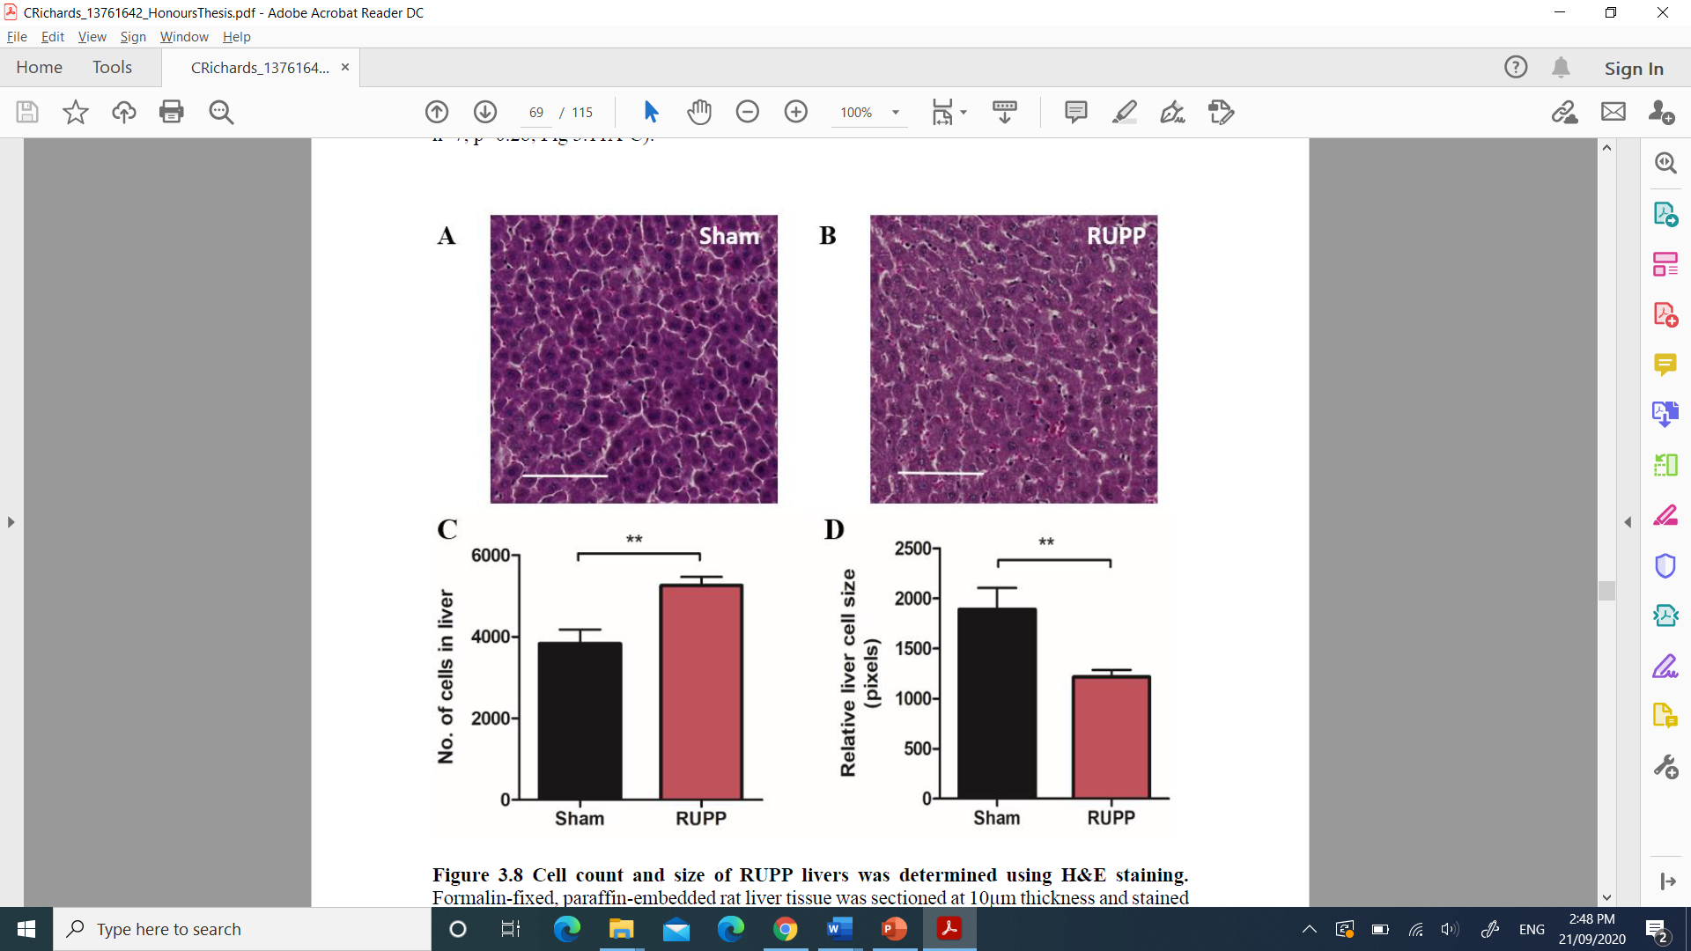
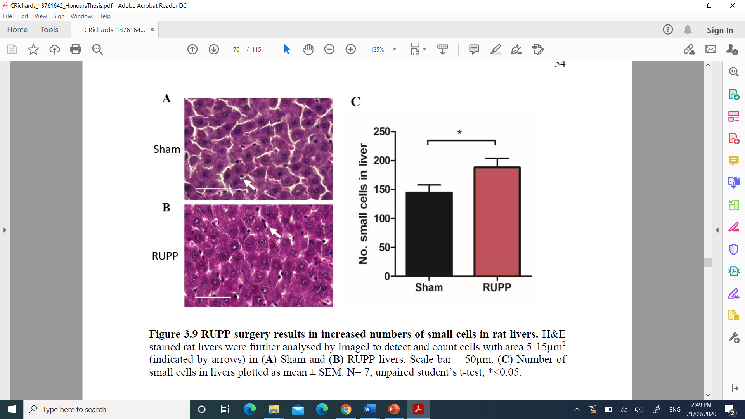
Additional Figure 3
A
B
E
Sham
RUPP
C
Sham
D
F
G
RUPP

Slide 4
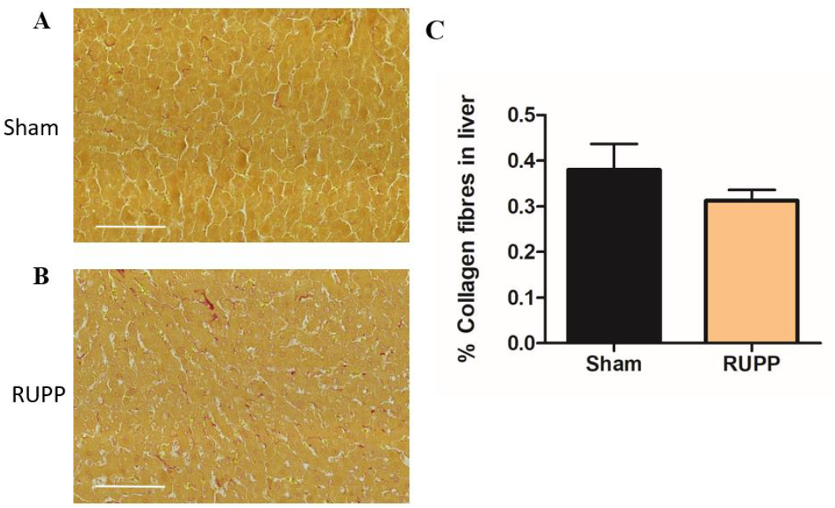
Additional Figure 4

