Slide 1
Supplementary Figures

Slide 2
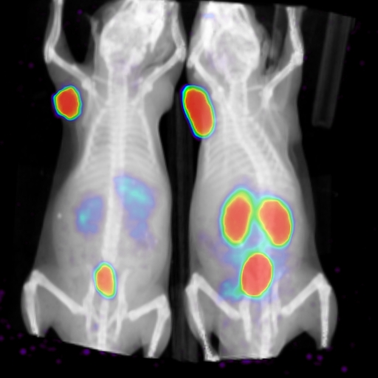
Supplementary Fig. 1
A
Type I
Type II
B
Type I
Type II
Supplementary Figure 1. A. Type I (with high tumor and high kidney uptake) and Type II (with high tumor and low kidney uptake) imaging agents, at 2 h post-injection. Figures were adapted from references [20] [21] (main text). B. The same ligand can be modified as Type I (left, ¹²⁵I-L1, no Lu) vs. Type II (right, after complexation with Lu, Lu- ¹²⁵I-L1), SNM Annual Meeting, Abstract no. 2490, 2018. (SPECT-CT was acquired at 2 h post-injection. Mice were administered with the radiotracers via tail vein ~5 min apart.)
PSMA-
PSMA+
Type I
Type II

Slide 3
Supplementary Fig. 2
Supplementary Figure 2. SPECT/CT imaging after administration of ¹⁷⁷Lu-L8 (111 MBq)
PSMA+ PC3 PIP
Tumor

Slide 4
Supplementary Fig. 3
Supplementary Figure 3. Kaplan–Meier survival plot of the treatment groups and control group (saline injection, 9 mice) after administration of single dose of 111 MBq of ¹⁷⁷Lu-PSMA-617 (9 mice), ¹⁷⁷Lu-L1 (10 mice) ¹⁷⁷Lu-L3 (10 mice), ¹⁷⁷Lu-L5 (10 mice) at 8 weeks post-treatment (Experiment 1)

Slide 5
Supplementary Fig. 4
Supplementary Figure 4. Relative tumor volume (V_{t}/V_{o} ) (top) and body weight (bottom) of individual mouse of the control group with saline treatment (n = 9) (Experiment 1)

Slide 6
Supplementary Fig. 5
Supplementary Figure 5. Relative tumor volume (V_{t}/V_{o} ) of individual mouse of the group treated with ¹⁷⁷Lu-PSMA-617 (n = 9, dose 111 MBq) (Experiment 1)

Slide 7
Supplementary Fig. 6
Supplementary Figure 6. Relative tumor volume (V_{t}/V_{o} ) (top) and body weight (bottom) of individual mouse of group treated with ¹⁷⁷Lu-L1 (n = 10, dose 111 MBq) (Experiment 1)

Slide 8
Supplementary Fig. 7
Supplementary Figure 7. Relative tumor volume (V_{t}/V_{o} ) (top) and body weight (bottom) of individual mouse of group treated with ¹⁷⁷Lu-L3 (n = 10, dose= 111 MBq) (Experiment 1)

Slide 9
Supplementary Fig. 8
Supplementary Figure 8. Relative tumor volume (V_{t}/V_{o} ) of individual mouse of group treated with ¹⁷⁷Lu-L5 (n = 10, dose 111 MBq) (Experiment 1)

Slide 10
Supplementary Fig. 9
Supplementary Figure 9. Relative tumor volume (Vt/Vo), body weight and survival data ¹⁷⁷Lu-1 and ¹⁷⁷Lu-PSMA-617 (Dose 111 MBq) (Experiment 1)

Slide 11
Supplementary Fig. 10
Supplementary Figure 10. Relative tumor volume (V_{t}/V_{o} ) (top) and body weight (bottom) of individual mouse of the experiments with 37 MBq dose (Experiment 2)

Slide 12
Supplementary Fig. 11
Supplementary Figure 11. Relative tumor volume (V_{t}/V_{o} ) (top) and body weight (bottom) of individual mouse of the experiments with 111 MBq dose (Experiment 2)

Slide 13
Supplementary Fig. 12
Supplementary Figure 12. Relative tumor volume (V_{t}/V_{o} ) (left) and body weight (right) of individual mouse of the control group with saline treatment (n = 4) for the experiments with 37 MBq and 111 MBq doses vs control group (Treatment Experiment 2).

Slide 14
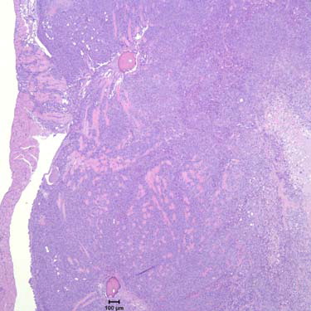
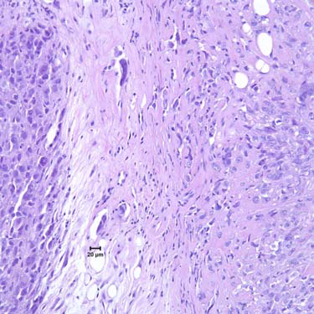
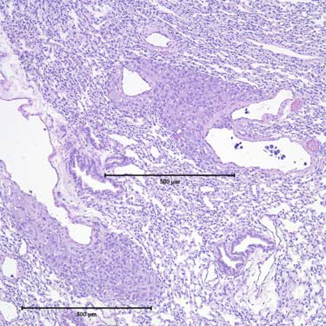
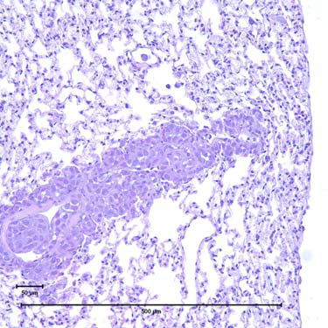
Supplementary Fig. 13
A
B
C
D
Supplementary Figure 13. H&E of selected tissues of a mouse treated with ¹⁷⁷Lu-PSMA-617 after 8 weeks.
Body wall Primary tumor (4.8 x orig magnification)
Higher magnification A, with intravascular tumor cells (24 x orig magnification).
(12x orig magnification)
(24x original magnification) lung, metastatic lesions, and intravascular tumor cells.

Slide 15
Supplementary Fig. 14
Supplementary Figure 14. Body-weight changes of tumor-free healthy CD-1 mice after single-administration of 111 MBq of ¹⁷⁷Lu-L1 (n = 3) and control group with saline injection (n =2).

Slide 16
Supplementary Fig. 15
Supplementary Figure 15. Representative H&E staining of selected normal organs A [low (scale 50 μm) and B, high resolution] of the tumor-free healthy CD-1 mice after one year administration of a single dose of 111 MBq of ¹⁷⁷Lu-L1 and the control group with saline treatment.
A
B
¹⁷⁷Lu-L1
1500 μm
1000 μm
10 μm
¹⁷⁷Lu-L1
^{Control}

Slide 17
Supplementary Fig. 16
Supplementary Figure 16. ¹⁷⁷Lu-radioactivity associated with plasma proteins or in soluble fraction 2 h after administration in mice (n = 2) of ¹⁷⁷Lu-L1 or ¹⁷⁷Lu-L9.

Slide 18
Scheme 1
Reagents and conditions: (a) NaBH₃CN, MeOH; (b) Boc-5-amino valeric acid, TSTU, DIPEA, DMF or Boc-6-aminohexanoic acid N-hydroxysuccinimide ester, Et₃N, DMF, overnight, rt; (c) TFA/CH₂Cl₂ (1:1); (d) 3a or 3c, DOTA-monoamide-NHS, DIPEA, DMSO, rt, 3h; (e)¹⁷⁷Lu⁺³/Lu^{+3,} pH ~4-5, 0.2 NH₄OAc, 5 min microwave at 40 watts at 95°C.

Slide 19
Scheme 2
Reagents and conditions: (a) DIPEA, DMF, rt, 16h; (b) TSTU, DMAP, TEA, DMSO, 4h;
(c) TFA/CH₂Cl₂ (1:1); (d) 3b or 3d, DIPEA, DMSO.

Slide 20
Scheme 3
ªReagents and conditions: (a) TEA, DMF; (b) (i) N‐Boc‐1,4 diaminobutane, DIEA,CH₂Cl₂; (ii) TFA/CH₂Cl₂ (1:1); (c) DIPEA, DMSO, 3h.

Slide 21
Scheme 4
Reagents and conditions: (a) (i) TSTU, DIPEA, DMF, RT for 1 h; (ii) 20% piperidine/DMF ; (b) DOTA-GA anhydride, DIPEA, DMSO, 3h (c) TFA/CH₂Cl₂ (1:1).

Slide 22
Scheme 5
(a) DIPEA, DMSO; (b) TFA/CH₂Cl₂ (1:1).

Slide 23
Scheme 6
(a) NaBH₃CN, MeOH; (b) Boc-5-amino valeric acid, TSTU, DIEA, DMF; (c) TFA/CH₂Cl₂ (1:1); (d) DOTA-monoamide-NHS, DIPEA, DMSO, rt, 3h.

Slide 24
Scheme 7
ªReagents and conditions: (a) TSTU, DIEA, DMF; (b) 16, triethyl amine, DMSO, 2 h.

