Slide 1
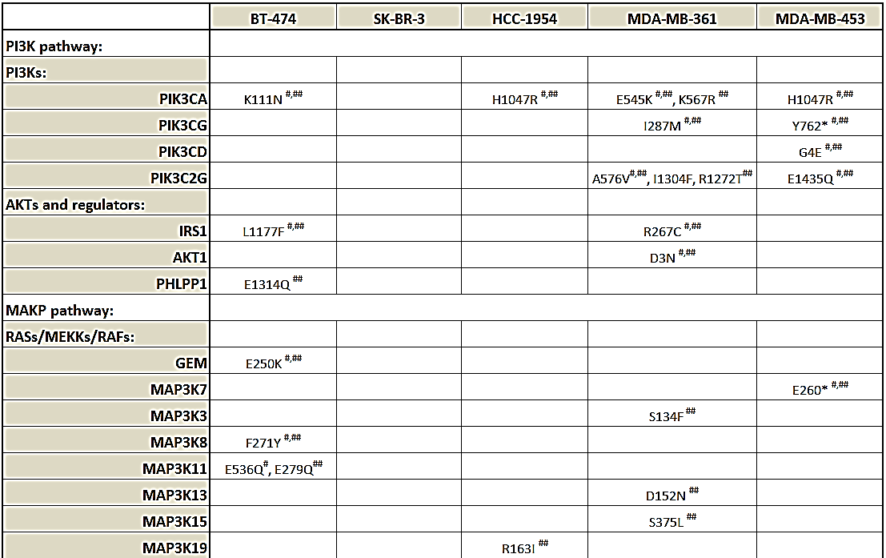
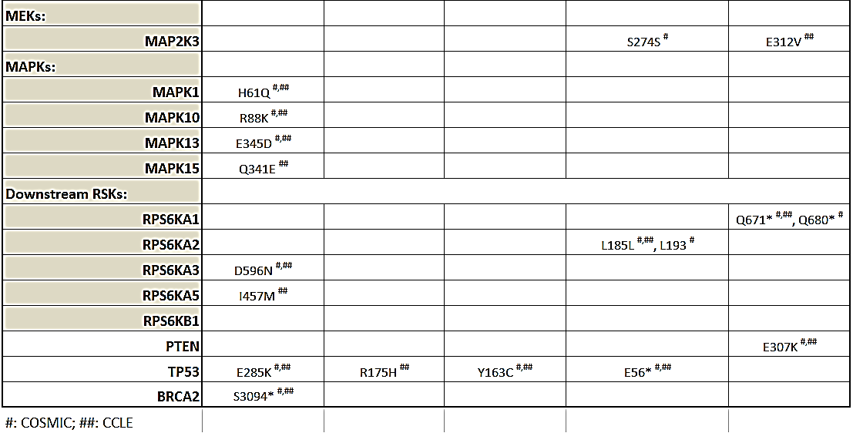
Supplemental table 1. Genomic mutations in the PI3K and MAPK pathways

Slide 2


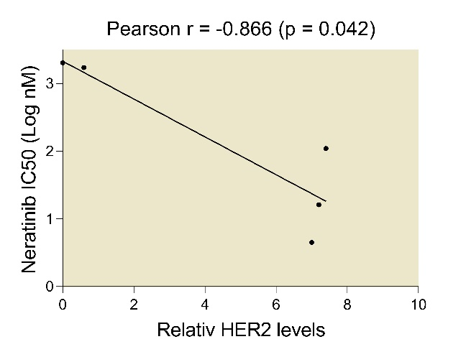
Supplemental Figure 1
A
C
MDA-MB-453
MDA-MB-361
BT-474
SK-BR-3
HCC-1954
HER2
β-actin
B
BT-474
SK-BR-3
HCC-1954
MDA-MB-361
MDA-MB-453
D
BT-474
SK-BR-3
HCC-1954
MDA-MB-361
MDA-MB-453

Slide 3
Supplemental table 2. Cell line sensitivity to neratinib and inhibitors targeting to the MAPK and PI3k/Akt pathways
Cell line | Neratinib | Trametinib | Alpelisib | Everolimus | Sapanisertib | Palbociclib
BT-474 | 4.5 | 72 | 1,035 | 1.2 | 4.5 | > 10,000
SKBR-3 | 16 | 15 | 1,229 | 0.8 | 4.0 | > 10,000
HCC-1954 | 110 | 15 | 455 | 0.1 | 8.1 | > 10,000
MDA-MB-361 | 1,716 | n/a | 555 | n/a | 12 | > 10,000
MDA-MB-453 | 2,024 | n/a | 325 | 1.0 | 11 | > 10,000

Slide 4
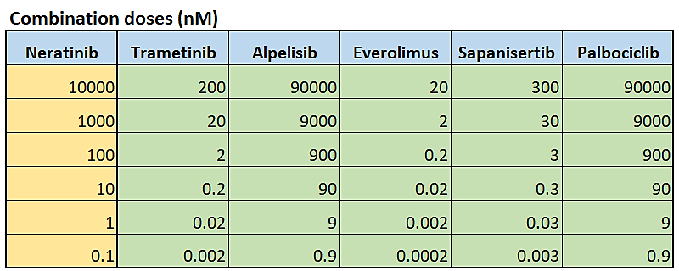
Supplemental Figure 2
A
Neratinib + Trametinib
B
Neratinib + Alpelisib
C
Neratinib + Everolimus
D
Neratinib + Sapanisertib
E
Neratinib + Palbociclib
Supplemental Table 3

Slide 5
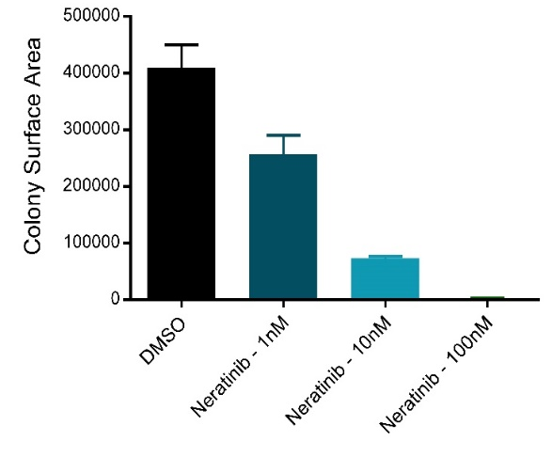
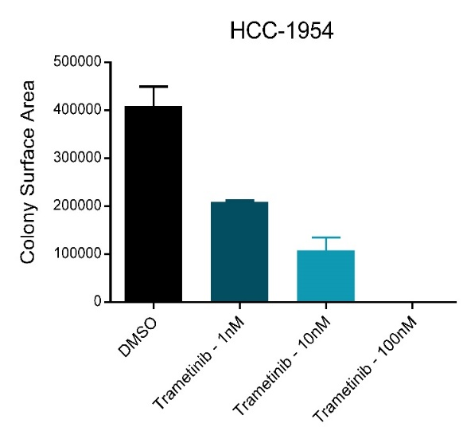
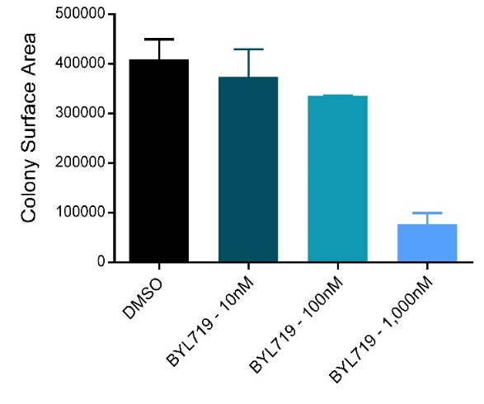
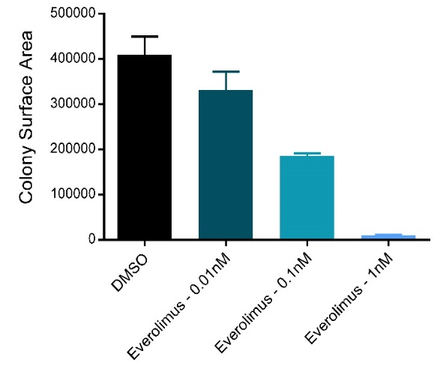
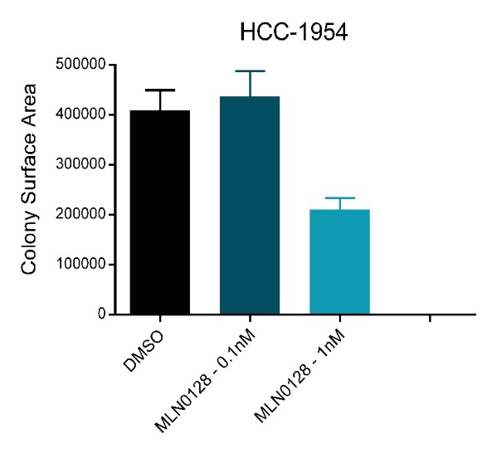
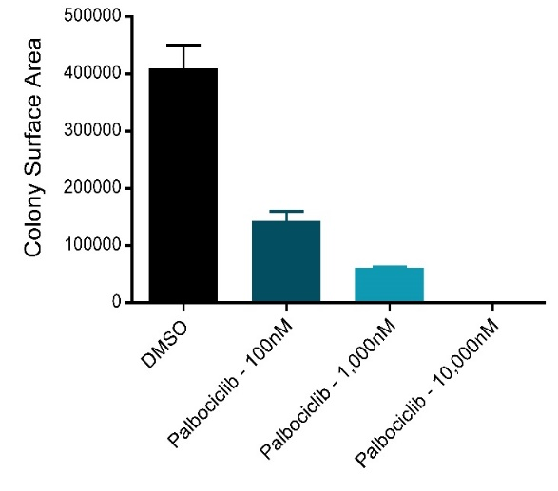
Suppl Fig 3
Neratinib (nM)
Trametinib (nM)
C
Alpelisib (nM)
A
B
0 1 10 100
0 1 10 100
0 10 100 1000
D
Everolimus (nM)
E
Sapanisertib (nM)
F
Palbociclib (nM)
0 0.01 0.1 1
0 0.1 1
0 100 1000 10000

Slide 6
Supplemental Figure 4
A
B
C
Neratinib + Trametinib
Neratinib + Everolimus
Neratinib + Alpelisib
D
Neratinib + Sapanisertib
E
Neratinib + Palbociclib

Slide 7
Supplemental Figure 5
A
B
C
D
E
F
G
H
I

Slide 8
Supplemental Figure 6
A
B
C
D
E

Slide 9
Supplemental Figure 7
A
B
C
D

Slide 10
Supplemental
Figure 7 (cont.)
F
E
G
H
I

Slide 11
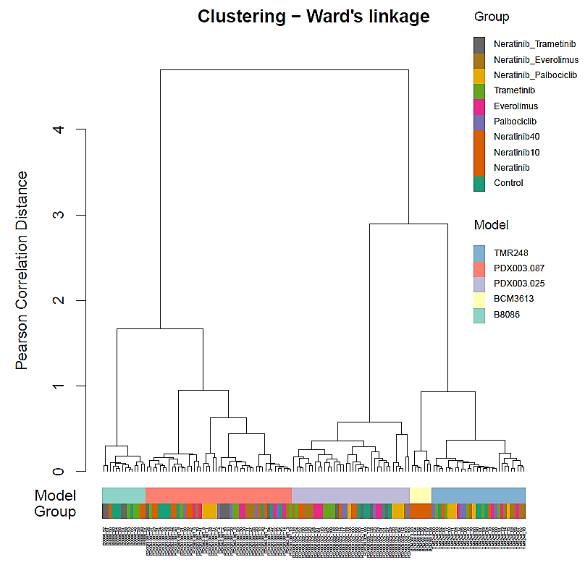
Supplemental Figure 8
Unsupervised hierarchical clustering of the PDX samples

Slide 12
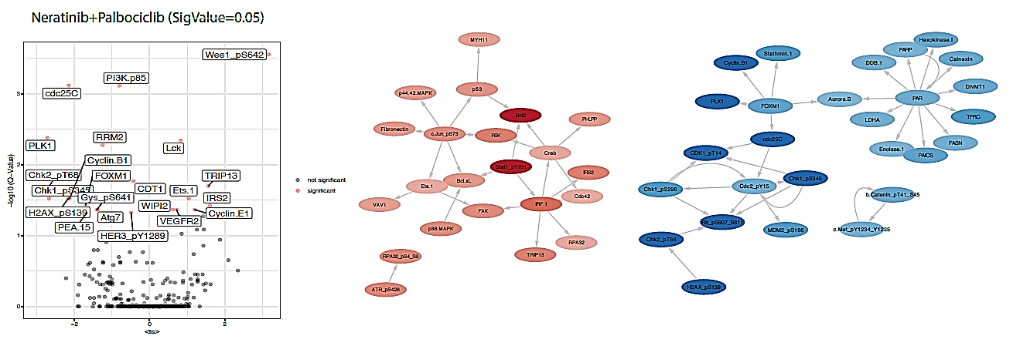
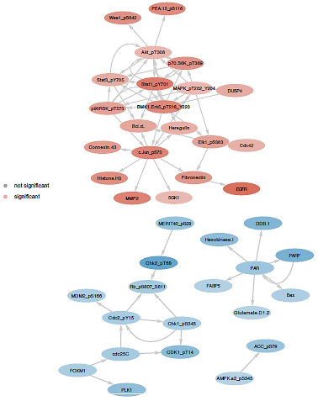
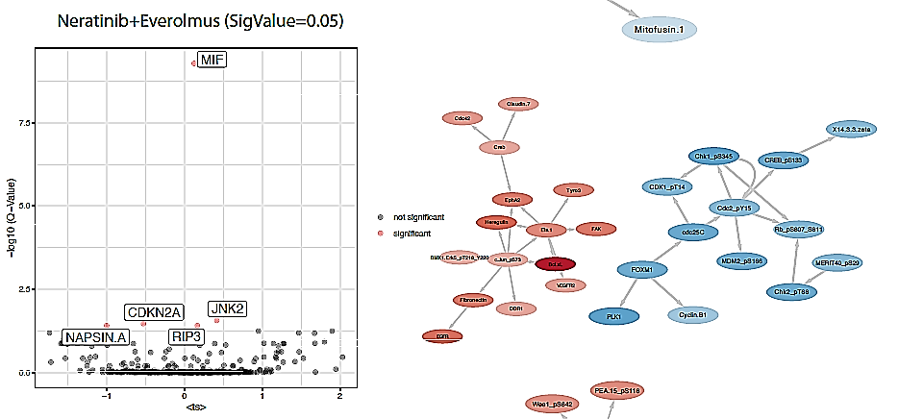
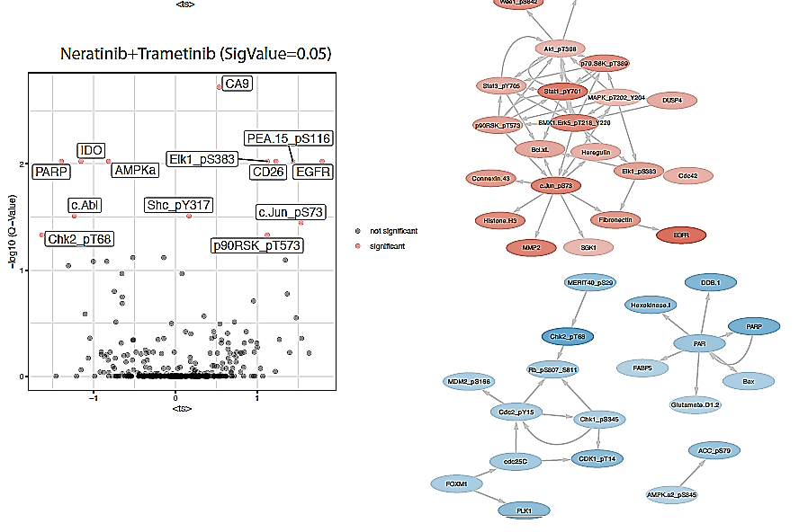
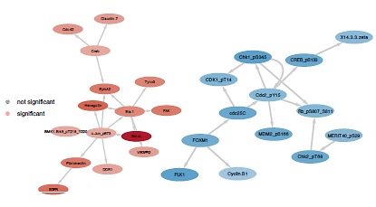
Suppl Figure 9
A
B
C

