Slide 1
Supplemental Presentation 1: Virtual Knee Exam

Slide 2
Core Knee Exam

Slide 3
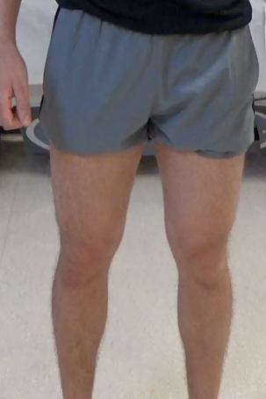
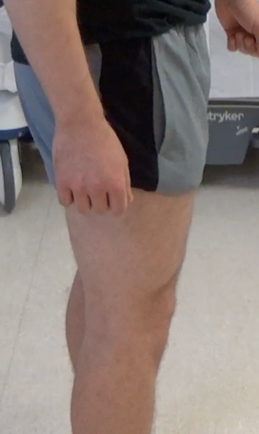
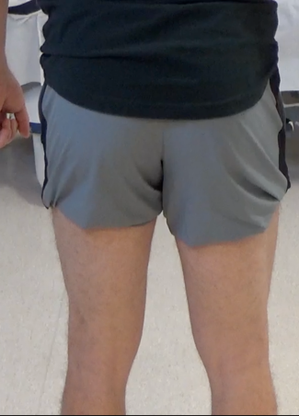
Inspection
Please stand facing the camera so that I can see the front of your knees.
Now, turn sideways so that I can see the injured knee from the side.
Now, turn away from the camera so I can see the back of your knees.
1. Front view
2. Side view
3. Back view

Slide 4
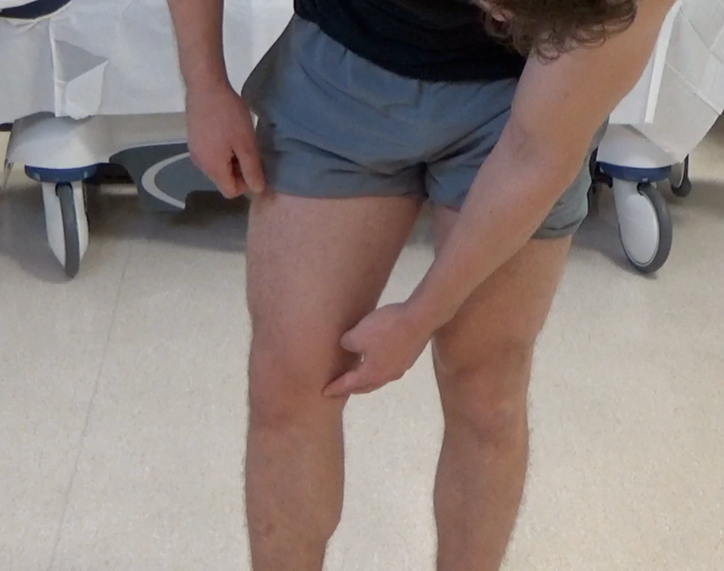
Location of Pain or Deformity
Turn back and face the camera. Have you noticed any deformities? If so, point to the location.
Does your knee hurt anywhere specifically? If so, please point to the location using one finger.

Slide 5
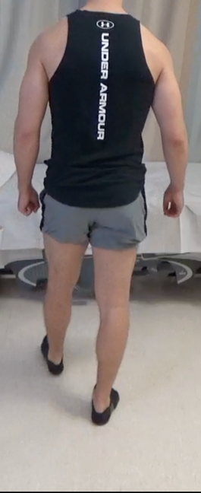
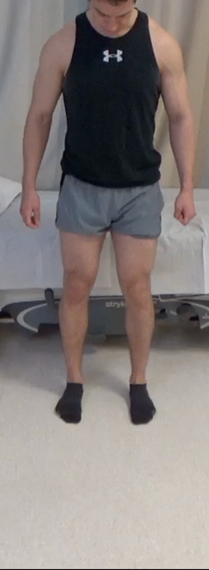
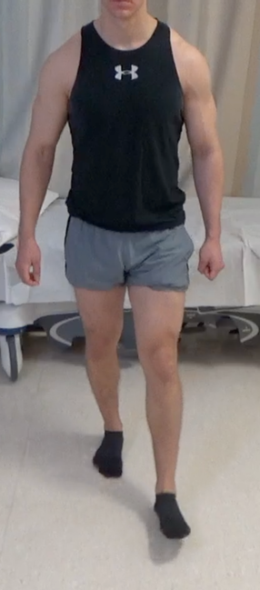
Observation:
Gait & Alignment
Please walk directly away from the camera for at least four steps. Turn around and face the camera.
Stand with your feet shoulder-width apart so that I can see your alignment.
Now walk directly back toward the camera to your starting position. Turn around and walk away from the camera and then again back towards the camera.
1. Walk away
2. Stand
3. Walk back

Slide 6
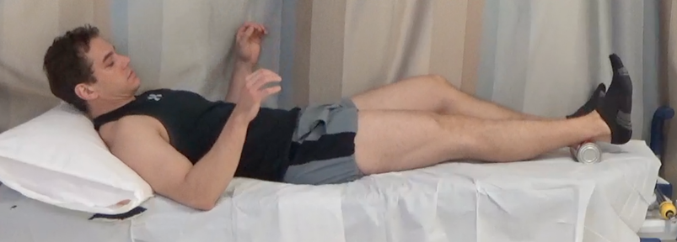
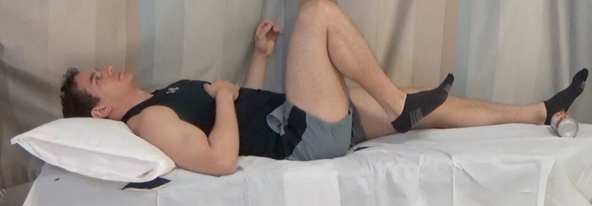
ROM
Fully straighten knee
Lay down on the floor positioned perpendicular to the camera, so that I can see your affected knee from the side. Place a soup can © under your heel.
Straighten out your knee as far as you are able. Try to straighten the knee as much as possible by pushing down and trying to touch the back of your knee to the floor. Does this cause pain?
Now, bend your knee as far as you are able. You can use a towel to assist if you wish. Does this cause pain?
©
Fully bend knee

Slide 7
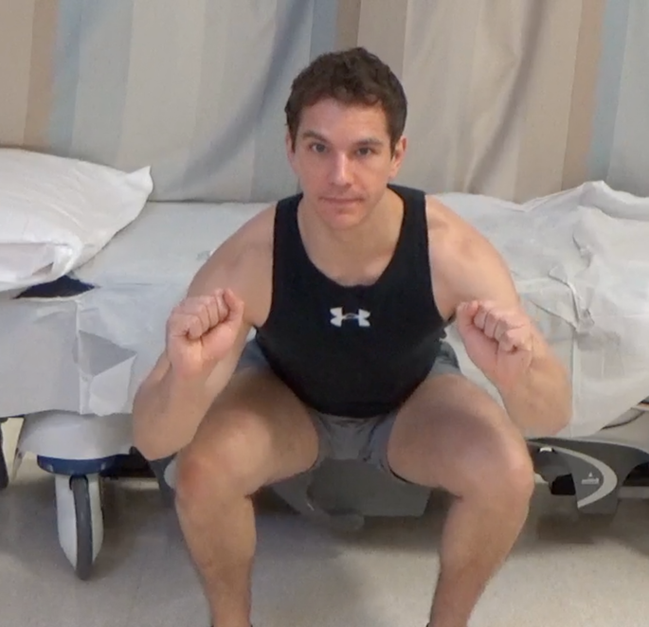
Double-Leg Squat
Face the camera so that I can from your waist to your feet. Standing on both feet, squat down far as you can, hold for one second, and then stand up. Repeat this a second time.

Slide 8
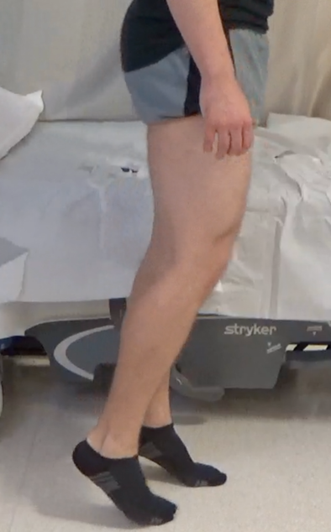
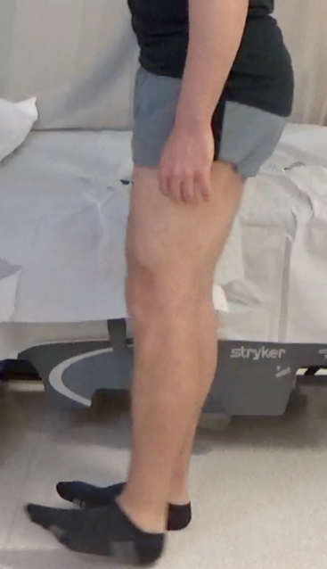
Neurovascular
1. Toe Walk
2. Heel Walk
“Do you have any areas of numbness, burning, or tingling? If so, please point to these areas.
Do you feel weak with any particular movements? If so, what feels weak?
Do the following:
Walk on your toes for several step.
Now turn and walk in the other direction several steps on your heels.

Slide 9
Meniscus Exam

Slide 10
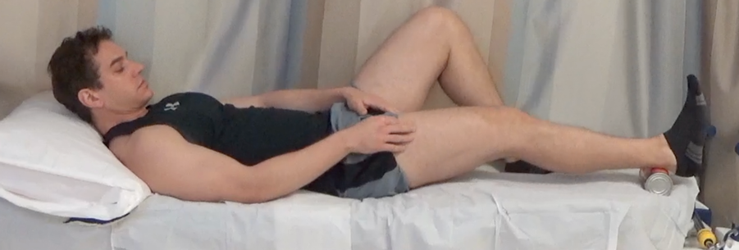
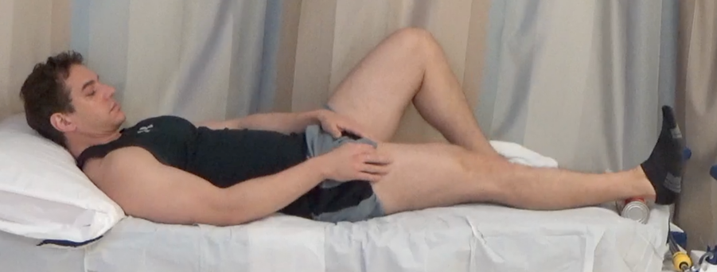
Bounce Test
Bounce knee from small bend to…
Lay down on the floor positioned perpendicular the camera, so that I can see your affected knee from the side. Place a soup can © behind your heel. Slightly bend your knee and then allow it to bounce down so that it is completely straight. Repeat this several times quickly. Does this cause pain?
©
…knee flat to ground and…
Repeat
©

Slide 11
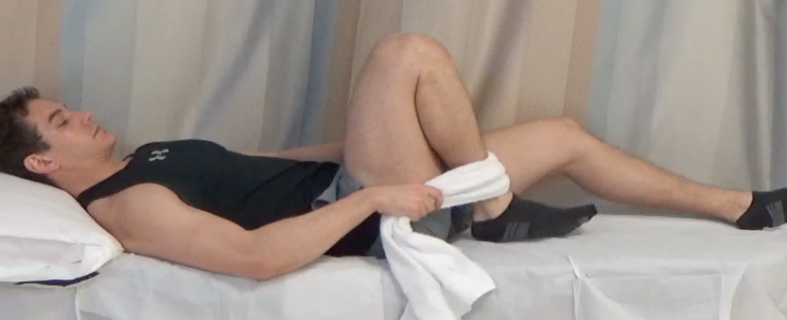
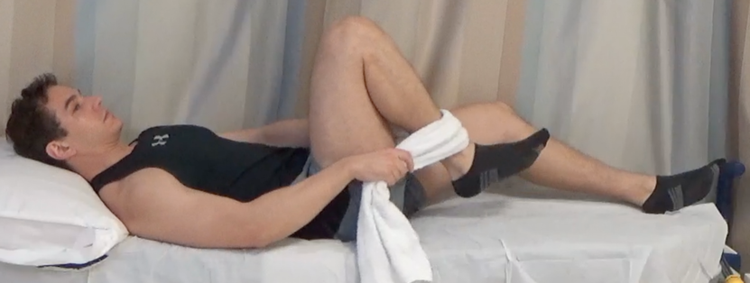
Hyperflexion
Pull heel to buttock then…
Wrap both of your hands or a towel around the front of your ankle. Pull your heel toward your buttock as far as it will go. Relax the towel and then pull it back again several times quickly. Does this cause pain?
…Relax the pull and…
Repeat

Slide 12
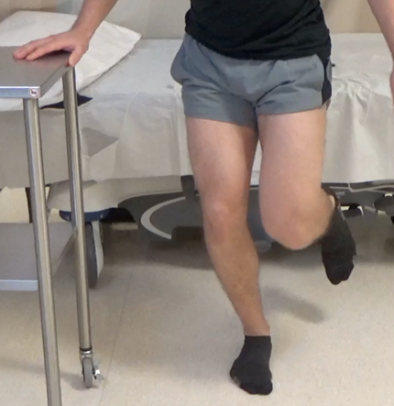
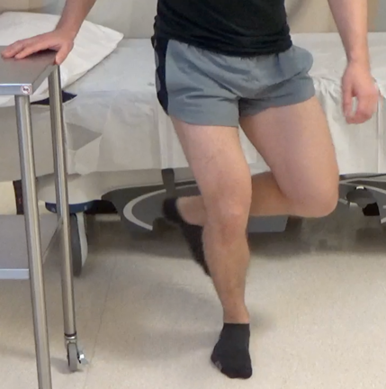
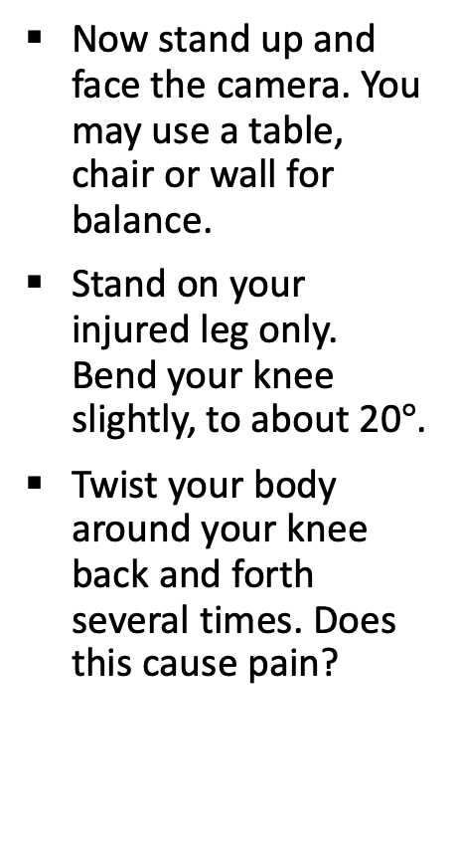
Thessaly
Now stand up and face the camera. You may use a table, chair or wall for balance.
Stand on your injured leg only. Bend your knee slightly, to about 20$°$.
Twist your body around your knee back and forth several times. Does this cause pain?

Slide 13
Ligament Exam

Slide 14
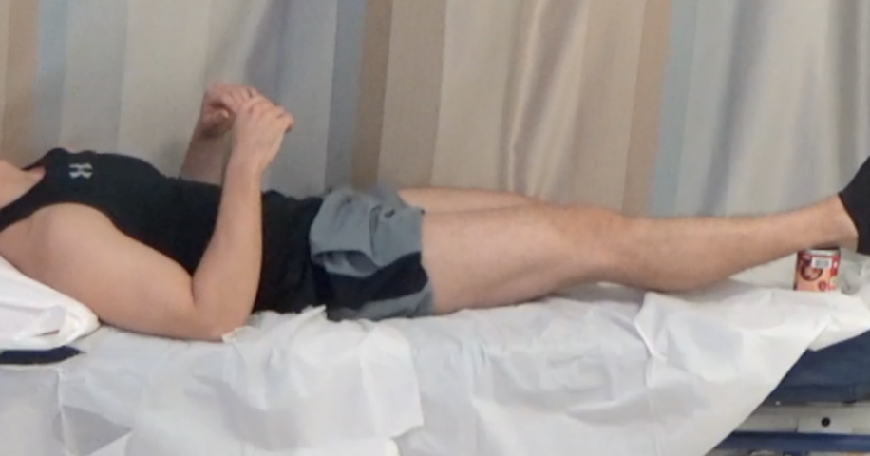
Recurvatum
Lay down on the floor positioned perpendicular to the camera, so that I can see your affected knee from the side. Place a soup can © on its end under your heel and let your muscles relax.
©

Slide 15
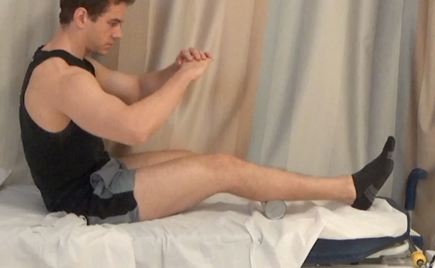
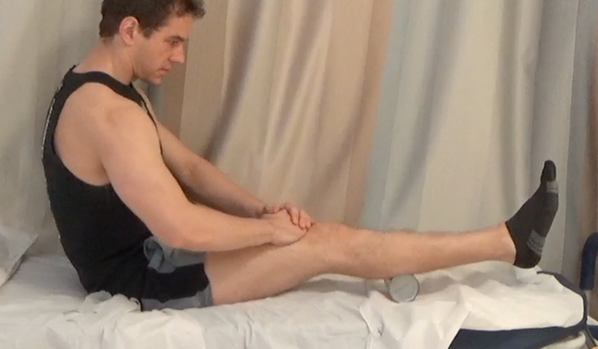
Lever Test
Place the soup can © under the top part of your calf muscle so that your knee is partially bent and your heel touches the floor.
Place the base of your palm just above your kneecap. Using both hands, push down toward the floor.
©
©

Slide 16
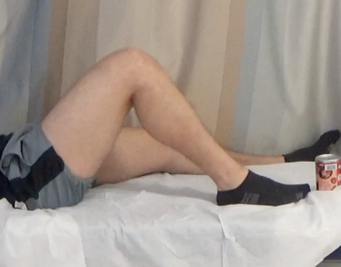
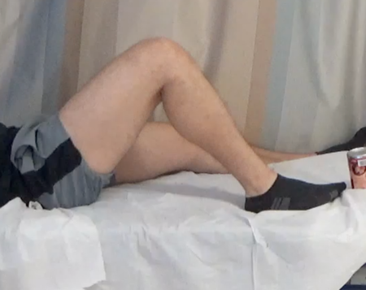

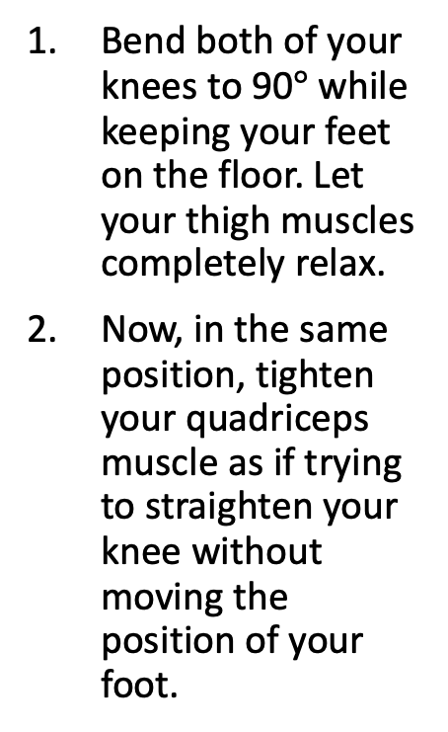
Posterior Sag & Quad Active
Bend both of your knees to 90$°$ while keeping your feet on the floor. Let your thigh muscles completely relax.
Now, in the same position, tighten your quadriceps muscle as if trying to straighten your knee without moving the position of your foot.
1. Relax quad
2. Fire quad

Slide 17
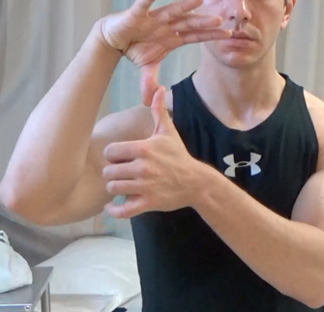
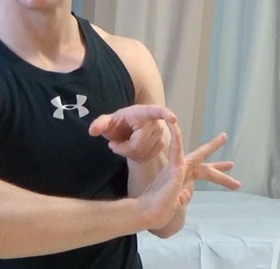
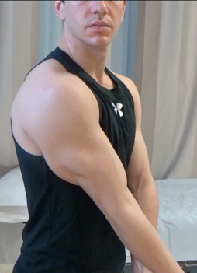
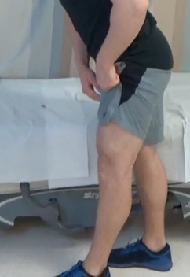
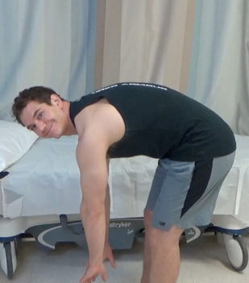
Laxity:
Beighton Criteria
Bend your wrist. Now, bend your thumb down and try to make it touch it to your forearm.
Bend your pinky back as far as it will go.
Stand perpendicular to the camera, straighten your elbows as far as they go.
Step back from the camera and stand perpendicular to it, straighten your knees as far as they go.
Bend at the waist while keeping your knees straight and attempt to place both palms on the floor.
1. Thumb to forearm
2. Pinkie hyperextension
3. Elbow Extension
4. Knee Extension
5. Palms to the floor

Slide 18
Patellofemoral Exam

Slide 19
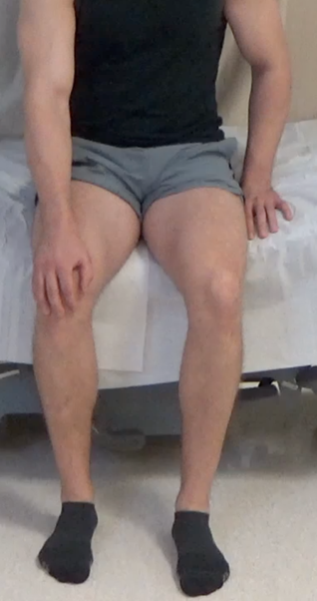
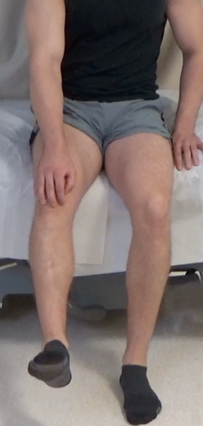
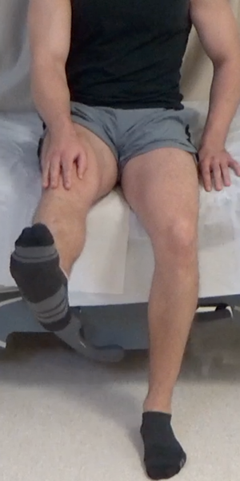
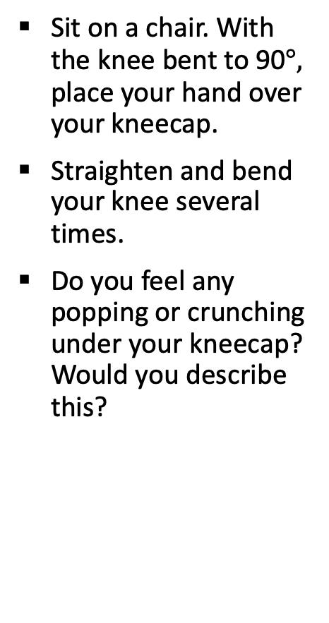
Crepitation
Sit on a chair. With the knee bent to 90$°,$ place your hand over your kneecap.
Straighten and bend your knee several times.
Do you feel any popping or crunching under your kneecap? Would you describe this?

Slide 20
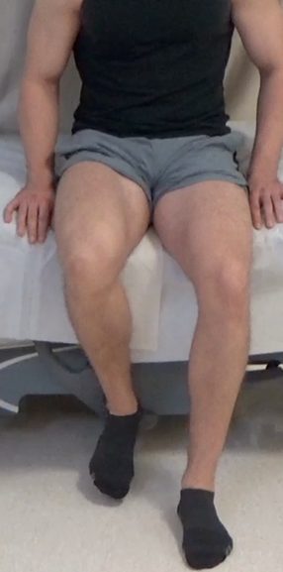
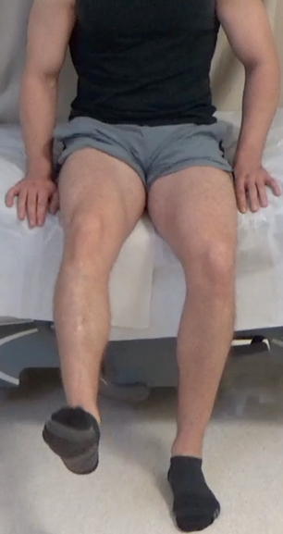
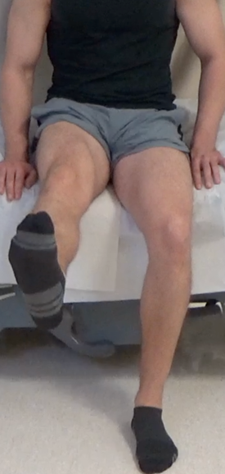
J-Sign
Now, remove your hand covering your kneecap so that I can see it.
Slowly straighten your knee all the way and then bend it. Do this 2-3 times.

Slide 21
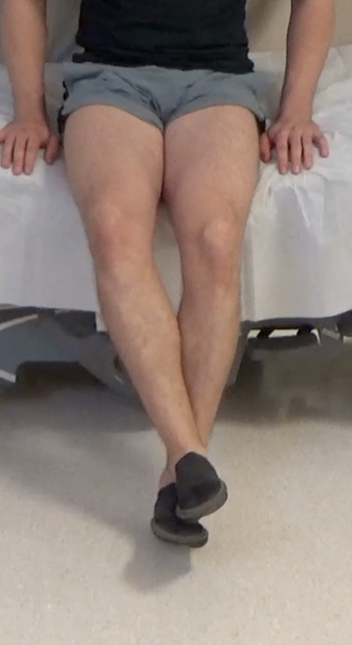
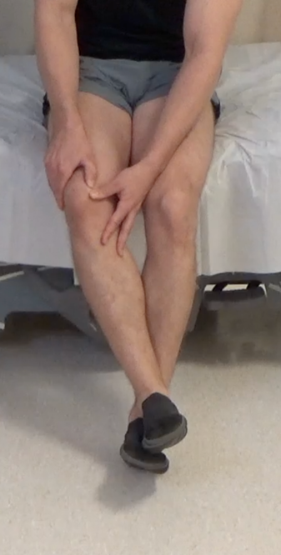
Apprehension
Cross your ankles so that your affected leg is on top. Your knee should be bent 20-30 degrees.
Use both of your thumbs to push the inside part of the kneecap towards the outside of the knee.
Does this make you nervous? Is this painful?

Slide 22
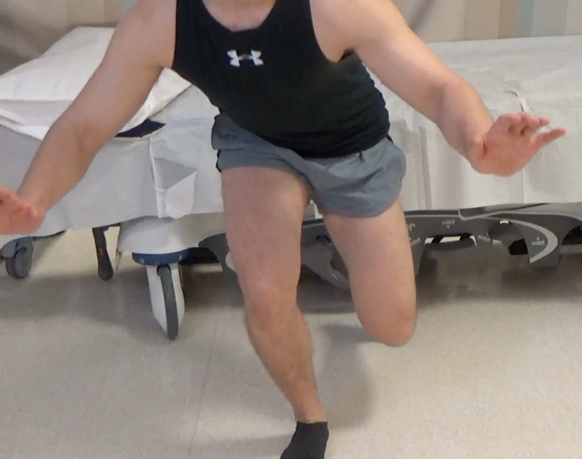
Single-Leg Squat
Stand up facing the camera so that I can at least see you from your waist to your feet. Stand on the unaffected leg. Squat down on one leg as far as you can , and then stand up. Repeat this. Not do the same on the affected leg. Squad down as far as you can, and then stand up. Repeat this.

