Slide 1

Supplemental Figure 1
A)
B)
C)
Cohort 1
Control Diet
Rosiglitazone Diet
Female SCID Beige
4 Weeks
D)
E)
Notes:
Tibia
µCT

Slide 2
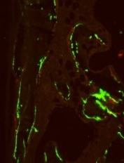
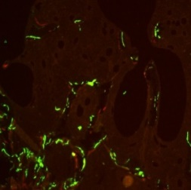
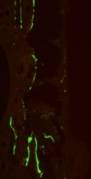
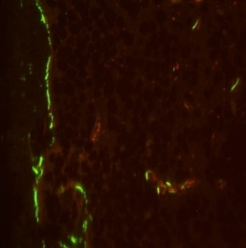
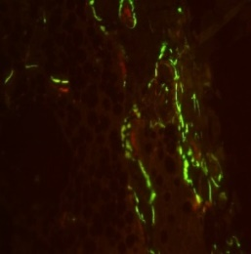
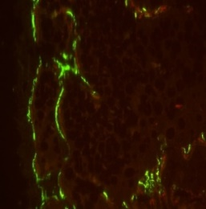
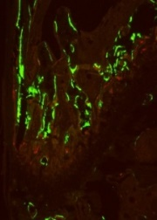
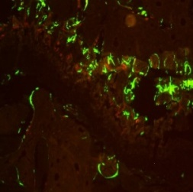
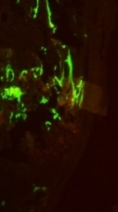
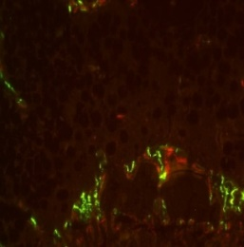
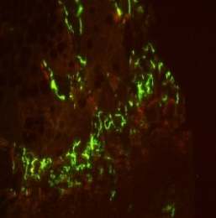
Supplemental Figure 2
A)
Rosiglitazone
B)
Control
C)
D)
Control
Rosiglitazone
Notes:
MAR = mineral apposition rate, rate at which minerals are being produced, It occurs at remodeling sites during bone formation
MS/BS = mineralizing surface per bone surface, reflecting active mineralization

Slide 3
Supplemental Figure 3
A)
B)
C)
D)
E)
F)

Slide 4





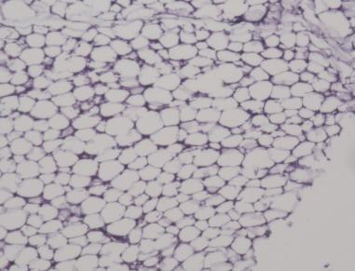
Supplemental Figure 4
A)
Cohort 2
4 Weeks
6 Weeks
Control Diet
Recovery Period
Control Diet + SOST Ab
Rosi Diet
Control Diet
Rosi Diet + SOST Ab
Control Diet + SOST Ab
Female SCID Beige
B)
C)
D)
Visceral Adipose
Inguinal Adipose
Vehicle
SOST Ab
Vehicle
SOST Ab
Control
Rosiglitazone
Notes:
Figure 4

Slide 5
Supplemental Figure 5
A)
B)
C)
4 Weeks
D)
4 Weeks
E)
10 Weeks
F)
10 Weeks

Slide 6
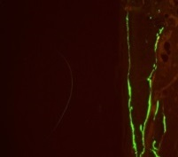
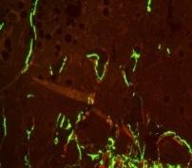
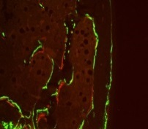
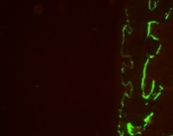
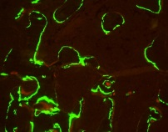
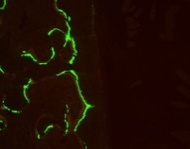
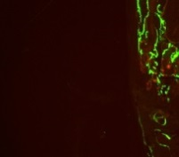
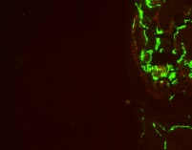
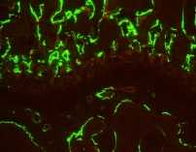
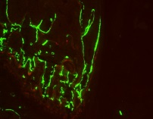
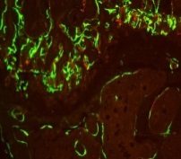
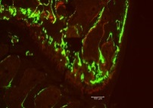
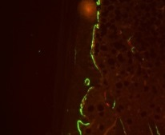
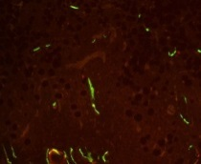
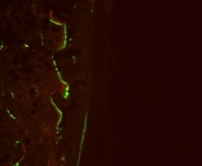
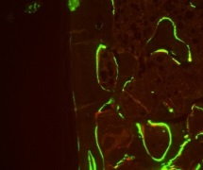
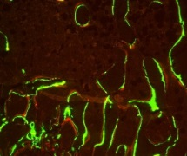
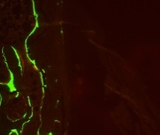
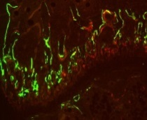
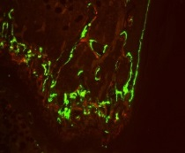
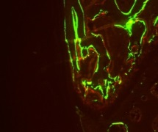
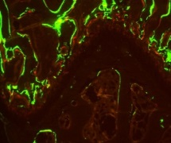
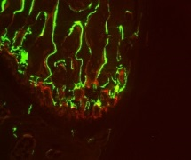
Supplemental Figure 6
A)
B)
C)
D)
Vehicle
SOST Ab
Control
Rosiglitazone
100 µm
Notes:
Tibia µCT

Slide 7
Supplemental Figure 7
A)
Vehicle
SOST Ab
B)
C)
Control
D)
E)
Rosiglitazone
F)
G)

Slide 8
Supplemental Figure 8
A)
B)
C)
D)
E)
F)
G)

