Slide 1
A
SCN1A
chr2
B
stronger
in cortex
stronger
in lung
C
PFC vs. HC | Right Ventricle (RV) | PFC vs. RV
Hippocampus | Pre-Frontal Cortex | Lung
PFC vs. Pancreas | Pancreas | PFC vs. Lung
Figure S1: Tissue and brain regional differences in chromatin conformation.
(A) Hi-C contact heatmaps showing chromosomal neighborhood of SCN1A at different ranges. (B) Contrasting differential Hi-C contact heatmaps showing differences between PFC and lung. (C) Hi-C contact map heatmaps at 40-kb resolution for a 5-Mb region around SCN1A gene. In the central rows and columns are the absolute contact maps, while the corner plots represent the differential contact maps between pre-frontal cortex (PFC) and the indicated tissue. For the latter, red color indicates stronger contacts in PFC in relation to the other tissue, and blue color the opposite.

Slide 2
a
Cortex
Hippocampus
Cerebellum
kDa
WT
1b+/-
1b-/-
kDa
WT
1b+/-
1b-/-
kDa
WT
1b+/-
1b-/-
250
250
250
250
Membrane
fraction
50
50
B-actin
B-actin
50
50
50
β-actin
*
*
ns
**
**
*
b
kDa
kDa
WT
1b+/-
1b-/-
WT
1b+/-
1b-/-
kDa
WT
1b+/-
1b-/-
250
250
250
Cytoplasmic
fraction
50
50
50
β-actin
ns
ns
ns
*
ns
Figure S2: Western blots of Na_{V}1.1 (250 kDa) and β-actin (45 kDa) proteins in P29-32 brain lysates, membrane and cytoplasmic fractions ran separately.
A) Membrane fraction western blot for cortex shows decrease in Na_{V}1.1 protein abundance in 1b^{+/-} (*P=0.0174) and 1b^{-/-} (**P=0.0014) mice. In the hippocampus there is also a decrease in 1b^{+/-} (*P=0.0445) and 1b^{-/-} (**P=0.0025) mice. In the cerebellum there was a decrease in Na_{V}1.1 in 1b^{-/-} (*P=0.0142) compared to WT. B) Cytoplasmic fraction western blot shows a decrease in NaV1.1 in 1b^{-/-} (*P=0.0321) versus wildtype, no other significant changes. 1b^{+/+} n=3, 1b^{+/-} n=3, 1b^{-/-} n=3. ANOVA with Tukey’s post-hoc, significance is versus WT. Error bars represent mean ± SEM. Bands not at 250 and 45 kDa are non-specific and do not show significant changes between genotypes.

Slide 3
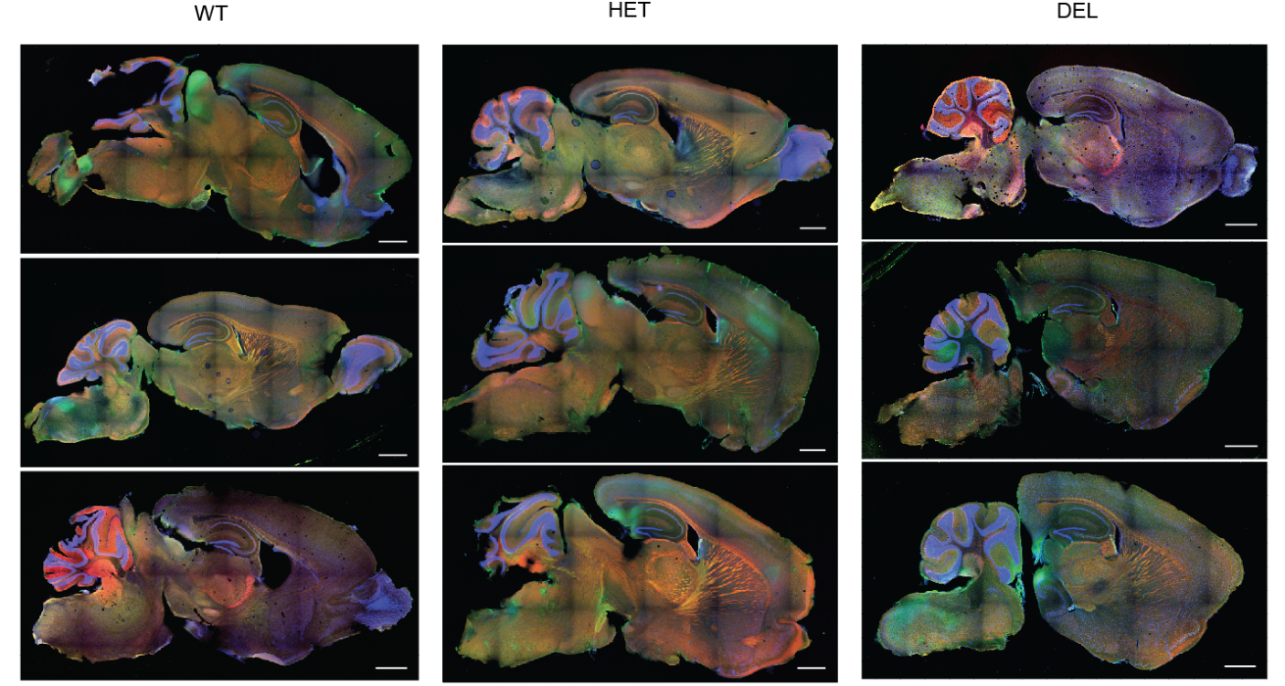
WT
1b^{+/-}
1b^{-/-}
Figure S3: Immunofluorescent analysis of sagittal sections of P28 mice. WT, heterozygous (1b^{+/-}) and knockout (1b^{-/-}) 1b mice (n=3 each genotype) underwent immunohistochemistry (IHC) for Na_{V}1.1 (green) and parvalbumin (red) expression (DAPI shown in blue). No observable difference between WT and 1b^{+/-}. In 1b^{-/-} mice Na_{V}1.1 appears reduced in brainstem (2/3 1b^{-/-}), corpus callosum (3/3) and hippocampus (3/3). No observable difference at the IF level in the cortex. WT in red box presented patchy labelling. Scale bars = 1 mm.

Slide 4
Figure S4: Seizure severity following Pentylenetetrazole (PTZ) administration in C57BL6/N mice. 80 mg/kg was chosen to ensure all seizure stages were reached.

Slide 5
A
B
m1b
m1a
WT1_F_For
WT1_F_Rev
WT1_F_For
WT1_F_Rev
WT2_M_For
WT2_M_Rev
WT2_M_For
WT2_M_Rev
1b+/-_M_For
1b+/-_M_Rev
1b+/-_M_For
1b+/-_M_Rev
1b-/-_M_For
1b-/-_M_Rev
1b-/-_M_For
1b-/-_M_Rev
3 -
WT_M
WT_M
1b+/-_M
1b+/-_M
1b-/-_M
1b-/-_F
WT_M
WT_M
1b+/-_M
1b+/-_M
1b-/-_M
1b-/-_F
C
n=104
D
Category | 1b-/- and 1b+/- Terms | #DE | p-val | FDR
GO:0007218 | neuropeptide signal. path. | 7 | 3.78E-08 | 0.000406
GO:0007610 | behavior | 19 | 2.83E-07 | 0.000869
GO:0045111 | intermed. filament cytoskeleton | 8 | 5.93E-07 | 0.001417
GO:0007186 | GPCR signaling pathway | 16 | 8.50E-07 | 0.001828
GO:0032230 | pos. reg. of syn. trans., GABA. | 4 | 4.41E-06 | 0.006586
GO:0099536 | synaptic signaling | 17 | 1.32E-05 | 0.013482
GO:0043005 | neuron projection | 25 | 2.79E-05 | 0.026058
Figure S5: Differential gene expression with Scn1a 1b deletion in P32 hippocampus. (a) Mouse (mm9) Scn1a and nearby-gene loci for P32 wild-type, 1b^{+/-}, and 1b^{-/-} mice. WT1 refers to mice sequenced with the 1b^{-/-} mutants. WT2 refers to mice sequenced with 1b^{+/-} mutants. (b) Coverage of the m1b (left) and m1a (right) loci across representative P32 wild-type and mutant mice. (c) Scatterplot of differentially-expressed genes meeting a p-value < 0.05 and fold-change > 1.5 threshold in both P32 heterozygous and homozygous 1b deletion datasets. (d) Table showing select pathways enriched in genes having shared differential-expression in both P32 mutant mouse datasets. Ontologies are biological pathways (BP), molecular function (MF), or cellular component (CC).

