Slide 1
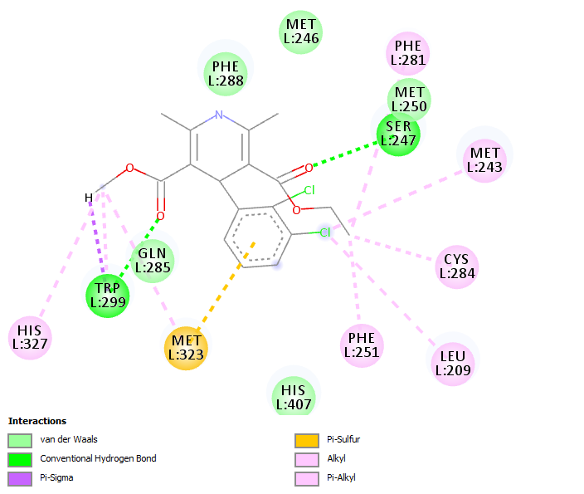
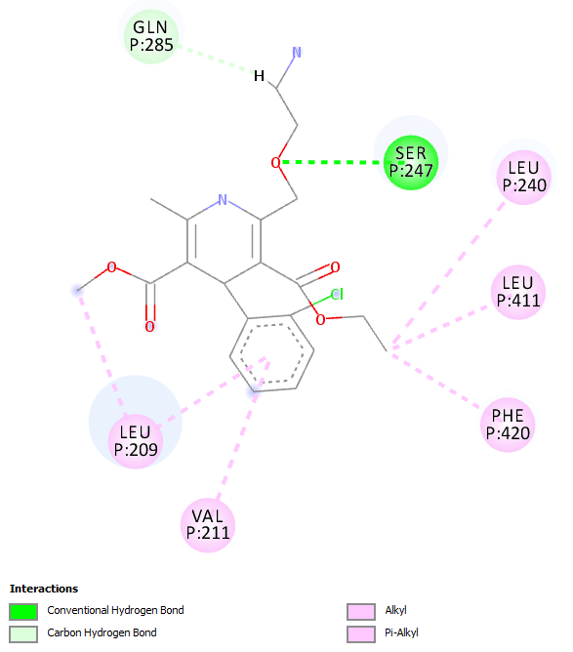
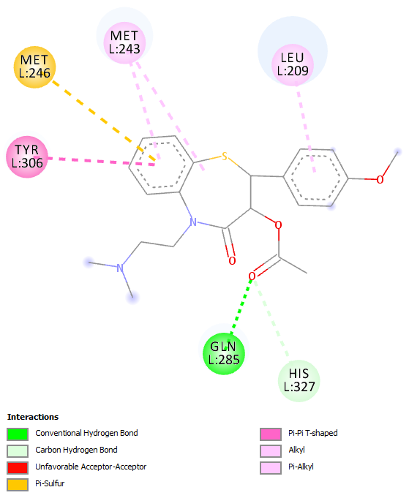
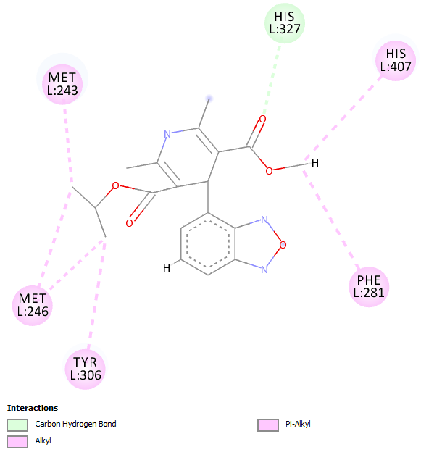
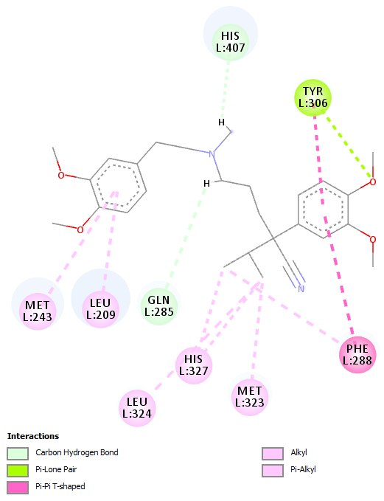
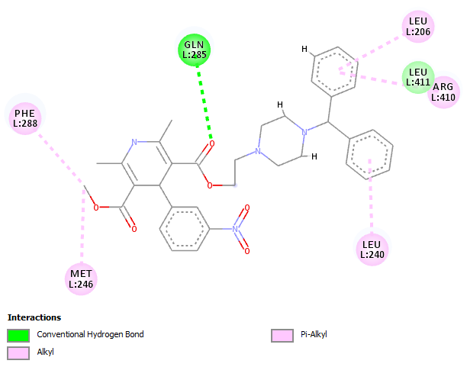
Supplemental Figure 1
A
Felodipine 2D Interaction Plot
B
Amlodipine 2D Interaction Plot
C
Diltiazem 2D Interaction Plot
D
Isradipine 2D Interaction Plot
E
Verapamil 2D Interaction Plot
F
Manidipine 2D Interaction Plot

Slide 2
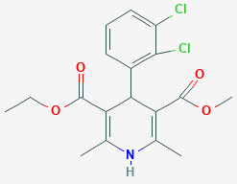
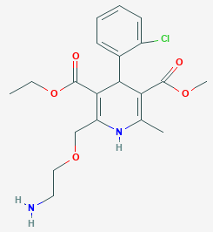
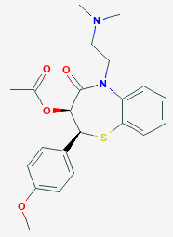
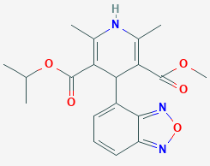
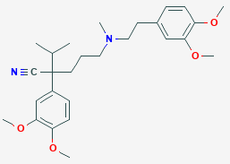
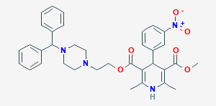
Supplemental Table 1
Compound Name | Structure
Felodipine
Amlodipine
Diltiazem
Isradipine
Verapamil
Manidipine

Slide 3
Supplemental Table 2
Amino acids | Interacting amino acid ID | Number of interacting PDBs (12 Total Cut Off <2)
LEU206 | 206 | 3
LEU209 | 209 | 5
VAL211 | 211 | 4
LEU240 | 240 | 3
MET243 | 243 | 9
MET246 | 246 | 5
SER247 | 247 | 7
MET250 | 250 | 3
PHE281 | 281 | 4
CYS284 | 284 | 4
GLN285 | 285 | 6
PHE288 | 288 | 9
TRP299 | 299 | 10
TYR306 | 306 | 6
MET323 | 323 | 5
LEU324 | 324 | 4
HIS327 | 327 | 5
HIS407 | 407 | 10
ARG410 | 410 | 3
LEU411 | 411 | 7
ILE414 | 414 | 4
PHE420 | 420 | 4
MET425 | 425 | 3

