Slide 1
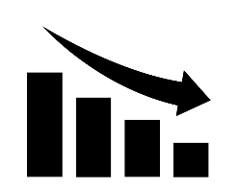




Achieved Clinic Blood Pressure Level and Chronic Kidney Disease Progression
in Children: A Report from the Chronic Kidney Disease in Children Cohort
HYPOTHESIS: In children with CKD, those with clinic BP <90th percentile have preserved renal function compared to those with higher BP
DESIGN: EXPOSURE: OUTCOMES:
30% ↓ eGFR or CKD 5 (KRT or Ktx)
Auscultatory Office BP
<50th Percentile
50th to <75th
75th to <90th
Glomerular CKD
(n=194)
_{0.28} 0.63 _{1.39}
_{0.28} 0.59 _{1.26}
_{0.18} 0.40 _{0.93}
754 children with CKD and HTN or BP > 90th percentile
Non-Glomerular CKD (n=560)
_{0.49} 0.78_{1.25}
_{0.33} 0.53 _{0.84}
_{0.46} 0.71 _{1.08}
Adjusted Hazard Ratios Compared to >90th Percentile (95% CI in subscript)
CONCLUSION: Achieved BP <90th percentile was associated with delayed CKD progression in children with both glomerular and non-glomerular CKD. These data may be useful when managing hypertension in children with CKD using office BP measurements.
Flynn et al. 2020 (GA by M. Starr)

