Slide 1
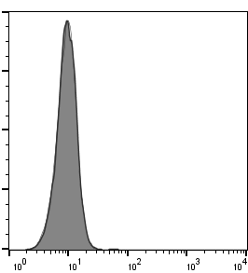
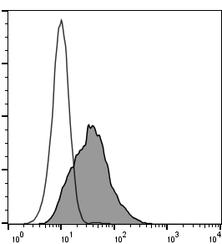
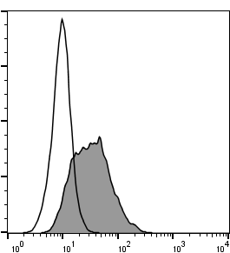
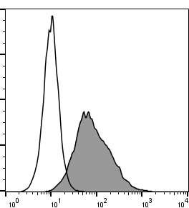
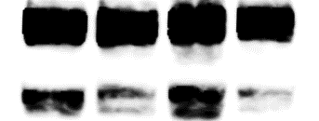
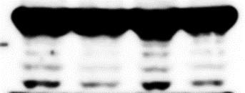






Mori et al., Supplementary Figure S5.
(A)
400
EV
400
OE
300
300
Control IgG
Count
200
200
100
Count
CD133
0
100
10⁰
10¹
10²
10³
10⁴
0
10⁰
10¹
10²
400
400
10³
10⁴
300
FF
300
EE
Count
Count
200
200
100
100
0
0
10⁰
10¹
10²
10³
10⁴
10⁰
10¹
10²
10³
10⁴
(B)
CD133
*
EV
Dead cells
(%, mean ± SD)
NS
*
OE
FF
EE
(C)
EV
OE
FF
EE
kDa
PARP
100
Caspase 9
50
37
Actin
50
(D)
EV
OE
FF
EE
kDa
p-AKT Ser⁴⁷³
75
1
2.62
1.58
1.98
50
AKT
75
p-Bad Ser¹³⁶
50
1
2.85
1.72
25
2.97
Bad
25
Actin
50

