Slide 1
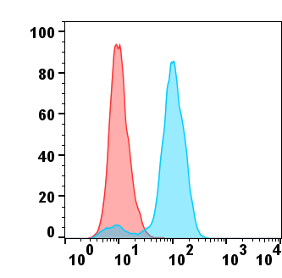
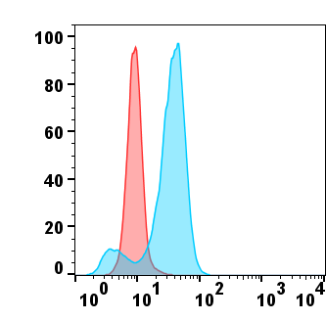
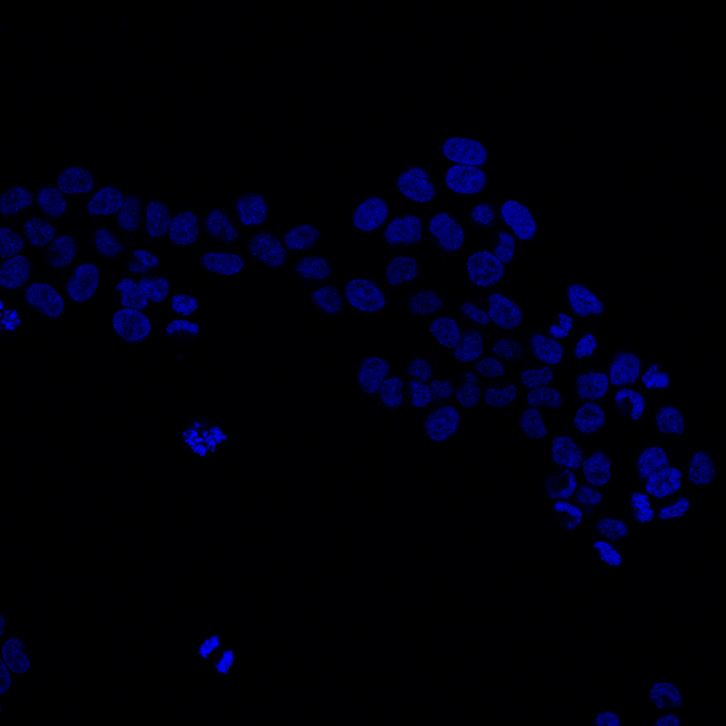
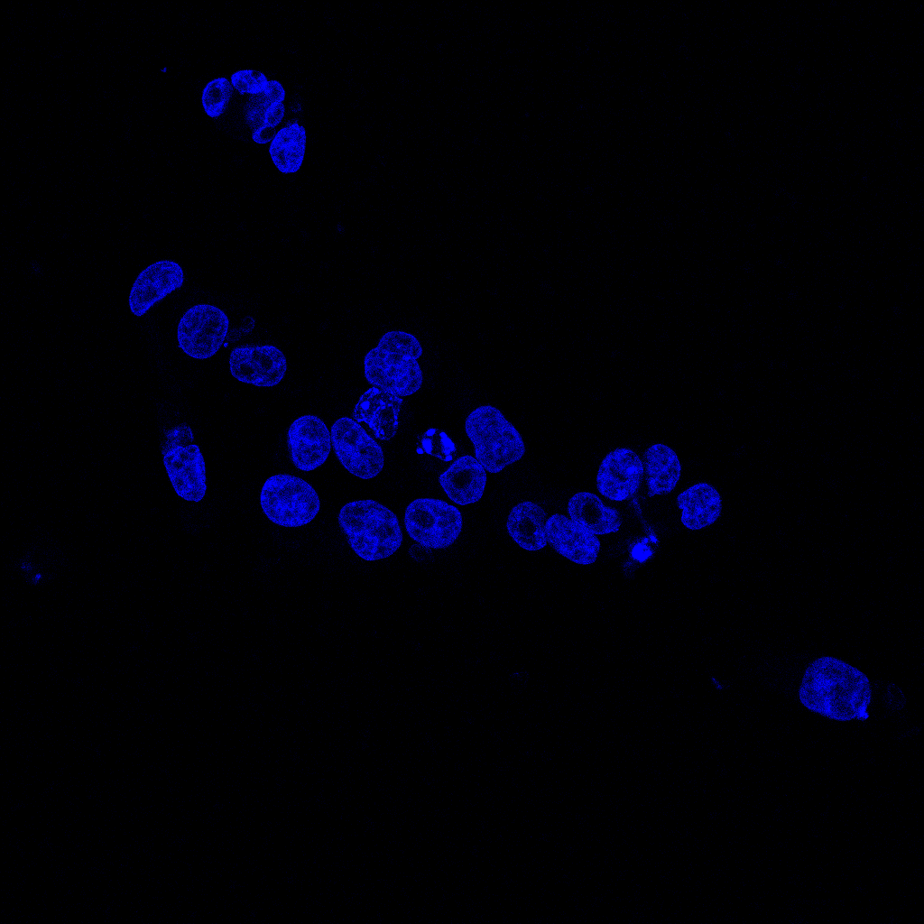
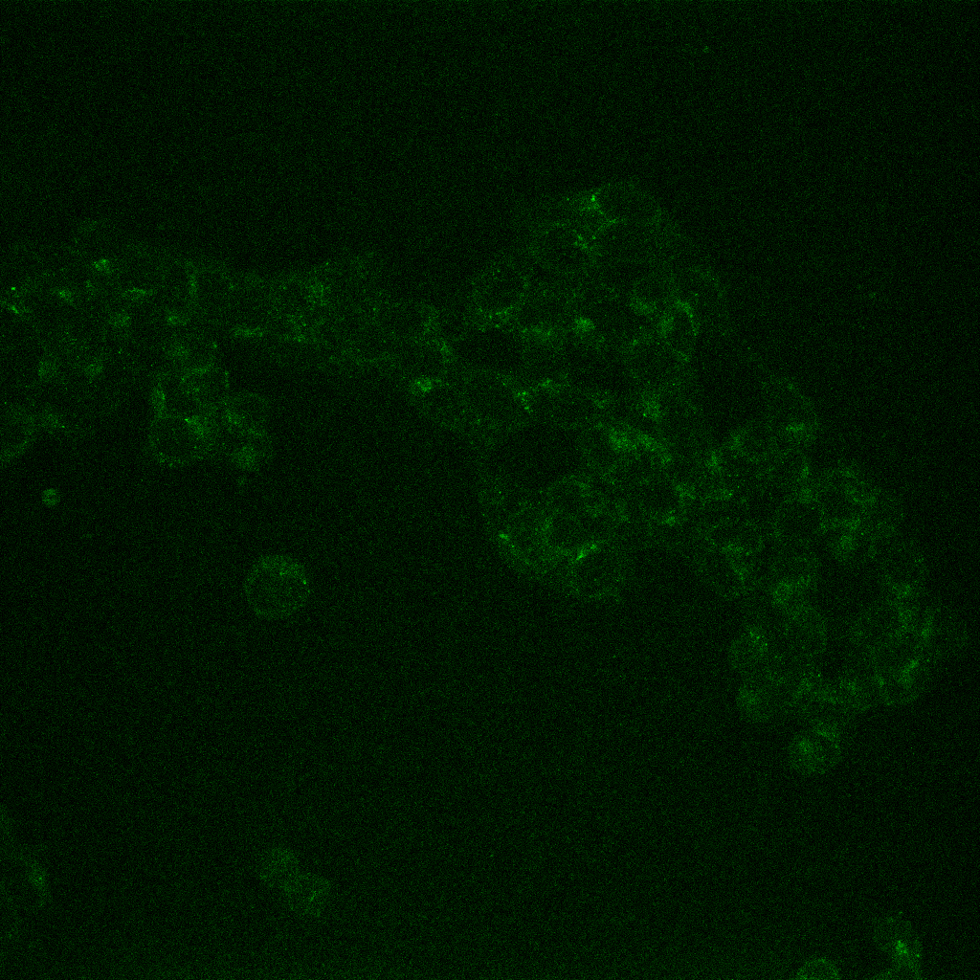
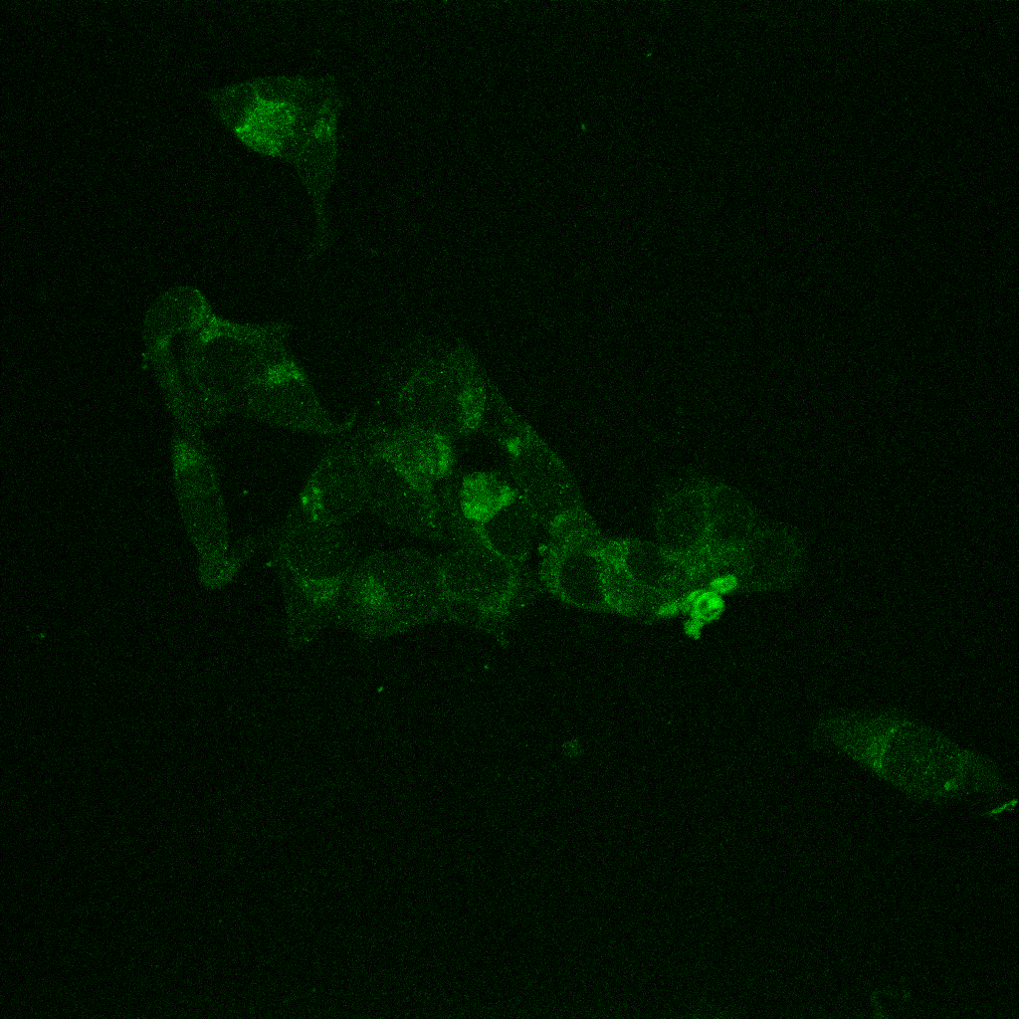
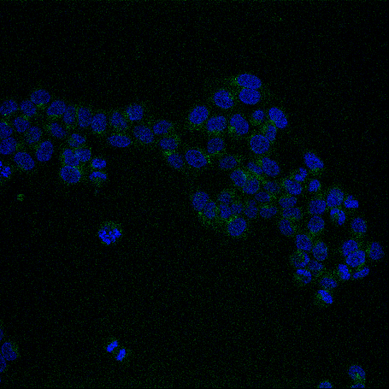
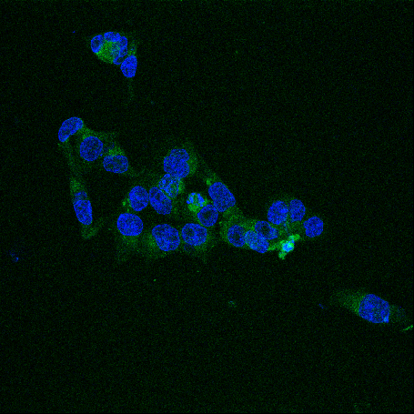
Mori et al., Supplementary Figure S3.
(A)
10% FBS
1% FBS
Control IgG
Normalized to mode
Normalized to mode
Anti-CD133
CD133
CD133
(B)
10% FBS
1% FBS
DAPI
*
CD133
Merged
Scale bars: 50 μm
36

