Slide 1
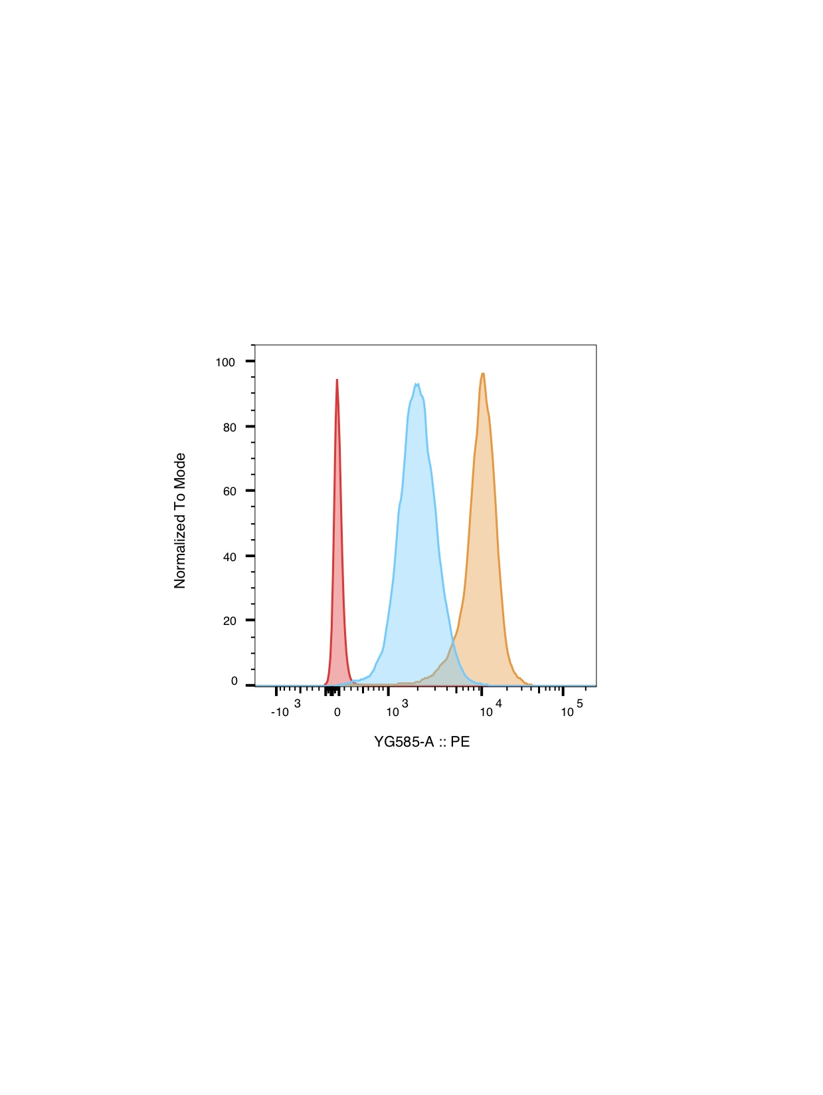
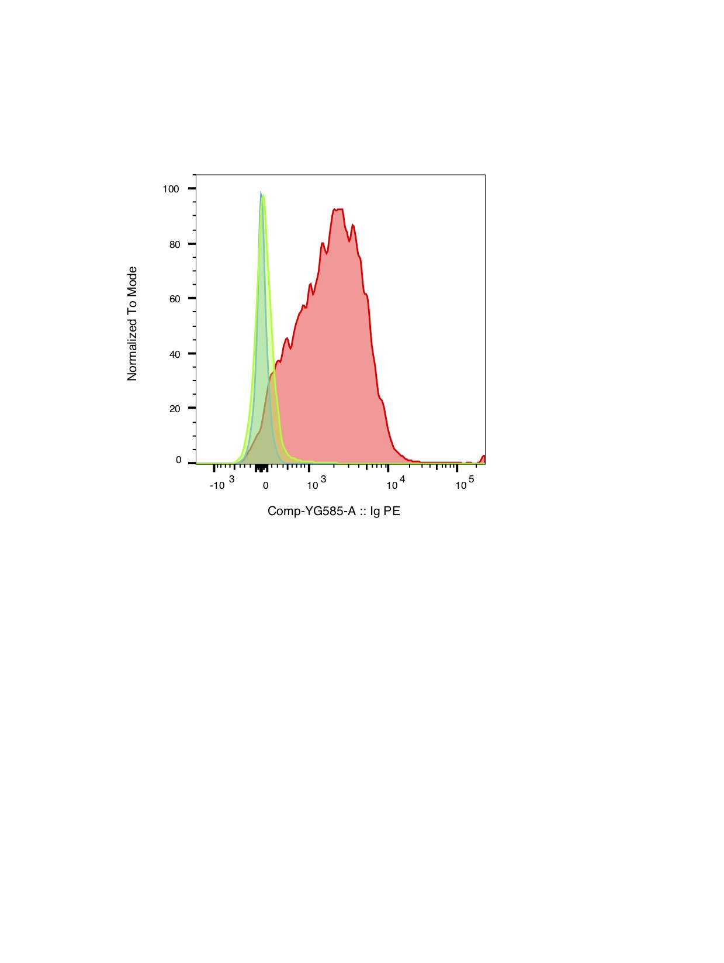
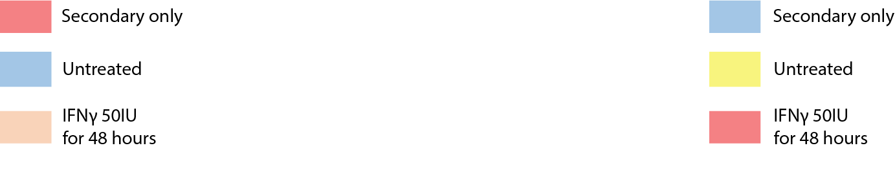
A
B
C
Pan-HLA-I W632-IgPE
D
Pan-HLA-II RM5.112-IgPE
E
F
Goncalves et al. Supplemental Figure 1

Slide 2
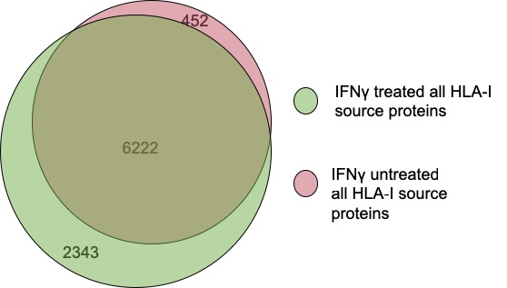
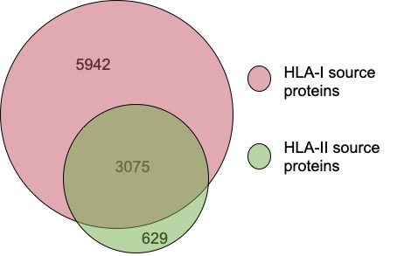
A
B
C
D
E
F
G
H
I
J
Goncalves et al. Supplemental Figure 2

Slide 3
A
B
C
D
E
F
G
Goncalves et al. Supplemental Figure 3

Slide 4
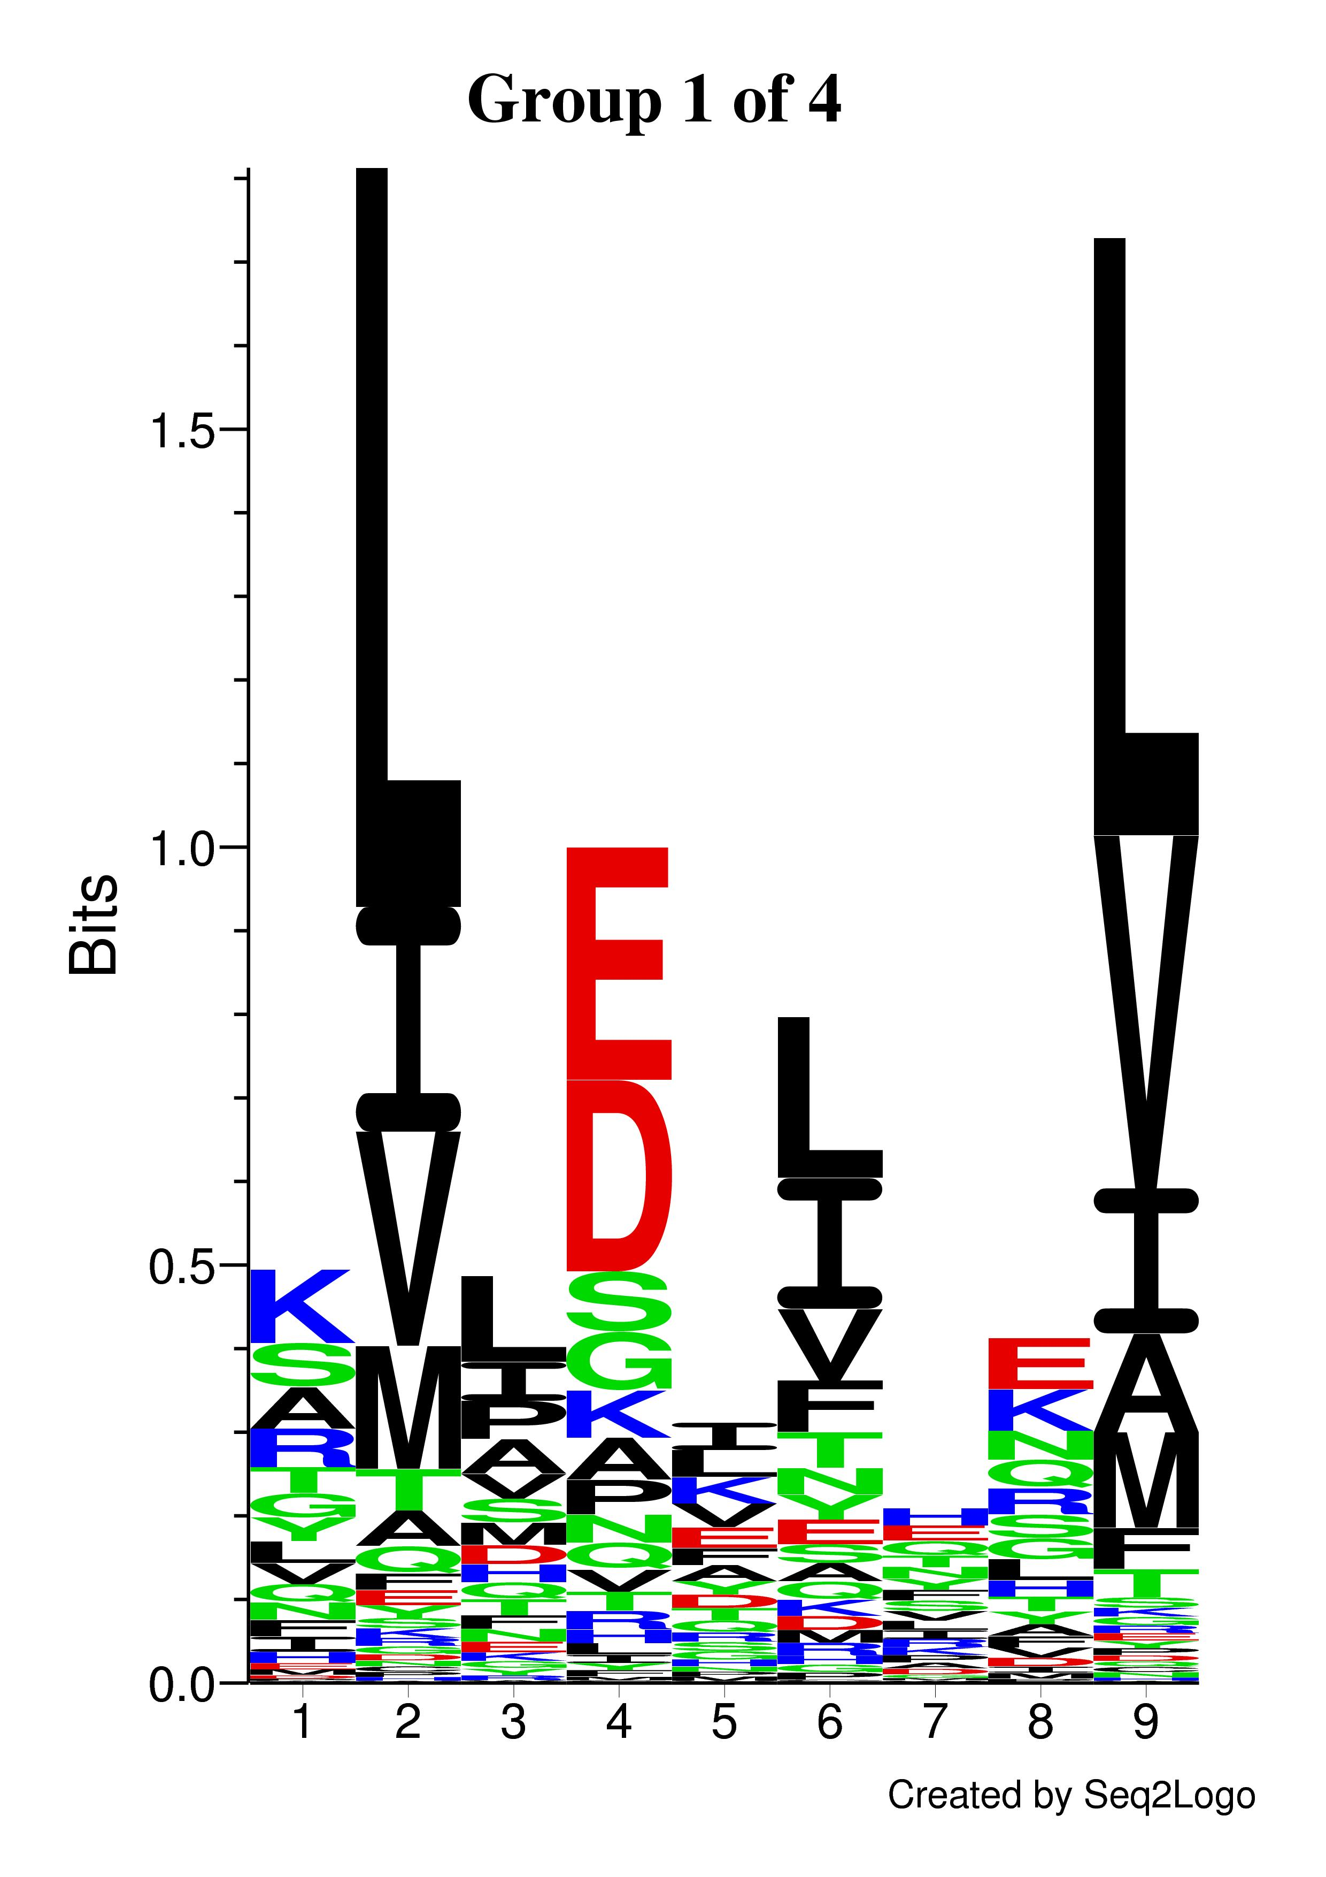
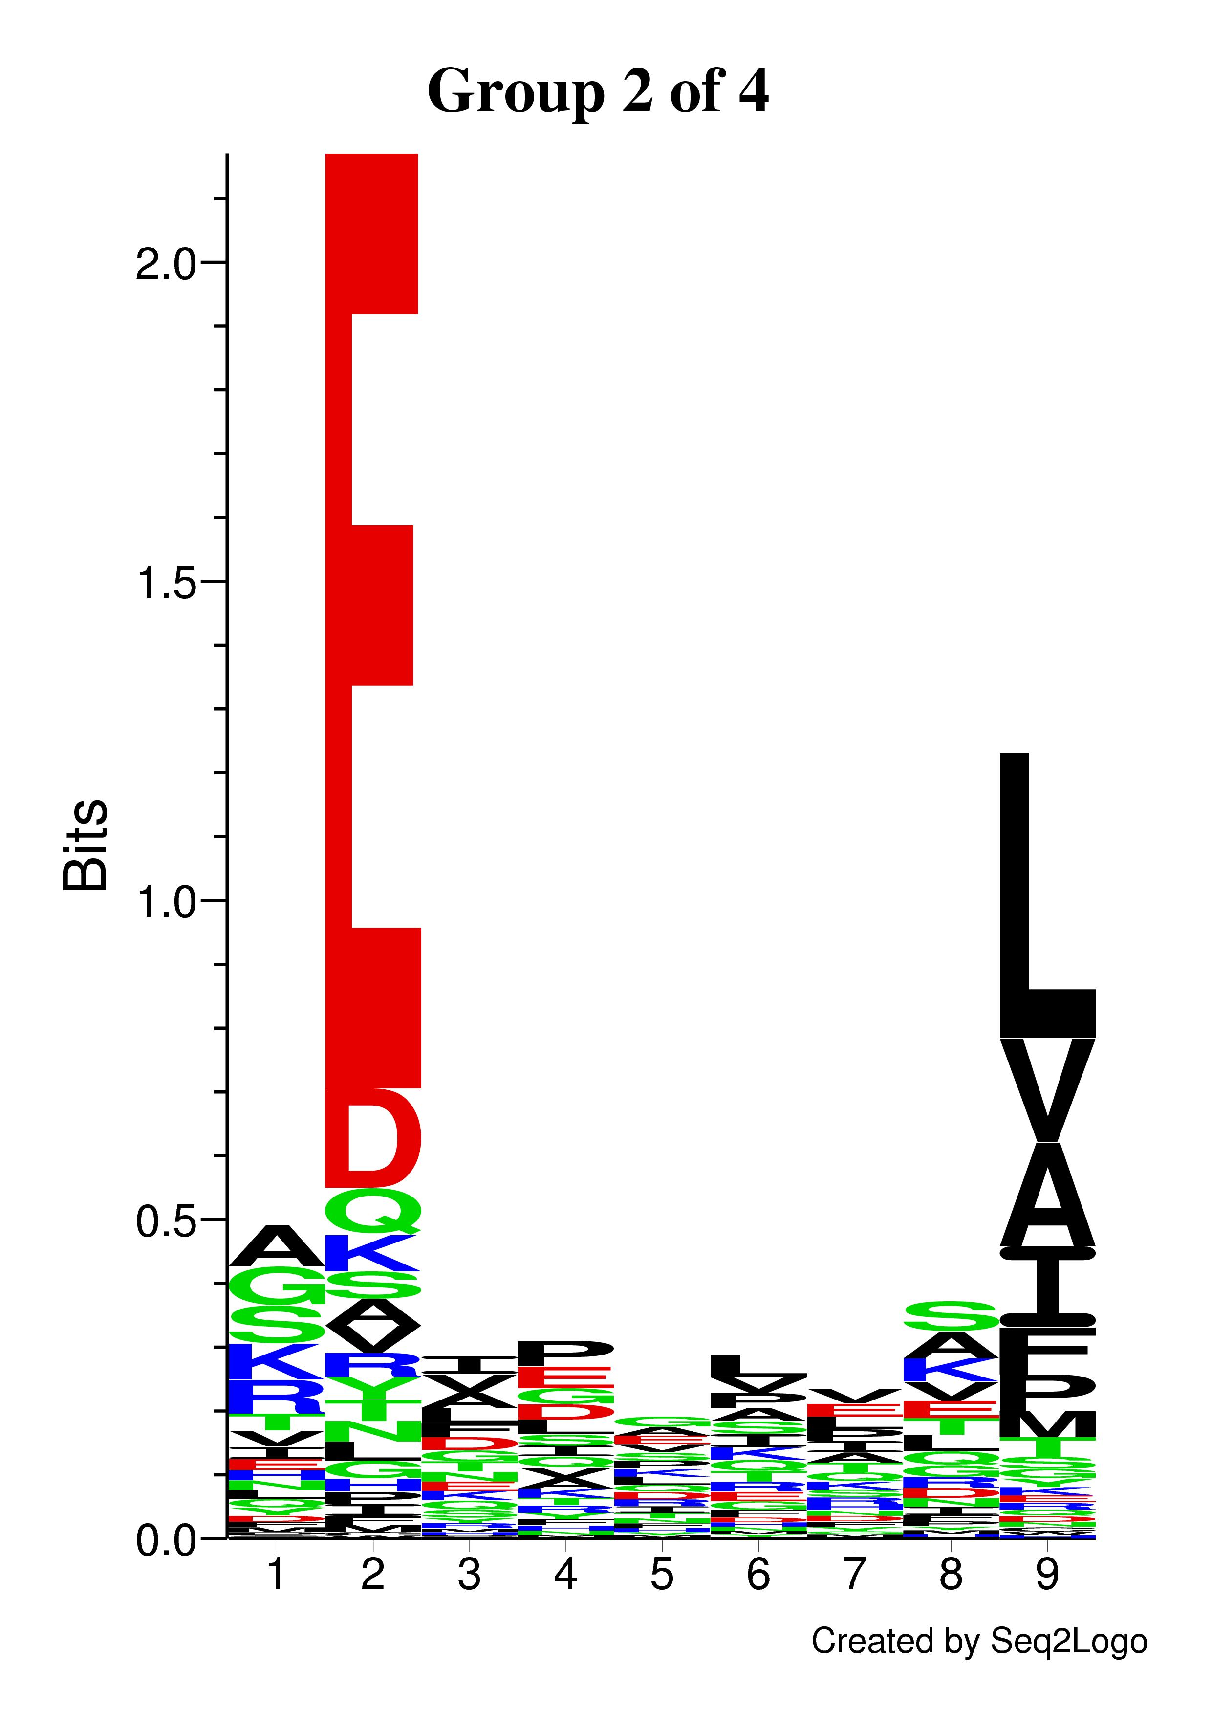
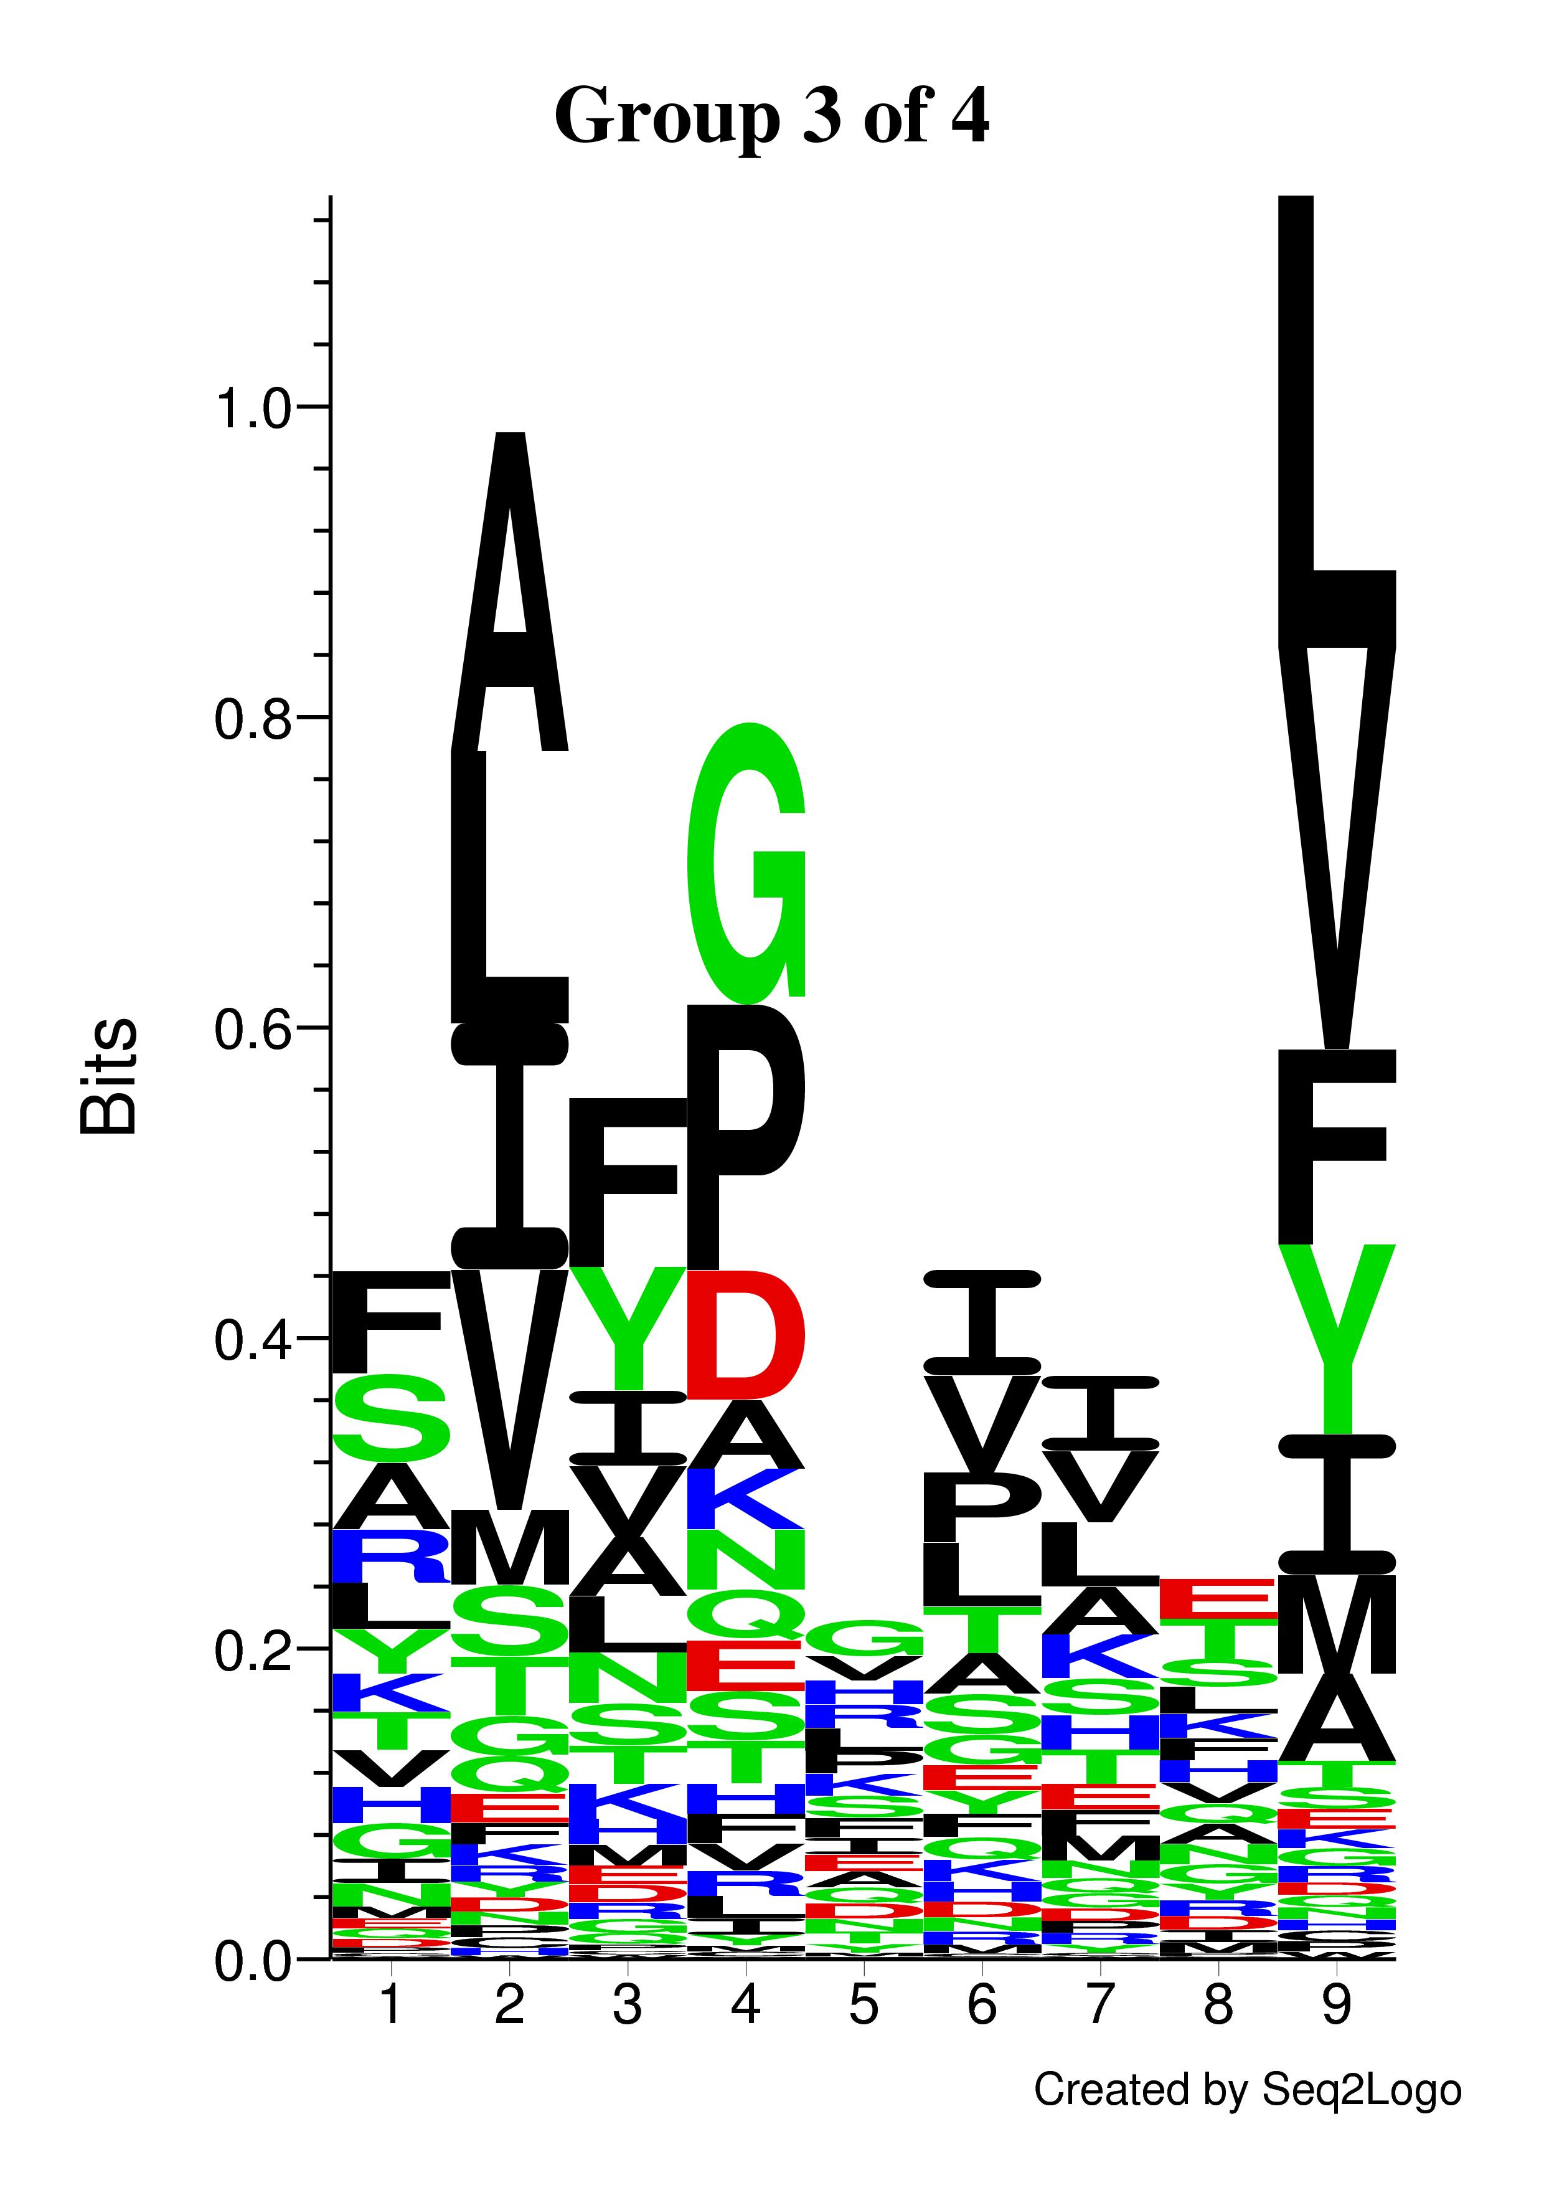
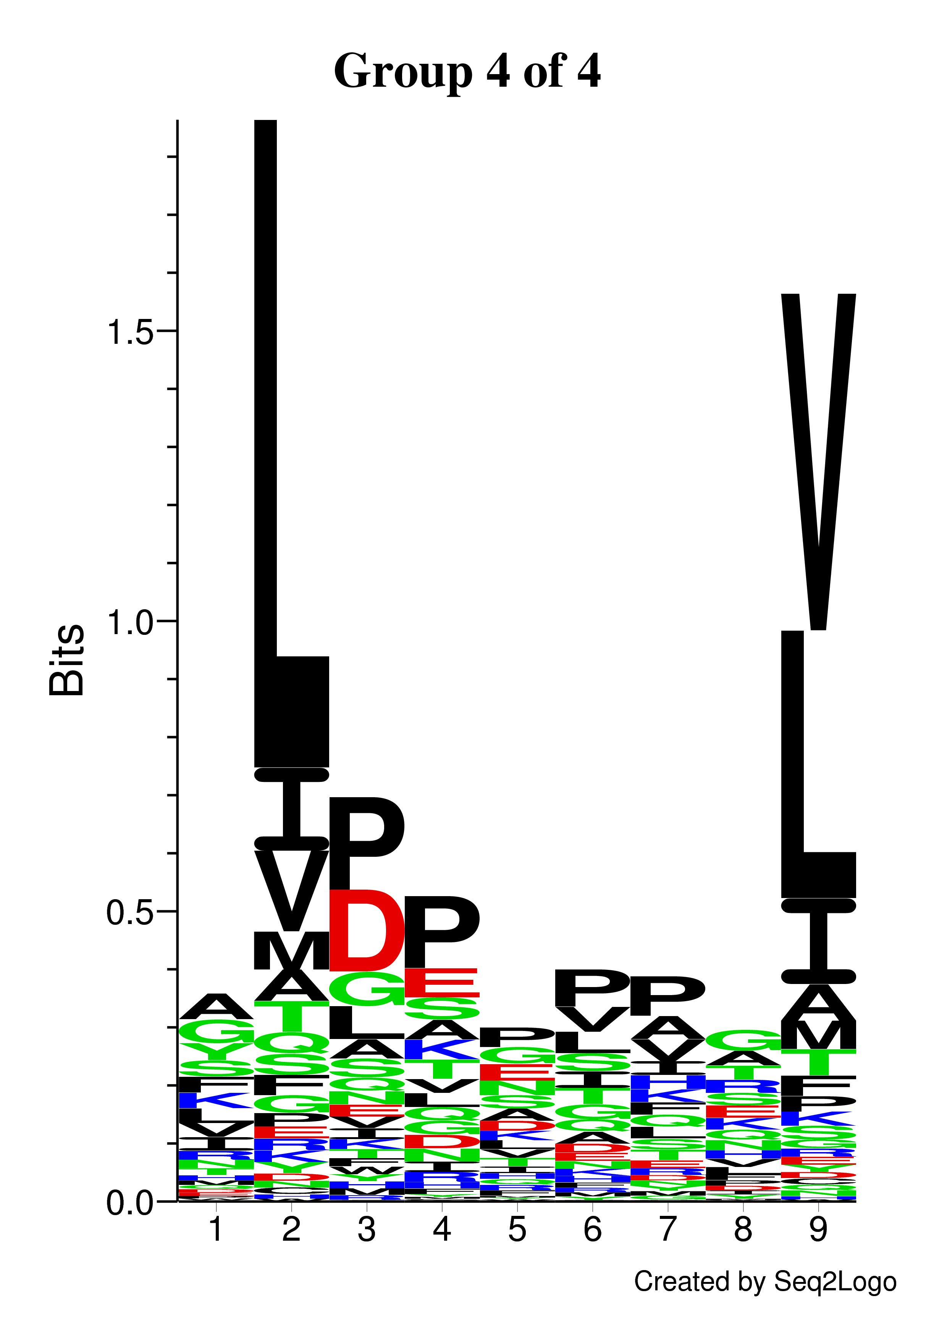
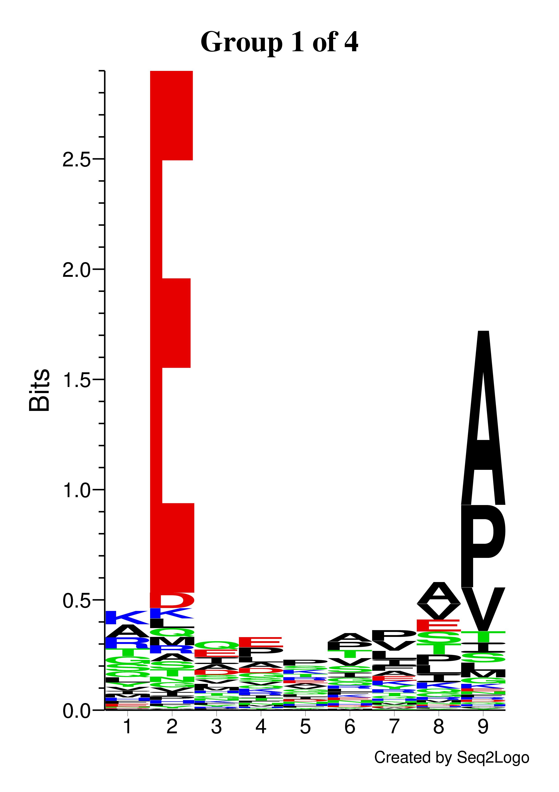
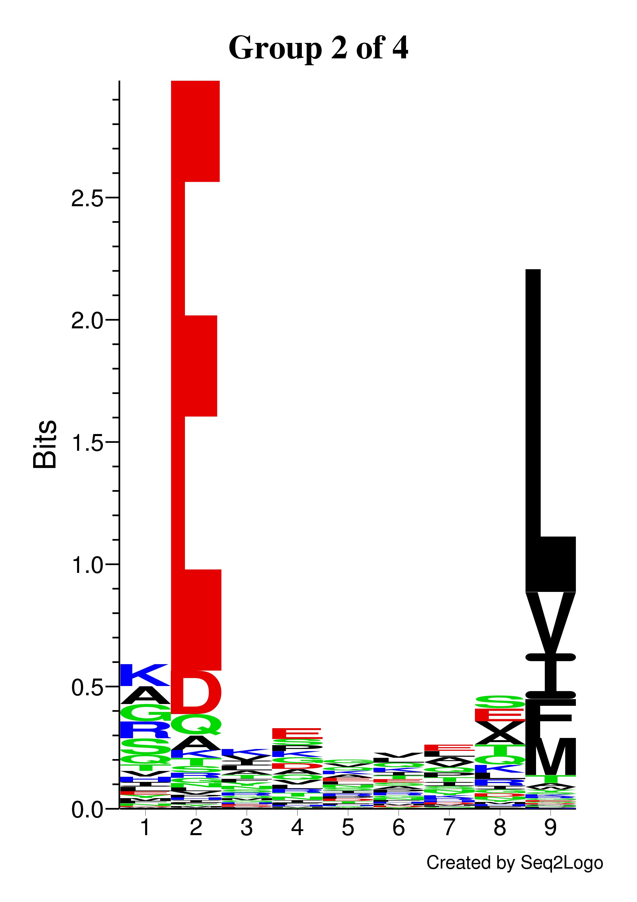
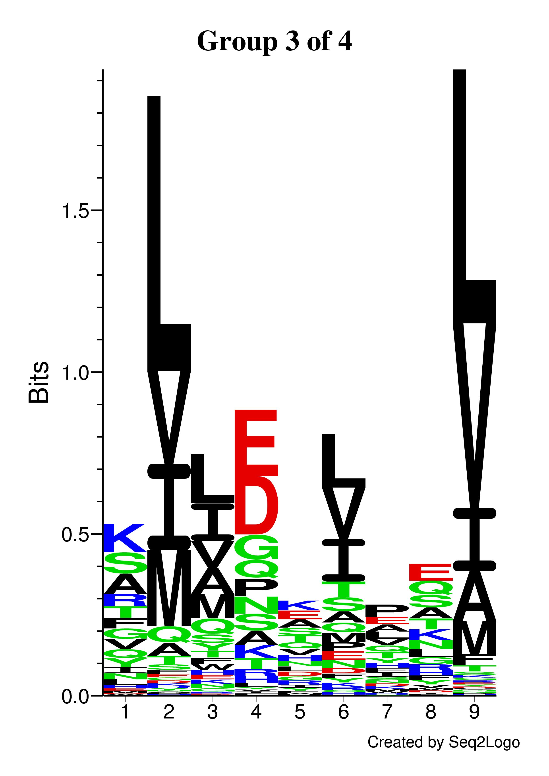
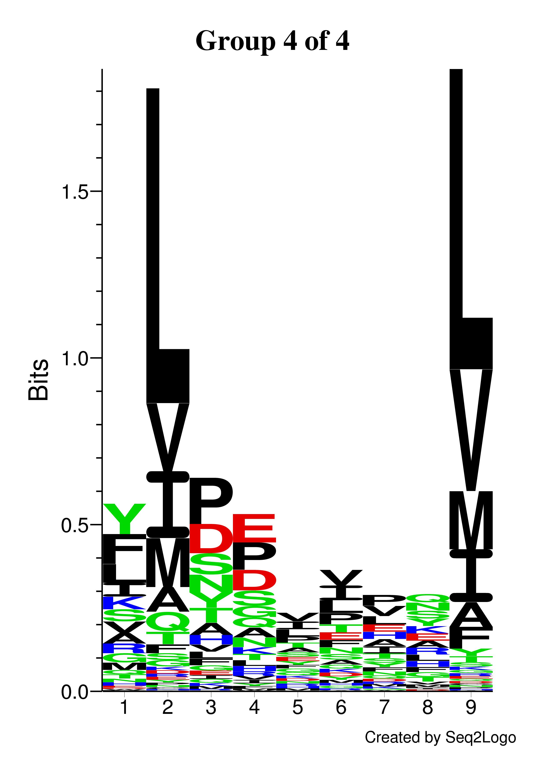
A
B
Goncalves et al. Supplemental Figure 4

Slide 5
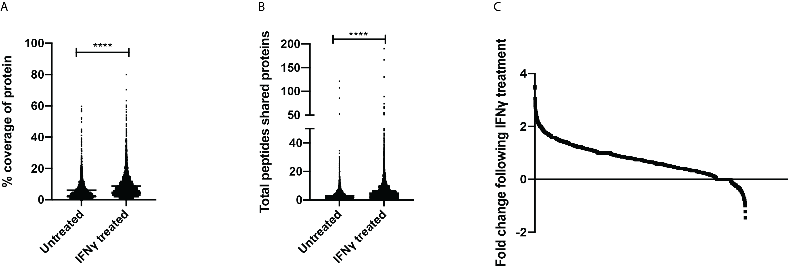
Goncalves et al. Supplemental Figure 5

Slide 6
Goncalves et al. Supplemental Figure 6

Slide 7
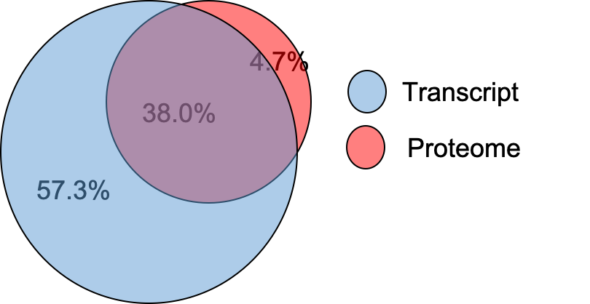
A
B
C
D
Goncalves et al. Supplemental Figure 7

Slide 8
A
B
C
D
E
F
Goncalves et al. Supplemental Figure 8

