Slide 1
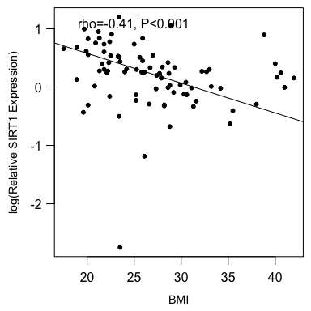
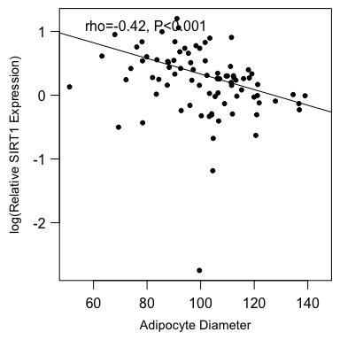
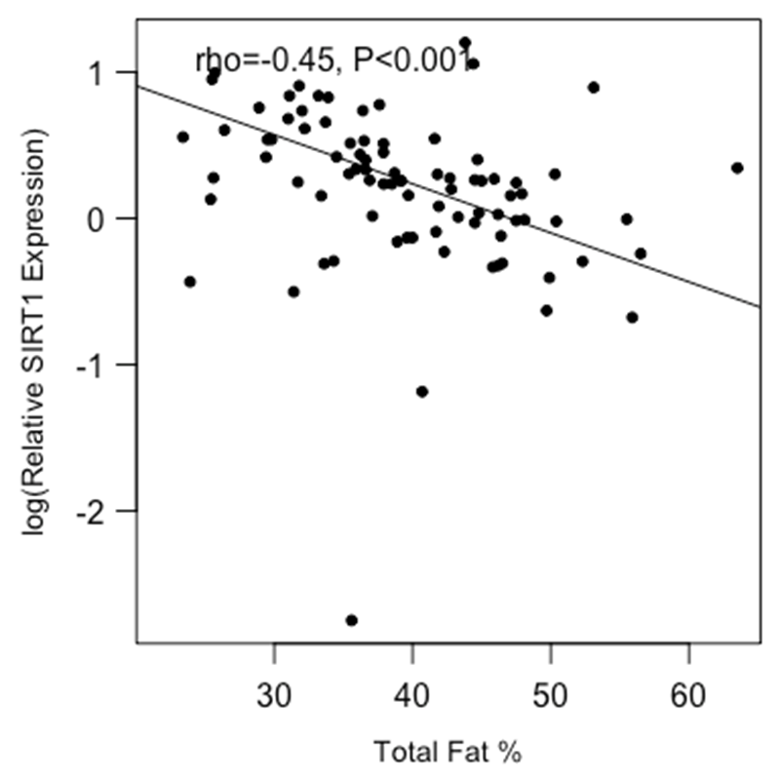
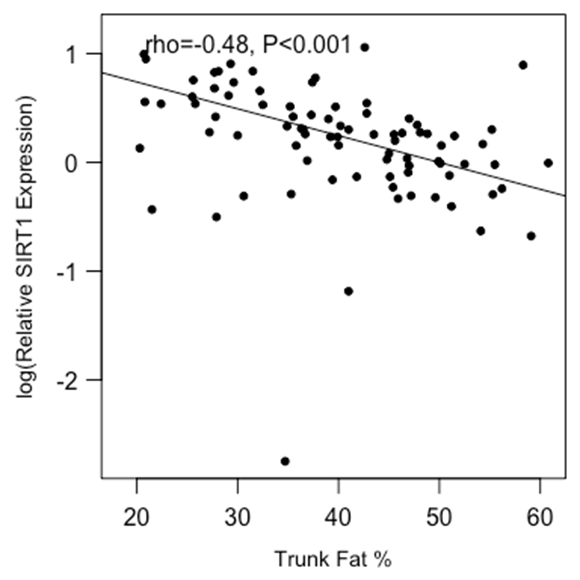
Supplemental Figure 1. Breast SIRT1 levels correlate with adiposity
A
B
C
D
Notes:
Figure S1. Breast SIRT1 levels correlate with adiposity. SIRT1 expression in the breast inversely correlated with (A) BMI, (B) adipocyte diameter, (C) total fat percentage, and (D) trunk fat percentage.

