Slide 1
Supplement 1
ALTTO Manuscript

Slide 2
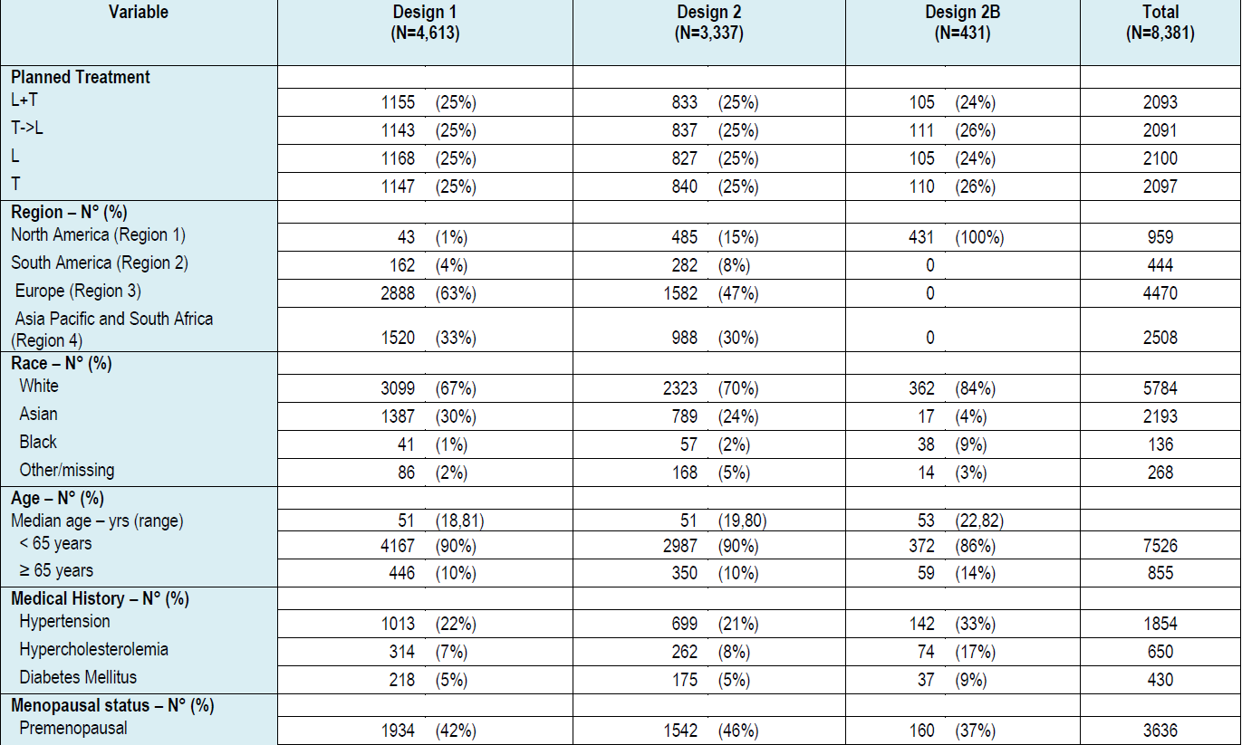
Baseline Characteristics of the Patients, Tumors and primary treatments by Design (Intention-to-treat Groups)

Slide 3
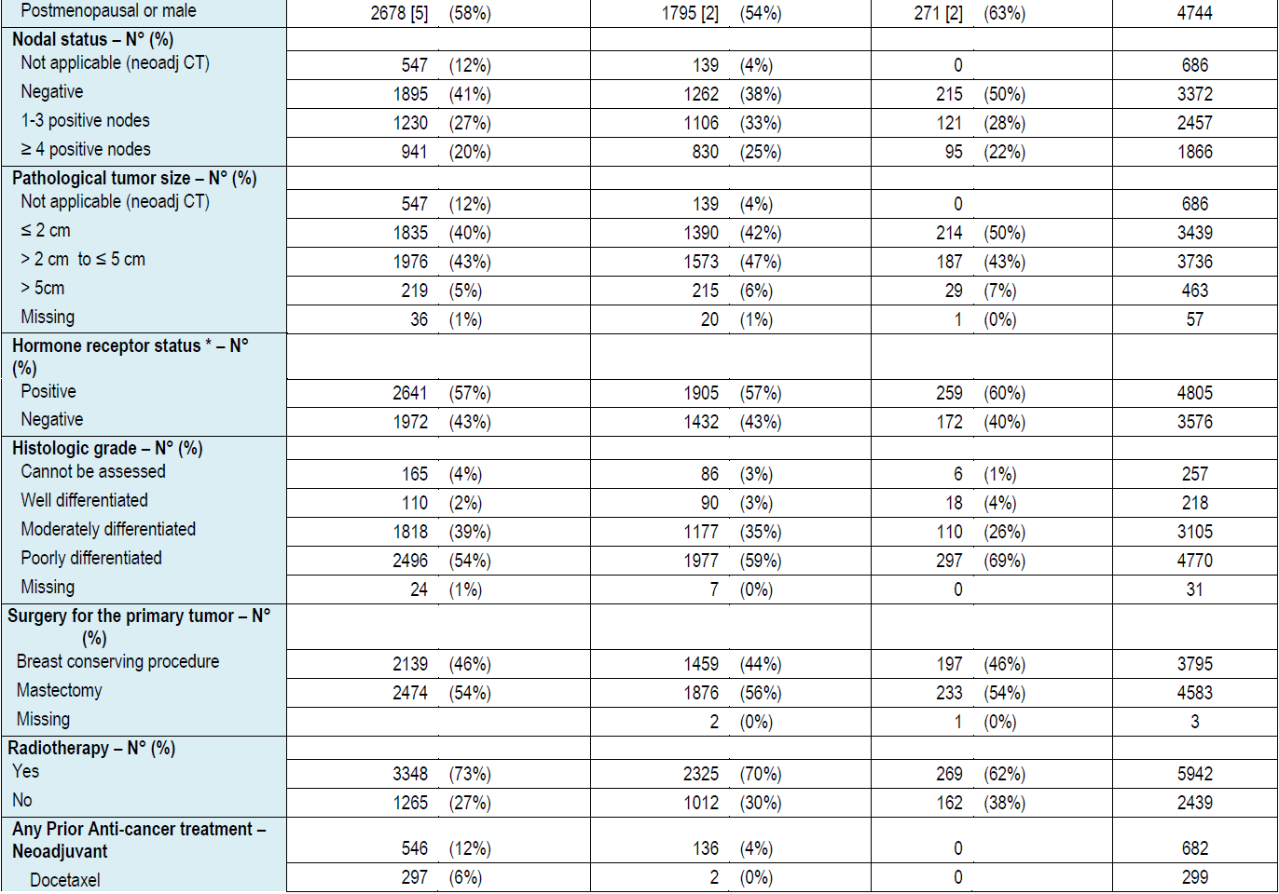

Slide 4
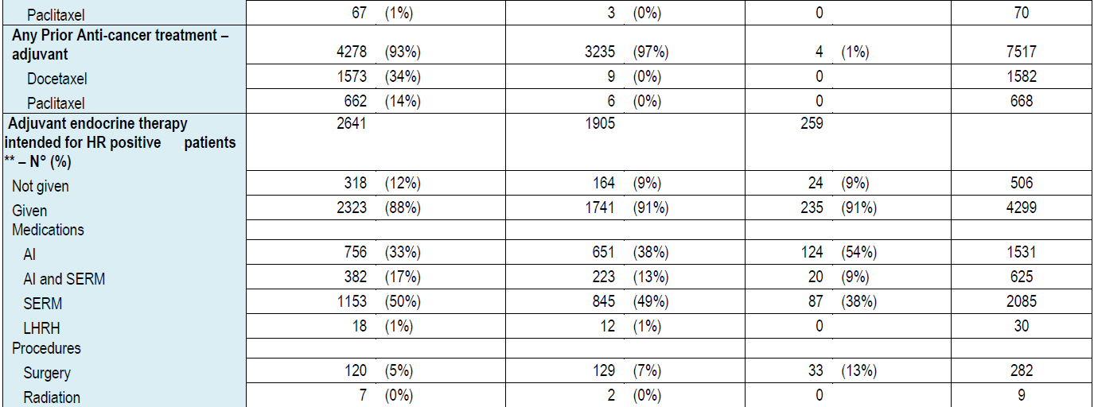
Abbreviations: L+T, lapatinib plus trastuzumab; T→L, trastuzumab followed by lapatinib; L, lapatinib; T, trastuzumab; neoadj CT, neoadjuvant chemotherapy; AI, aromatase inhibitor; SERM, selective estrogen receptor modulator; LHRH, luteinizing hormone-releasing hormone.
*Only 10 patients had hormone receptor status derived from local laboratory results and were not enrolledwithin any particular treatment arm or included in any positive/
negative result.
**For six patients, hormone receptor status was from a local laboratory

Slide 5
Distribution of patient characteristics by Treatment Arm
 | Lap+Tras (N = 2093) | Tras-Lap (N = 2091) | Tras (N = 2097)
Menopausal Status
Premenopausal | 908 (43%) | 929 (44%) | 908 (43%)
Postmenopausal or male | 1185 (57%) | 1162 (56%) | 1189 (57%)
Pathological primary tumour size - largest diameter of invasive component (mm)
Missing | 27 | 41 | 38
≤ 2cm | 937 (45%) | 938 (46%) | 942 (46%)
> 2cm to ≤ 5cm | 1002 (49%) | 980 (48%) | 990 (48%)
> 5cm | 127 (6%) | 132 (6%) | 127 (6%)
Histologic grade
Missing | 10 | 7 | 9
Gx: Differentiation cannot be assessed | 79 (4%) | 61 (3%) | 59 (3%)
G1: Well differentiated | 51 (2%) | 59 (3%) | 48 (2%)
G2: Moderately differentiated | 774 (37%) | 793 (38%) | 744 (36%)
G3: Poorly differentiated/undifferentiated | 1179 (57%) | 1171 (56%) | 1237 (59%)

Slide 6
Overall AE summary by Arm
 | Lap+Tras (N=2061) | Tras->Lap (N=2076) | Lap (N=2057) | Tras (N=2076)
Any AE | 1979 [1974] (96%) | 1956 [1948] (94%) | 1964 [1962] (95%) | 1834 [1820] (88%)
AEs related to study treatment | 1922 [1919] (93%) | 1801 [1797] (87%) | 1857 [1855] (90%) | 1329 [1319] (64%)
AEs leading to permanent discontinuation | 481 [482] (23%) | 261 [262] (13%) | 317 [314] (15%) | 171 [169] (8%)
AEs leading to dose reductions | 413 [412] (20%) | 275 [274] (13%) | 448 [445] (22%) | 81 [81] (4%)
AEs leading to dose interruptions/delays | 945 [944] (46%) | 668 [668] (32%) | 821 [816] (40%) | 419 [417] (20%)
Any SAE | 459 [430] (22%) | 391 [352] (19%) | 461 [431] (22%) | 326 [292] (16%)
SAEs related to study treatment | 276 [274] (13%) | 191 [186] (9%) | 275 [274] (13%) | 116 [112] (6%)
Fatal SAEs | 19 [9] (<1%) | 19 [14] (<1%) | 23 [15] (1%) | 17 [9] (<1%)
Fatal SAEs related to study treatment | 3 [2] (<1%) | 3 [3] (<1%) | 4 [4] (<1%) | 4 [3] (<1%)

Slide 7
Summary of Cardiac Adverse Events by Arm
 | Lap+Tras (N=2061) | Tras->Lap (N=2076) | Lap (N=2057) | Tras (N=2076)
Number of subjects with events | 181 (9%) | 144 (7%) | 120 (6%) | 220 (11%)
Number of events | 221 | 166 | 142 | 268
Event characteristics
No. of events | 221 | 166 | 142 | 268
Serious | 33 (15%) | 28 (17%) | 19 (13%) | 29 (11%)
Investigational product-related | 186 (84%) | 128 (77%) | 81 (57%) | 232 (87%)
Leading to withdrawal | 83 (38%) | 38 (23%) | 14 (10%) | 90 (34%)
Fatal (Grade 5) | 2 (<1%) | 3 (2%) | 2 (1%) | 2 (<1%)

Slide 8
