Slide 1
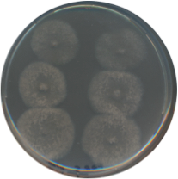
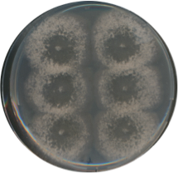
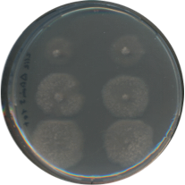
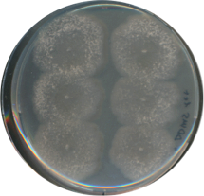
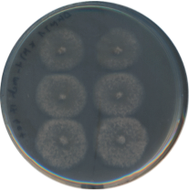
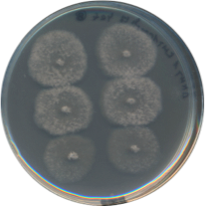
Fig. S11A
Step 1
0 day
Growth starting point
4 days
Stationary phase, plug#3
Edge, stationary phase, plug#2
Growing phase, plug#1
8 days
Step 2
Step 3
#3a
#3b
#3a
#3b
3 Days
#2a
#2b
#2a
#2b
3 Days
#1a
#1b
#1a
#1b
WT
ΔPaKmt1
ΔPaKmt1
PaKmt1⁺

Slide 2
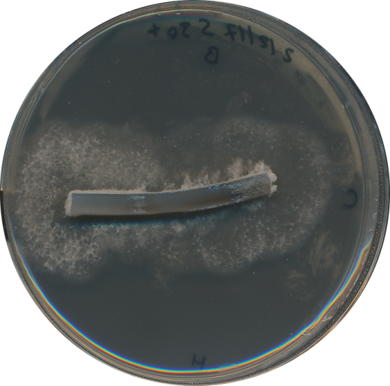
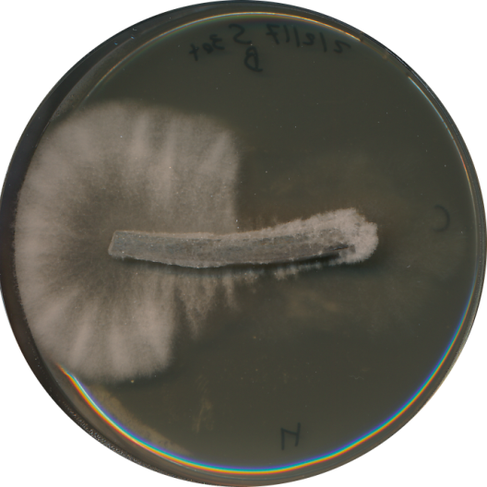
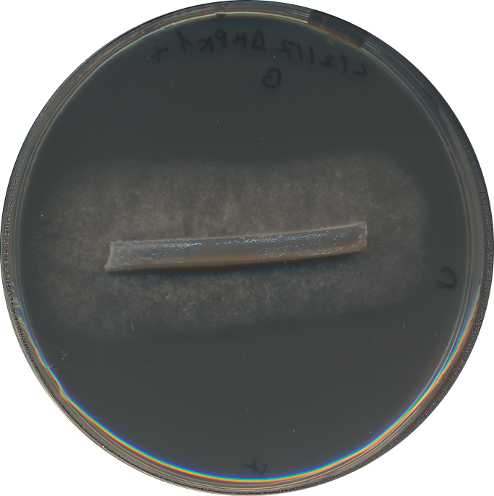
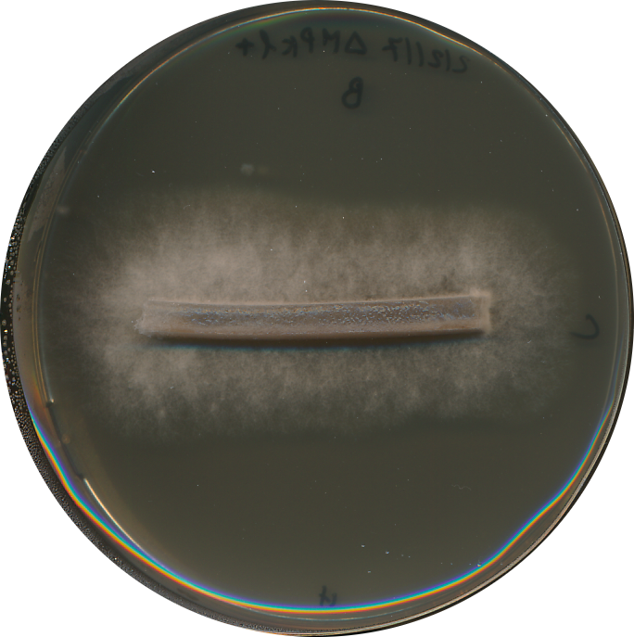
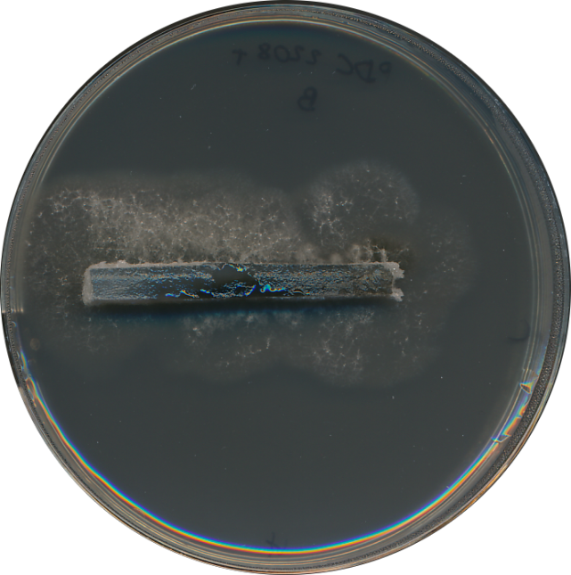
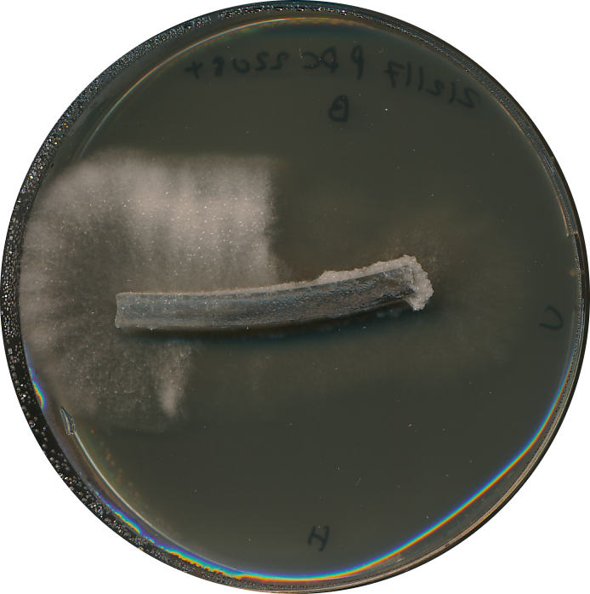
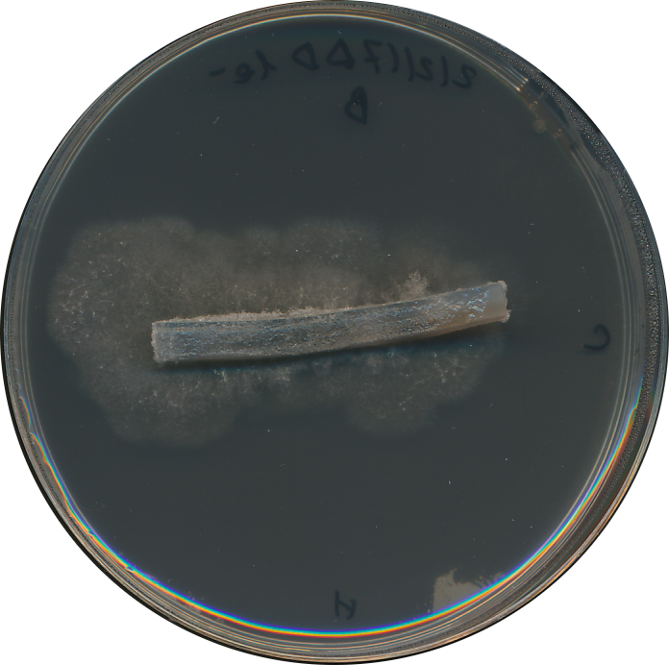
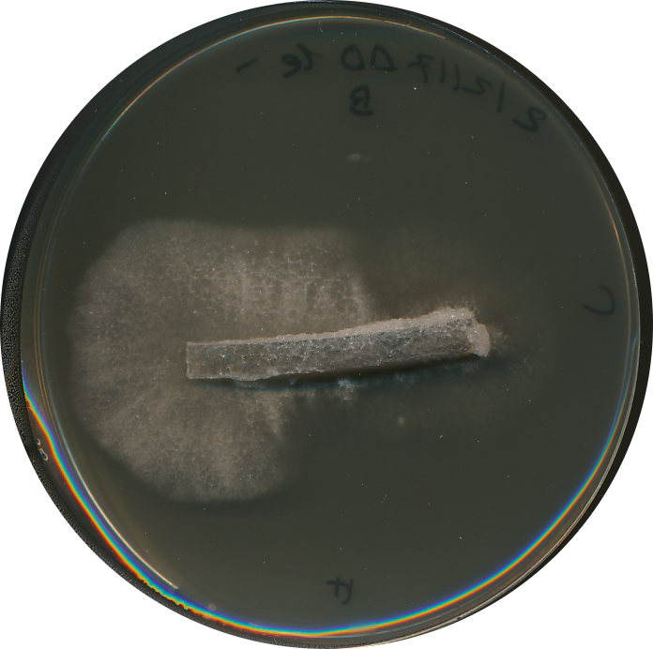
Fig. S11B
M2
M2+ YE
WT
ΔPaMpk1
PDC2208
ΔPaKmt1

