Slide 1
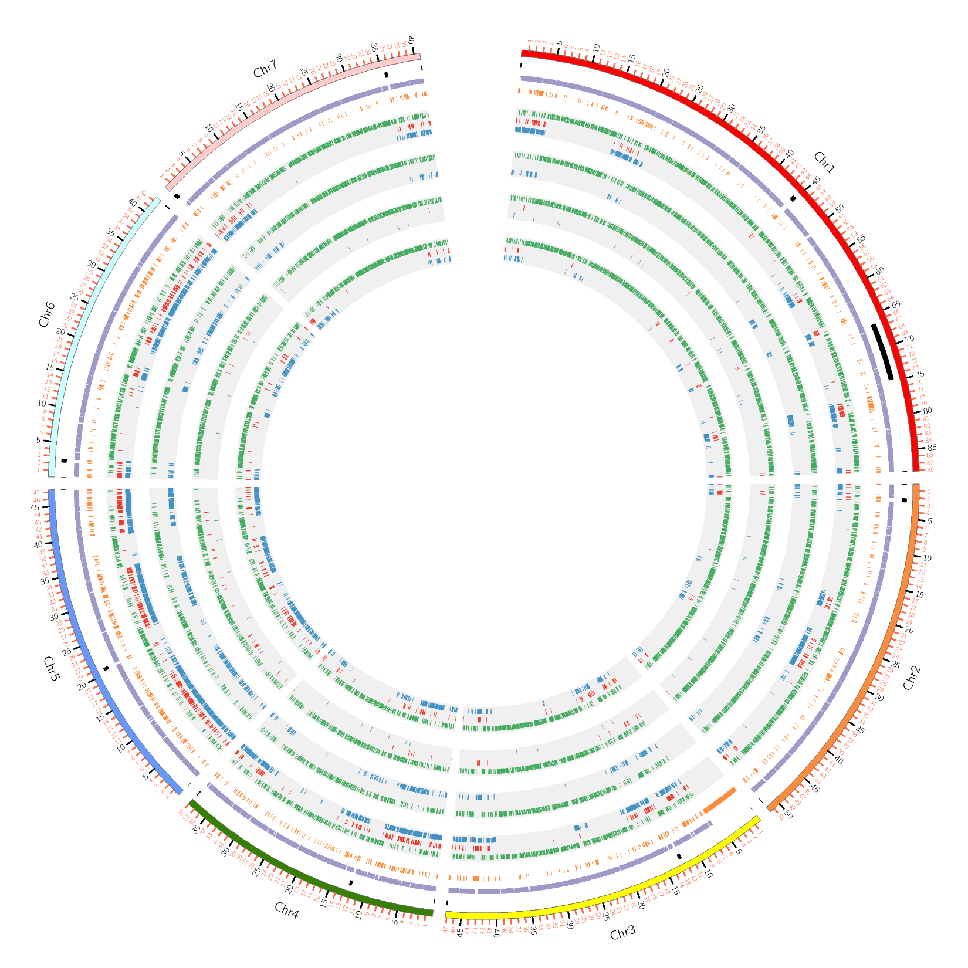
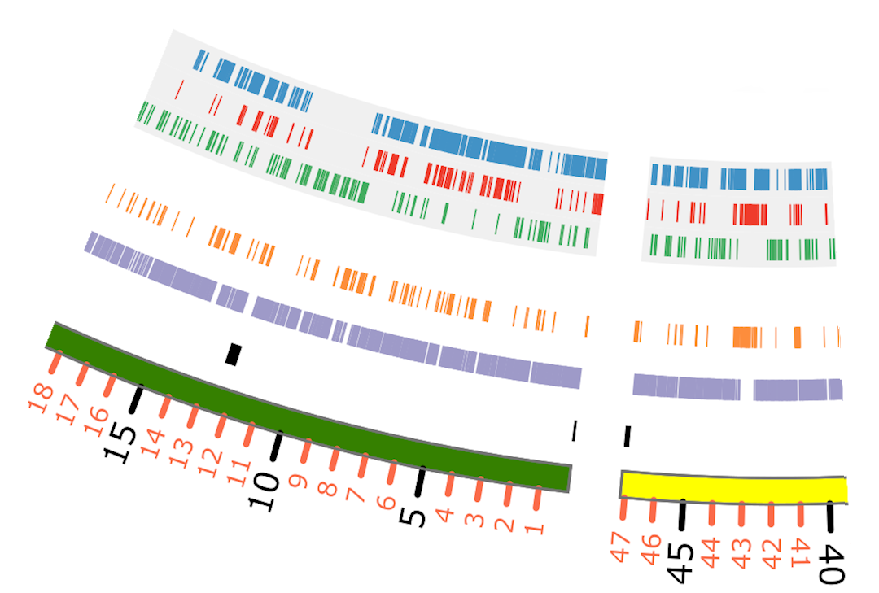
Fig. S4
Chr7
WT
∆PaKmt1
Chr1
∆PaKmt6
∆PaHP1
Chr6
Mat region
Telomeres and centromeres
Genes
Repeats
H3K4me3
H3K9me3
H3K27me3
Chr5
Chr2
rDNA
Chr4
Chr3

