Slide 1
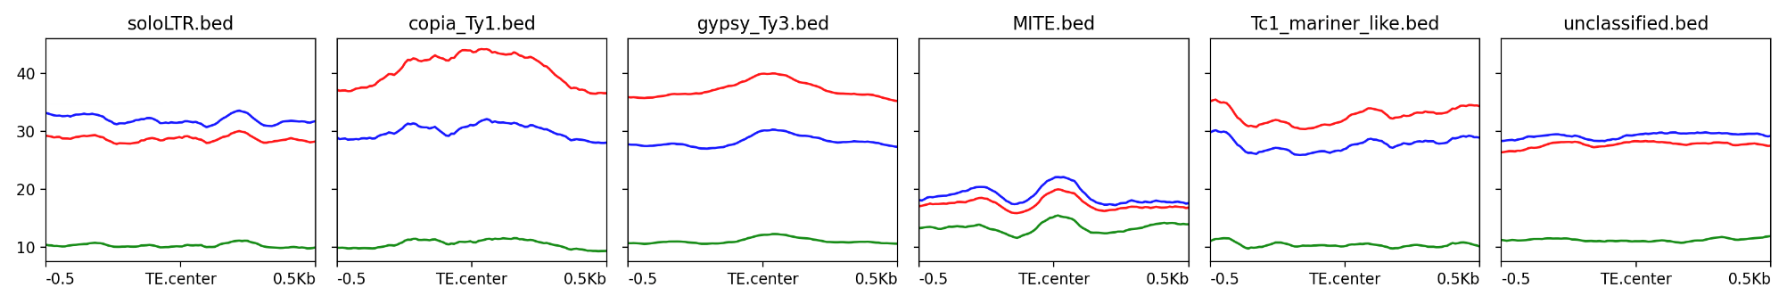
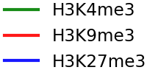
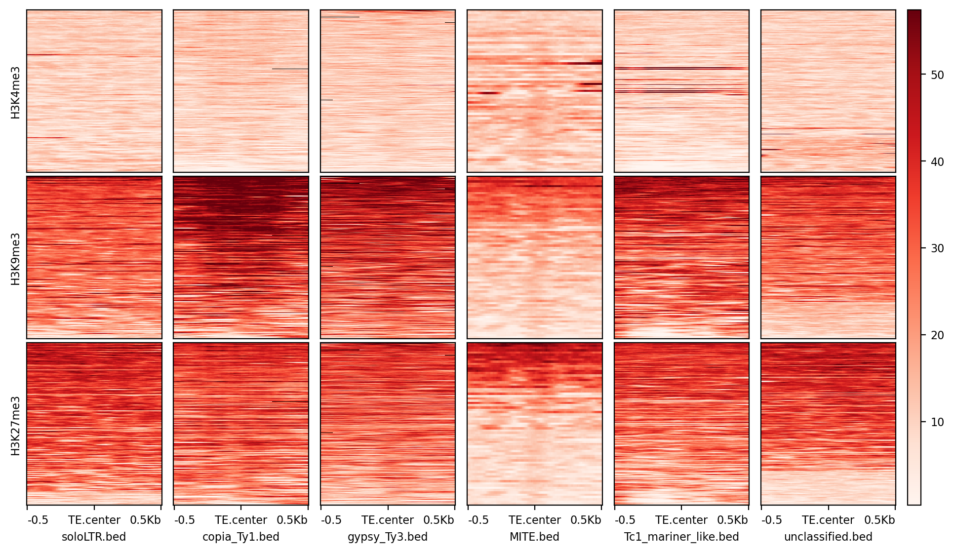
Fig. S5A
soloLTR
Copia_Ty1
Gypsy_Ty3
MITE
Tc1_mariner
Unclassified
40
30
Modification
levels
20
10
50
H3K4me3
40
H3K9me3
30
20
H3K27me3
10
-0.5
0
+0.5
-0.5
0
+0.5
-0.5
0
+0.5
-0.5
0
+0.5
-0.5
0
+0.5
-0.5
0
+0.5

Slide 2
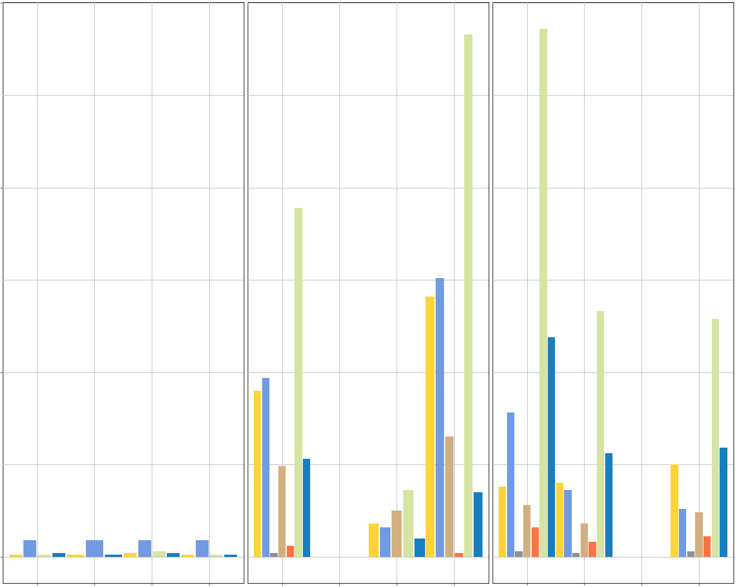







Fig. S5B
400
H3K4me3
H3K9me3
H3K27me3
200
TE families
Gypsy_Ty3
NUMBER OF TEs
Tc1_mariner
Mutator
Copia_Ty1
MITE
100
soloLTR
Unclassified
0
WT
WT
WT
ΔPaKmt1
ΔPaKmt6
ΔPaHP1
ΔPaKmt1
ΔPaKmt6
ΔPaHP1
ΔPaKmt1
ΔPaKmt6
ΔPaHP1

Slide 3
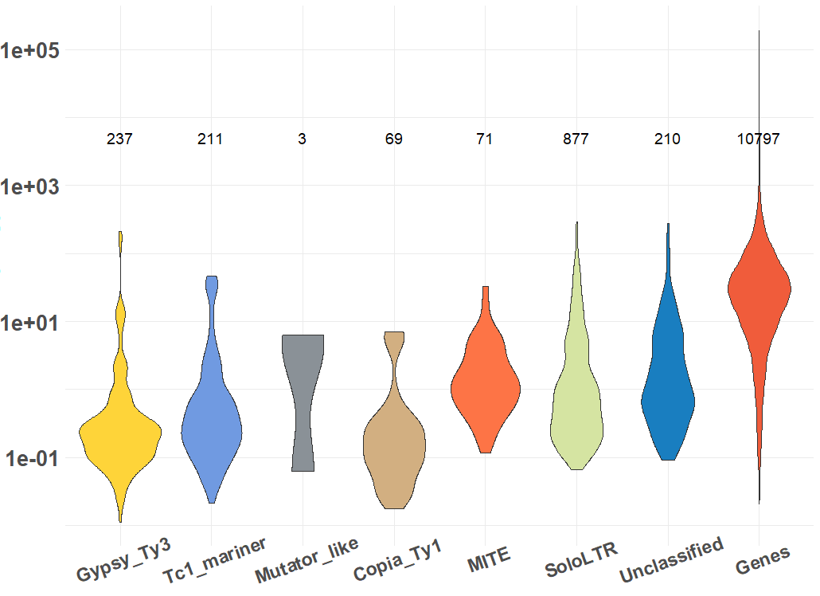
Fig. S5C
Log TPM

