Slide 1
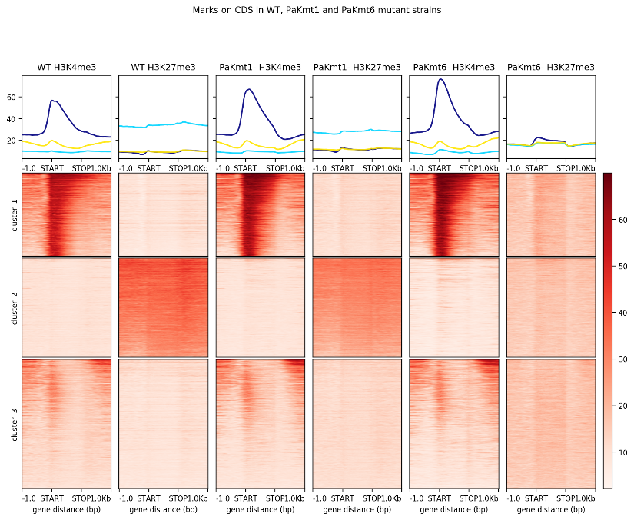
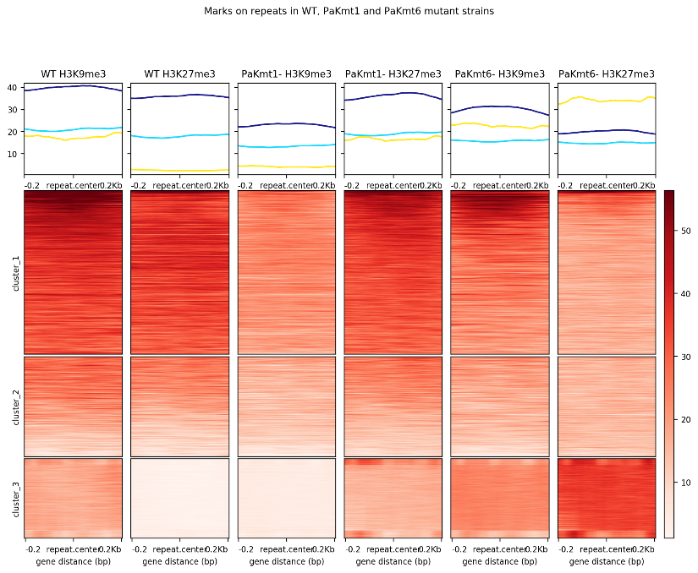
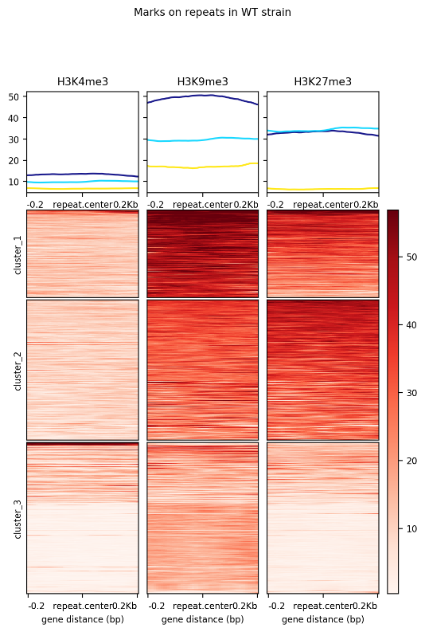
Fig. S9
CDS
Repeats
WT
ΔPaKmt1
ΔPaKmt6
WT
ΔPaKmt1
ΔPaKmt6
H3K4me3
H3K27me3
H3K4me3
H3K27me3
H3K4me3
H3K27me3
40
H3K4me3
H3K27me3
H3K4me3
H3K27me3
H3K4me3
H3K27me3
60
30
40
20
20
10
Cluster 1
50
Cluster 1
40
Cluster 2
30
Cluster 2
20
Cluster 3
10
Cluster 3
-1
-1
-1
-1
-1
-1
0
0
0
0
0
0
+1
+1
+1
+1
+1
+1
-0.2
-0.2
-0.2
-0.2
-0.2
-0.2
STOP
STOP
STOP
STOP
STOP
STOP
+0.2
+0.2
+0.2
+0.2
+0.2
+0.2
START
START
START
START
START
START

