Slide 1
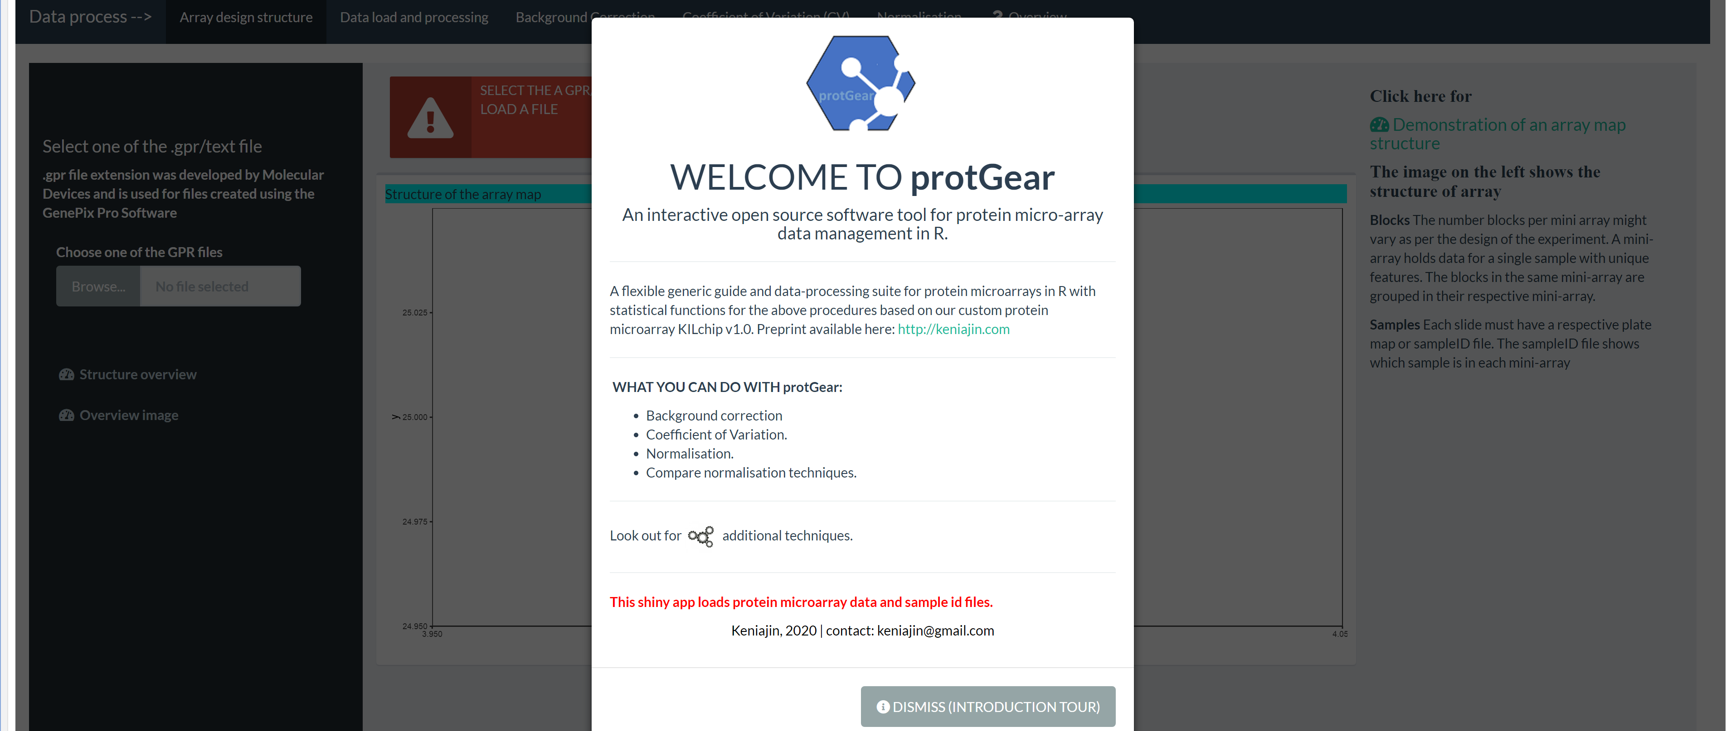
Figure 1: The protGear Shiny® app interface on load

Slide 2
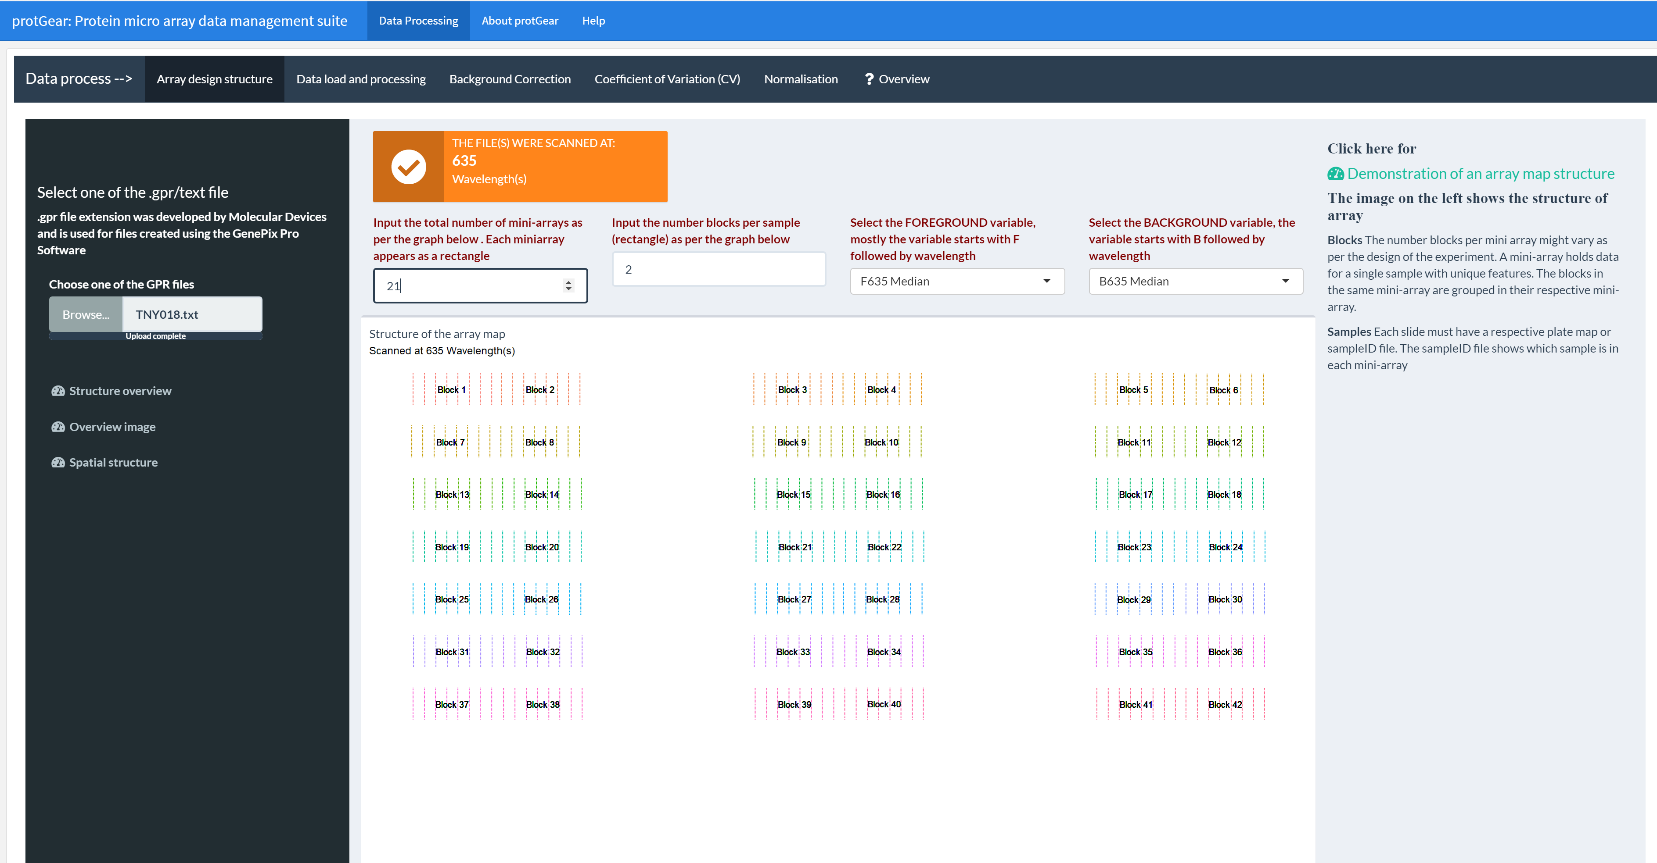
Figure 2: Checking the array design structure

Slide 3
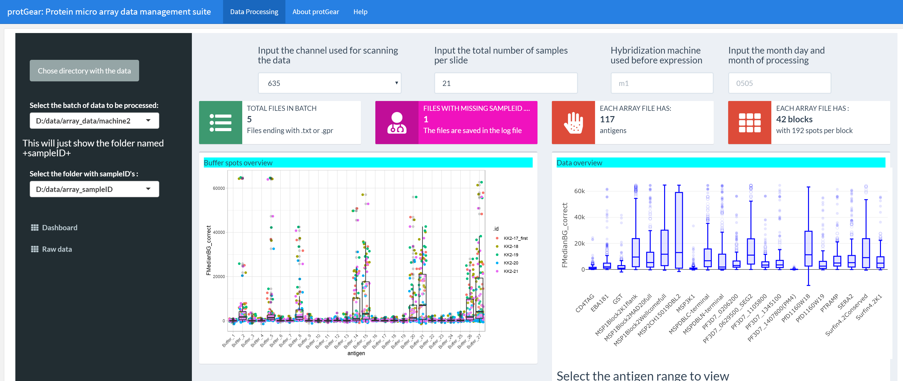
Figure 3: Loading the array data files

Slide 4
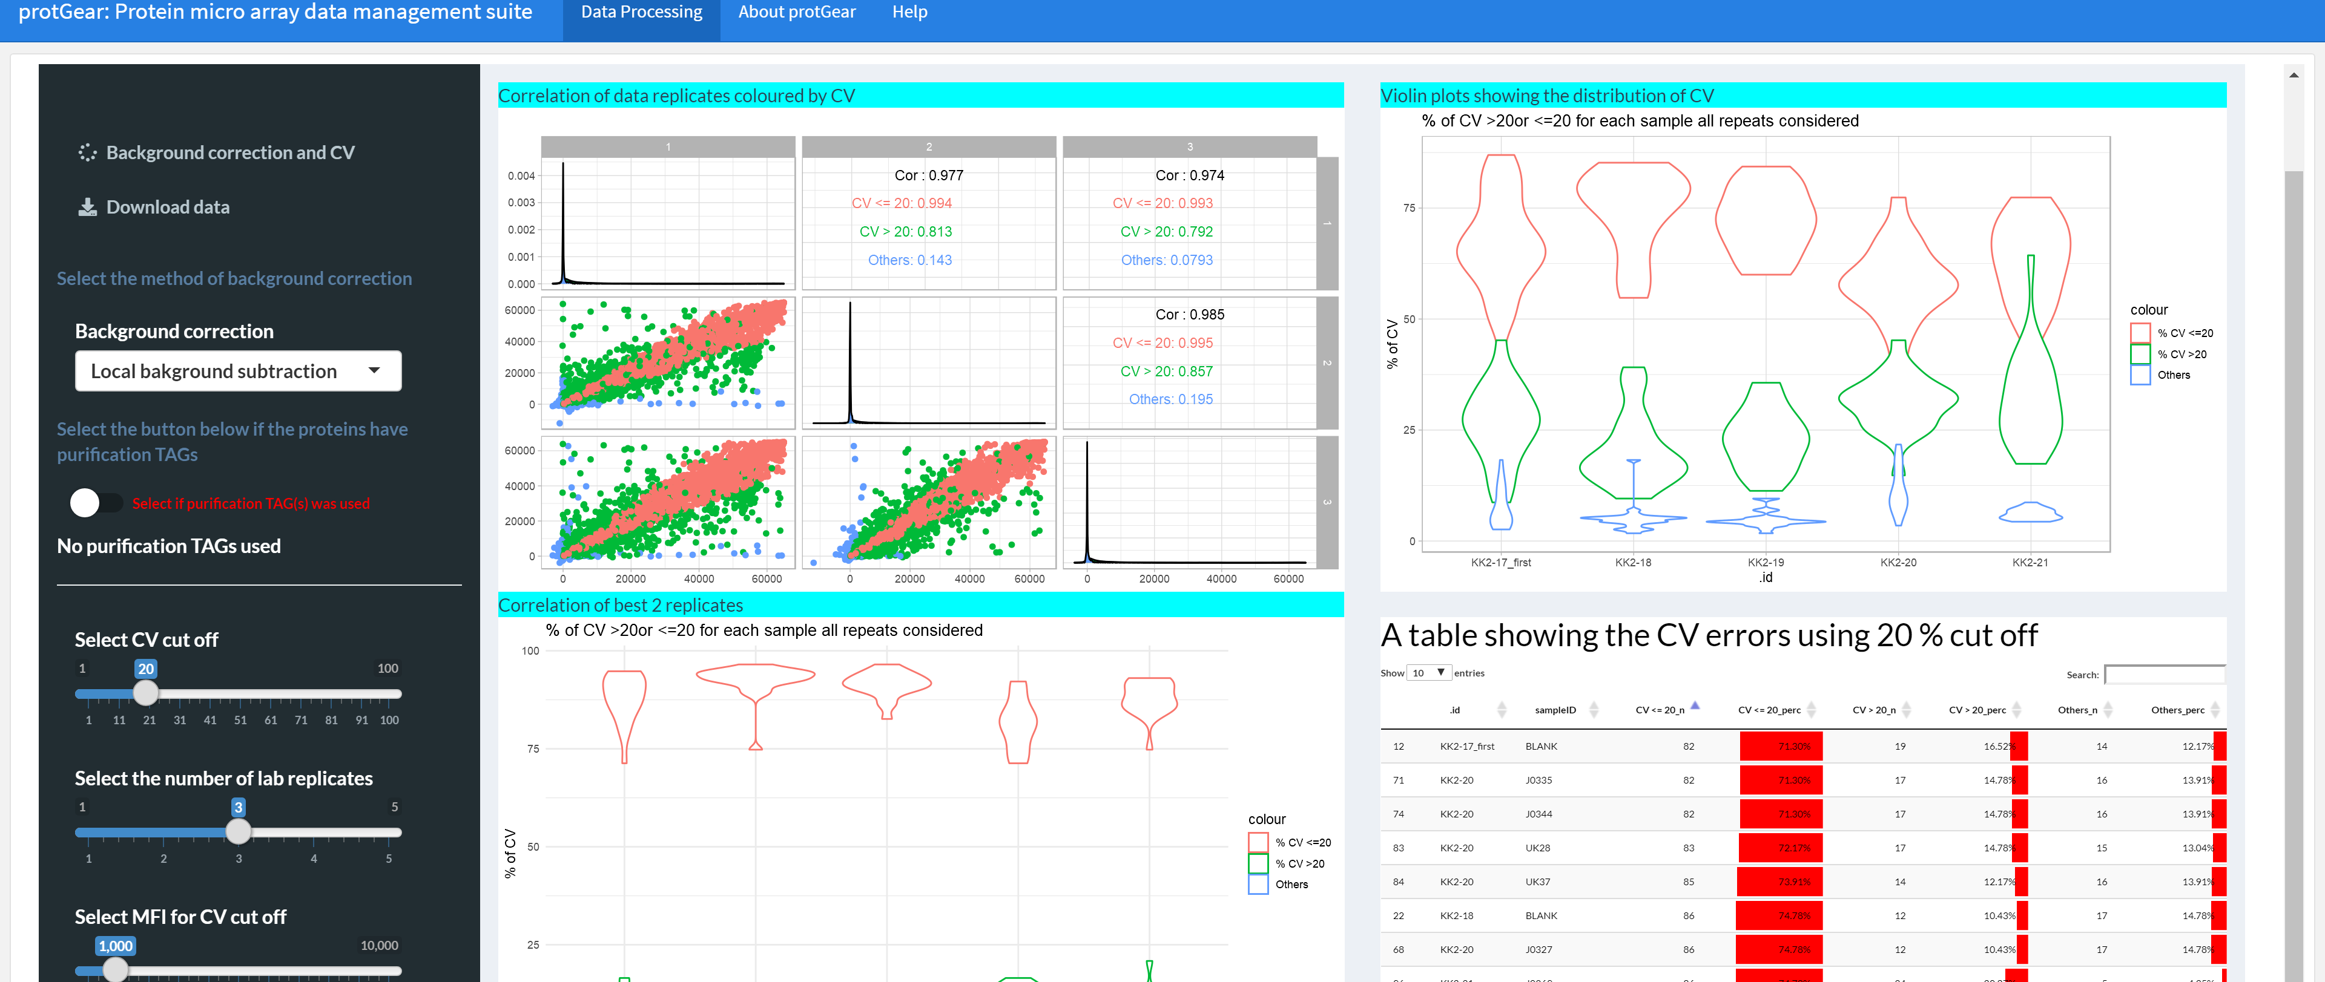
Figure 4: The visualization of the CV on the dashboard

Slide 5
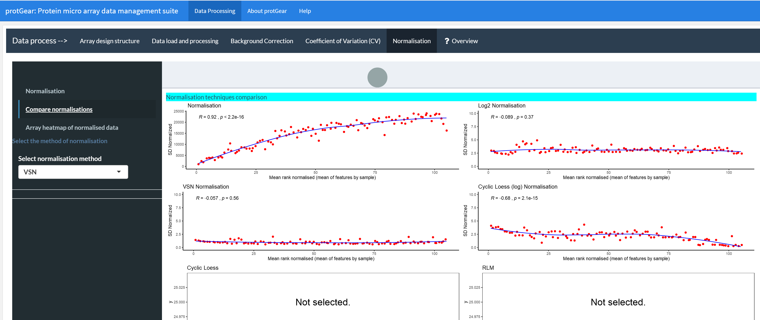
Figure 5: Normalisation

Slide 6
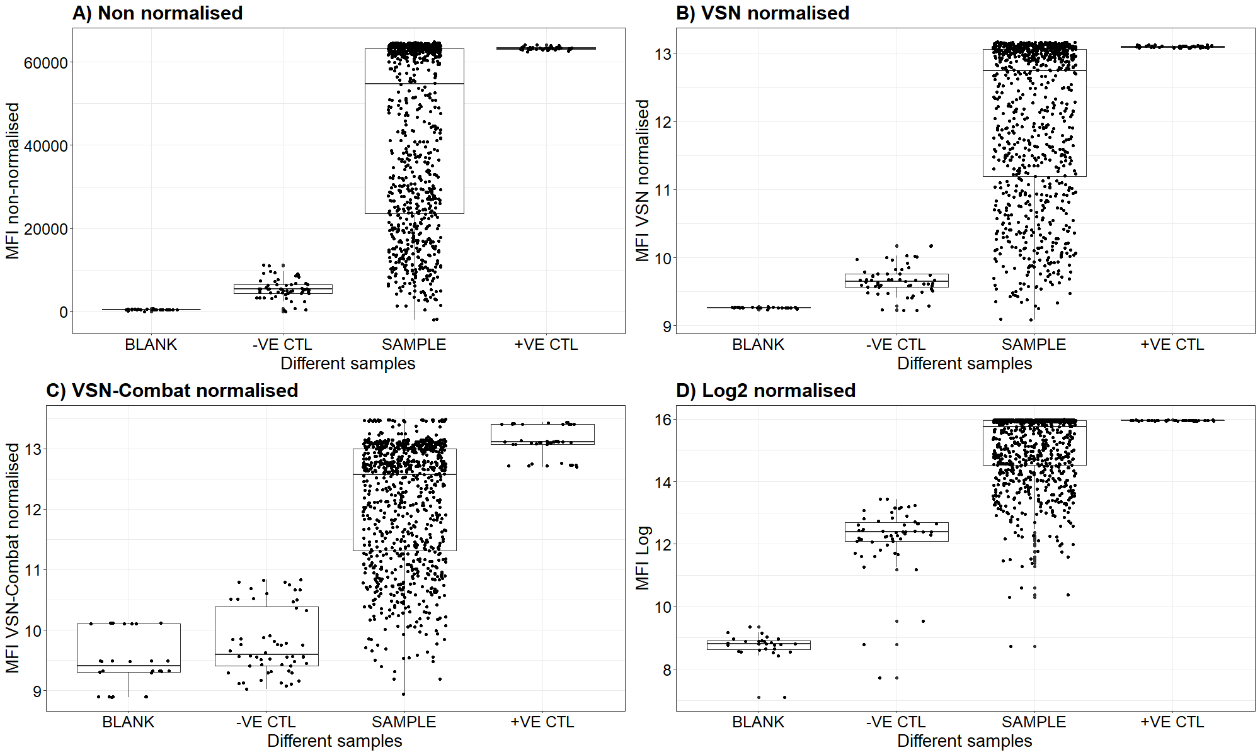
Figure 6: Comparison of normalization
Figure 6: Performance of VSN and log normalisaiton A) non-normalised data, B) VSN without batch correction, D) Log normalization on blank which is the sample buffer labeled as BLANK , negative (malaria naïve sera) controls labeled as -VE CTL, serum samples labeled as SAMPLE and positive (malaria immune sera) controls labeled as +VE CTL. This is a sample dataset of the KILchip v1.0 which was used as the test data in this tool.

