Slide 1
Figure S1
A
30
Normoxia
Hypoxia
20
Relative RNA expression
(fold change)
10
0
PANX2
PIANP
SHISA7
SLC6A8
TUBB4A
KDM6B
RNF208
CYP2T1P
LINC00603
C19orf54
BCORL1
MTND2P28
RP11-973D8.5
RP11-386I14.4
RP11-707G18.1
B
30
Normoxia
27
Hypoxia
24
21
Relative RNA expression
(fold change)
9
6
3
0
SLC35G5
SLC6A8
SLC2A4
SLC9A1
SLC43A1
SLC39A4
SLC17A7
SLC6A19
SLC25A23
SLC12A7
SLC22A23
SLC6A21P
SLC35E1P1
SLC9A3R2
SLC25A25-AS1

Slide 2
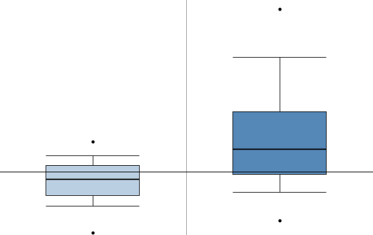
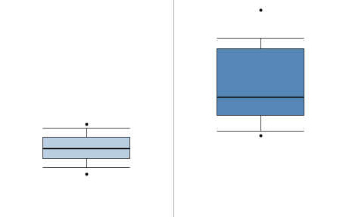
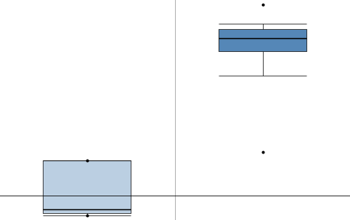
Figure S2
P=2.02 × 10⁻⁶
Bladder cancer
P=1.67 × 10⁻⁵
Colorectal cancer
5.0
0.0
4.0
-0.5
3.0
-1.0
2.0
Log2 median-centered intensity
Log2 median-centered intensity
-1.5
1.0
0.0
-2.0
-1.0
-2.5
-2.0
Bladder
BC
Colon
CRC
P=1.61 × 10⁻⁶
Esophageal Squamous Cell Carcinoma
P=7.21 × 10⁻⁷
Clear Cell Renal Cell Carcinoma
5.0
6.0
4.0
5.0
3.0
4.0
Log2 median-centered intensity
Log2 median-centered intensity
3.0
2.0
2.0
1.0
1.0
0.0
Esophagus
ESCC
0.0
Fetal
Kidney
Kidney
CCRC
P=4.70 × 10⁻⁷
Squamous Cell Lung Carcinoma
P=1.92 × 10⁻⁸
Melanoma
8.0
4.0
6.0
3.0
4.0
2.0
2.0
Log2 median-centered intensity
Log2 median-centered intensity
0.0
1.0
-2.0
0.0
-4.0
Lung
SCLC
Skin
Melanoma

Slide 3
Figure S3
A
B
Relative HIF1A mRNA
expression
1.5
shNC
shHIF1A
Relative HIF2A mRNA
expression
1.5
shNC
shHIF2A
1.0
**
**
1.0
**
**
0.5
0.5
0.0
0.0
MDA-MB-231
BT549
MDA-MB-231
BT549
MDA-MB-231
BT549
MDA-MB-231
BT549
HIF1A
shNC
shHIF1A
shNC
shHIF1A
HIF2A
shNC
shHIF2A
shNC
shHIF2A
β-Actin
β-Actin
C
D
Relative Slc6a8 mRNA
expression
1.5
shNC
shHIF1A
Relative Slc6a8 mRNA
expression
1.5
shNC
shHIF2A
1.0
1.0
0.5
0.5
0.0
0.0
MDA-MB-231
BT549
MDA-MB-231
BT549
MDA-MB-231
BT549
MDA-MB-231
BT549
SLC6A8
shNC
shHIF1A
shNC
shHIF1A
SLC6A8
shNC
shHIF2A
shNC
shHIF2A
β-Actin
β-Actin
E
F
10
R=0.02398 P=0.7992
10
R=0.08047 P=0.3926
8
8
The expression of HIF1A
log2(TPM_Value +1)
The expression of HIF2A
log2(TPM_Value+1)
6
6
4
4
2
2
2
4
6
8
10
2
4
6
8
10
The expression of Slc6a8
log2(TPM_Value +1)
The expression of Slc6a8
log2(TPM_Value +1)

Slide 4
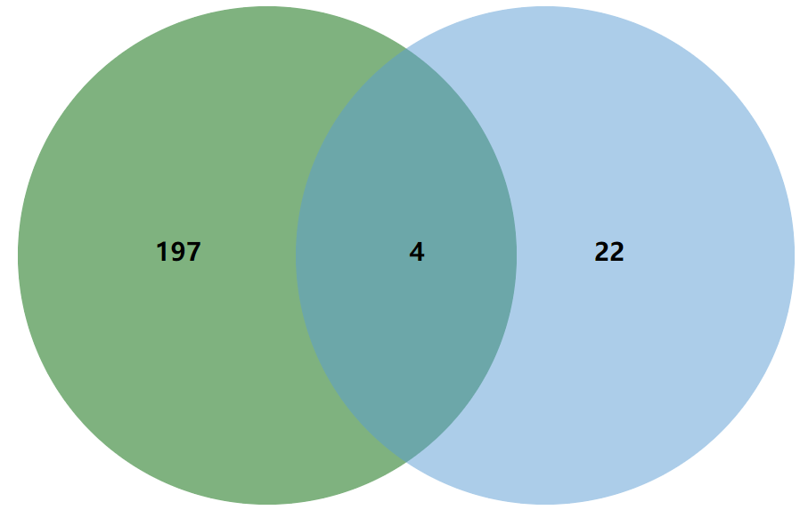
Figure S4
A
B
Hypoxia-upregulated TFs
10
R=-1.153 P=0.2198
Predicted TFs of Slc6a8
8
197
TP53
The expression of TP53
log2(TPM_Value +1)
p65/NF-κB
6
4
FOS
4
22
ETV4
2
2
4
6
8
10
The expression of Slc6a8
log2(TPM_Value +1)
C
D
12
R=0.01034 P=0.9127
8
R=0.09292 P=0.3233
10
6
8
The expression of ETV4
log2(TPM_Value +1)
The expression of FOS
log2(TPM_Value +1)
4
6
2
4
2
0
2
4
6
8
10
2
4
6
8
10
The expression of Slc6a8
log2(TPM_Value+ 1)
The expression of Slc6a8
log2(TPM_Value+ 1)
E
30
MDA-MB-231
BT549
Norx
24
Hypx
18
12
Relative mRNA expression
4
2
0
FOS
TP53
FOS
ETV4
TP53
ETV4
p65/NF-κB
p65/NF-κB

Slide 5
Figure S5
A
MDA-MB-231
BT549
Norx
Hypx
Norx
Hypx
shNC
shNC+Cr
JC-1 aggregate
shSlc6a8
shSlc6a8+Cr
B
MDA-MB-231
BT549
Norx
Hypx
Norx
Hypx
shNC
shNC+Cr
ROS
shSlc6a8
shSlc6a8+Cr

Slide 6
Figure S6
A
Hypoxia
2.0
shNC
shNC+Cr
shNC+NAC
**
*
1.5
**
*
Cell viability
(Relative absorbance)
1.0
0.5
0.0
MDA-MB-231
BT549
B
Hypoxia
shNC
shNC+Cr
shNC+Cr+AKTi
2.0
**
**
1.5
*
*
Cell viability
(Relative absorbance)
1.0
0.5
0.0
MDA-MB-231
BT549

