Slide 1
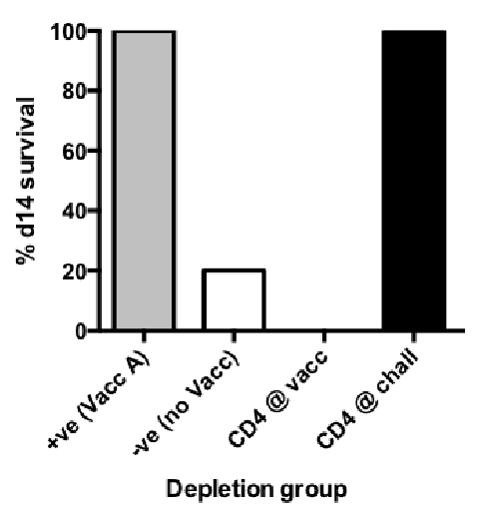
Supplementary Figure 1: T cell depletion with H1N1 challenge shows CD4 T cells are needed at vaccination for optimal protection. Mice were treated as per Figure 3A with anti-CD4 and CD8 monoclonal antibodies, and challenged with 10LD₅₀ A/California/07/2009 pandemic H1N1 virus. (A) Survival at day 14 post infection (n=5). (B) Lung viral loads by TCID50 MDCK assay (n=3).

