Slide 1
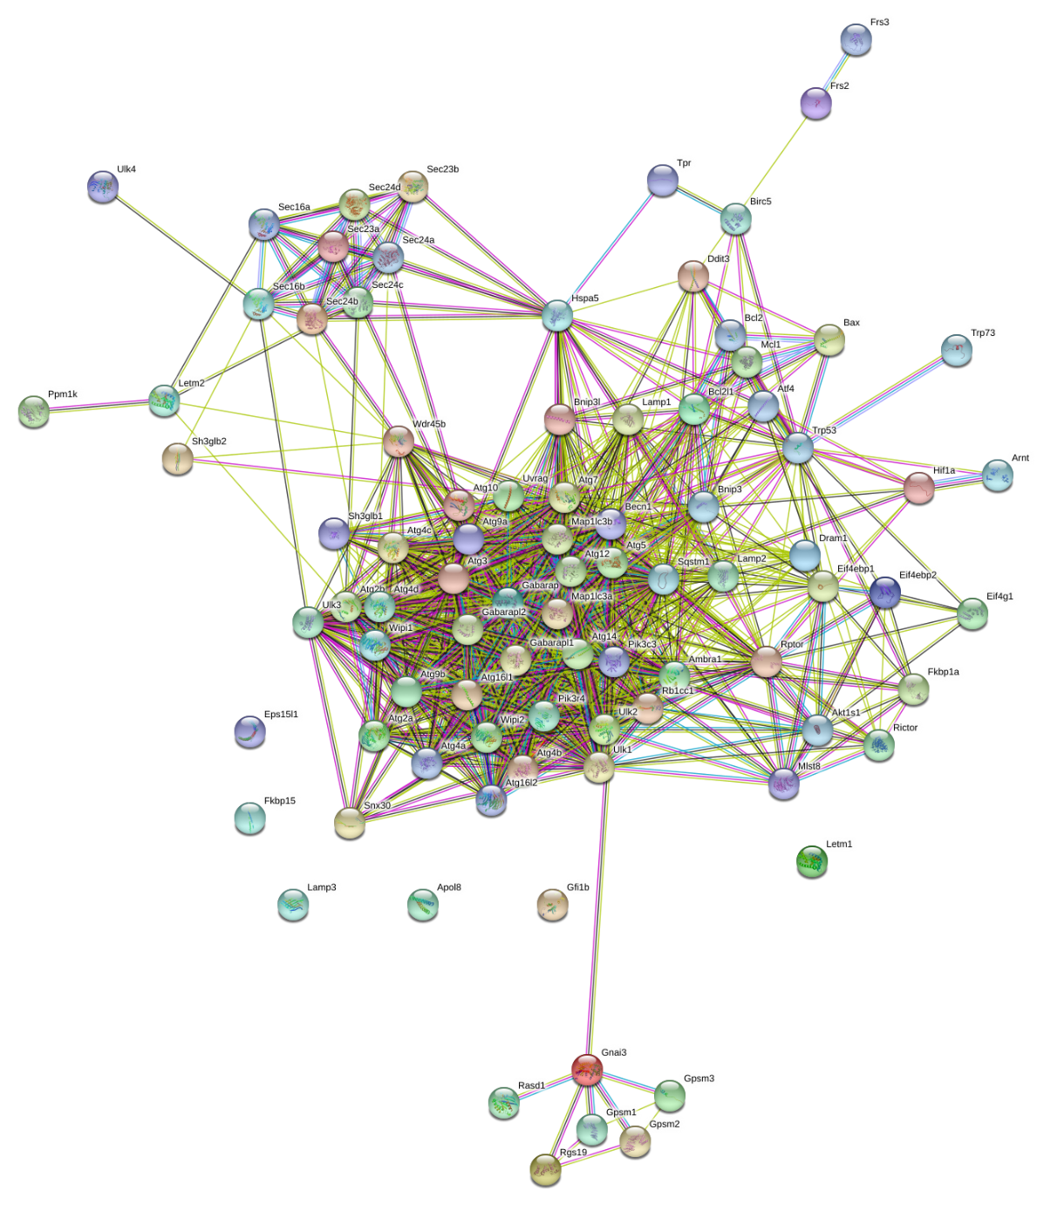
Supplementary Figure 1
Supplementary Fig 1: STRING clustering analysis of 88 autophagic genes under study to evaluate the strength of interactions among genes. The altered genes (ATG16L1, ATG3, ATG7, DRAM1, MAP1LC3A, SQSTM1, ULK3, UVRAG) are central in the pathway.

