Slide 1
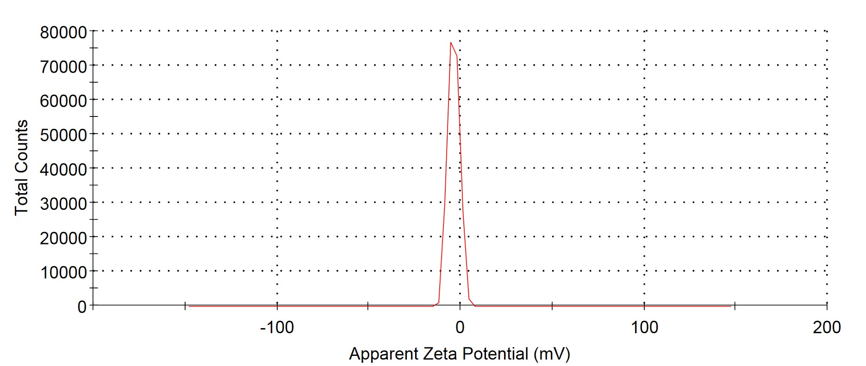
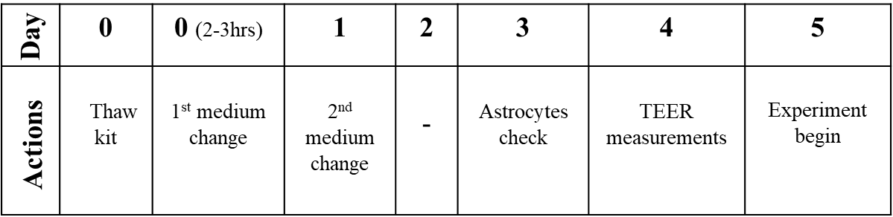
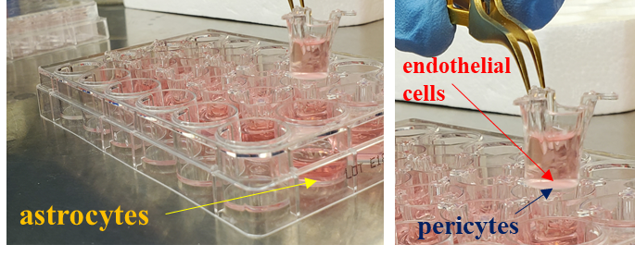
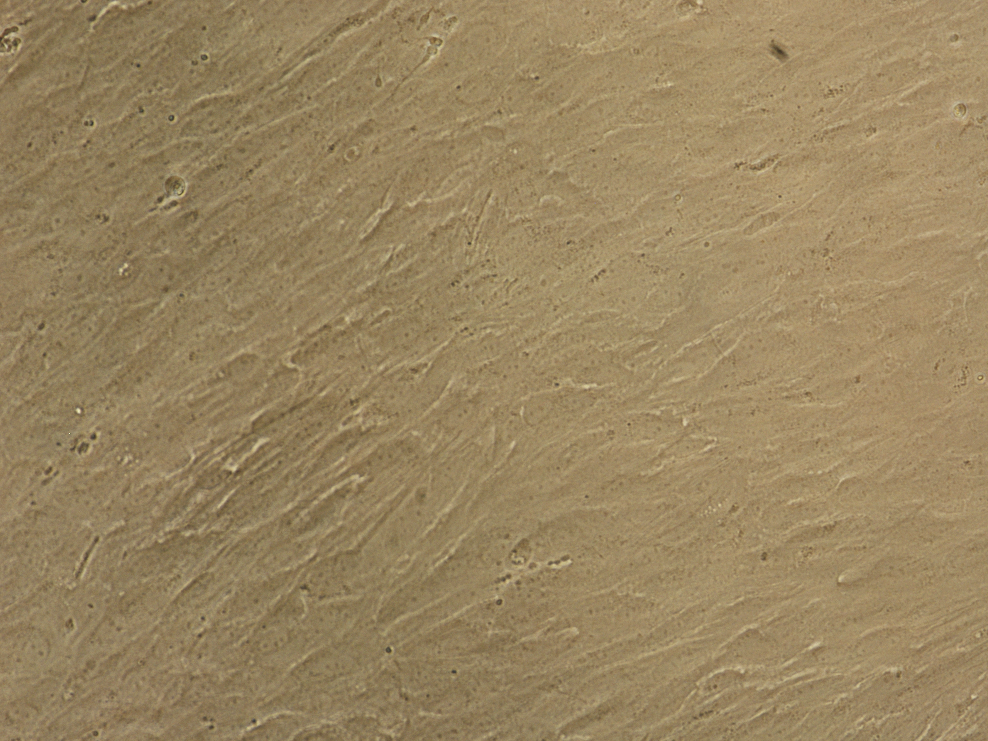
Supplementary figure 1
a
b
c
Astrocytes
(Day-3)
500 μM
Supplementary figure 1: (a) UV spectra of mimosine coated gold nanoparticles (Mimo-AuNPs) displaying the surface plasmon resonance for gold (~525nm) after 2 (black) and 367 (red) days indicating the stability of the nanoparticles. The concentration of the recorded sample was 1mM. (b) The surface zeta potential graph for Mimo-AuNPs showing a zeta potential of -6mV. (c) Sketch diagram depicting the ability of Mimo-AuNPs to cross the blood-brain barrier (BBB) using commercial RBT-24 kit. In brief, the culture plate comprising co-cultures of rat brain astrocytes (lower compartment), pericytes (basolateral) and vascular endothelial cells (apical) as shown in lower panel was first thawed using the media provided by the company. Subsequently, media changes were made to achieve cell growth and to develop BBB integrity at 37°C in 5% CO₂ over 4-5 days. On day 3, the morphology of the astrocytes was observed for confluency. On day 4, to evaluate the integrity of the formed endothelial barrier and tight junctions, the trans endothelial resistance (TEER) of the cells was measured using EVOM2-Epithelial Voltohmmeter. The TEER value was calculated by the formula as indicated in the manuscript. The wells which showed TEER value > 150 Ω x cm² were subjected to the experiments. On day 5, 900µl assay buffer was added to the brain side (i.e., astrocytes) and the drugs (i.e., 50μM mimosine, AuNPs and Mimo-AuNPs diluted in 200µl assay buffer) were added to the blood side (endothelial cells) of the trans wells. The plate was incubated for 30mins with mild shaking and then samples from both the apical and basolateral sides were collected and the concentrations of mimosine, AuNPs and Mimo-AuNPs were detected using UV visible spectra and DLS. The BBB apparent permeability co-efficient value (P_{app}), which represents the efficiency of the drug to cross BBB, was calculated according to the protocol.

