Slide 1
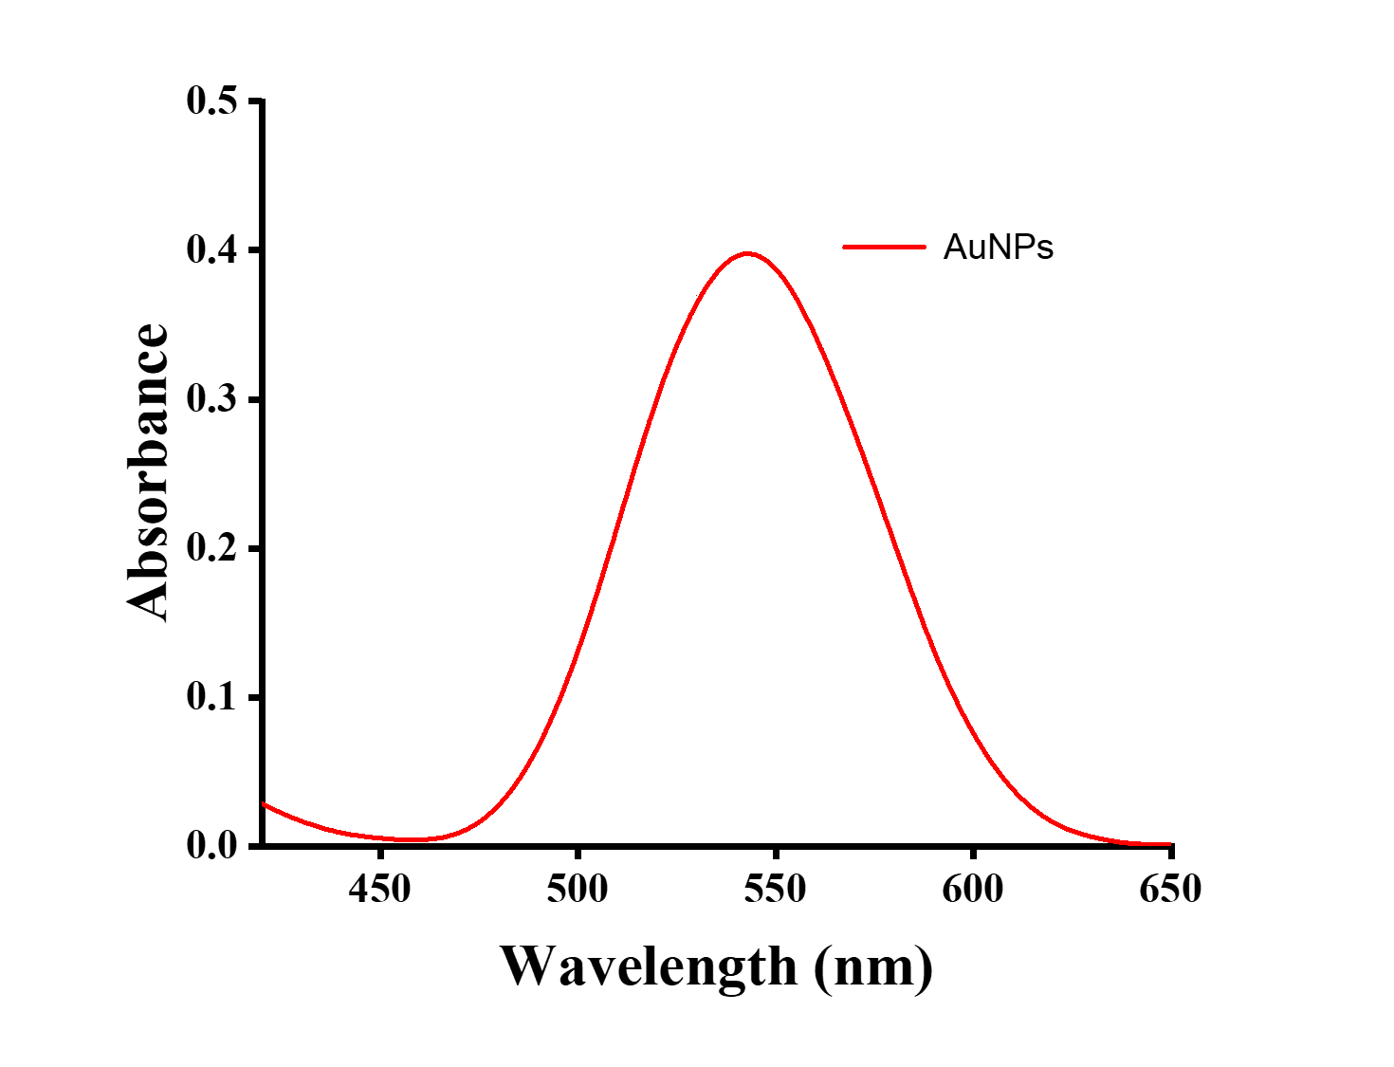
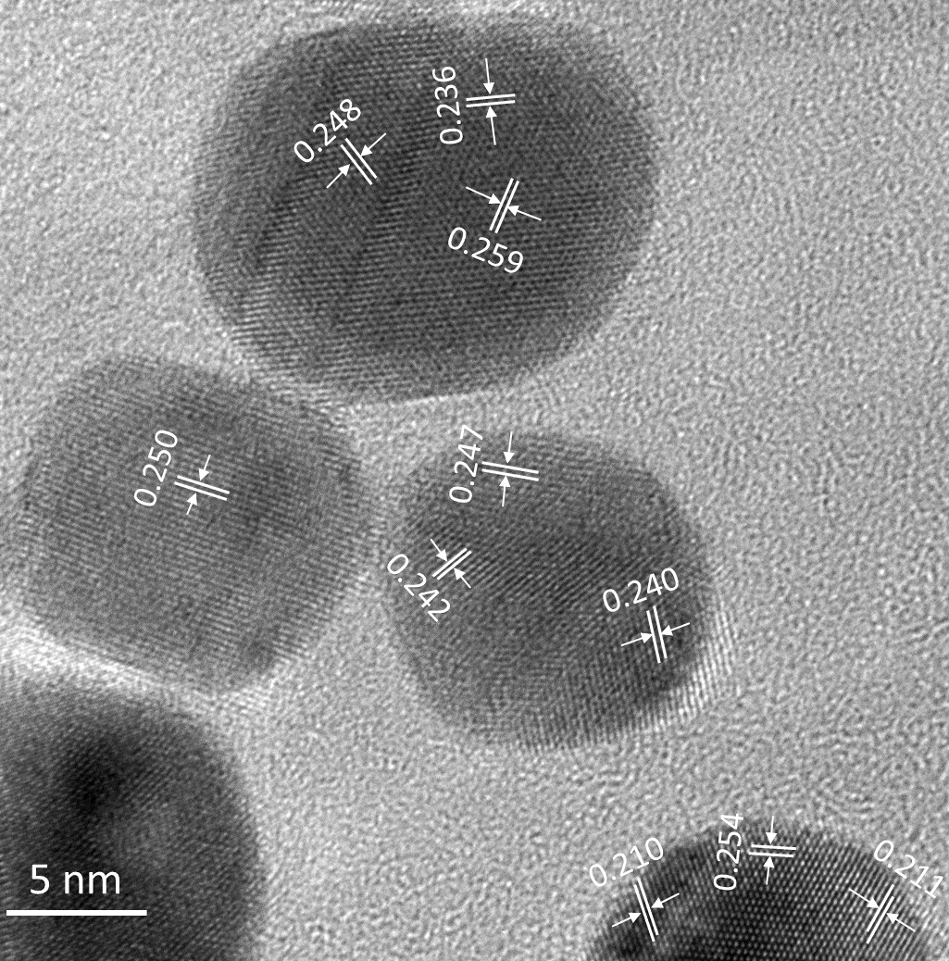
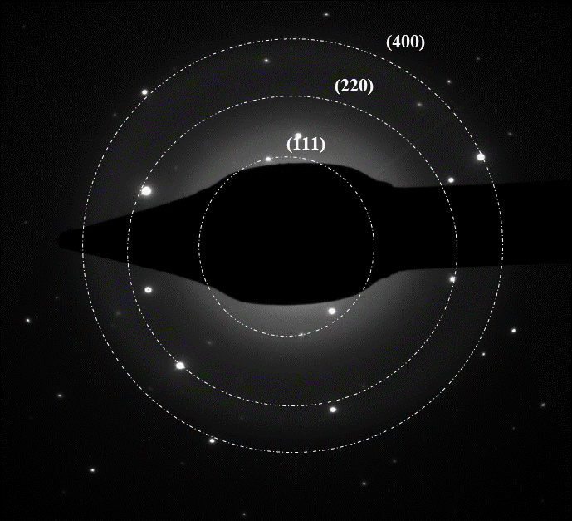
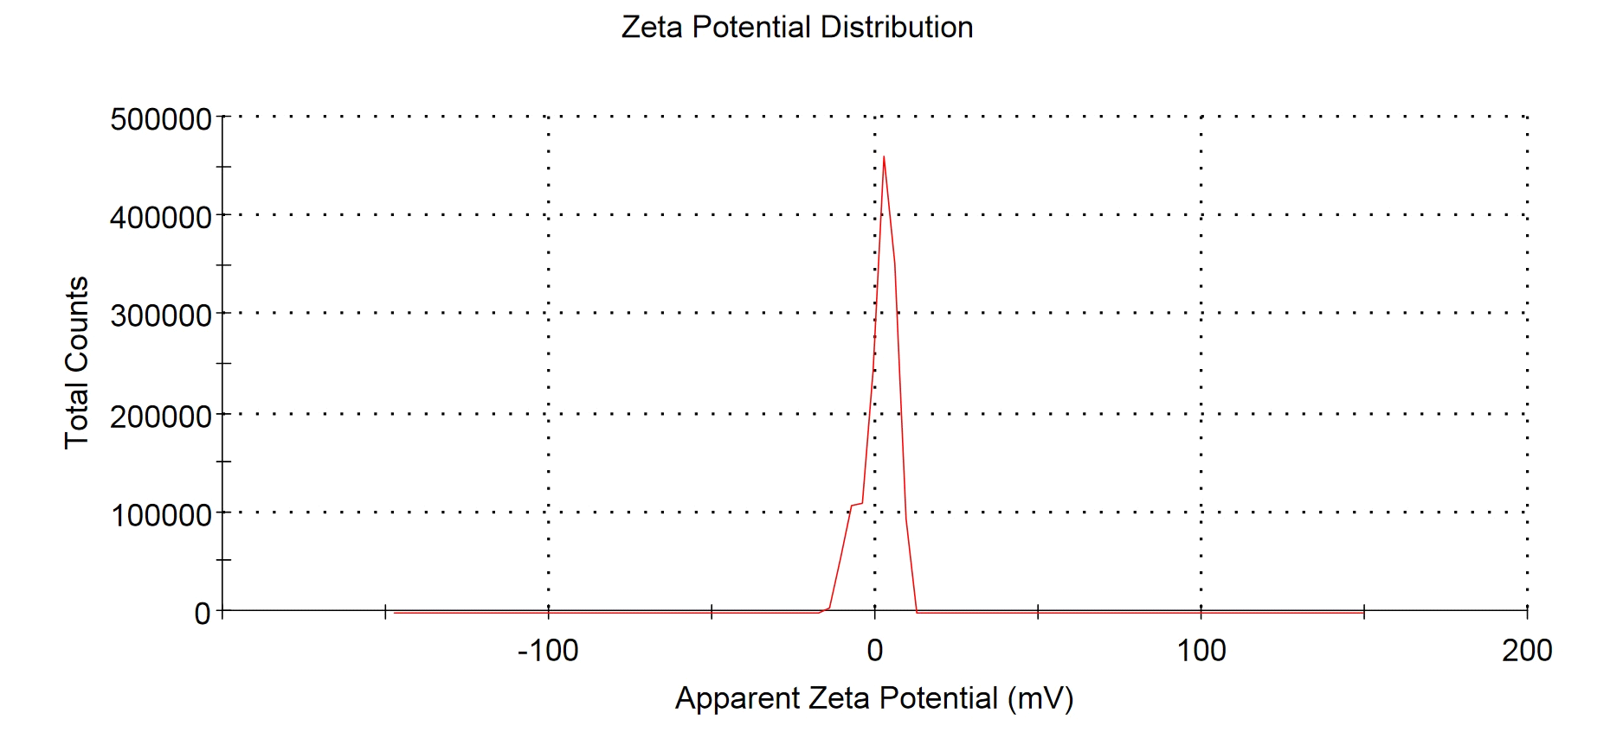
Supplementary figure 2
a
b
c
d
e
20
15
Intensity (Percent)
10
5
0
1
10
100
1000
10000
Size (d.nm)
Supplementary figure 2: (a) UV spectra of gold nanoparticles (AuNPs) displaying the surface plasmon resonance for gold (~530nm). (b) High resolution TEM data showing a fringe spacing of 2.1Å, 2.3Å, 2.4Å, and 2.5 Å of AuNPs. (c) Selected area electron diffraction pattern (SAED) of AuNPs showing the Scherrer ring patterns indicating (111), (220) and (400) FCC gold of nanocrystalline nature. (d) Dynamic light scattering (DLS) peak of AuNPs depicting an average diameter of ∼15-50nm. (e) The surface zeta potential graph of AuNPs showing a zeta potential of -1mV.

