Slide 1
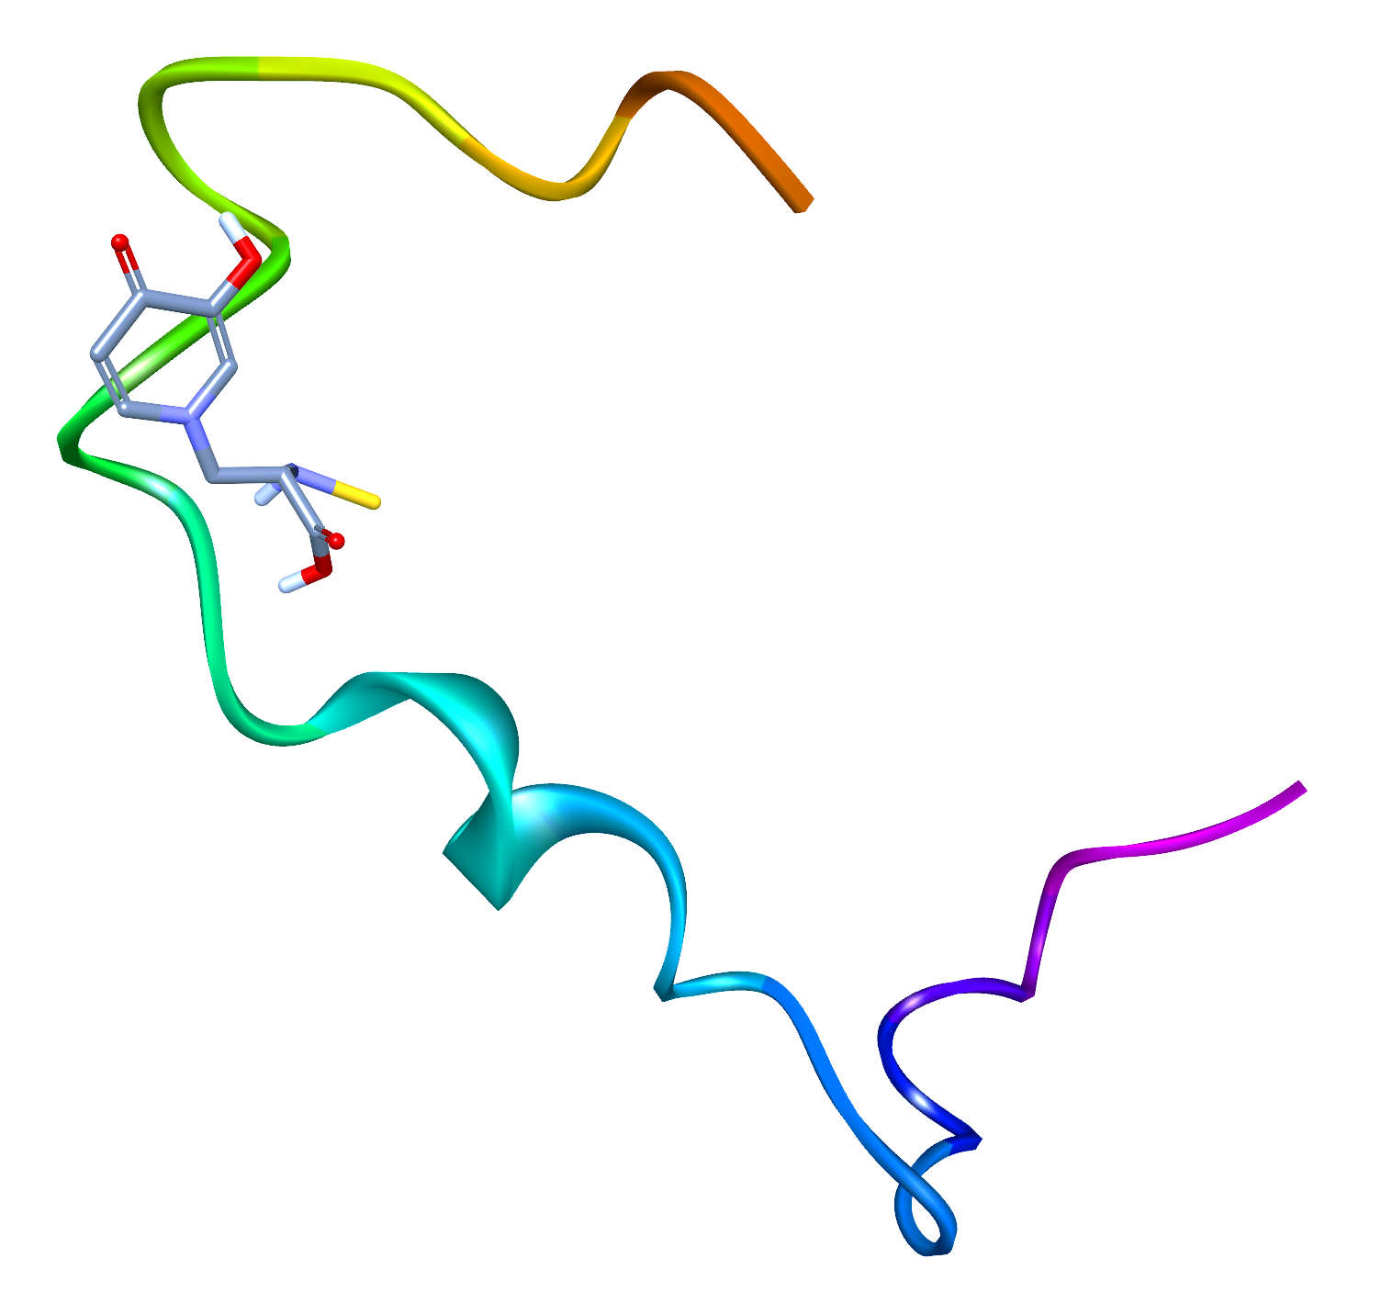
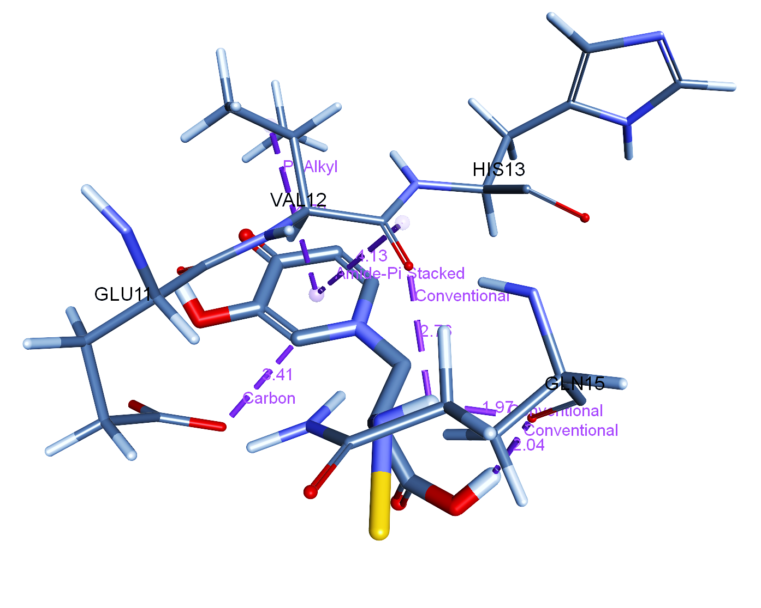
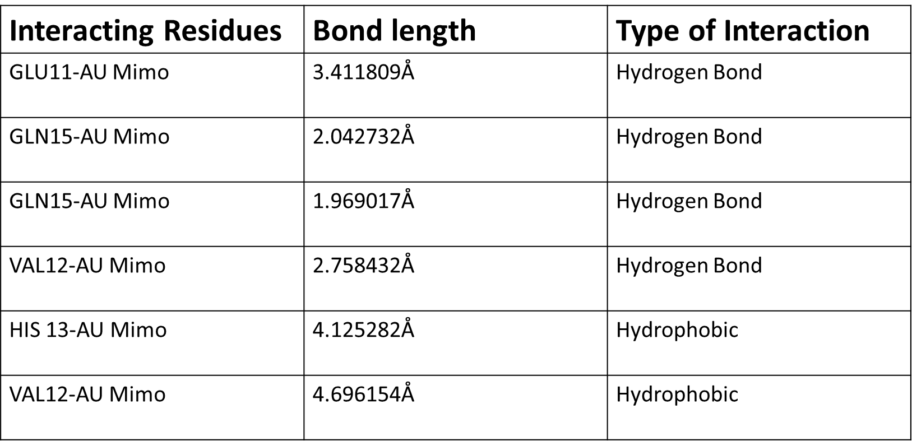
Supplementary figure 5
Supplementary figure 5: Molecular docking data using AutoDock Vina revealing the interaction of Mimo-AuNPs (Au-mimo) with the monomeric Aβ₁₋₄₂ (PDB: ID: 6SZF) representing 6 viable interactions including 4 hydrogen and 2 hydrophobic interactions with amino acid residues such as Glutamine, Valine, Glutamic acid and Histidine, respectively.

