Slide 1
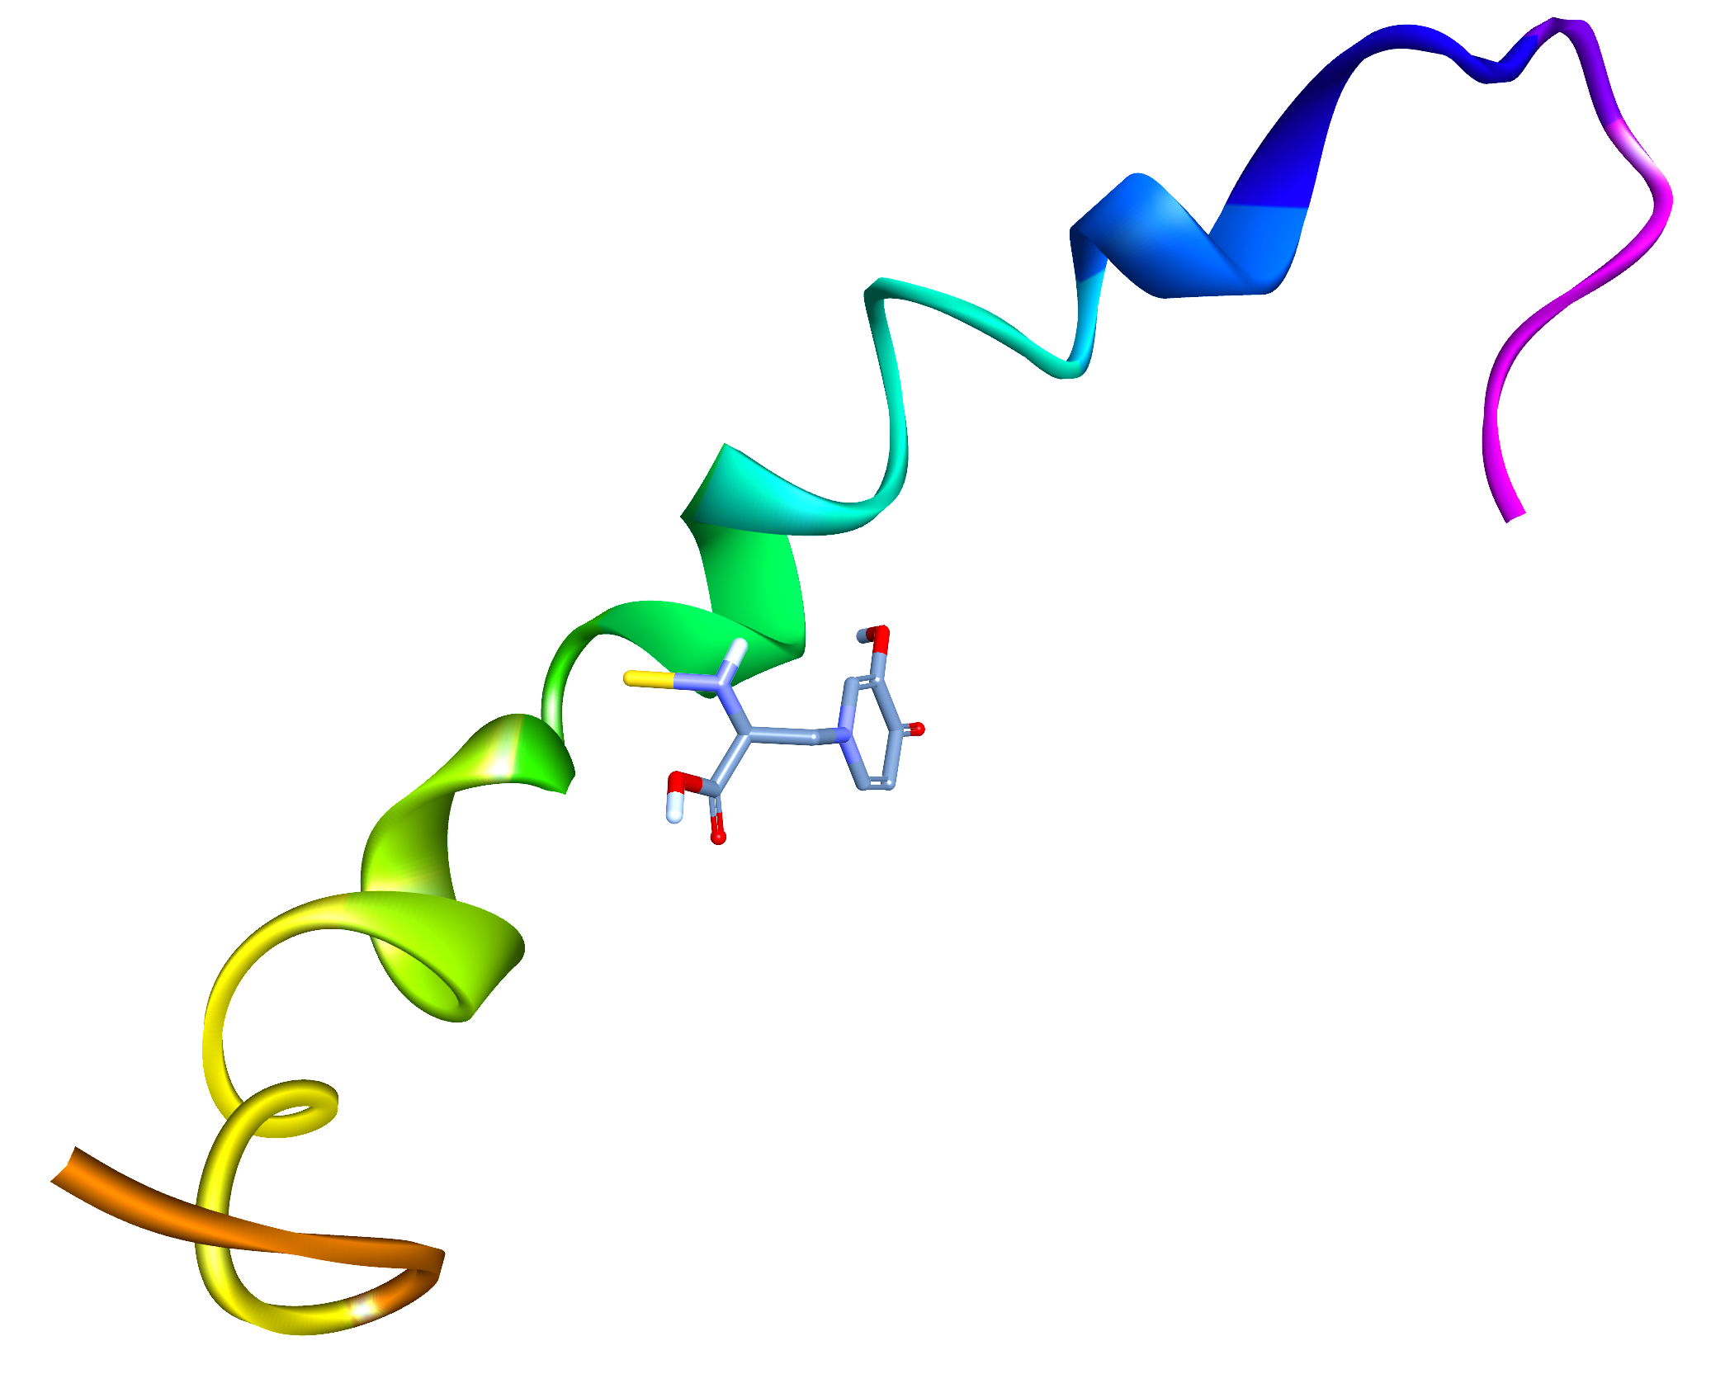
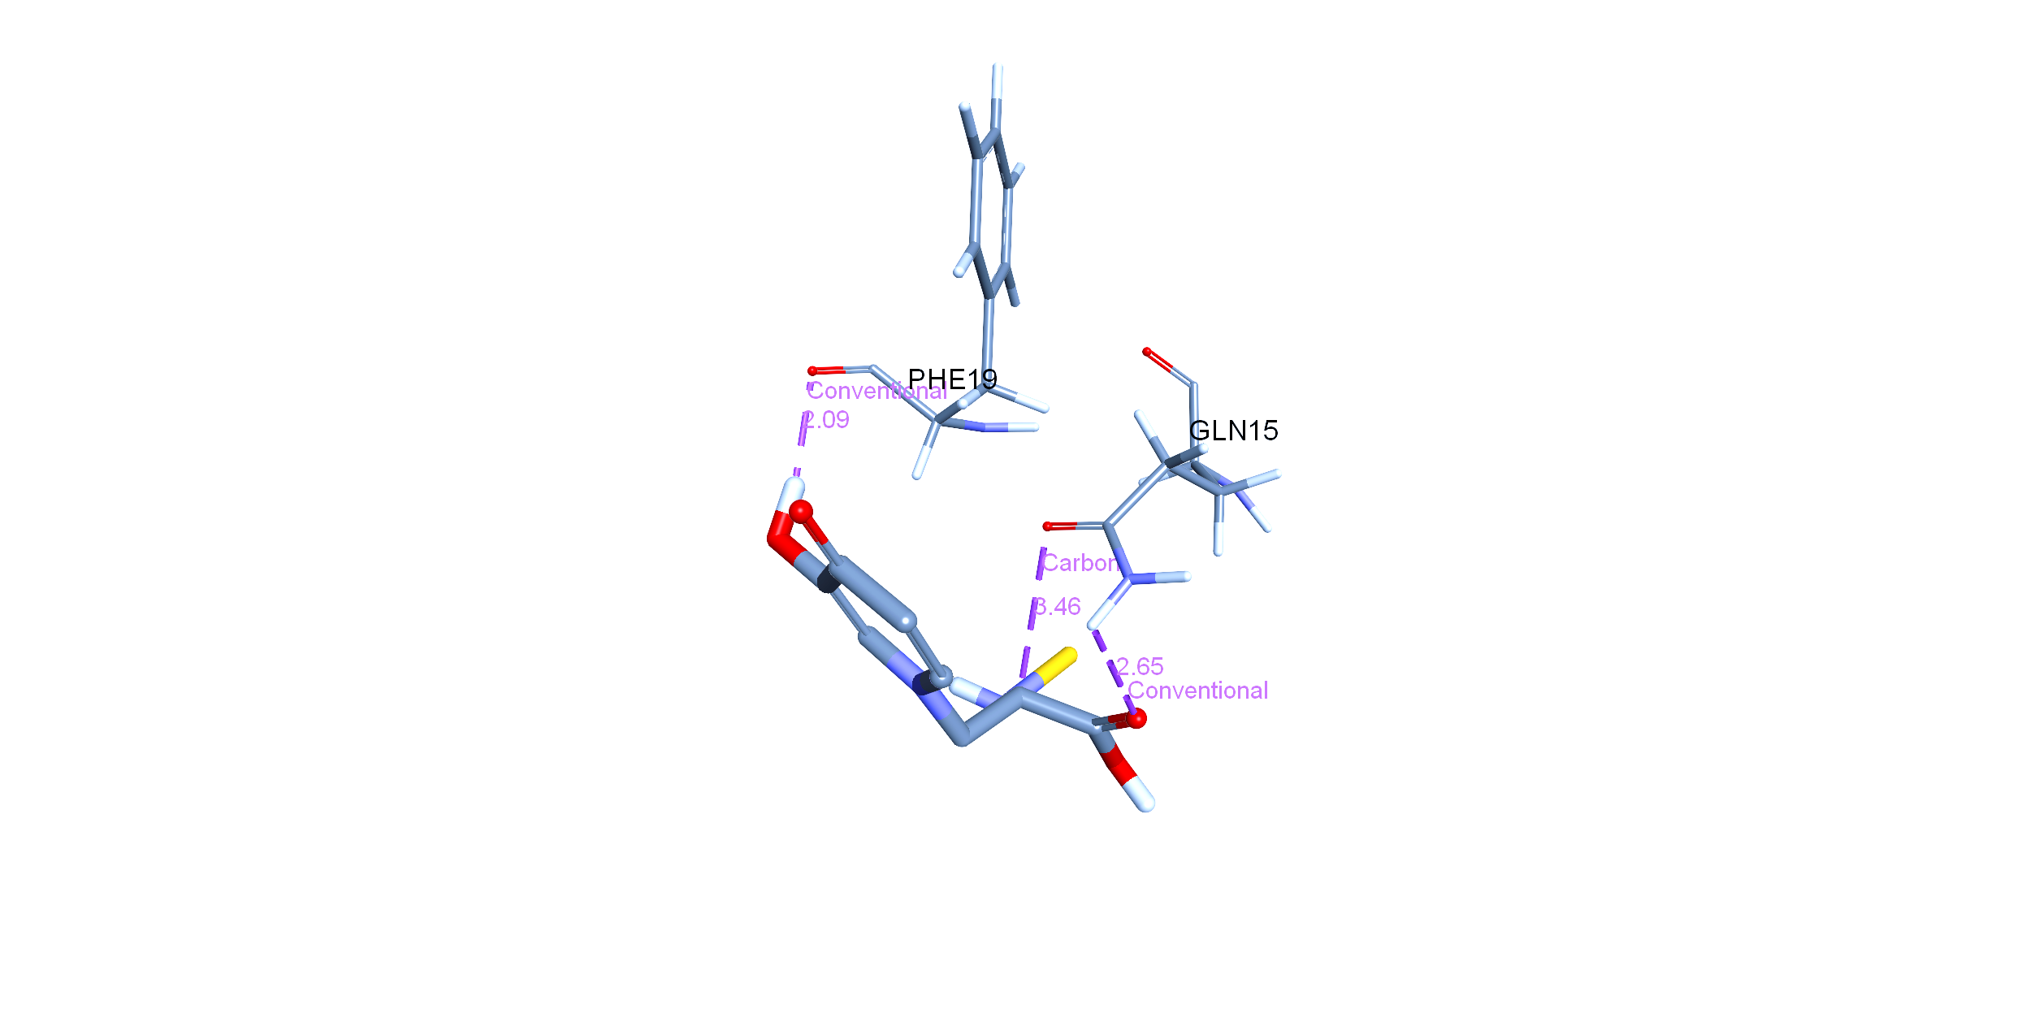
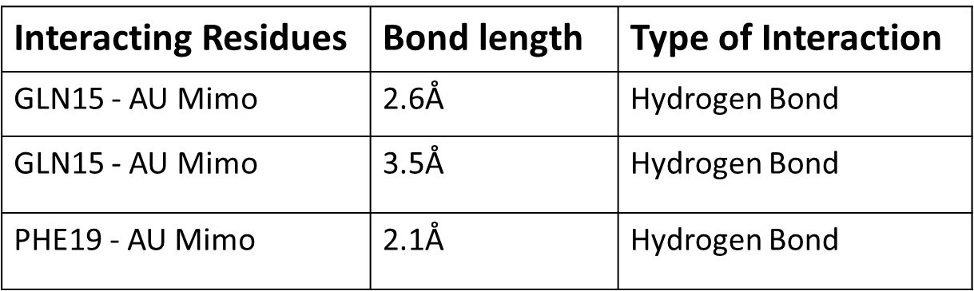
Supplementary figure 6
Supplementary figure 6: Molecular docking data using AutoDock Vina revealing the interaction of Mimo-AuNPs (Au-mimo) with the monomeric Aβ₁₋₄₂ (PDB: ID: 1ZOQ) representing 3 viable interactions including 3 hydrogen bonds with amino acid residues such as Phenylalanine and Glutamine, respectively.

