Slide 1
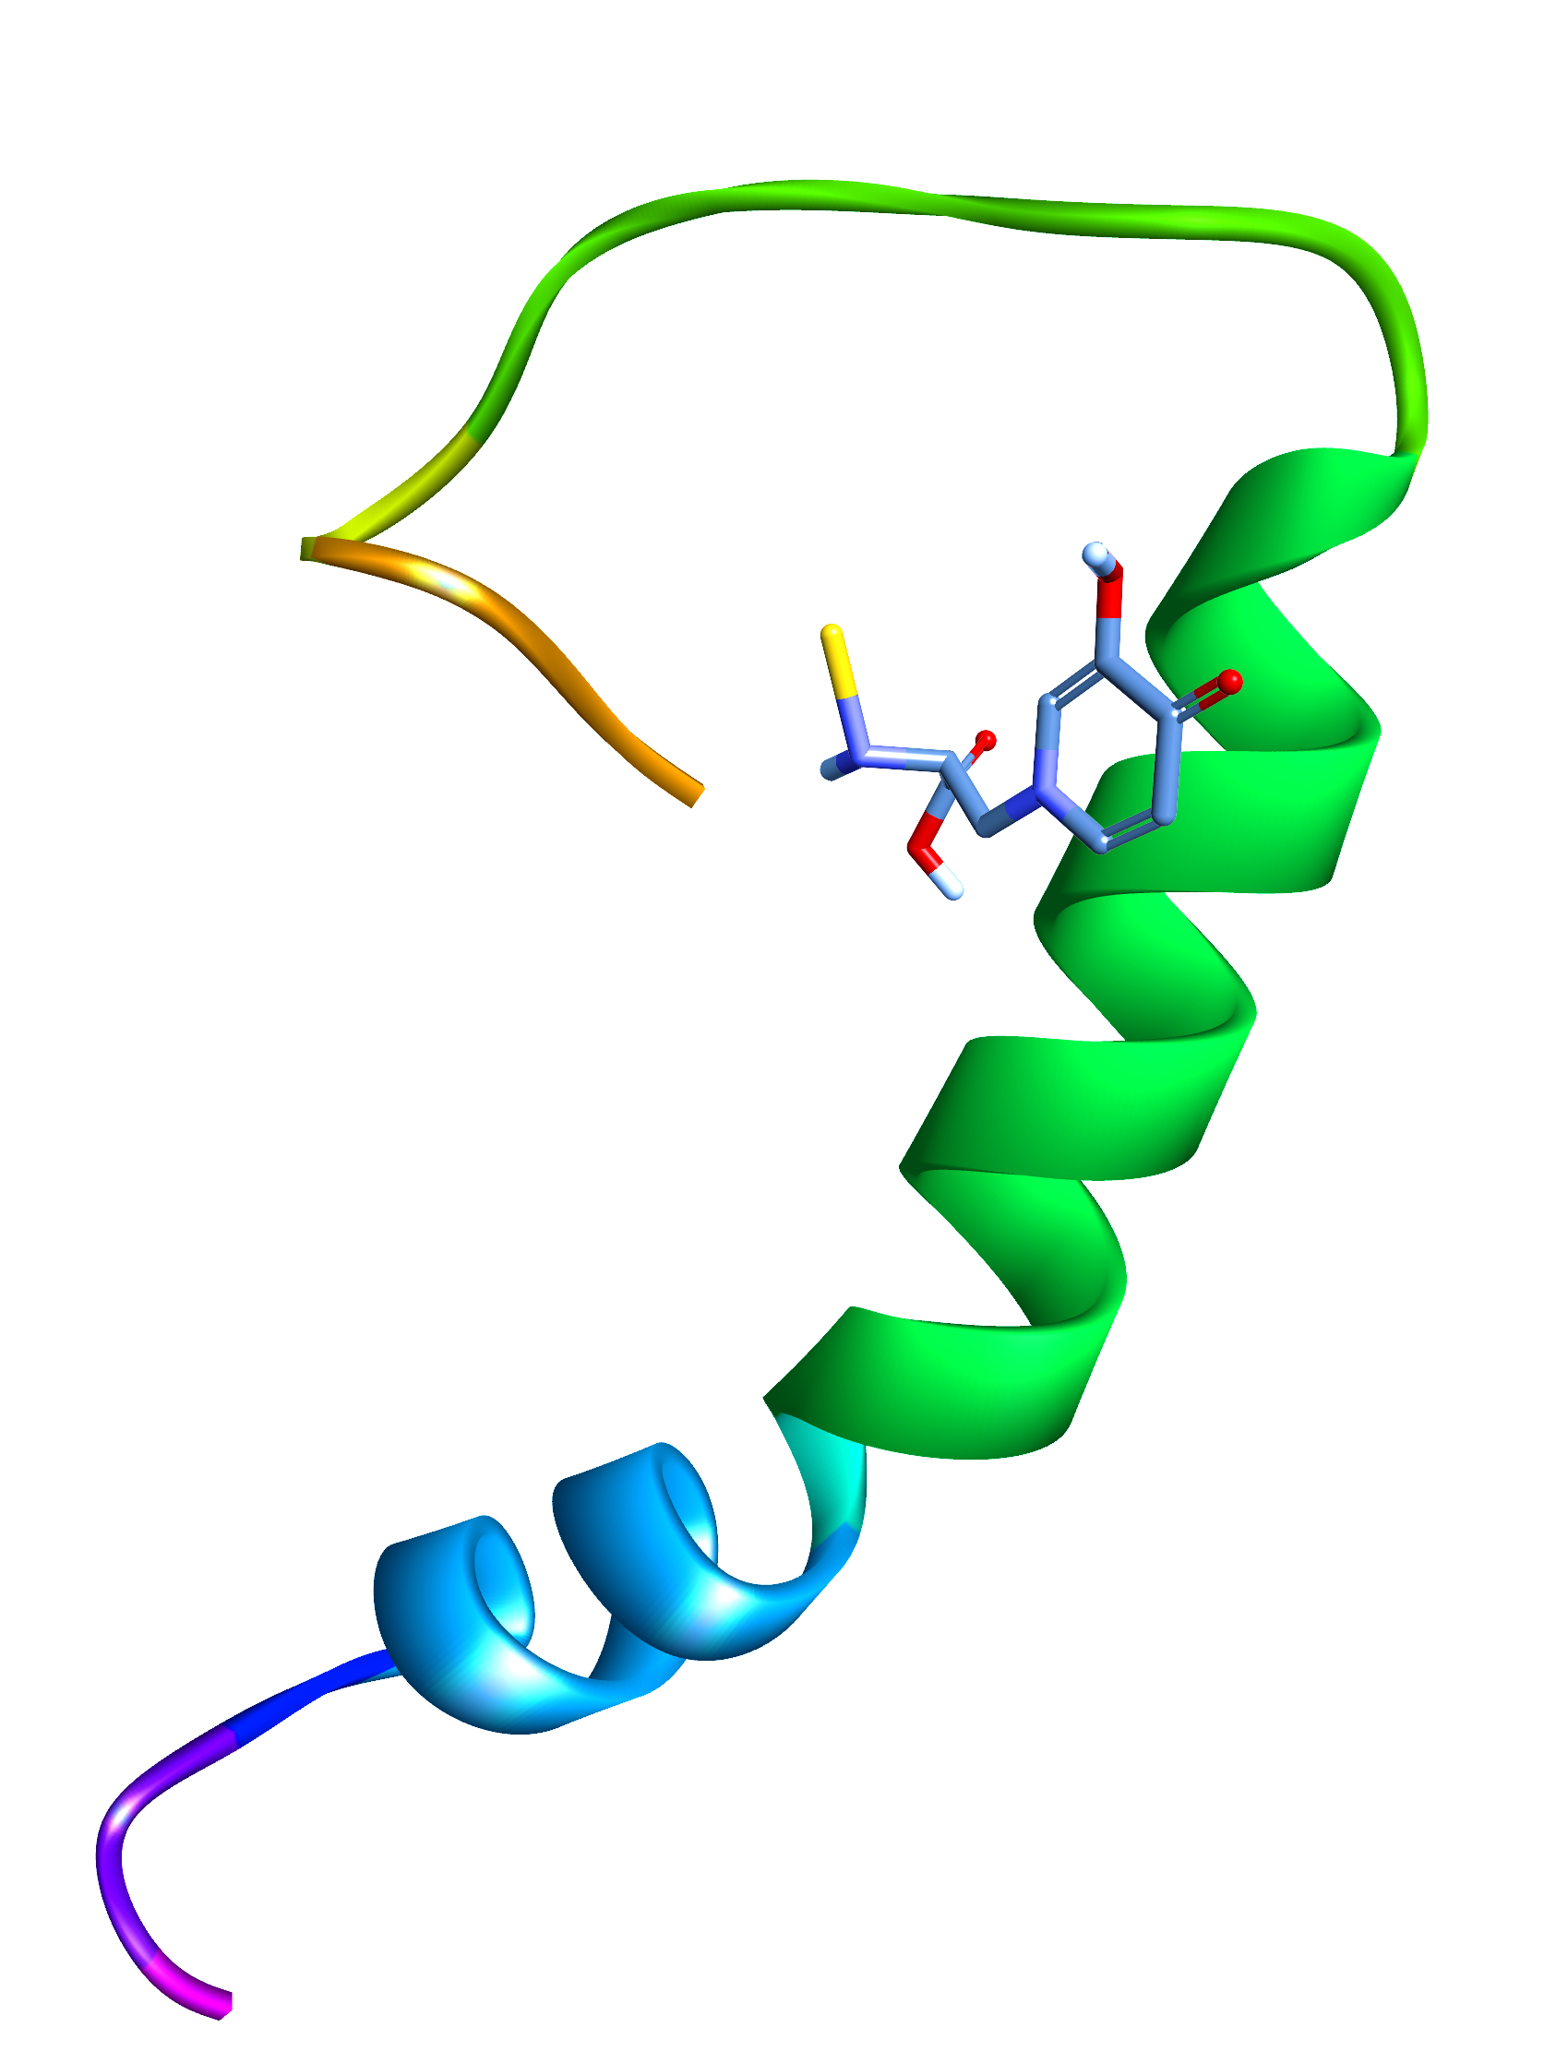
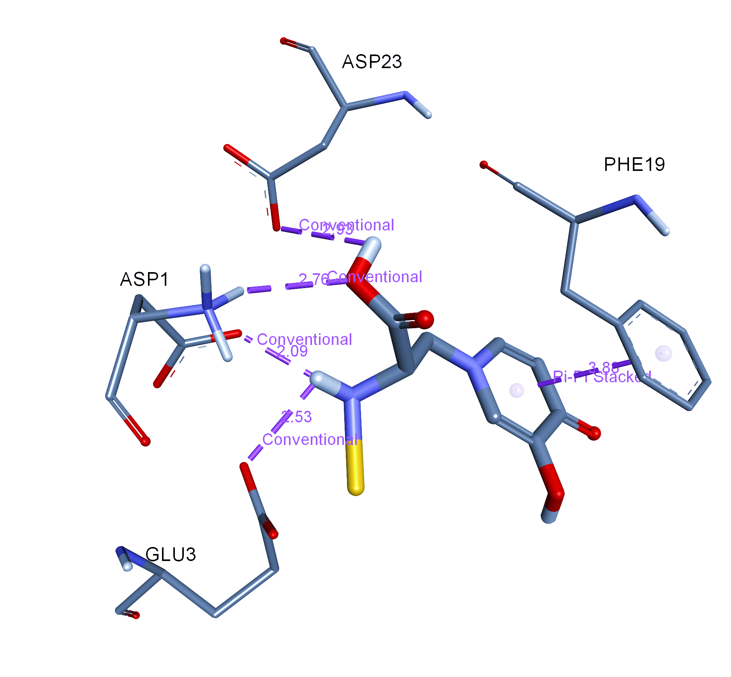
Supplementary figure 7
Supplementary figure 7: Molecular docking data using AutoDock Vina revealing the interaction of Mimo-AuNPs (Au-mimo) with the monomeric Aβ₁₋₄₀ (PDB: ID: 1BA4) representing 8 viable interactions including 7 hydrogen and 1 hydrophobic interactions with amino acid residues such as Phenylalanine, Lysine, Glutamic acid and Aspartic acid, respectively.

