Slide 1
Sup. Table 1. Demographic profile of 40 cases of OSCC in GSE 37991.
Variables | Categories | N (%)
Mean age | 49.3
Sex | Female | 0 (0.0)
 | Male | 40 (100.0)
Alcohol drinking | No | 8 (22.2)
 | Yes | 32 (77.8)
Betel quid chewing | No | 0 (0.0)
 | Yes | 40 (100.0)
Cigarette smoking | No | 0 (0.0)
 | Yes | 40 (100.0)
Location | Tongue | 24 (61.1)
 | Buccal | 16(38.9)
Lymph node metastasis | No | 23 (55.6)
 | Yes | 17 (44.4)
TMN stage | I | 1 (2.5)
 | II | 14 (35.0)
 | III | 10 (25.0)
 | IV | 15 (37.5)
Chemotherapy | No | 34 (86.1)
 | Yes | 6 (13.9)
Radiotherapy | No | 17 (45.4)
 | Yes | 23(55.6)

Slide 2
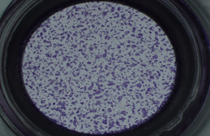
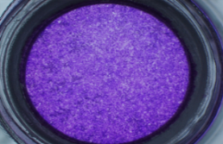
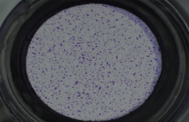
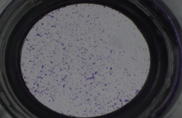
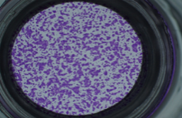
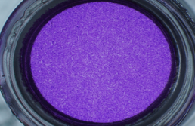
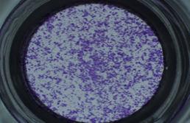
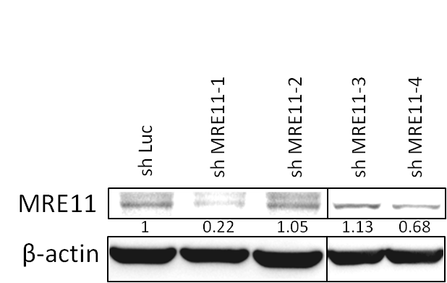
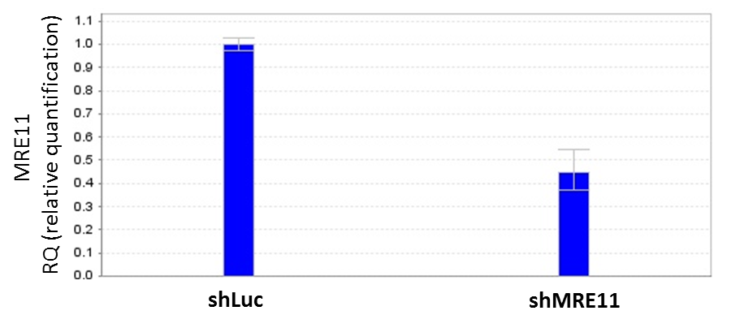
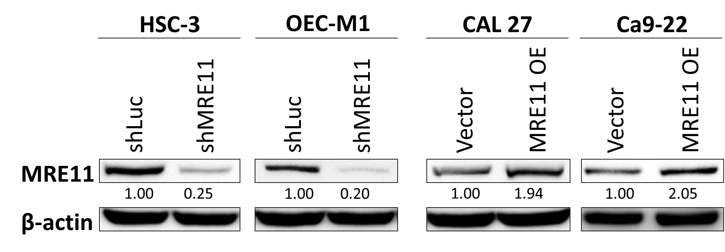
Fig. S1
A
HSC-3
OEC-M1
CAL 27
Ca9-22
24hr
48hr
B
C
D

Slide 3
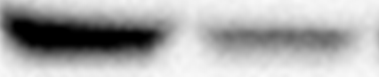
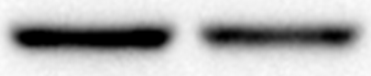




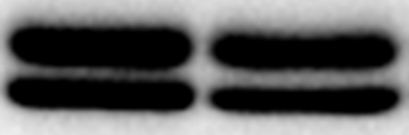


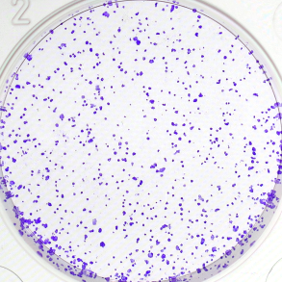
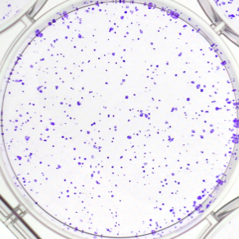
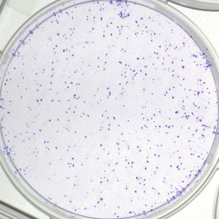
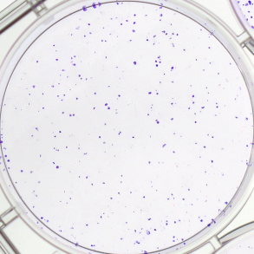
E
F
HSC-3
OEC-M1
shLuc
shMRE11
shLuc
shMRE11
p-AKT (S473)
AKT
p-ERK1/2
ERK1/2
MRE11
β-actin
p-AKT
p-ERK1/2
p-AKT
p-ERK1/2
G
HSC-3
OEC-M1
H
shLuc
shMRE11
shLuc
shMRE11

Slide 4
Fig. S2

Slide 5
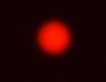
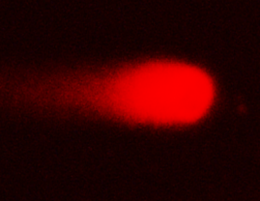




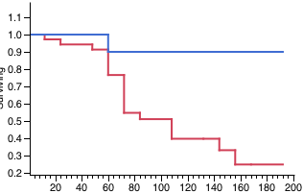

Fig. S3
A
B
C
HSC-3
Comet tail
(DNA double strand breaks)
CDDP (5μg/mL)
-
+
( - )
( + )
shLuc
shMRE11
shLuc
shMRE11
γ-H2AX
β-actin
MRE11
D
E
F
Chemotherapy (+)
p=0.03
Overall survival
High MRE-11 expression (n=36)
Low MRE-11 expression (n=17)
Months
Notes:
MRE11 overexpression significantly increases the CDDP resistance of CAL 27 cell line.

Slide 6
Fig. S4
A
CAL27
MRE11 OE
Position | Gene name | Fold | Function
A07 | CDH11 | -4.49 | adhesion
B07 | CXCR4 | 9.96 | migration and invasion
C02 | FLT4 | -1.49 | angiogenesis
E02 | MMP2 | -2.48 | ECM degradation
E05 | MMP9 | -2.69 | ECM degradation
F01 | NR4A3 | 3.52 | differentiation
F06 | RORB | -2.98 | differentiation
G01 | SSTR2 | 2.24 | proliferation
G10 | TRPM1 | -5.22 | proliferationand differentiation
B

Slide 7
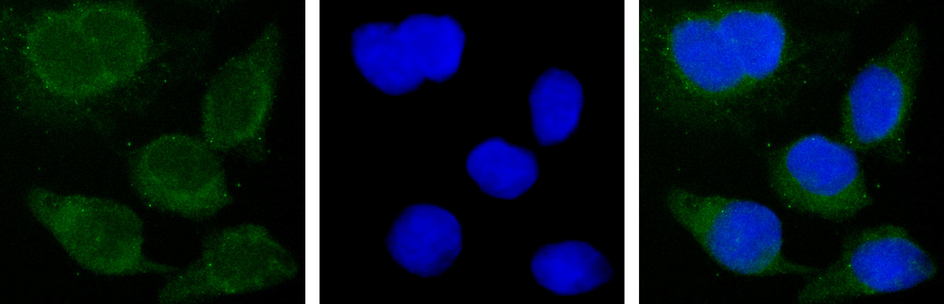
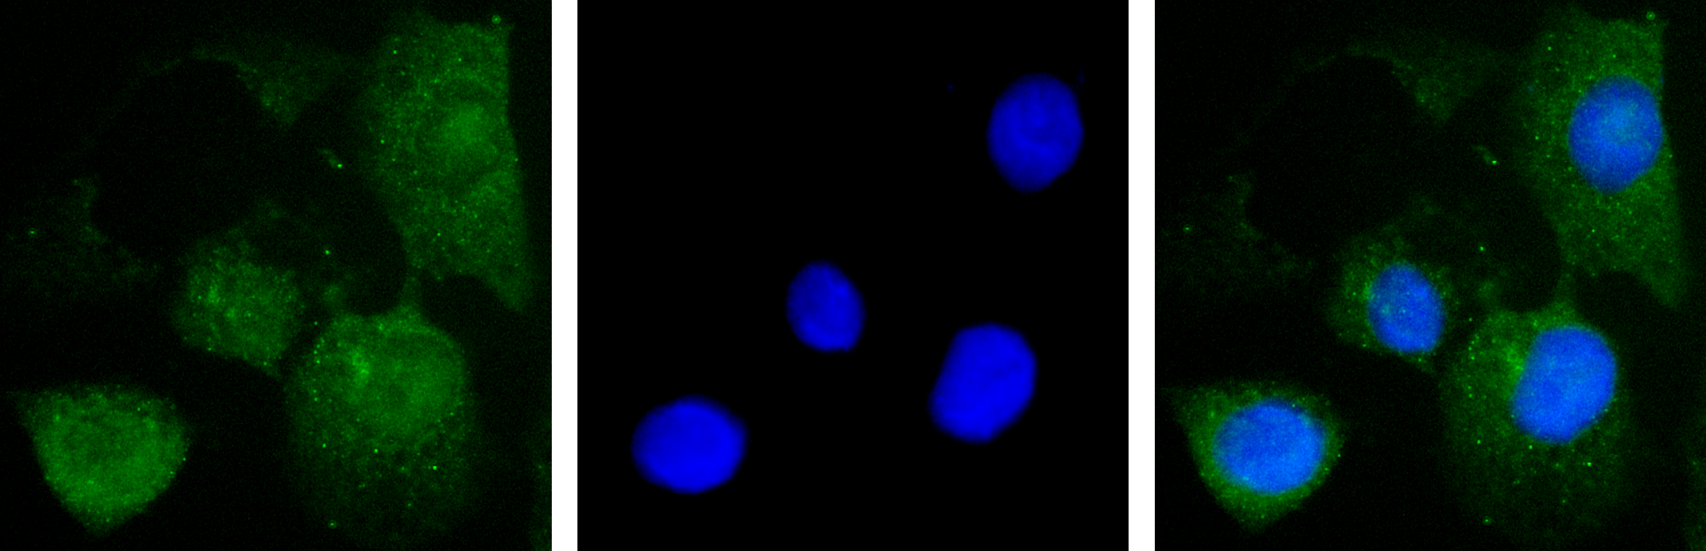
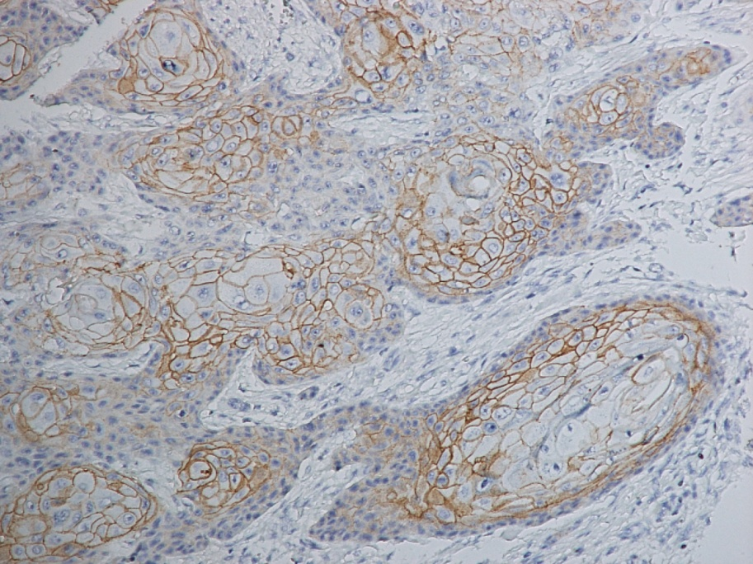
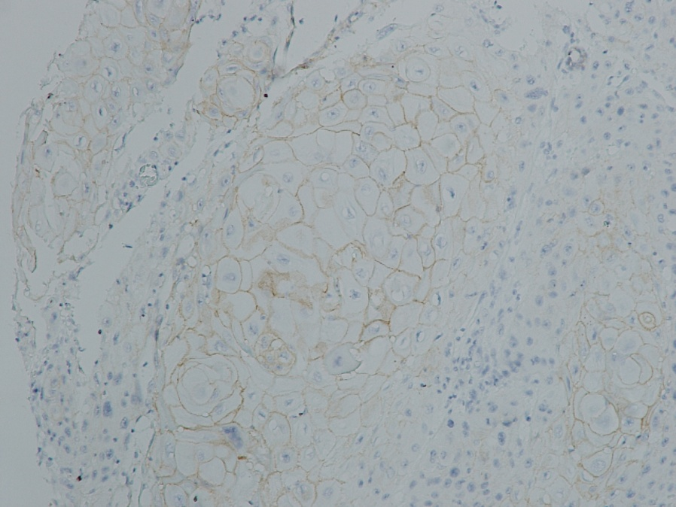
Fig. S5
A
FOXA2
DAPI
Merge
shLuc
HSC-3
shMRE11
400X
B
C
E-cadherin (high)
E-cadherin (low)
100X
100X

Slide 8
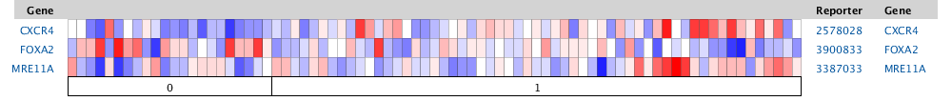
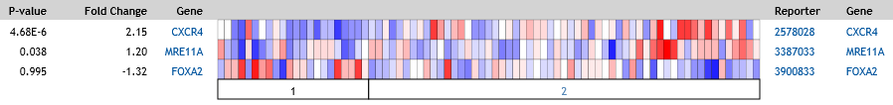
D
I: Heat map view:
Peng et al, 2011 (GSE25099)
Normal (n=22)
Tumor (n=57)
II: Scatter plot/correlation plot:
MRE11A
MRE11A
FOXA2
CXCR4
FOXA2
CXCR4

Slide 9
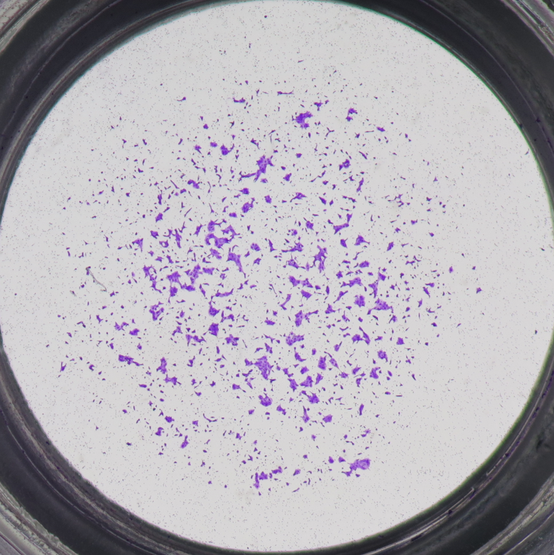
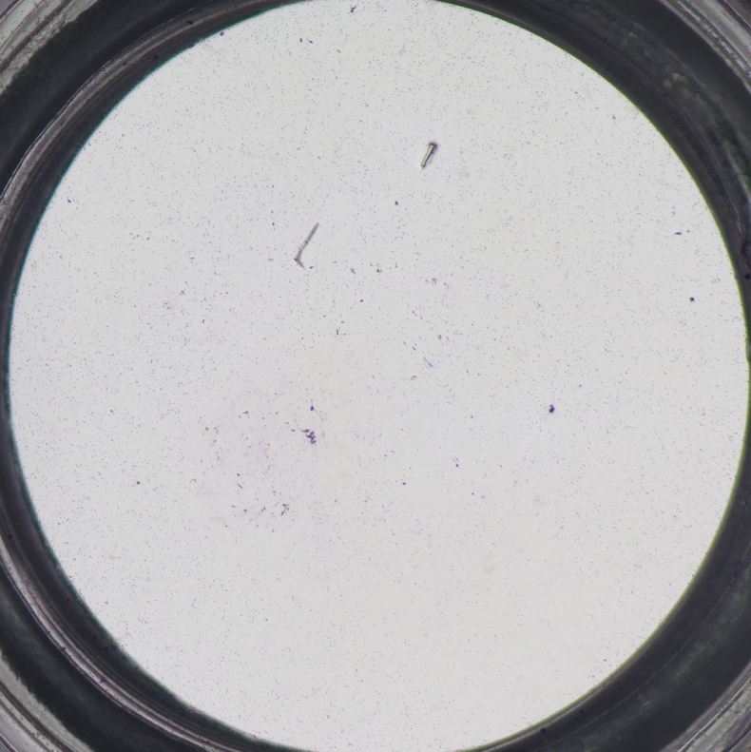
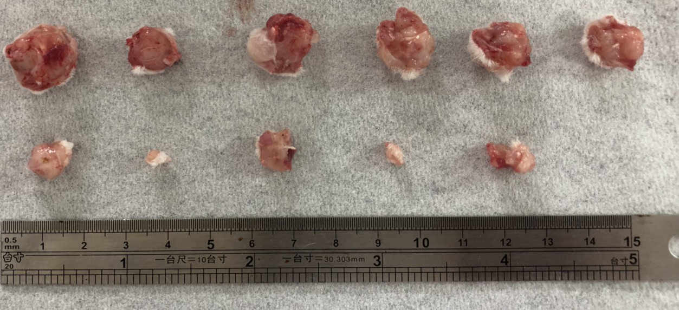
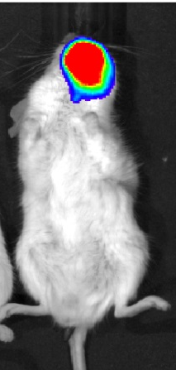
Fig. S6
A
B
LN1-1
shLuc
shMRE11
24h
C
D
shLuc
shMRE11
shLuc
shMRE11

Slide 10
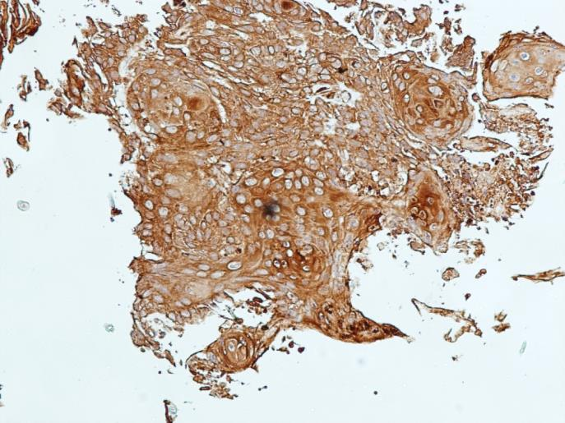
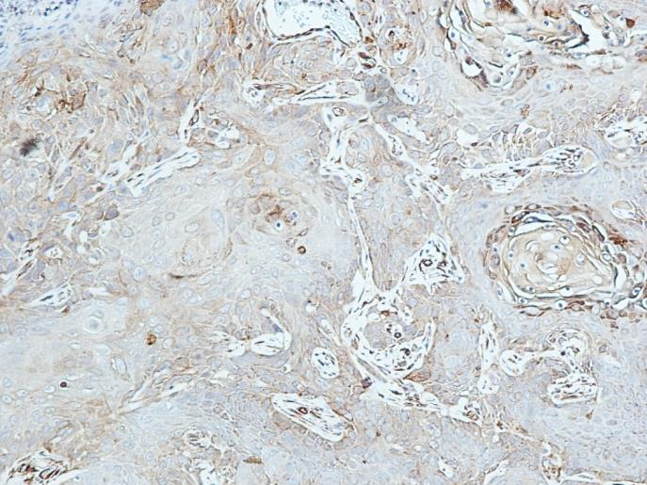
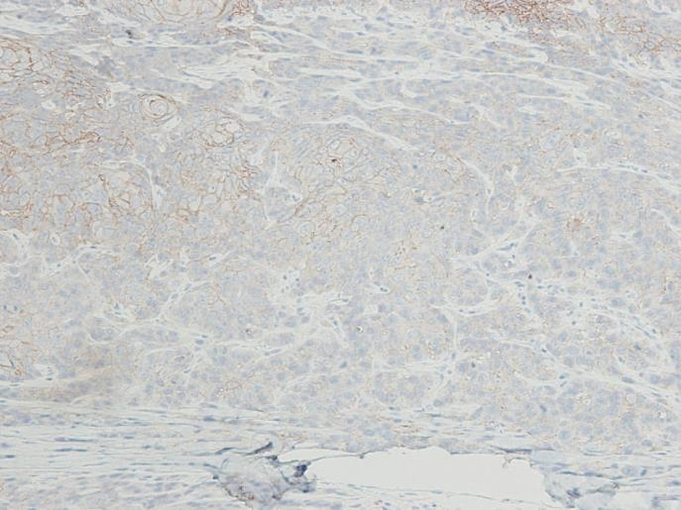
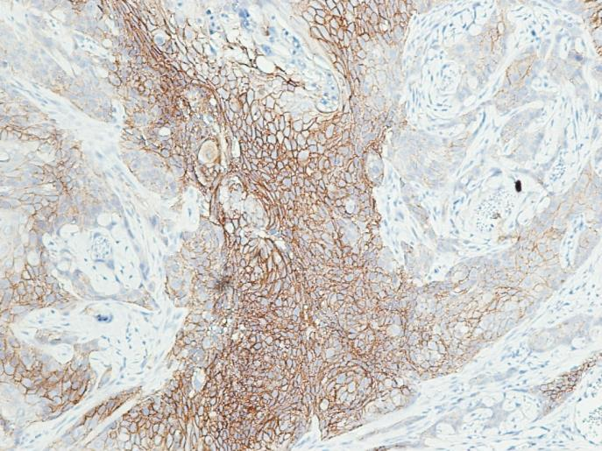
Fig. S7
A
B
100x
100x
100x
100x

Slide 11
Sup. Table 2. MRE11 knockdown and overexpression on oral cancer migration in zebrafish.
 |  | shLuc | shMRE11 | p-value | Vector | MRE11OE | p-value
 | migration | N (%) | N (%) |  | N (%) | N (%)
24h | No | 182 (87.9) | 241 (87.3) | 0.84 | 46 (65.7) | 43 (45.7) | 0.034
 | Yes | 25 (12.1) | 35 (12.7) |  | 24 (34.3) | 51 (54.3)
48h | No | 160 (82.5) | 229 (89.1) | 0.04 | 37 (56.9) | 37 (42.0) | 0.025
 | Yes | 34 (17.5) | 28 (10.9) |  | 28 (43.1) | 51 (58.0)

Slide 12
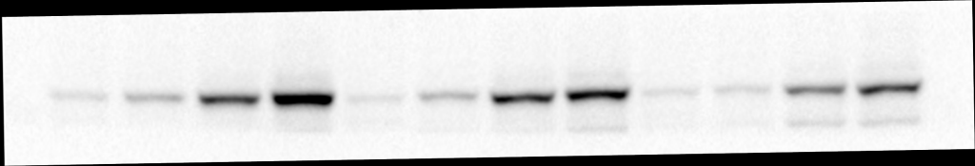












Fig. S8
HSC-3
OEC-M1
CAL 27
Ca9-22
shLuc
shMRE11
shLuc
shMRE11
Vector
MRE11 OE
Vector
MRE11 OE
p-STAT3 (Y705)
STAT3
MRE11
β-actin

Slide 13
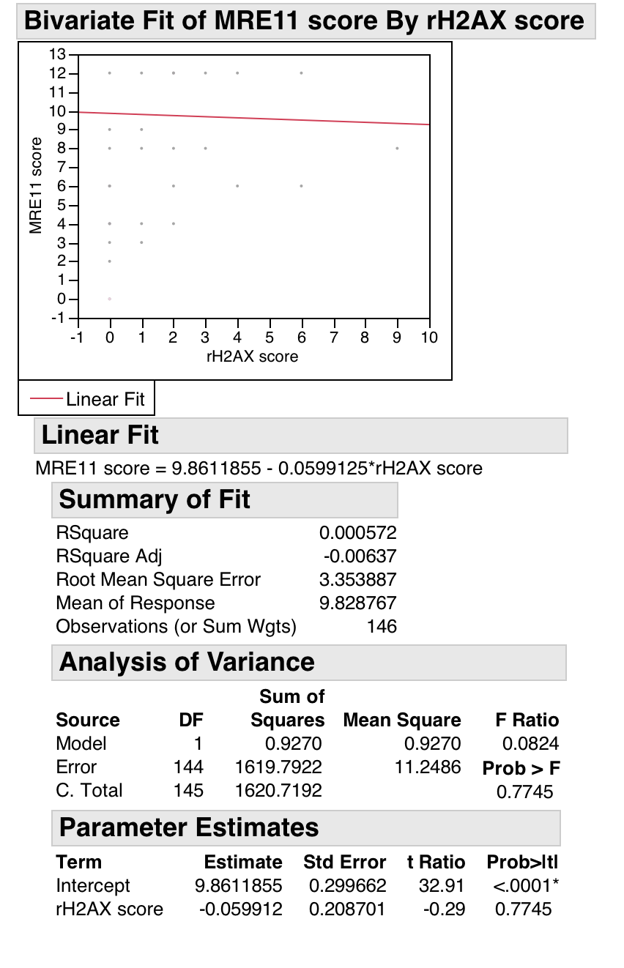
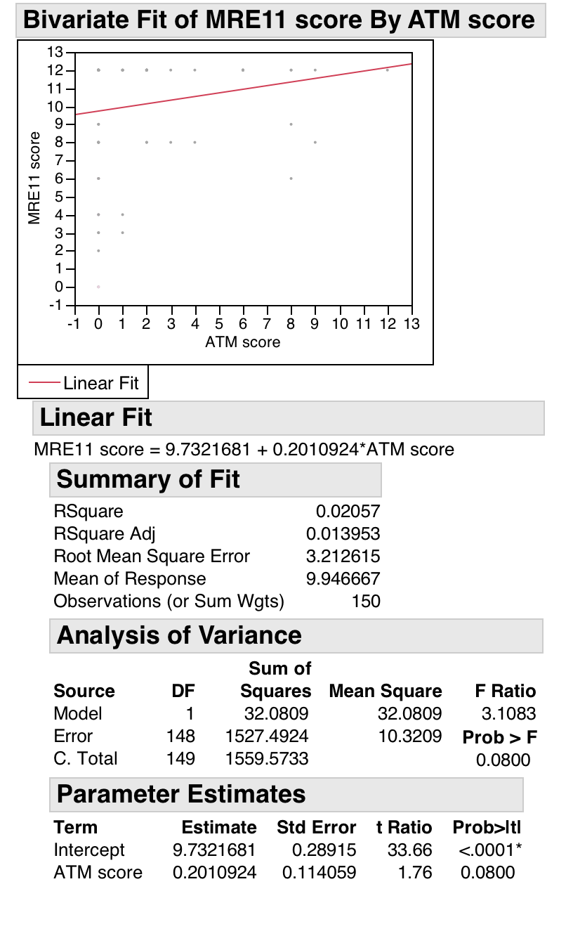

Fig. S9
A
B
C
MRE11 score
MRE11 score
MRE11 score
N = 145
r = -0.06
p = 0.77
N = 149
r = 0.20
p = 0.08
N = 147
r = 0.04
p = 0.72
rH2AX score
p-ATM score
p-ATR score

