Slide 1
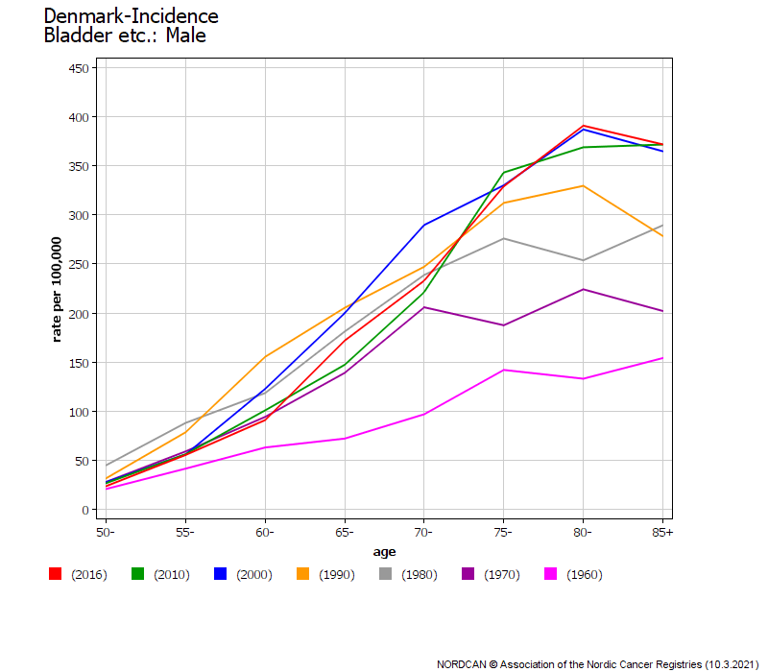
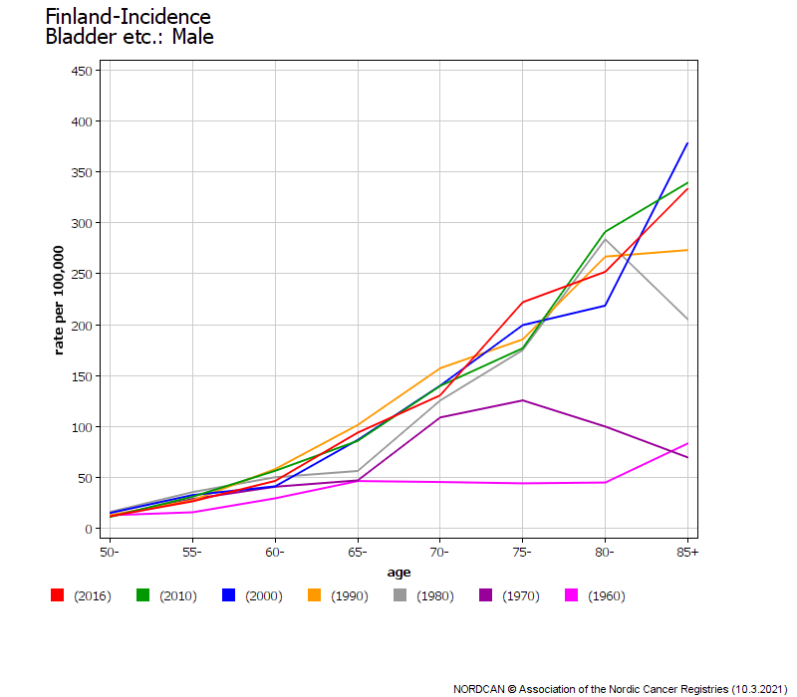
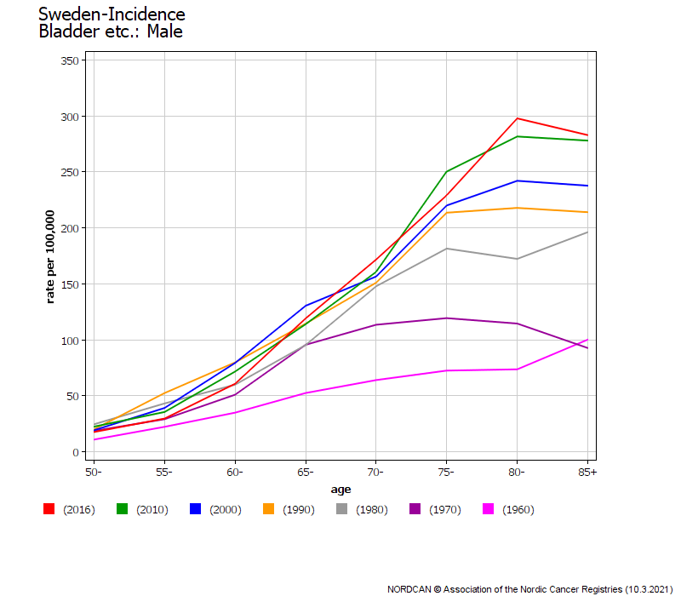
Supplementary Fig. 1
A
B
C

Slide 2
LEGEND TO SUPPLEMENTARY FIGURE 1
Supplementary Fig. 1. Age-specific incidence data for bladder cancer plotted in 10-year intervals from 1960 onwards (except for 2016) for Danish (A), Finnish (B) and Swedish (C) males. The scale for y-axis for Sweden is different from the other countries.

