Slide 1
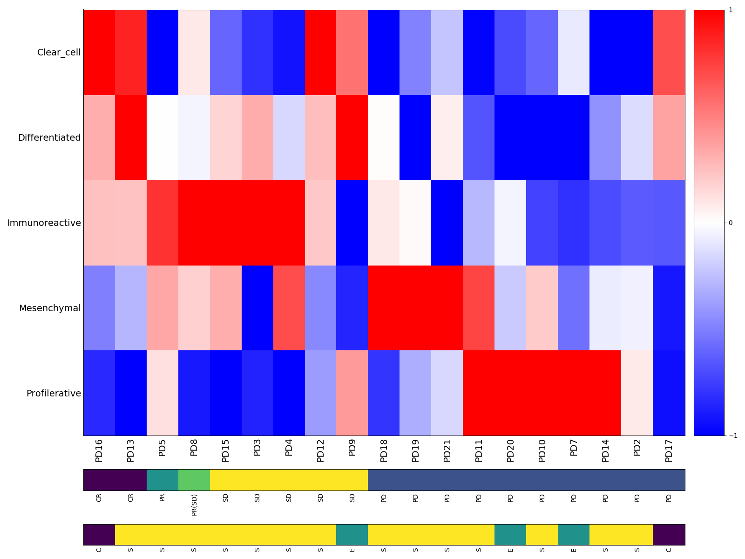
Supplementary Figure S2
Multi-signature heatmap organized by response
1
Clear cell
Differentiated
Immunoreactive
0
Mesenchymal
Proliferative
-1
CR
PR
SD
PD
Clear
Serous
Endometrioid
SD(CR)

