Slide 1
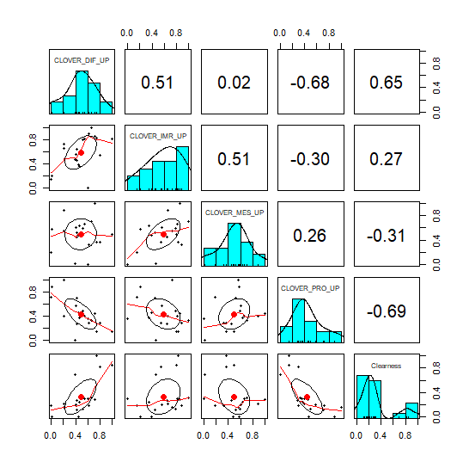
Supplementary Figure S5
Distributions and correlations among the five ovarian cancer gene signatures
Distribution
Paiwise Pearson correlation
Dif
Imr
Mes
Pro
Cle
Pairwise scatterplot
Differentiated (Dif)
Immunoreactive (Imr)
Mesenchymal (Mes)
Proliferative (Pro)
Clear cell (Cle)

