Slide 1
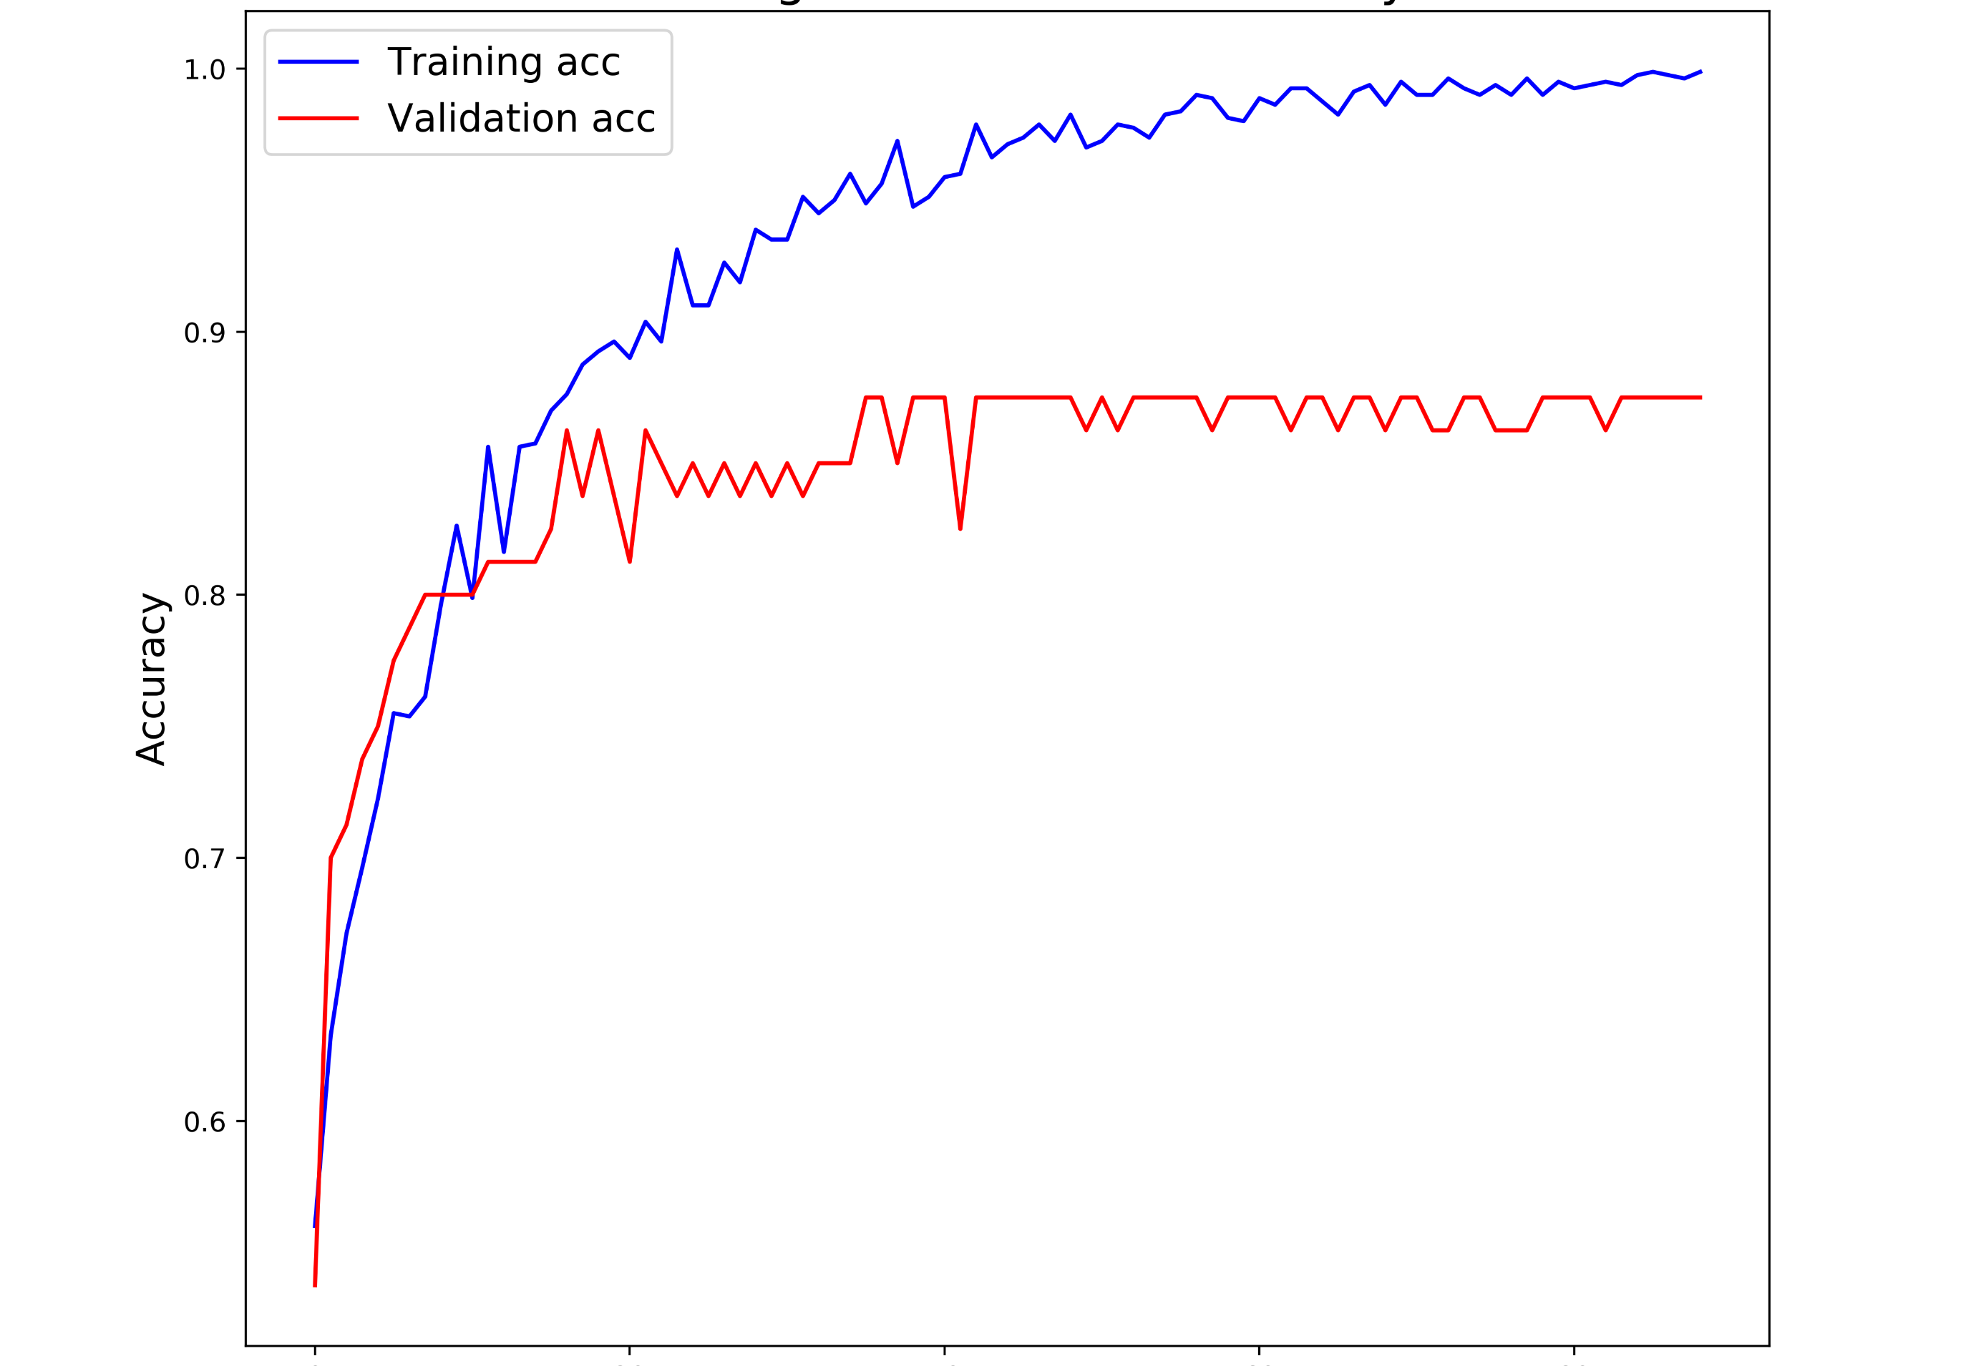
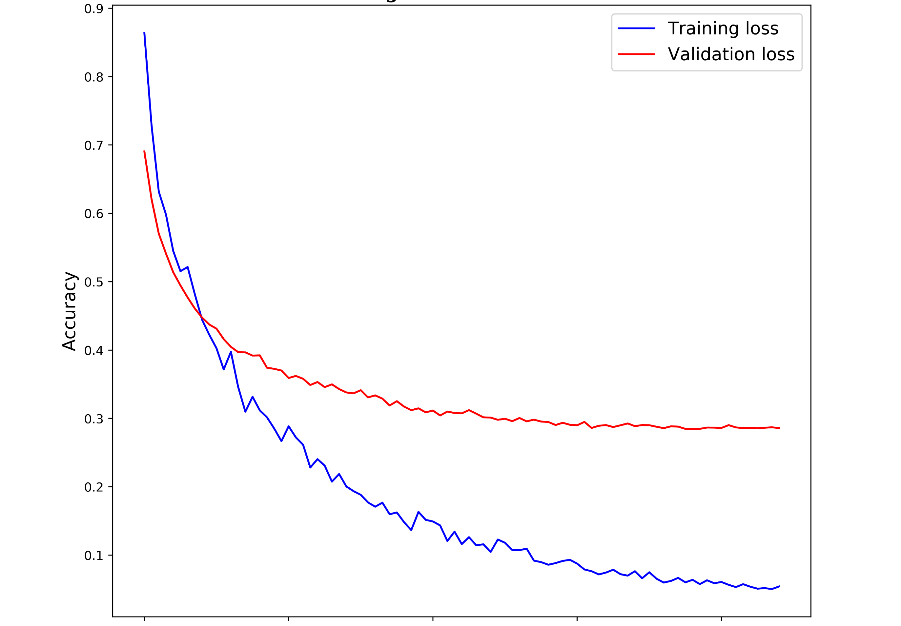
(A)
0.9
(B)
1.0
TA
0.9
VA
0.7
Accuracy
0.8
Loss
0.5
0.7
0.3
VL
0.6
0.1
0
20
40
60
80
0
20
40
60
80
TL
Epochs
Epochs
Supplementary File 2. Training metrics for the InceptionV3 model. (A)Training accuracy (TA) and validation accuracy (VA) by epoch. (B) Training Loss (TL) and validation loss (VL) by epoch.

