Slide 1
Poplar aquaporin PIP1;1 promotes Arabidopsis growth and development
Huani Leng, Cheng Jiang, Xueqin Song, Mengzhu Lu, Xianchong Wan

Slide 2
Figure S1. Phylogenetic analysis of the Populus and Arabidopsis PIPs based on their full-length protein sequences. Multiple alignment amino-acid analysis was done using the ClustalW program and phylogenetic trees were constructed using NJ method with the Bootstrap Test of Phylogeny tool (1,000 replicates) in MEGA 4.0 (http://www.megasoftware.net).

Slide 3
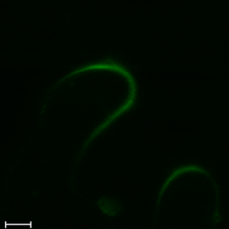
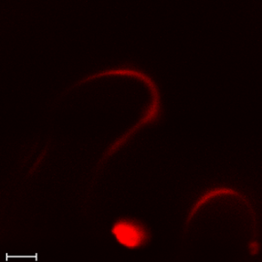
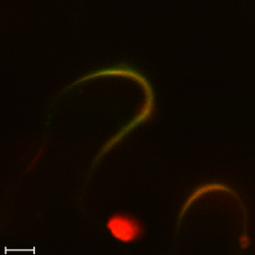
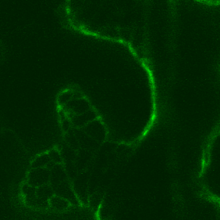
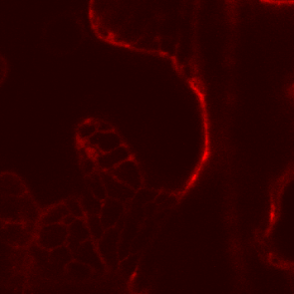
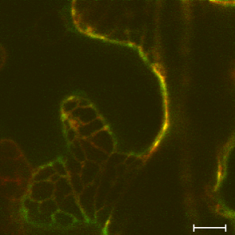
A
PIP1;1
FM4-64
Merged
B
PIP1;1
HDEL
Merged
Figure S2. Subcellular localization of PtoPIP1;1. (A) Confocal laser scanning microscopy images of the leaf epidermal cells of N. benthamiana transiently expressing PtoPIP1;1–YFP and stained with FM4-64. (B) Confocal laser scanning microscopy images of the leaf epidermal cells of N. benthamiana transiently co-expressing PtoPIP1;1-YFP and HDEL, the ER marker. Bars = 10 µm.

Slide 4
9
OE bolting
WT bolting
6
Rosette leaves number
3
0
9
13
16
19
22
25
WT
OE-1
OE-5
Figure S3. The number of rosette leaves over time under long day before bolting

Slide 5
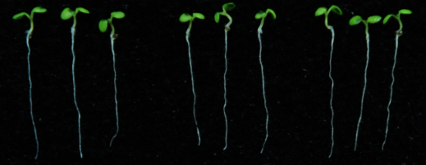
A
WT
OE-1
OE-5
B
C
18
200
16
14
150
12
*
10
100
**
Root length (mm)
Cell length (µm)
8
6
50
4
2
0
WT
0
OE-1
OE-5
Figure S4. Root length and root cell length of PtoPIP1;1 OE Arabidopsis. (A) Photographs of WT and two PtoPIP1;1 OE lines at 6 DAS. (B) Root length of WT and PtoPIP1;1 OE Arabidopsis. (C) The length of the sixth (Left) and the final (Right) elongated cell of WT and PtoPIP1;1 OE Arabidopsis. Data was analyzed statistically using Student’s t-test. *P < 0.05. **P < 0.01.

Slide 6
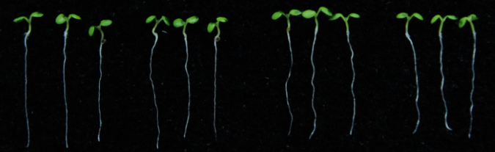
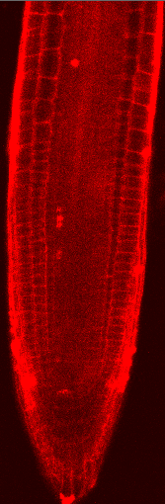
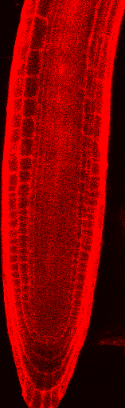

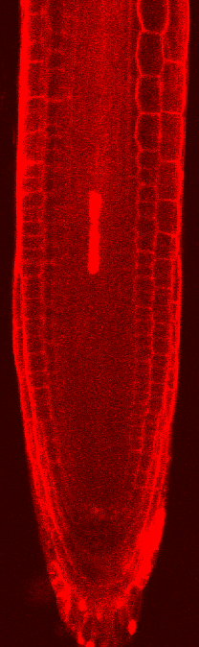


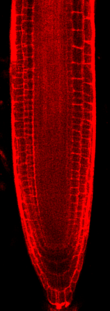

A
WT
PIP1;1
PIP1;3
PIP2;3
B
C
250
200
**
150
Root meristem size (µm)
100
50
WT
PIP1;1
PIP1;3
PIP2;3
0
WT
PIP1;1
PIP1;3
PIP2;3
Figure S5. Root meristem zone of PtoPIP1;3 and PtoPIP1;3 OE Arabidopsis. (A) Roots of WT, PtoPIP1;1 OE, PtoPIP1;3 OE and PtoPIP1;3 OE Arabidopsis at 6 DAS. (B) Root meristem zone. Green and white arrowheads indicatethe QC and the cortex TZ, respectively. The insert shows a blow-up of elongating cells exiting from the meristem at the TZ. (C) Measurements of root meristem size represented in B. Data was analyzed statistically using Student’s t-test. **P < 0.01.

Slide 7
ZmPIP1;1 IPITGTGINPARSLGAAVIYNQHHAWAD
ZmPIP1;2 IPITGTGINPARSLGAAIIYNRDHAWND
ZmPIP2;5 IPITGTGINPARSLGAAVIYNNDKAWND
AtPIP1;2 IPITGTGINPARSLGAAIIFNKDNAWDD
PtPIP1;1 IPITGTGINPARSLGAAIIFNRDKAWDD
PtPIP1;3 IPITGTGINPARSLGAAIIFNKDHAWDD
PtPIP2;3 IPITGTGINPARSLGAAVIYNQDKAWDD
Figure S6. Loop E sequences from ZmPIP1;1, ZmPIP1;2, ZmPIP2;5, PtPIP1;1, PtPIP1;3 and PtPIP2;3. Amino acid that differ between these PIPs are indicated in red.

