Slide 1
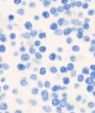
Supplementary Figure S1.
A
CD11b
CD15
CD33
CD38
EpCAM
IgG Cont.
HL-60
LNCaP
Cell Pellets
Apheresis
B
CD11b
CD15
CD33
CD38
EpCAM
IgG Cont.
IHC
Colon Adenoma
IgG Cont.
CD11b
CD15
CD33
CD38
EpCAM
Single-plex IF
C
CD38
CD79a
CD33
CD3
IgG Cont.
IHC
Appendix
CD38
CD79a
CD33
CD3
IgG Cont.
Single-plex IF

Slide 2
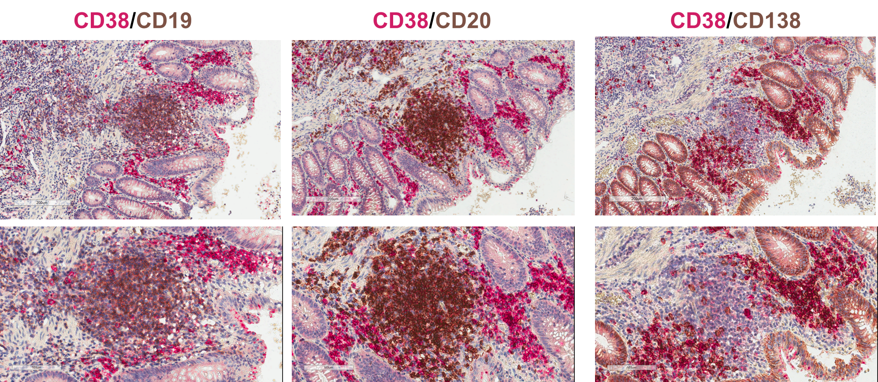
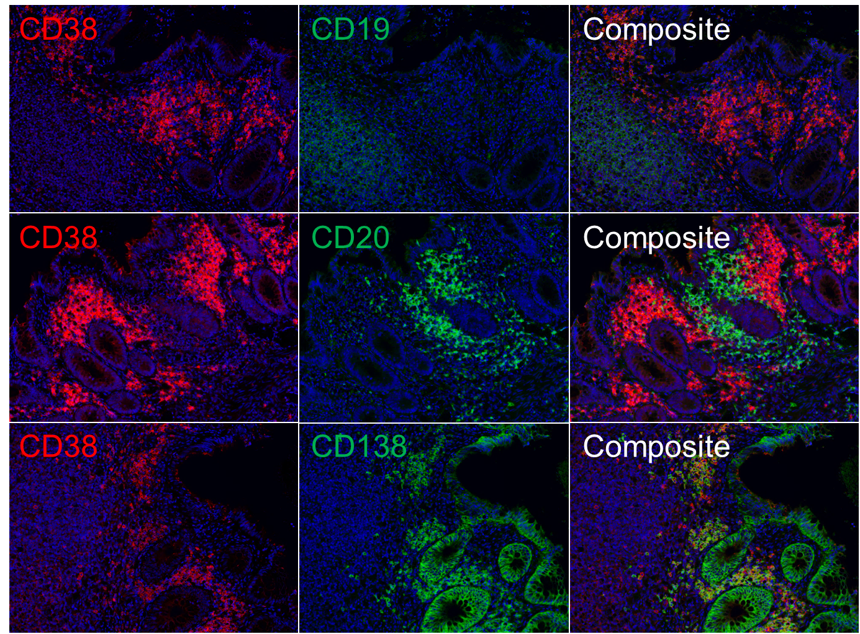
Supplementary Figure S2.
A
Appendix
Dual color IHC
B
Appendix
Simulated pseudo-immunofluorescence

Slide 3
Supplementary Figure S3.
Composite image
CD38
CD79a
CD33
CD3
Merge
Inset
Tonsil
Notes:
100um

Slide 4
Supplementary Figure S4.
A
Spectral unmixing
Multispectral Image
DAPI
CD38
CD11b
CD15
CD33
EpCAM
Tissue segmentation
Stroma / Tumor / Empty
B
C
Cell segmentation
D
E
Immunphenotyping
Simulated pseudo-DAB IHC
CRPC – Lymph node
DAPI / CD38⁺ TIICs (pseudo-DAB)
Notes:
100um

Slide 5
Supplementary Figure S5.
A
Multispectral Image
A
Multispectral Image
Spectral unmixing
DAPI
CD38
CD79a
CD33
CD3
Tissue segmentation
Stroma / Tumor
Cell segmentation / Immunophenotyping
B
C
D
Simulated pseudo-DAB IHC
Stroma
Tumour
DAPI / CD38⁺ TIICs (pseudo-DAB)
CSPC - TURP
Notes:
100um

Slide 6
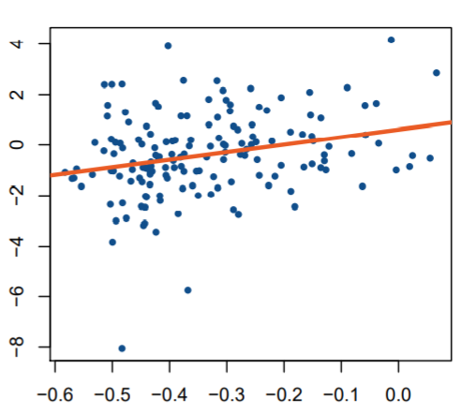
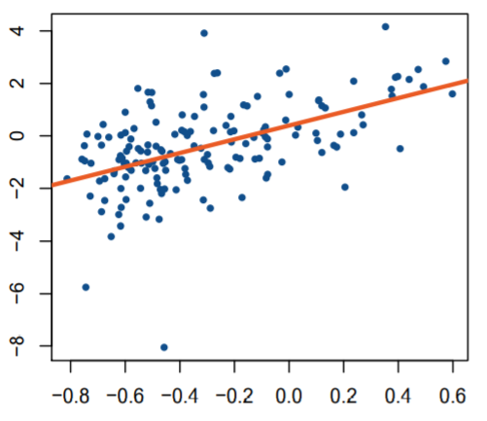
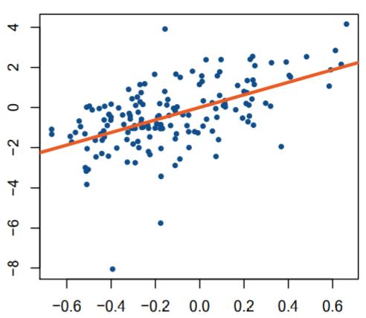
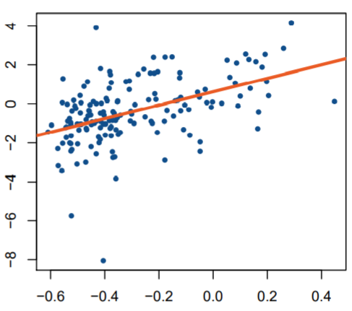
Supplementary Figure S6.
A
P=6.5x10⁻⁴
B
P=7.9x10⁻¹⁰
CD38 expression (logFKPM)
CD38 expression (logFKPM)
C
KEGG TGFbeta signalling pathway
D
Biocarta IL10 signaling pathway
p=4.0e-14
p=2.0e-10
P=4.0x10⁻¹⁴
P=2.0x10⁻¹⁰
CD38 expression (logFKPM)
CD38 expression (logFKPM)
Reactome regulating IFNgamma signaling
TNFalpha signaling via NFkB

Slide 7
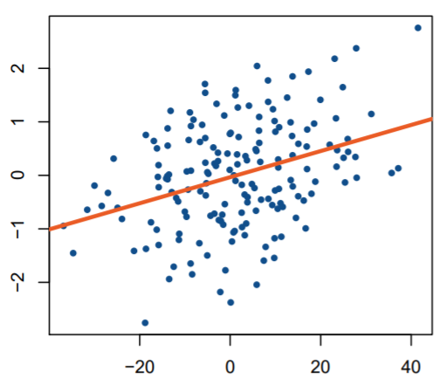
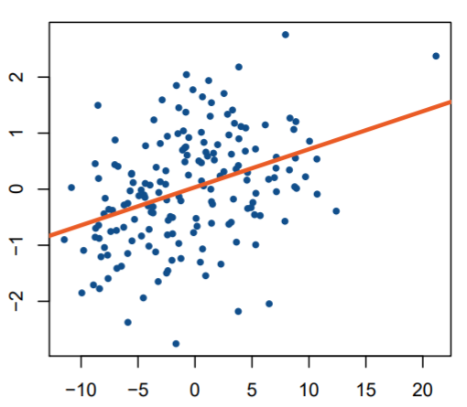
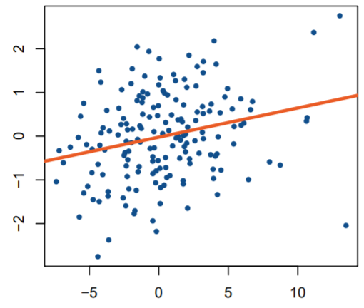
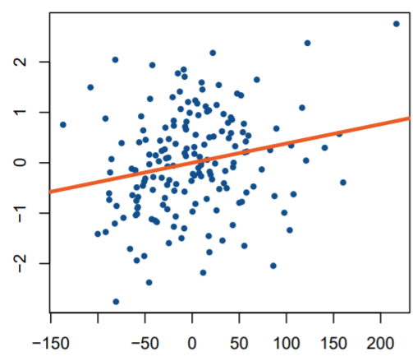
Supplementary Figure S7.
A
P=1.8x10⁻⁶
B
P=3.9x10⁻⁷
CD38 expression (Quantile norm)
CD38 expression (Quantile norm)
KEGG TGFbeta signalling pathway
Biocarta IL10 signalling pathway
C
P=7.6x10⁻³
D
P=3.5x10⁻³
CD38 expression (Quantile norm)
CD38 expression (Quantile norm)
Reactome regulation of IFNgamma signalling
TNFalpha signalling via NFkB

Slide 8
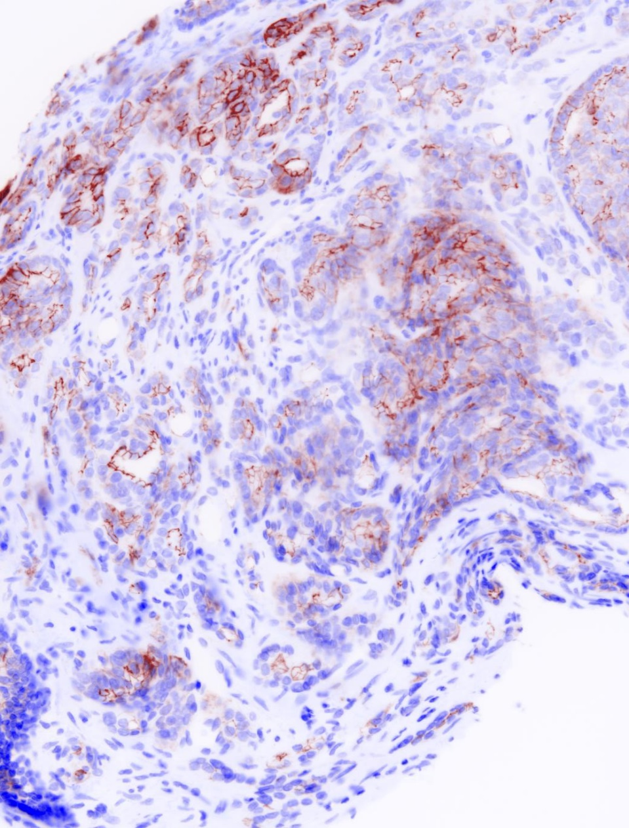
Supplementary Figure S8.
A
CD38 positive tumour
B
CD38 negative tumour
Patient_38
Patient_10
DAPI / CD38⁺ tumor cells (pseudo-DAB)
DAPI / CD38⁺ TIICs (pseudo-DAB)
Prostate needle core Bx
TURP
CD38 H-score:
Membranous = 30;
Cytoplasmic = 50
CD38 H-score:
Membranous = 0;
Cytoplasmic = 0
Scale Bar 100µm

