Slide 1
Intron (ca. 2.8 kb)
Intron
Intron
Intron
F
Q
RNaseP-F
RNaseP-P
RNaseP-R
A
Intron (ca. 2.8 kb)
Intron
Intron
Intron
F
Q
(EXON 2)
RNaseP-F
B
RNaseP-P
RNase P-R8
Fig. 1_Suppl

Slide 2
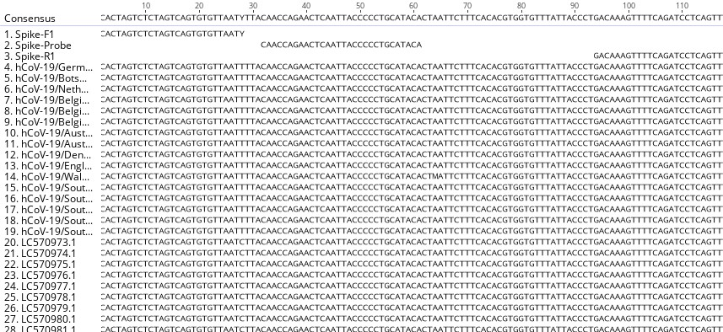
Fig. 2_Suppl
49,812 SARS-CoV-2 sequences

Slide 3
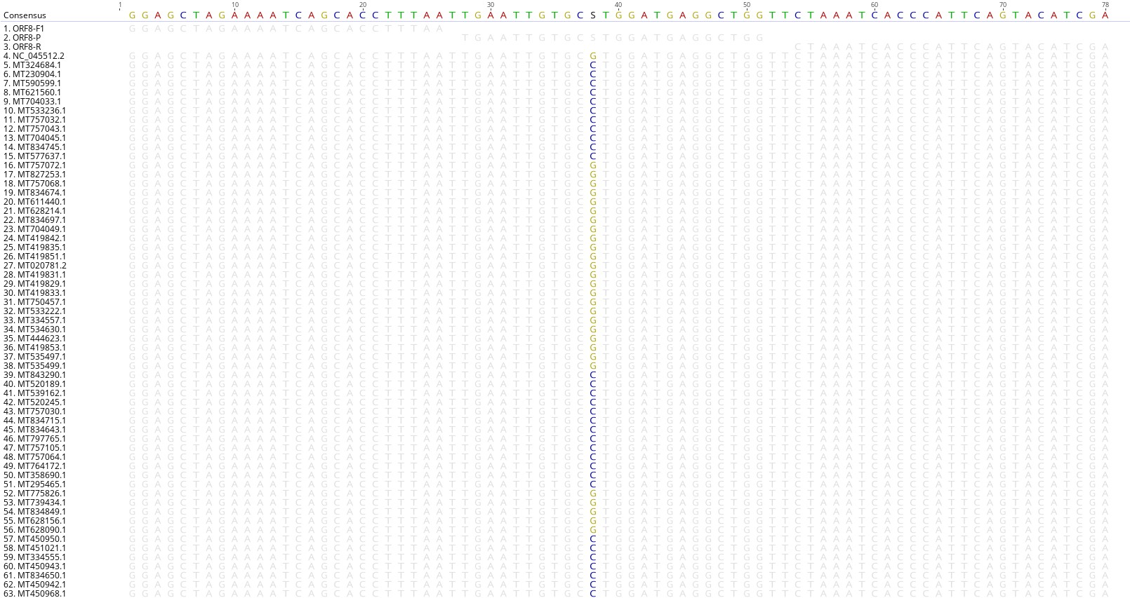
Fig. 3_Suppl
49,426 SARS-CoV-2 sequences

Slide 4
Table. 1_Suppl

Slide 5
Table. 2_Suppl

Slide 6
N1/N2 Assay
SORP Assay
Table. 3_Suppl

