Slide 1
1+
(weak)
2+
(moderate)
3+
(strong)
BCL2
ROR1
Supplementary Figure 1. Representative immunohistochemical images of small cell lung cancer (SCLC) tumor microarray (TMA) showing images of scoring categories for protein expression.

Slide 2
Sample | Tumor Stage | Treated or Untreated
1 | 3B | Untreated
2 | 3A | Untreated
3 | 3A | Untreated
4 | 4 | Treated
5 | 3B | Untreated
6 | 3A | Untreated
7 | 3A | Untreated
8 | 3B | Untreated
9 | 4 | Untreated
10 | 3B | Treated
11 | 4 | Untreated
12 | 1B | Untreated
13 | NA | Treated
14 | 4 | Untreated
15 | 1B | Untreated
16 | 4 | Untreated
17 | 4 | Untreated
18 | 4 | Untreated
19 | 4 | Untreated
20 | 4 | Untreated
21 | 3A | Untreated
22 | 3B | Untreated
23 | 4B | Untreated
24 | 3B | Untreated
25 | 1B | Untreated
26 | 1A | Untreated
27 | 4A | Untreated
28 | 1B | Untreated
Supplementary Table 1. Treatment status and tumor stage of FFPE SCLC samples.

Slide 3
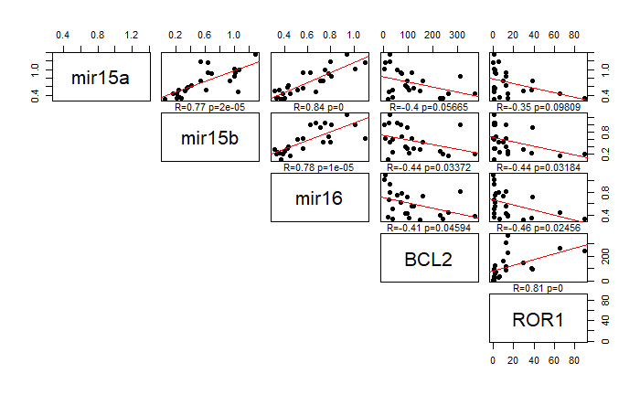
Supplementary Figure 2. Correlation between relative expression of miR-15a, miR-15b, and miR-16, BCL2, and ROR1 in 28 SCLC FFPE samples normalized to actin and Human Lung RNA.

Slide 4
Supplementary Figure 3. KAN0441571C dose-response curves using results from 2 aggregated experiments for H146, H187, H209 and H211 SCLC cell lines, and 1 experiment for H1417 and H1963 SCLC cell lines.

Slide 5
Supplementary Figure 4. Venetoclax dose-response curves for H146, H187, H209, H211, H1417 and H1963 SCLC cell lines.

Slide 6
 | KAN571C (nM) | Venetoclax (μM)
H69 | 350.90 | 25.09
H82 | 417.20 | 13.63
H146 | 234.50 | 6.75
H187 | 232.50 | 7.08
H209 | 237.10 | 20.67
H211 | 183.40 | 18.42
H1417 | 540.30 | 11.48
H1963 | 196.00 | >50
Average | 298.99 | 16.74
Supplementary Table 2. IC50 values of KAN0441571C and venetoclax in eight SCLC cell lines.

Slide 7
H146
H187
H209
H211
H1417
H1963
Supplementary Figure 5. Combinatorial index over F_{a} graphs for H146, H187, H209, H211, H1417 and H1963 SCLC cell lines.

Slide 8
H146
H187
H209
H211
H1417
H1963
Supplementary Figure 6. Isobole synergy analysis for H146, H187, H209, H211, H1417 and H1963 SCLC cell lines.

Slide 9
Kinase | KAN0441571C kinase activity IC50 (nM)
CDK4 | 29
CDK6 | 28
CDK7 | 106
CDK9 | 5.7
CDK13 | 42
CDK17 | 1180
JAK1 | 1190
JAK2 | 957
JAK3 | 451
TYK2 | 111
PDGFRb | 36
Aurora A | 580
FLT3 | 39
MKNK2 | 3430
ROCK2 | 2090
Supplementary Table 3. Potencies of KAN04415171C against off-target kinases determined by Flashplate-based radiometric ³³P assay (ProQinase, Freiburg, Germany) subsequent to identification of off-target effectors via KINOMEscan™ (DiscoverX, San Diego, CA, USA) profiling.

Slide 10
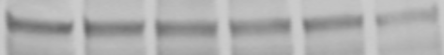
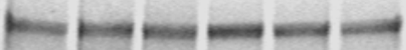
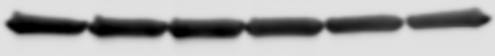
KAN571C (nM)
0
100
200
300
500
1000
pROR1
Normalized signal
1.00 | 0.97 | 0.88 | 0.90 | 0.99 | 0.50
ROR1
Normalized signal
1.00 | 0.91 | 0.87 | 1.50 | 1.20 | 1.14
Actin
pROR1/ROR1 ratio
3.36
3.56
3.40
2.02
2.77
1.48
Normalized pROR1/ROR1 ratio
1.00
1.06
1.01
0.60
0.82
0.44
Supplementary Figure 7. Effect of KAN0441571C on pROR1 levels after 2h treatment. Experiments were repeated with an n=3, with representative data shown.

Slide 11
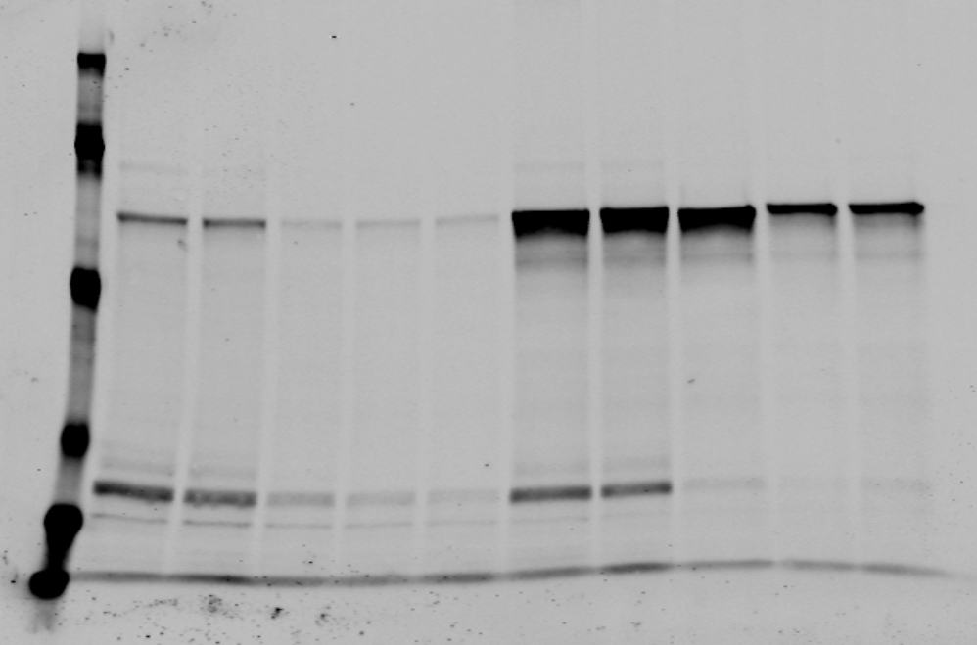
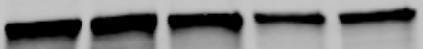
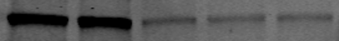
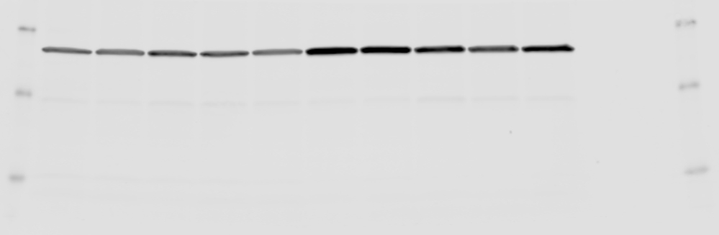
A,
H69
H82
KAN571C (nM)
0
100
200
300
500
1000
0
100
200
300
500
1000
ROR1
1.00 | 0.97 | 1.17 | 1.02 | 1.06 | 0.95
1.00 | 0.87 | 1.16 | 0.95 | 0.98 | 0.88
P-ROR1
1.00 | 0.76 | 0.28 | 0.37 | 0.43 | 0.29
1.00 | 0.84 | 0.59 | 0.69 | 0.49 | 0.38
P-ROR1/ROR1
1.00 | 0.78 | 0.24 | 0.36 | 0.41 | 0.31
1.00 | 0.97 | 0.51 | 0.73 | 0.50 | 0.43
ERK
1.00 | 0.95 | 0.82 | 0.86 | 0.88 | 0.92
1.00 | 0.94 | 0.87 | 0.92 | 1.04 | 1.00
P-ERK
1.00 | 1.09 | 0.88 | 0.55 | 0.92 | 0.56
1.00 | 1.19 | 0.68 | 0.71 | 0.41 | 0.32
P-ERK/ERK
1.00 | 1.15 | 1.08 | 0.64 | 1.04 | 0.61
1.00 | 1.28 | 0.79 | 1.77 | 0.40 | 0.32
Actin
B,
H69
H82
Control
1H
1D
2D
3D
Control
1H
1D
2D
3D
β-catenin
Non-P-β-catenin
Actin
Supplementary Figure 8. Downstream impact of ROR1 inhibition. (A) Effect of KAN0441571C on pROR1 and pERK levels after 30 min treatment in H69 and H82 cell lines. (B) Decrease in total and active (Non-P) β-catenin levels over a time course of 3 days after 1 μM KAN0441561C treatment. Experiments were repeated with an n=3, with representative data shown.

Slide 12
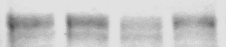
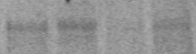
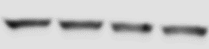
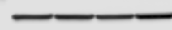
shRNA
shRNA
P
NTC
#1
#2
P
NTC
#1
#2
ROR1
ROR1
Actin
Actin
Supplementary Figure 9. Analysis of ROR1 shRNA effect on cell proliferation in combination with venetoclax treatment, and western plot analysis of knockdown levels. Experiments, including shRNA knockdown, were repeated with an n=2, with representative data shown. *** = p ≤ 0.001, **** = p ≤ 0.0001

Slide 13
SNS-032
Abemaciclib
H69
H82
H69
H82
Supplementary Figure 10. Combination index and isobole analysis of venetoclax (Dose B) in combination of SNS-032 or abemaciclib in H69 and H82 cell lines.

