Slide 1
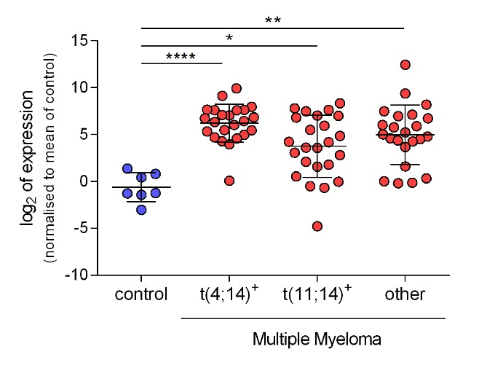
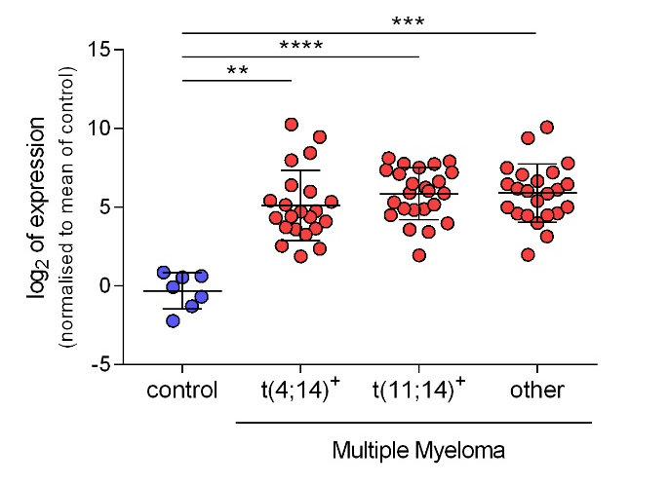
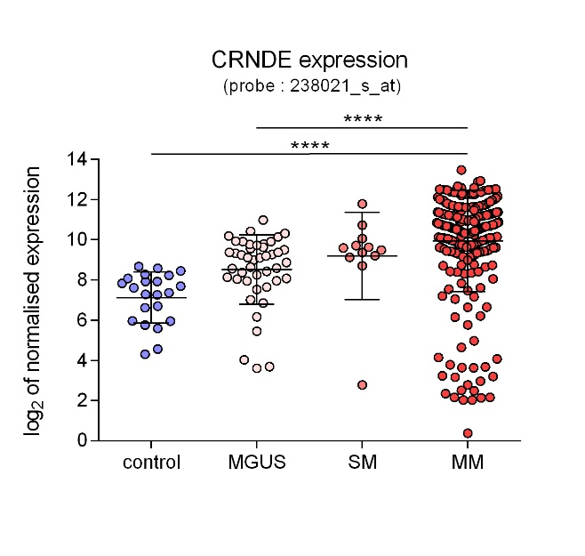
A.
CRNDE expression
CRNDEh
gVC-In4
B.
DAVID ET AL., SUPPLEMENTAL FIGURE 2
Notes:
DAVID ET AL., SUPPLEMENTAL FIGURE 2

