Slide 1
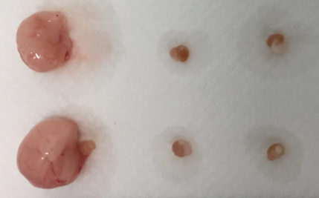
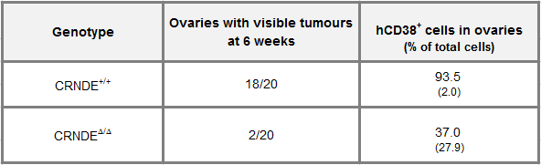
A.
CRNDE^{+/+}
CRNDE^{Δ/Δ}
uninjected
10 mm
B.
***
(p=4.2E-7,
Pearson's Chi squared test)
**
(p=0.008,
Mann Whitney)
DAVID ET AL., SUPPLEMENTAL FIGURE 6
Notes:
DAVID ET AL., SUPPLEMENTAL FIGURE 6

