Slide 1
Impella 5.0 support before, during and after surgical ventriculoplasty following acute myocardial infarction in the COVID-19 era – a case report
May 2020
EHJ-CR-D-20-00574R2

Slide 2
Introduction
Left ventricular (LV) aneurysms complicate anterior myocardial infarctions in 8-15% of cases^{[1]}
In case of associated LV dysfunction, rapidly evolving heart failure may follow, and urgent surgery becomes life-saving^{[2]}
Short-term mechanical circulatory support may be used in such cases as a bridge to surgery, and as means to aid weaning off extracorporeal circulation^{[3] [4]}

Slide 3
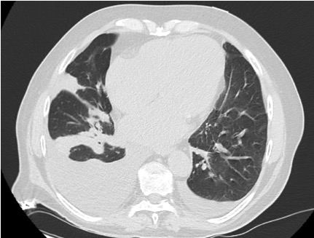
Case Presentation
History and Examination Findings
70-year old male with previous anterior MI, treated with PCI on LAD
Complained of fatigue, hypotension, dyspnea
Repeatedly refused assessment in the ER for fear of contracting COVID-19 pneumonia
Subsequently presented with syncope
Placed in “gray” ward because of
CT scan showing bilateral pneumonia
Rapidly evolving cardiogenic shock, which
prompted transfer to “clean” ICU once
nose-swab for COVID-19 tested negative

Slide 4
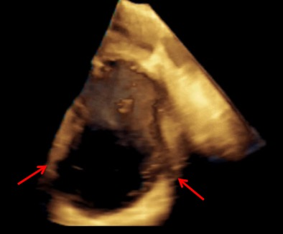
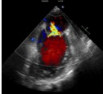
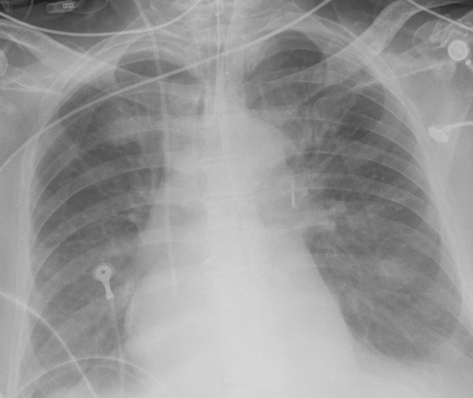
Case Presentation
Investigations
Echocardiography:
Severely dilated (EDV = 198 ml, iEDV = 94 ml/m2), hypokinetic left ventricle with apical aneurysm (distal part of the cavity, inferior to papillary muscle implant; figure a, red arrows indicating aneurysm)
Ejection fraction of 30%
No LV thrombus
Moderate mitral regurgitation due to multiple central jets and annular dilatation (figure b)
Increased left ventricular filling pressures
Normal right ventricular dimensions and function with severe pulmonary hypertension (PAPs 75 mmHg)
Chest X-Ray:
Severe pulmonary congestion (figure c)
a
b
c

Slide 5
Case Presentation
Management
Urgent Heart Team to evaluate optimal management
Ventriculoplasty and mitral valve repair appeared to be the best options, with Impella 5.0 as short-term mechanical circulatory support with the following aims:
      Pre-surgery: - Reduce pulmonary congestion and hypertension
  - Reduce left ventricular filling pressure
      Post-surgery: - Aid weaning off extracorporeal circulation

Slide 6
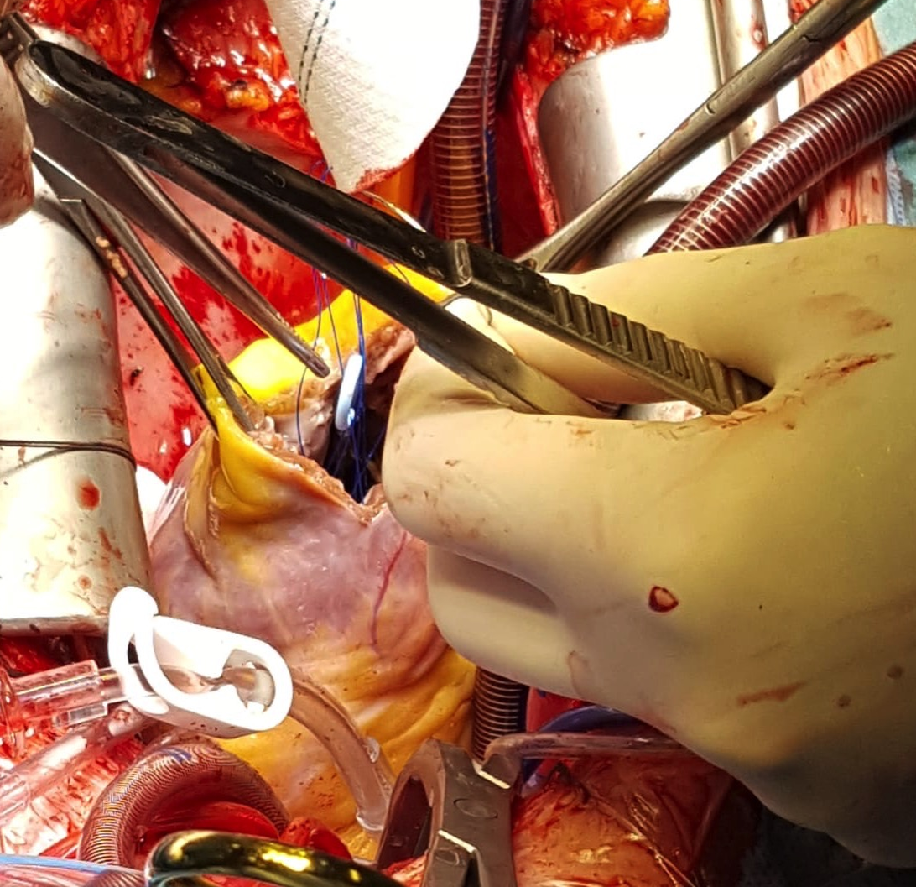
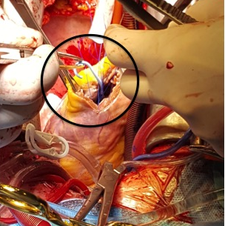
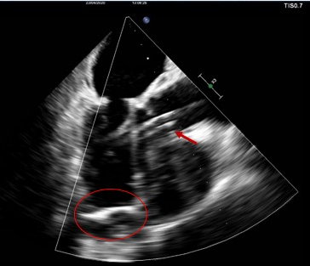
Discussion
a
b
c
Figures a and b: intraoperative images of the Impella 5.0 catheter in the LV apex (circled)
Figure c: intraoperative transesophageal echocardiography showing LV pericardial patch
(circled) and Impella 5.0 support (arrow)

Slide 7
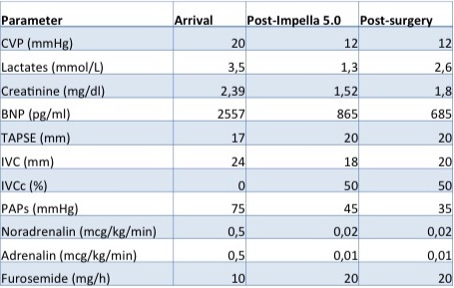
Discussion
Impella 5.0:
Effective in the pre-operative phase, supporting hemodynamics (reduction in lactates, BNP and creatinine, table 1), reducing pulmonary congestion and pulmonary artery pressure (reduction in CVP, PAPs, IVC diameter and collapsibility) and terminating ventricular arrhythmias
Optimally tolerated during surgery
Effective in the post-operative phase, facilitating weaning off extracorporeal circulation with only minimal amounts of inotropes (table 1)
No major complications
Table 1: biochemical and hemodynamic parameters and pharmacological support at arrival, after Impella 5.0 positioning and after cardiac surgery.
(CVP: Central Venous Pressure; BNP: Brain Natriuretic Peptide; TAPSE: Tricuspid Annular Plane Systolic Excursion; IVC: Inferior Vena Cava; PAPs: Pulmonary Artery Systolic Pressure)

Slide 8
Learning Points
Left ventricular remodeling with apical aneurysm and consequent LV dysfunction is a complication of acute anterior myocardial infarction^{[1]}
Prompt recognition and treatment could help prevent progression to acute heart failure and cardiogenic shock^{[2]}
In case of ongoing cardiogenic shock, support with a short-term mechanical circulatory device is adequate to both support the patient in the acute phase and to precondition the heart-lung system for high-risk surgery
Safe, clean pathways for high-risk patients must be created even in critical situations such as the ongoing COVID-19 pandemic to prevent increase in morbidity and mortality in patients not affected by the virus itself

Slide 9
References
[1] Lawrence H. Cohn, David H. Adams. Cardiac Surgery in the adult. 3rd ed. McGraw-Hill Professional; 2007
[2] Castelvecchio S, Pappalardo OA, Menicanti L. Myocardial reconstruction in ischaemic cardiomyopathy. Eur J. Cardio-thoracic surgery 2019; 1;55(Suppl 1):i49-i56
[3] Via G, Buson S, Tavazzi G, Halasz G, Quagliana A, Moccetti M, Demertzis S, Cassina T. Early cardiac unloading with Impella CP in acute myocardial infarction with ventricular septal defect. ESC Heart Fail 2020; 7(2):708-71
[4] Rios SA, Bravo CA, Weinreich M, Olmedo W, Villablanca P, Alvarez Villela M, Ramakrishna H, Hirji S, Robles OA, Mahato P, Gluud C, Bhatt DL, Jorde UP. Meta-Analysis and Trial Sequential Analysis Comparing percutaneous Ventricular Assist Devices Versus Intra-Aortic Balloon Pump During High-Risk PercutaneousCoronary Intervention or Cardiogenic Shock. Am J Cardiol. 2018; 122(8):1330-1338

