Slide 1
SUPPLEMENTARY INFORMATION
Dual herbal combination of W. somnifera and five Rasayana herbs: A phytochemical, antioxidant, and chemometric profiling

Slide 2
Table S1: Plant Species Binominal nomenclature and their voucher details
S.No | Plant Species with Family name | Herbarium Voucher no.
1. | Bacopa monnieri (L.)-Wettest. - PLANTAGINACEAE | BSI/SRC/5/23/2019/Tech/3219
2. | Withania somnifera (L.) Dunal- SOLANACEAE | BSI/SRC/5/23/2019/Tech/3220
3. | Ocimum basilicum L.- LAMIACEAE | BSI/SRC/5/23/2019/Tech/3221
4. | Phyllanthus emblica L. PHYLLANTHACEAE | BSI/SRC/5/23/2019/Tech/3222
5. | Asparagus racemosus Willd. - ASPARAGACEAE | BSI/SRC/5/23/2019/Tech/3223
6. | Tinospora sinensis (Lour.) MERR. -MENISPERMACEAE | BSI/SRC/5/23/2019/Tech/3224
Table S3: Percentage yield of methanolic combinatorial extracts
S. No | Combinatorial extracts | Ratio of combinatorial extracts (20g) | Yield (g) | Yield % (w/w)
a. | W |  | 4 | 20
 | W:P | W:P/4:1 | 4.4 | 22
2. |  | W:P/1:1 | 5.1 | 26
3. |  | W:P/1:4 | 4.6 | 23
4. | W:B | W:B/4:1 | 3.4 | 17
5. |  | W:B/1:1 | 5 | 25
6. |  | W:B/1:4 | 3.4 | 17
7. | W:T | W:T/4:1 | 5.9 | 30
8. |  | W:T/1:1 | 2.4 | 12
9. |  | W:T/1:4 | 6.2 | 31
10. | W:O | W:O/4:1 | 4.9 | 24.5
11. |  | W:O/1:1 | 5.3 | 26.5
12. |  | W:O/1:4 | 3.4 | 17
13. | W:A | W:A/4:1 | 4.6 | 23
14. |  | W:A/1:1 | 5 | 25
15. |  | W:A/1:4 | 4.3 | 21.5
Table S2: Samples abbreviation and their dual fractions
S.No | Sample Combinations | Sample proportions
 | Abbreviation acc. to local name | 4:16g | 10:10g | 16:4g
 |  | 1:4 | 1:1 | 4:1
1. | W. somnifera (W) – Ashwagandha | 20g
2. | P. emblica (W:P) – Amla | W:P1 | W:P2 | W:P3
3. | B. monnieri (W:B) – Brahmi | W:B1 | W:B2 | W:B3
4. | T. sinensis (W:T) – Giloy | W:T1 | W:T2 | W:T3
5. | O. basilicum (W:O) – Sweet basil | W:O1 | W:O2 | W:O3
6. | A. racemosus (W:A) - Shatavari | W:A1 | W:A2 | W:A3
Abbreviation: W. somnifera (W) along with combination [4:1(1), 1:1(2), 1:4(3)] is mentioned as P. emblica (W:A), B. monnieri (W:B), T. sinensis (W:T), O. basilicum (W:O) and A. racemosus (W:A) combinatorial methanolic extracts followed by their fractions numeral

Slide 3
Table S4: DPPH and FRAP activity of methanolic combinatorial extracts and standard ascorbic acid
S. NO | COMBINATORIAL EXTRACTS | DPPH IC₅₀ (µg/mL) | FRAP (µM FeE/g)
 | Ascorbic acid | 15.68 ± 1.2 | 163.48 ± 27.41
 | A | 11.56 ± 3.69 | 4.56 ± 0.54
 | AA1 | 17.39 ± 1 | 57.92 ± 4.26
 | AA2 | 7.86 ± 0.4 | 109.4 ± 6.2
 | AA3 | 7.89 ±1.52 | 138.34 ± 9.25
 | AB1 | 134.3 ± 8.2 | 6.35 ± 0.73
 | AB2 | 99.87 ± 10.12 | 5.47 ± 0.64
 | AB3 | 102.5 ± 6.72 | 5.89 ± 1.1
 | AG1 | 33.22 ± 6.67 | 5.45 ± 0.65
 | AG2 | 37.27 ± 8.19 | 8.63 ± 0.98
 | AG3 | 30.27 ± 8.05 | 7.26 ± 0.1
 | AS1 | 27.19 ± 4.67 | 3.5 ± 0.42
 | AS2 | 16.91 ± 4.96 | 3.78 ± 0.45
 | AS3 | 8.995 ± 2.64 | 15.32 ± 1.64
 | AT1 | 11.01 ± 2.72 | 4.24 ± 0.5
 | AT2 | 12.90 ± 4.50 | 5.99 ± 0.69
 | AT3 | 21.64 ± 4.16 | 3.94 ± 0.46
Table S4. DPPH and FRAP activity for standard ascorbic acid and the combinatorial extracts W. somnifera (W) along with combination [4:1(1), 1:1(2), 1:4(3)] of P. emblica (W:P), B. monnieri (W:B), T. sinensis (W:T), O. basilicum (W:O) and A. racemosus (W:A). mean ± SD (n=3)

Slide 4
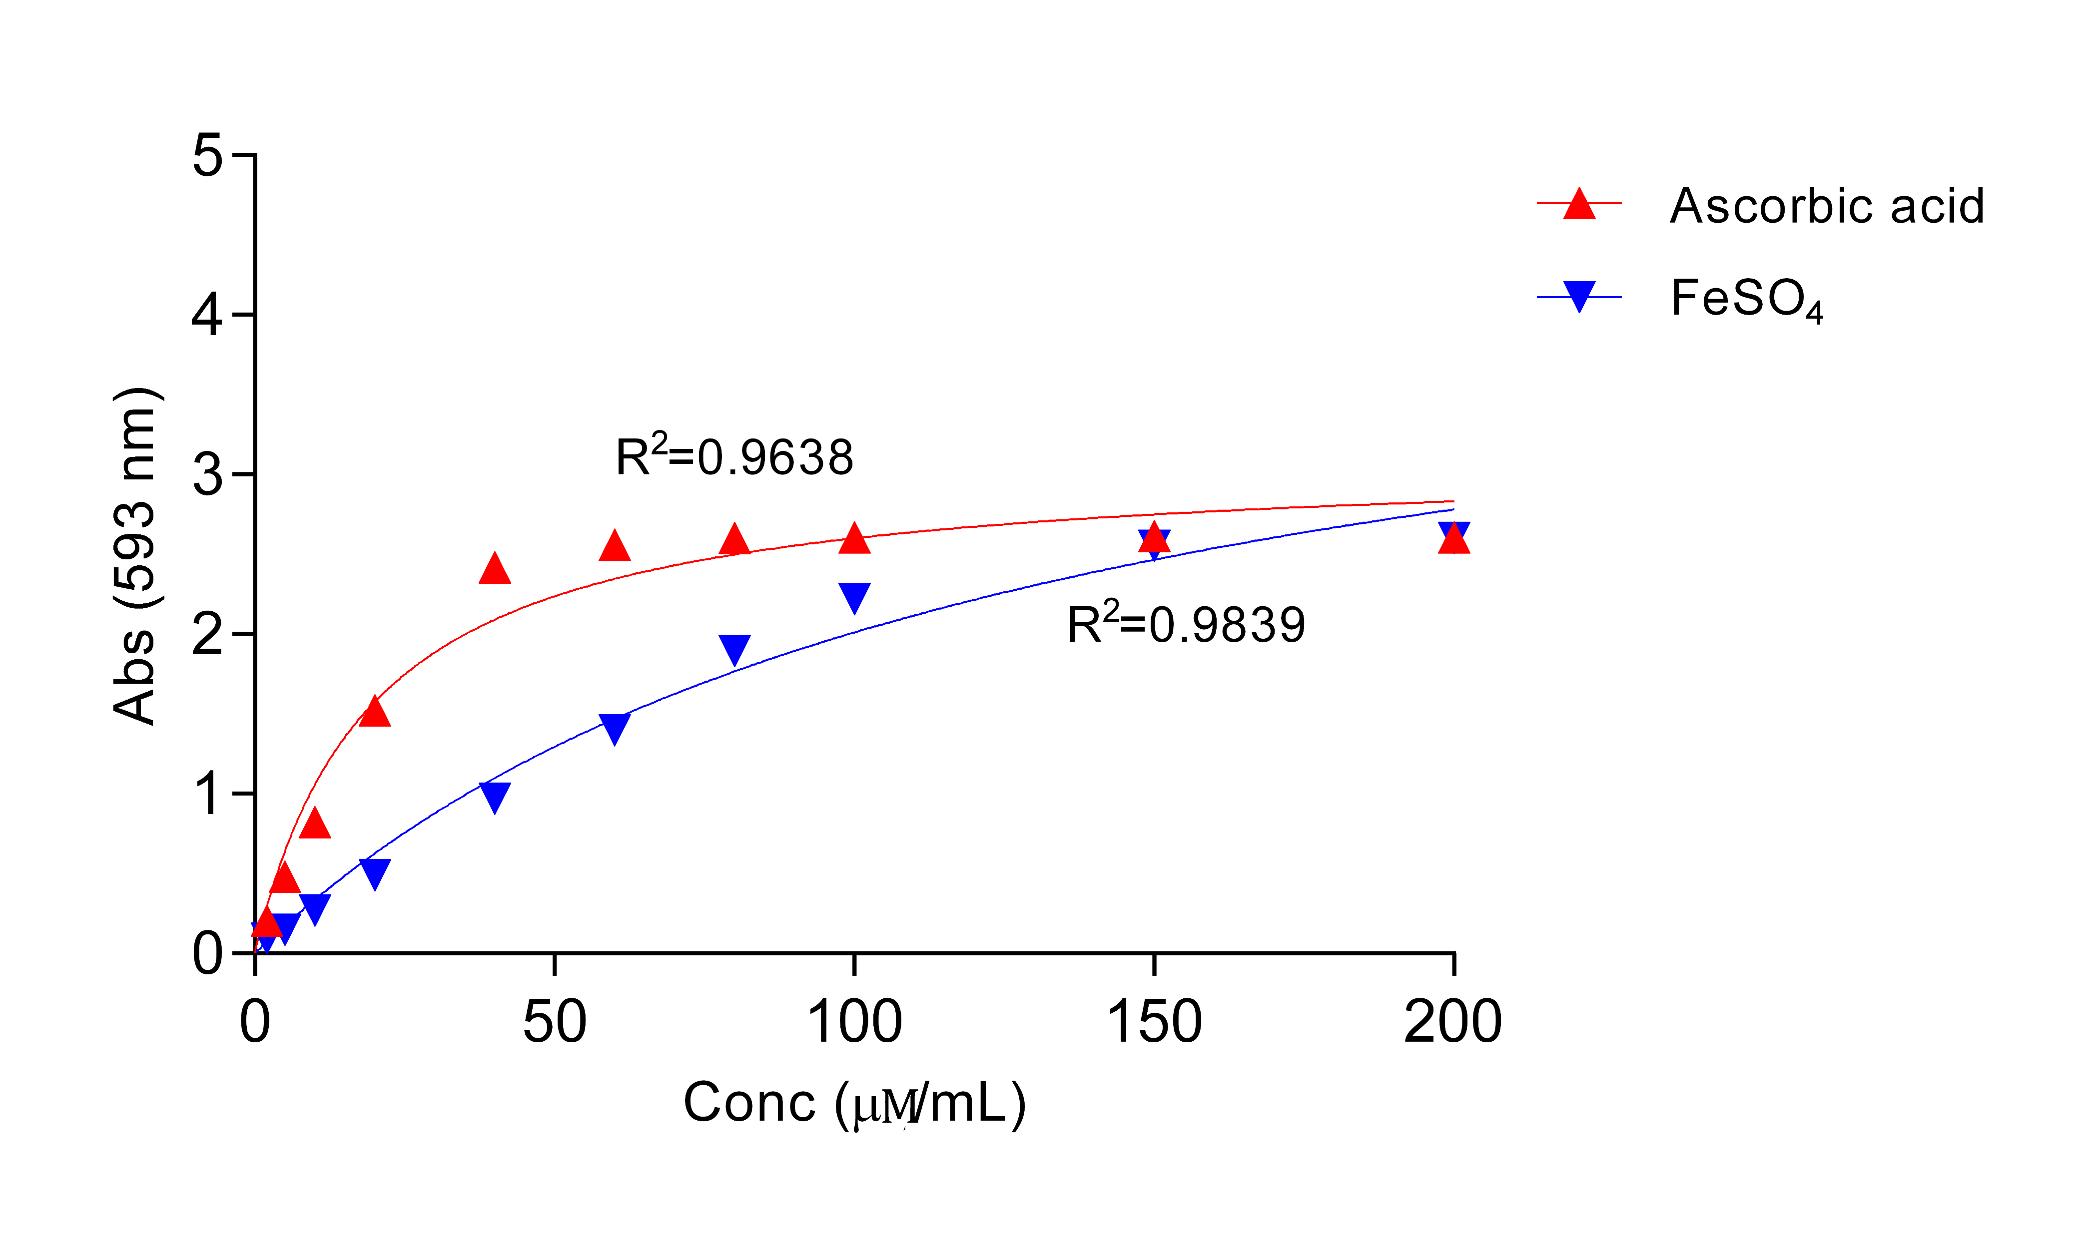
Fig S1: Ferric Reducing Antioxidant Power (FRAP) assay calibration curve for Ascorbic acid and FeSO₄
Fig S1. Standard non-linear calibration curve for the standard Ascorbic acid and FeSO₄

Slide 5
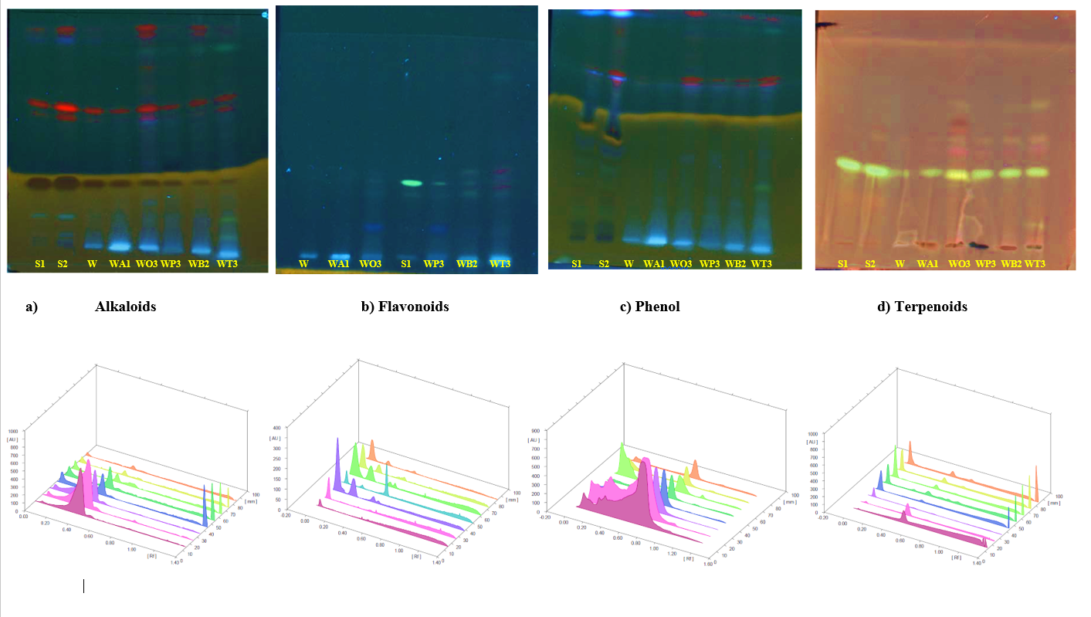
Fig S2: HPTLC fingerprinting profile of secondary metabolites (UV 366 nm) and 3D diagram of HPTLC densitogram of methanolic combinatorial extracts
Fig S2. HPTLC chromatogram and 3D densitogram of (a) Alkaloids Track S1, S2 (Std): Colchicine (b) Flavonoids Track S1 (Std): Quercetin (c) Phenol Track S1, S2: Catechin (d) Terpenoids Track S1, S2 (Std): Oleanolic acid and common tracks W: W. somnifera and in combination with ratios A. racemosus W: A/ 4:1 ; O.basilicum W:O/ 1:4; P. emblica W:P/ 1:4; B. monnieri W:B/1:1 ; T. sinensis W:T/ 1:4 methanolic combinatorial extracts.

Slide 6
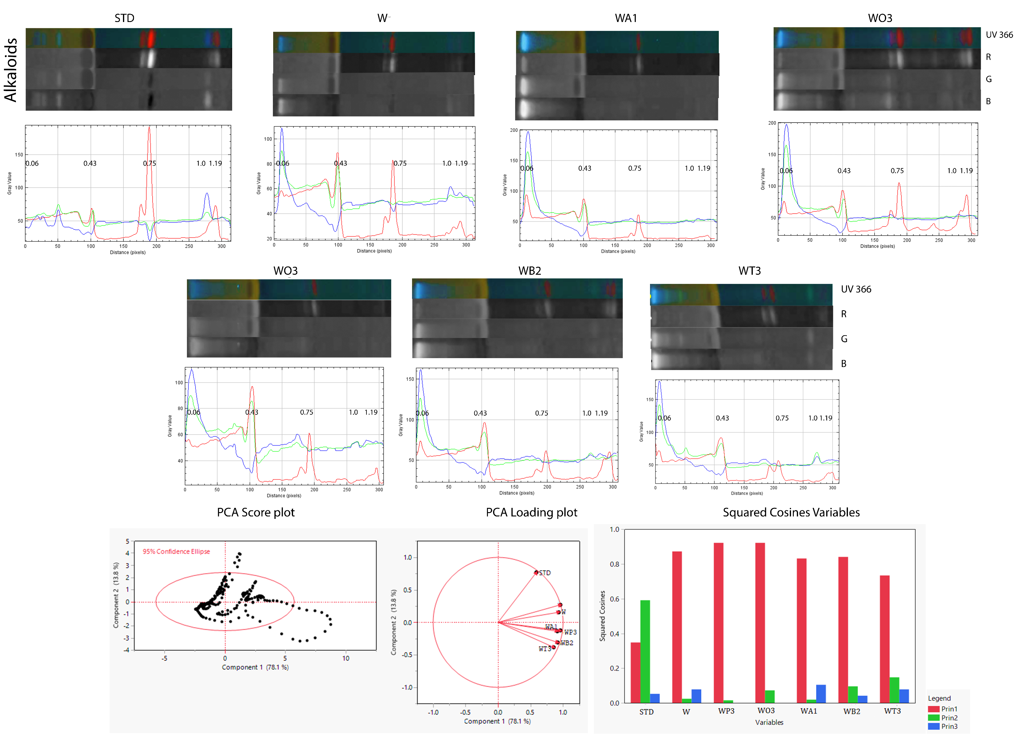
Tables S5: Alkaloid PCA data matrices
Formatted Loading Matrix
 | Prin1 | Prin2 | Prin3 | Prin4 | Prin5 | Prin6
WO3 | 0.959717 | 0.269327 | -0.018197 | -0.073004 | -0.018940 | -0.019681
WP3 | 0.959705 | -0.123609 | 0.012723 | -0.232844 | 0.053237 | -0.080468
W | 0.933605 | 0.154438 | -0.279754 | -0.003380 | -0.158112 | 0.035470
WB2 | 0.959705 | -0.309077 | 0.204083 | -0.061293 | 0.035595 | 0.131676
WA1 | 0.911628 | -0.137236 | -0.323280 | 0.168965 | 0.130489 | -0.003770
WT3 | 0.856357 | -0.384205 | 0.279289 | 0.175611 | -0.075390 | -0.067188
STD | 0.589996 | 0.768550 | 0.228605 | 0.082125 | 0.046899 | 0.005521
Loading Matrix
 | Prin1 | Prin2 | Prin3 | Prin4 | Prin5 | Prin6
STD | 0.59000 | 0.76855 | 0.22861 | 0.08212 | 0.04690 | 0.00552
W | 0.93360 | 0.15444 | -0.27975 | -0.00338 | -0.15811 | 0.03547
WP3 | 0.95970 | -0.12361 | 0.01272 | -0.23284 | 0.05324 | -0.08047
WO3 | 0.95972 | 0.26933 | -0.01820 | -0.07300 | -0.01894 | -0.01968
WA1 | 0.91163 | -0.13724 | -0.32328 | 0.16896 | 0.13049 | -0.00377
WB2 | 0.91677 | -0.30908 | 0.20408 | -0.06129 | 0.03560 | 0.13168
WT3 | 0.85636 | -0.38421 | 0.27929 | 0.17561 | -0.07539 | -0.06719
Squared Cosines of Variables
 | Prin1 | Prin2 | Prin3 | Prin4 | Prin5 | Prin6
STD | 0.34810 | 0.59067 | 0.05226 | 0.00674 | 0.00220 | 0.00003
W | 0.87162 | 0.02385 | 0.07826 | 0.00001 | 0.02500 | 0.00126
WP3 | 0.92103 | 0.01528 | 0.00016 | 0.05422 | 0.00283 | 0.00648
WO3 | 0.92106 | 0.07254 | 0.00033 | 0.00533 | 0.00036 | 0.00039
WA1 | 0.83107 | 0.01883 | 0.10451 | 0.02855 | 0.01703 | 0.00001
WB2 | 0.84046 | 0.09553 | 0.04165 | 0.00376 | 0.00127 | 0.01734
WT3 | 0.73335 | 0.14761 | 0.07800 | 0.03084 | 0.00568 | 0.00451
Fig S3: Line profile plot of alkaloids chromatogram represented in red (R), green(G) and blue (B) type – individual extracts showing variation in peaks and R_{f} values. Principal component analysis (PCA) is performed on the data variances to yield score plot, loading plot of PC1, PC2 and individual total data scores for each sample on PCs.

Slide 7
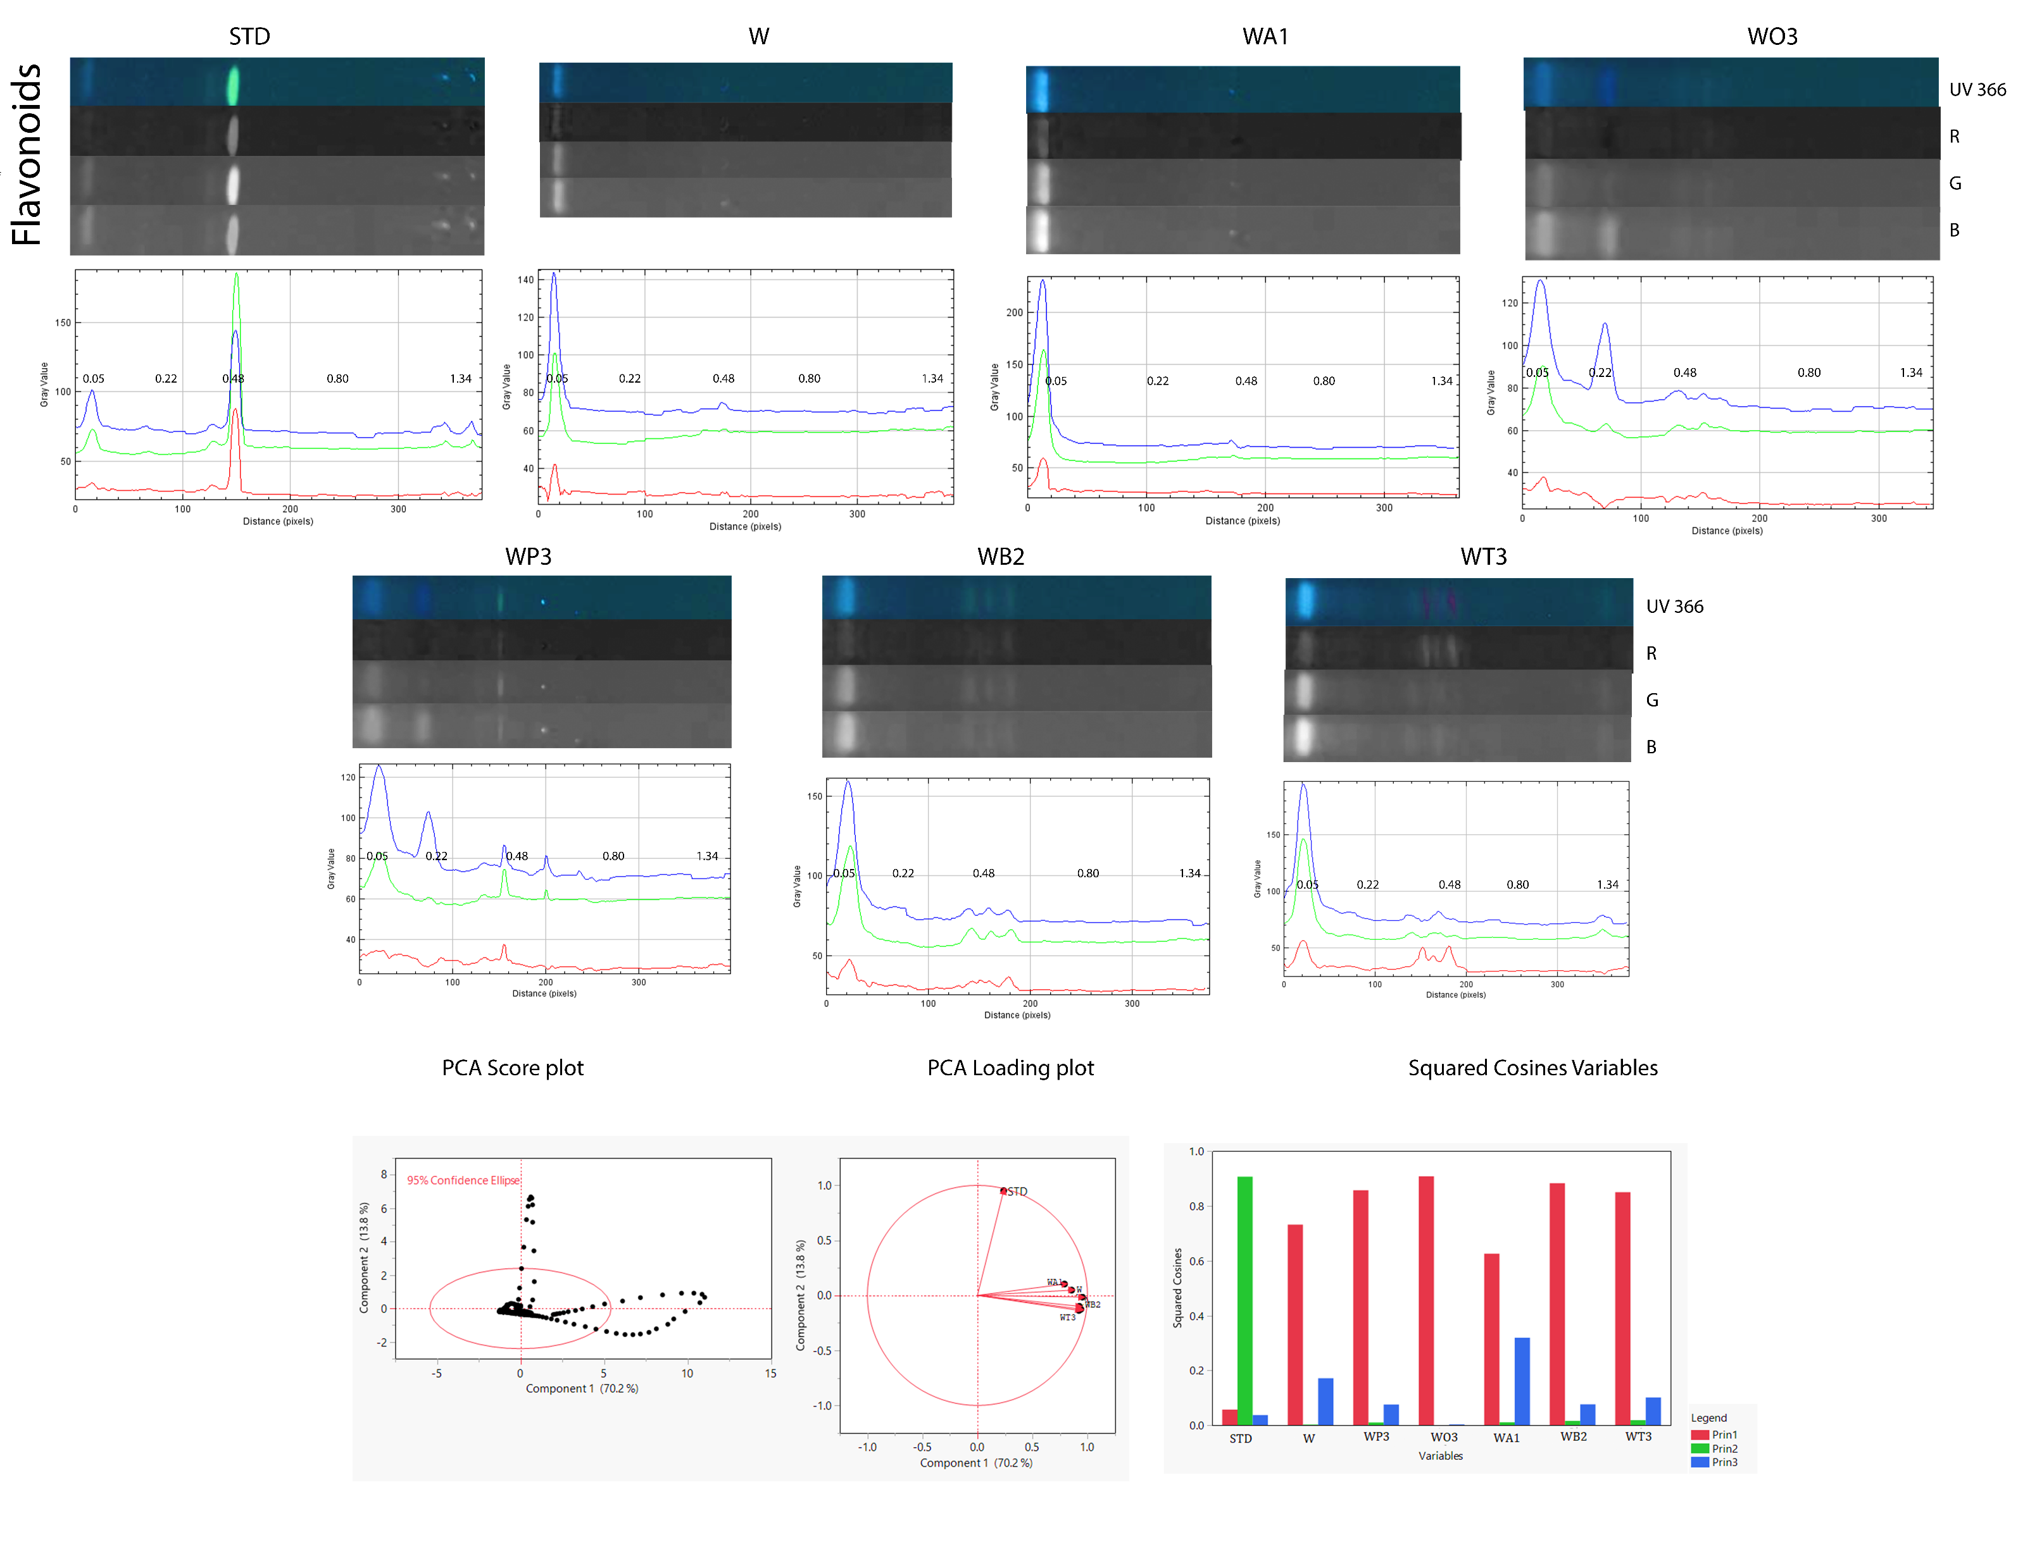
Table S6: Flavonoids PCA data matrices
Formatted Loading Matrix
 | Prin1 | Prin2 | Prin3 | Prin4 | Prin5 | Prin6 | Prin7
AS3 | 0.952626 | -0.014975 | -0.054285 | -0.231201 | -0.159240 | -0.102575 | 0.000311
AB2 | 0.939379 | -0.125212 | 0.276297 | 0.108379 | 0.091173 | -0.056959 | -0.047403
AA3 | 0.925590 | -0.099223 | 0.275292 | -0.183131 | -0.006099 | 0.155159 | -0.001840
AG3 | 0.921798 | -0.136307 | 0.317626 | 0.158144 | 0.043247 | -0.039362 | 0.048918
A | 0.855529 | 0.047954 | -0.414010 | 0.275599 | -0.122184 | 0.058637 | -0.006700
AT1 | 0.790887 | 0.103022 | -0.565071 | -0.122450 | 0.171626 | -0.007726 | 0.008308
STD | 0.238310 | 0.951989 | 0.191663 | 0.013542 | 0.002625 | -0.000687 | 0.000021
Loading Matrix
 | Prin1 | Prin2 | Prin3 | Prin4 | Prin5 | Prin6 | Prin7
STD | 0.23831 | 0.95199 | 0.19166 | 0.01354 | 0.00262 | -0.00069 | 0.00002
A | 0.85553 | 0.04795 | -0.41401 | 0.27560 | -0.12218 | 0.05864 | -0.00670
AA3 | 0.92559 | -0.09922 | 0.27529 | -0.18313 | -0.00610 | 0.15516 | -0.00184
AS3 | 0.95263 | -0.01498 | -0.05429 | -0.23120 | -0.15924 | -0.10257 | 0.00031
AT1 | 0.79089 | 0.10302 | -0.56507 | -0.12245 | 0.17163 | -0.00773 | 0.00831
AB2 | 0.93938 | -0.12521 | 0.27630 | 0.10838 | 0.09117 | -0.05696 | -0.04740
AG3 | 0.92180 | -0.13631 | 0.31763 | 0.15814 | 0.04325 | -0.03936 | 0.04892
Squared Cosines of Variables
 | Prin1 | Prin2 | Prin3 | Prin4 | Prin5 | Prin6 | Prin7
STD | 0.05679 | 0.90628 | 0.03673 | 0.00018 | 0.00001 | 0.00000 | 0.00000
A | 0.73193 | 0.00230 | 0.17140 | 0.07595 | 0.01493 | 0.00344 | 0.00004
AA3 | 0.85672 | 0.00985 | 0.07579 | 0.03354 | 0.00004 | 0.02407 | 0.00000
AS3 | 0.90750 | 0.00022 | 0.00295 | 0.05345 | 0.02536 | 0.01052 | 0.00000
AT1 | 0.62550 | 0.01061 | 0.31931 | 0.01499 | 0.02946 | 0.00006 | 0.00007
AB2 | 0.88243 | 0.01568 | 0.07634 | 0.01175 | 0.00831 | 0.00324 | 0.00225
AG3 | 0.84971 | 0.01858 | 0.10089 | 0.02501 | 0.00187 | 0.00155 | 0.00239
Fig S4: Line profile plot of flavonoids chromatogram represented in red (R), green(G) and blue (B) type – individual extracts showing variation in peaks and R_{f} values. Principal component analysis (PCA) is performed on the data variances to yield score plot, loading plot of PC1, PC2 and individual total data scores for each sample on PCs.

Slide 8
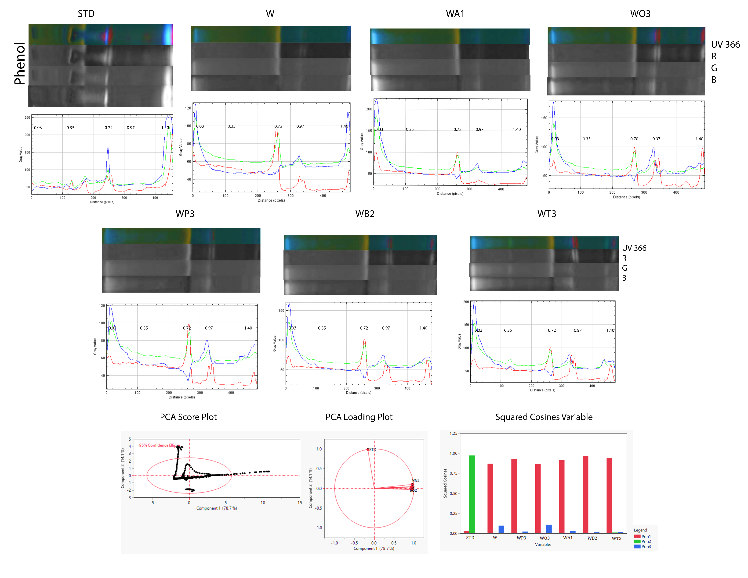
Table S7: Phenol PCA data matrices
Formatted Loading Matrix
 | Prin1 | Prin2 | Prin3 | Prin4 | Prin5 | Prin6 | Prin7
WB2 | 0.981782 | 0.038436 | 0.109901 | -0.057357 | -0.101425 | -0.051804 | 0.079292
WT3 | 0.969563 | 0.099928 | -0.120260 | -0.104260 | -0.136986 | -0.041994 | -0.064034
WP3 | 0.962727 | -0.034170 | -0.145114 | 0.172770 | -0.062897 | 0.130639 | 0.007722
WA1 | 0.957303 | 0.045385 | 0.171518 | -0.168516 | 0.110922 | 0.106461 | -0.007553
W | 0.932418 | -0.014568 | 0.309337 | 0.161132 | 0.050665 | -0.072312 | -0.030580
WO3 | 0.929926 | 0.029976 | -0.325503 | 0.007296 | 0.151198 | -0.072635 | 0.014037
STD | -0.161676 | 0.986329 | 0.009443 | 0.028696 | 0.006701 | 0.007040 | 0.003134
Loading Matrix
 | Prin1 | Prin2 | Prin3 | Prin4 | Prin5 | Prin6 | Prin7
STD | -0.16168 | 0.98633 | 0.00944 | 0.02870 | 0.00670 | 0.00704 | 0.00313
W | 0.93242 | -0.01457 | 0.30934 | 0.16113 | 0.05067 | -0.07231 | -0.03058
WP3 | 0.96273 | -0.03417 | -0.14511 | 0.17277 | -0.06290 | 0.13064 | 0.00772
WO3 | 0.92993 | 0.02998 | -0.32550 | 0.00730 | 0.15120 | -0.07264 | 0.01404
WA1 | 0.95730 | 0.04538 | 0.17152 | -0.16852 | 0.11092 | 0.10646 | -0.00755
WB2 | 0.98178 | 0.03844 | 0.10990 | -0.05736 | -0.10142 | -0.05180 | 0.07929
WT3 | 0.96956 | 0.09993 | -0.12026 | -0.10426 | -0.13699 | -0.04199 | -0.06403
Squared Cosines of Variables
 | Prin1 | Prin2 | Prin3 | Prin4 | Prin5 | Prin6 | Prin7
STD | 0.02614 | 0.97284 | 0.00009 | 0.00082 | 0.00004 | 0.00005 | 0.00001
W | 0.86940 | 0.00021 | 0.09569 | 0.02596 | 0.00257 | 0.00523 | 0.00094
WP3 | 0.92684 | 0.00117 | 0.02106 | 0.02985 | 0.00396 | 0.01707 | 0.00006
WO3 | 0.86476 | 0.00090 | 0.10595 | 0.00005 | 0.02286 | 0.00528 | 0.00020
WA1 | 0.91643 | 0.00206 | 0.02942 | 0.02840 | 0.01230 | 0.01133 | 0.00006
WB2 | 0.96390 | 0.00148 | 0.01208 | 0.00329 | 0.01029 | 0.00268 | 0.00629
WT3 | 0.94005 | 0.00999 | 0.01446 | 0.01087 | 0.01877 | 0.00176 | 0.00410
Fig S5: Line profile plot of phenol chromatogram represented in red (R), green(G) and blue (B) type – individual extracts showing variation in peaks and R_{f} values. Principal component analysis (PCA) is performed on the data variances to yield score plot, loading plot of PC1, PC2 and individual total data scores for each sample on PCs.

Slide 9
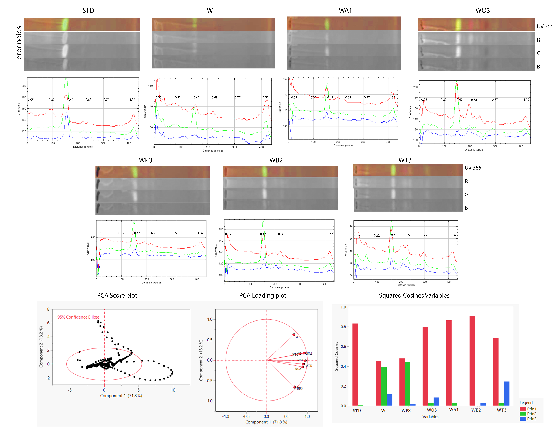
Table S8: Terpenoids PCA data matrices
Formatted Loading Matrix
 | Prin1 | Prin2 | Prin3 | Prin4 | Prin5 | Prin6 | Prin7
WB2 | 0.953909 | -0.014593 | -0.164402 | -0.065273 | 0.151894 | 0.005112 | -0.188302
WA1 | 0.930426 | 0.173011 | -0.003730 | 0.079920 | -0.182185 | -0.254396 | -0.008092
STD | 0.912166 | -0.098060 | -0.013798 | -0.387541 | -0.014920 | 0.005607 | 0.087779
WO3 | 0.893633 | -0.168942 | 0.288880 | 0.076116 | -0.220123 | 0.182484 | -0.043360
WT3 | 0.828520 | 0.159653 | -0.494477 | 0.157257 | -0.006245 | 0.107809 | 0.084661
WP3 | 0.691734 | -0.664965 | 0.135052 | 0.151379 | 0.173527 | -0.062812 | 0.064146
W | 0.673467 | 0.625225 | 0.342990 | 0.056992 | 0.178291 | 0.026370 | 0.046500
Loading Matrix
 | Prin1 | Prin2 | Prin3 | Prin4 | Prin5 | Prin6 | Prin7
STD | 0.91217 | -0.09806 | -0.01380 | -0.38754 | -0.01492 | 0.00561 | 0.08778
W | 0.67347 | 0.62523 | 0.34299 | 0.05699 | 0.17829 | 0.02637 | 0.04650
WP3 | 0.69173 | -0.66496 | 0.13505 | 0.15138 | 0.17353 | -0.06281 | 0.06415
WO3 | 0.89363 | -0.16894 | 0.28888 | 0.07612 | -0.22012 | 0.18248 | -0.04336
WA1 | 0.93043 | 0.17301 | -0.00373 | 0.07992 | -0.18218 | -0.25440 | -0.00809
WB2 | 0.95391 | -0.01459 | -0.16440 | -0.06527 | 0.15189 | 0.00511 | -0.18830
WT3 | 0.82852 | 0.15965 | -0.49448 | 0.15726 | -0.00625 | 0.10781 | 0.08466
Squared Cosines of Variables
 | Prin1 | Prin2 | Prin3 | Prin4 | Prin5 | Prin6 | Prin7
STD | 0.83205 | 0.00962 | 0.00019 | 0.15019 | 0.00022 | 0.00003 | 0.00771
W | 0.45356 | 0.39091 | 0.11764 | 0.00325 | 0.03179 | 0.00070 | 0.00216
WP3 | 0.47850 | 0.44218 | 0.01824 | 0.02292 | 0.03011 | 0.00395 | 0.00411
WO3 | 0.79858 | 0.02854 | 0.08345 | 0.00579 | 0.04845 | 0.03330 | 0.00188
WA1 | 0.86569 | 0.02993 | 0.00001 | 0.00639 | 0.03319 | 0.06472 | 0.00007
WB2 | 0.90994 | 0.00021 | 0.02703 | 0.00426 | 0.02307 | 0.00003 | 0.03546
WT3 | 0.68645 | 0.02549 | 0.24451 | 0.02473 | 0.00004 | 0.01162 | 0.00717
Fig S6: Line profile plot of terpenoids chromatogram represented in red (R), green(G) and blue (B) type – individual extracts showing variation in peaks and R_{f} values. Principal component analysis (PCA) is performed on the data variances to yield score plot, loading plot of PC1, PC2 and individual total data scores for each sample on PCs.

Slide 10
Clustered HCA Heatmap dataset
Table S9: Sample Variables in this Cluster
STD, WT3, W, WA1, WO3, WB2, WP3
Table S10: Phyto Variables in this Cluster
Terpenoids, Alkaloids, Flavonoids, Phenol
Number Distance Distance
Link Clusters Value Bar
6 1 12.043553 |IIIIIIIIIIIIIIIIIIIIIIIIIIIIII
5 2 6.698098 |IIIIIIIIIIIIIIIII
4 3 4.544102 |IIIIIIIIIII
3 4 3.403101 |IIIIIIII
2 5 2.867377 |IIIIIII
1 6 2.397905 |IIIIII
Cophenetic Correlation 0.982922
Delta(0.5) 0.075702
Delta(1.0) 0.087617
Number Distance Distance
Link Clusters Value Bar
3 1 6.295821 |IIIIIIIIIIIIIIIIIIIIIIIIIIIIII
2 2 5.234879 |IIIIIIIIIIIIIIIIIIIIIIIII
1 3 2.689426 |IIIIIIIIIIIII
Cophenetic Correlation 0.988686
Delta(0.5) 0.029991
Delta(1.0) 0.035287

