Slide 1
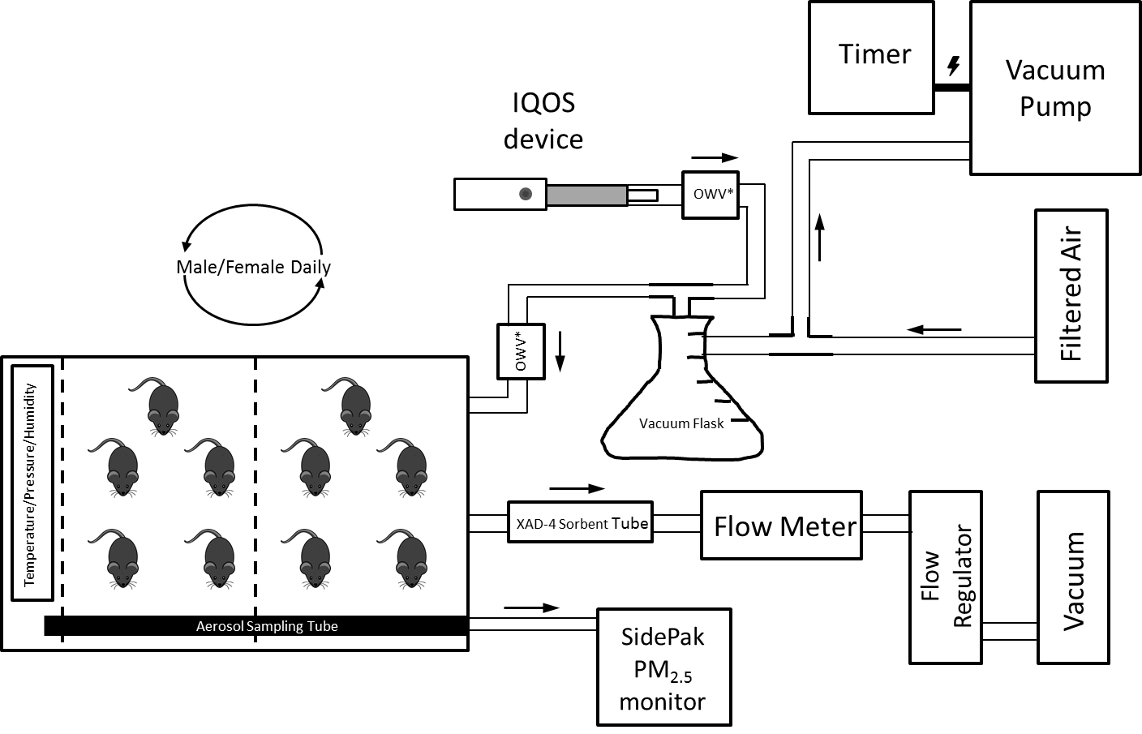
Supplemental Figure 1
Supplemental Figure 1. Schema of a system for exposing small animals to emissions from IQOS products.
OWV (one-way valve); ---- Wire Mesh
Note: Items are not to scale

Slide 2
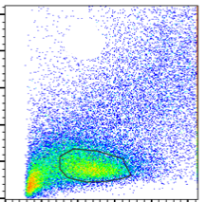
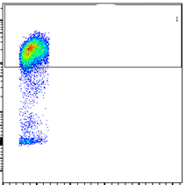
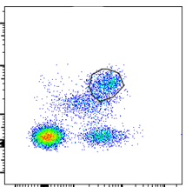
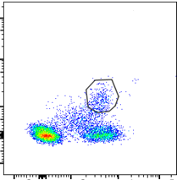
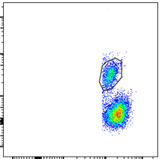
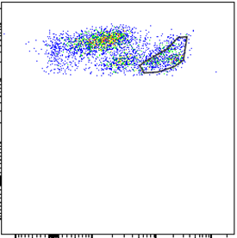
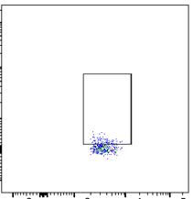
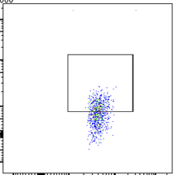
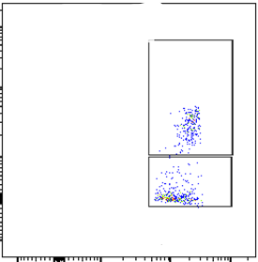
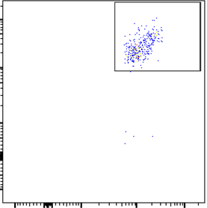
Supplemental Figure 2
A
42
SSC
FSC
SSC⁺ CD45⁺ gate
B
FSC⁺ SSC⁺ gate
C
D
E
79
11
4
14
CD45
CD4
CD8
CD19
F
SSC
G
CD3
H
CD3
CD45
CD3⁺CD4⁺ gate
CD3⁺CD4⁺ gate
CD45
Rorγt
IL-17
19
21
39
CD11b
CD4
CD4
I
CD11b⁺ CD45⁺ gate
J
CD11b⁺ LY-6G⁻ gate
56
96
LY-6G
CD68
43
CD11b
CD11b

Slide 3
Supplemental Figure 3
Male
Female
Albumin (ng/mL)
Air
IQOS
CS

Slide 4
Supplemental Figure 4
A
Male
B
Male
C
Male
Female
**
Female
**
Female
Air
IQOS
CS
Air
IQOS
CS
Air
IQOS
CS
D
E
F
Male
Male
Male
Female
Female
Female
Air
IQOS
CS
Air
IQOS
CS
Air
IQOS
CS
G
H
Male
Male
Female
Female
Air
IQOS
CS
Air
IQOS
CS

Slide 5
Supplemental Figure 5
A
B
C
D
E
F
G
H
I
J
K
L
M
N

