Slide 1
Stepwise regression of non-culprit lipid-rich plaque observed using serial NIRS-IVUS and OCT measurements after aggressive cholesterol-lowering treatment with PCSK9 inhibitor
August 2020
EHJ-CR-D-20-00961

Slide 2
Introduction
Patients with acute coronary syndrome (ACS) face substantial risks of future adverse cardiac events ¹.
This risk is partly attributable to the presence of vulnerable plaques or lipid-rich plaques (LRP) in non-culprit lesions (NCL).
Coronary imaging, including near-infrared spectroscopy (NIRS), may detect vulnerable plaques that trigger lesion-related myocardial infarction ³.
However, the treatment strategy for vulnerable plaques in angiographically mild NCLs is less well-known.

Slide 3
Case Presentation
History and Examination Findings
A 60-year-old man presented to our hospital with chest pain at rest, and was diagnosed with unstable angina pectoris (UAP).
Physical examination revealed no abnormality.
      heart rate, 70 b.p.m.; blood pressure, 128/64 mmHg; oxygen saturation, 98% in ambient room air.
ECG
      sinus rhythm and inverted T wave in leads I, aVL, and V1–V4 without prior Q-wave.
Echocardiography
      LVEF 60%, no segmental wall motion abnormality.
Laboratory tests
      normal levels of serum CK at 115 mg/dL with CK-MB at 1 mg/dL, and troponin-T at 0.012 ng/mL.
Coronary risk factor
      Dyslipidaemia and Hypertension.
      (only on dietary intervention).
      He had a high levels of low-density lipoprotein cholesterol (LDL-C) on admission (LDL-C 153 mg/dL, HDL-C 62 mg/dL, TG, 243 mg/dL, HbA1c, 5.5 %).

Slide 4
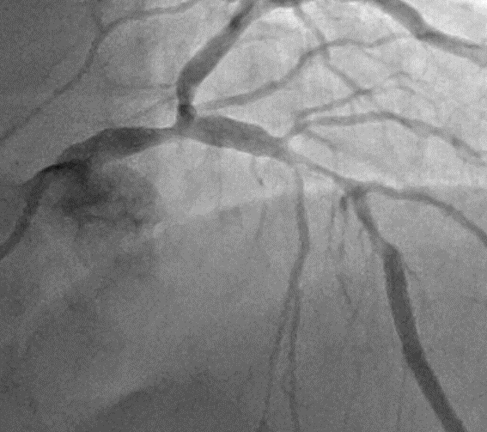
Case Presentation
Investigations
Urgent coronary angiography showed 90% narrowing in the mid-portion of the left descending artery as culprit lesion (white arrow), and 50% narrowing in the distal left main trunk artery as non-culprit lesion (yellow arrow).
After revascularization of the culprit lesion, we evaluated the non-culprit lesion using intravascular imaging.

Slide 5
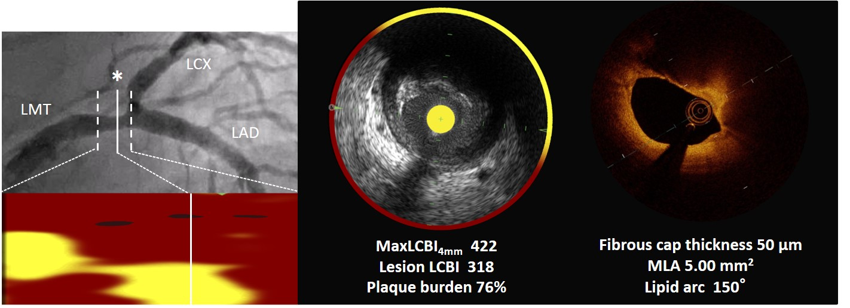
Case Presentation
Investigations
The NIRS-IVUS images showed extensive amounts of lipidic materials as LRP. Maximum LCBI_{4mm} was 422. The OCT showed LRP with a thin-cap and thickness of 50 µm.

Slide 6
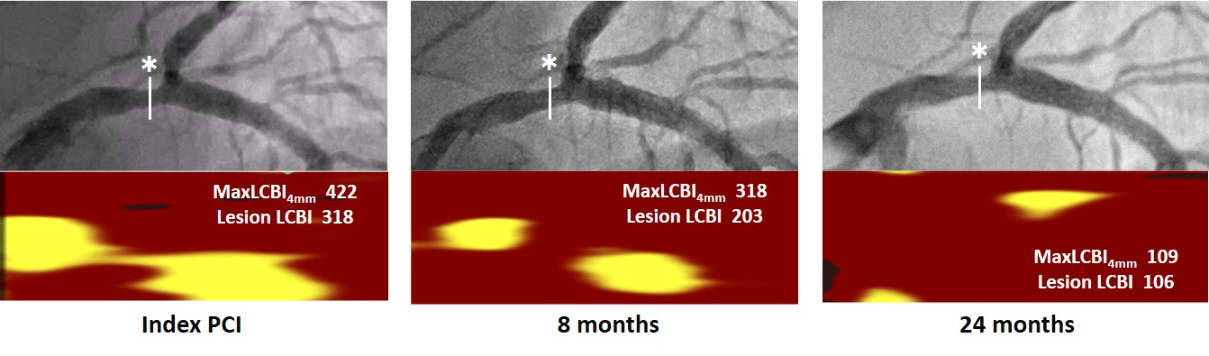
Case Presentation
Management
We prescribed aggressive lipid lowering therapy using PCSK9 inhibitors and statin, and serial assessment with intravascular imaging.
The chemogram showed that yellow pixels were significantly and gradually reduced during the follow-up time of 24 months with no remarkable change of angiogram coronary stenosis.

Slide 7
Case Presentation
Management
Rosuvastatin 10mg, Alirocumab 75mg / 2week
Max LCBI_{4mm}
LDL-C
LDL-C, mg/dL | 153 | 76 | 14 | 15 | 11 | 14 | 10
MaxLCBI_{4mm} | 422 |  | 417 | 318 | 265 |  | 109
The line graph demonstrated that LDL-C levels decreased immediately, while the LCBI value decreased gradually and with a delay.

Slide 8
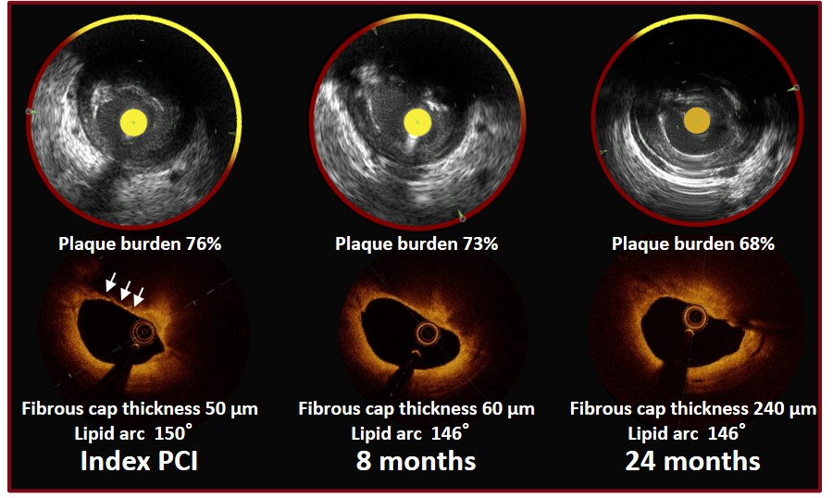
Case Presentation
Management
The OCT at index PCI detected a TCFA with a thickness of 50 µm (white arrow). This thickness increased to 240 µm at 24 months.
Meanwhile, no significant difference was seen in plaque burden and lipid arc during follow-up.

Slide 9
Discussion
The rates of non-culprit- and culprit-related MACE were similar, and 9% patients had subsequent non-culprit events within two years ³.
Previous study demonstrated that a cut off of 400 for max LCBI_{4mm} , a plaque burden of 70% or more, and thin-cap fibroatheroma (TCFA) in non-culprit lesions was associated with adverse cardiac events ²⁻⁵.
Our case had LRP (maxLCBI_{4mm} 422) and TCFA with fibrous cap thickness of 50 µm in LM, which may directly lead to death or serious cardiac outcomes.

Slide 10
Discussion
Early aggressive lipid-lowering therapy with a PCSK-9 inhibitor showed favourable outcomes for high-risk NCL LRPs in the LMT, as assessed by serial intravascular imaging, using NIRS-IVUS and OCT.
As plaque stabilization of high-risk LRP may be required for at least several years, and this tends to lag behind the decrease in LDL-C levels, the serial assessment of high-risk LRP may be meaningful, in terms of treatment strategy.

Slide 11
Learning Points
Aggressive and early lipid lowering therapy may effectively cause lipid rich plaque (LRP) regression; however, it may take 2 years of such treatment to decrease the lipid core.
There is a delay of several months between the decrease of low-density lipoprotein cholesterol (LDL-C) and the regression of LRP.
Follow-up by NIRS-IVUS imaging such as 8months is not sufficient to assess LRP, and longer-term follow-up such as 24 months will be needed in future large-scale studies.

Slide 12
References
Jernberg T, Hasvold P, Henriksson M, Hjelm H, Thuresson M and Janzon M. Cardiovascular risk in post-myocardial infarction patients. Eur Heart J. 2015;36:1163-70.
Stone GW, Maehara A, Lansky AJ, de Bruyne B, Cristea E and Mintz GS et al. A prospective natural-history study of coronary atherosclerosis. N Engl J Med. 2011;364:226-35.
Waksman R, Di Mario C, Torguson R, Ali ZA, Singh V and Skinner WH et al. Identification of patients and plaques vulnerable to future coronary events with near-infrared spectroscopy intravascular ultrasound imaging: a prospective, cohort study. The Lancet. 2019;394:1629-1637.
Virmani R, Burke AP, Farb A and Kolodgie FD. Pathology of the Vulnerable Plaque. J Am Coll Cardiol. 2006;47:C13-C18.
Tian J, Ren X, Vergallo R, Xing L, Yu H and Jia H et al. Distinct Morphological Features of Ruptured Culprit Plaque for Acute Coronary Events Compared to Those With Silent Rupture and Thin-Cap Fibroatheroma. J Am Coll Cardiol. 2014;63:2209-2216.

