Slide 1
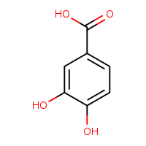
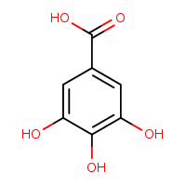
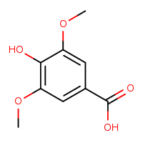
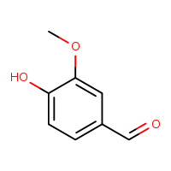
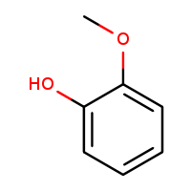
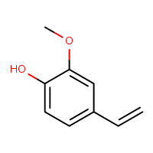
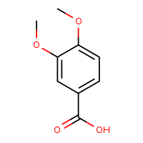
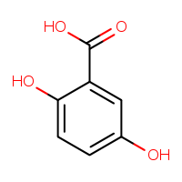
protocatechuic acid
gallic acid
syringic acid
vanillin
guaiacol
p-vinylguaiacol
veratric acid
2,5-dihydroxy-
benzoic acid
Supplementary Figure 1. Chemical structures of the remaining eight aromatic compounds used to test the specificity of induction of faeB expression

